Slide 1
Pagans and Christians Lecture Two
Platonism and Stoicism
Jews in the Roman Empire
Jews Thinking Like Greeks
Philo of Alexandria

Slide 2
Plato (427-347 BC)

Slide 3
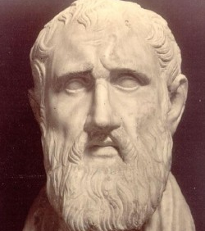
Zeno of Citium (d. 264 BC)

Slide 4
Epicurus (341-270 BC)

Slide 5
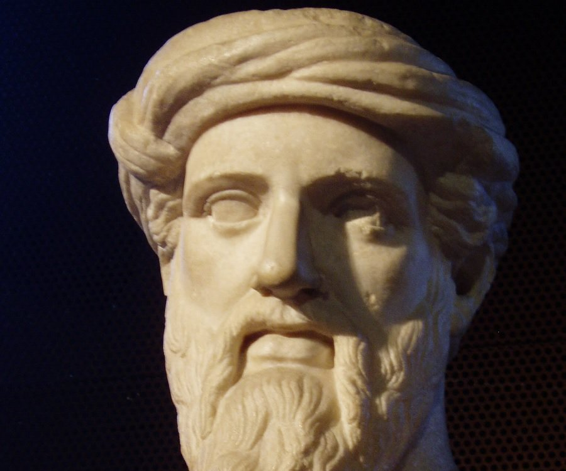
Pythagoras (6th century BC)

Slide 6
Plato (427-347 BC)

Slide 7
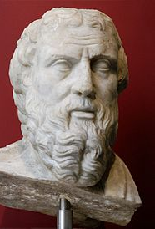
Plutarch (46-120 BC)

Slide 8
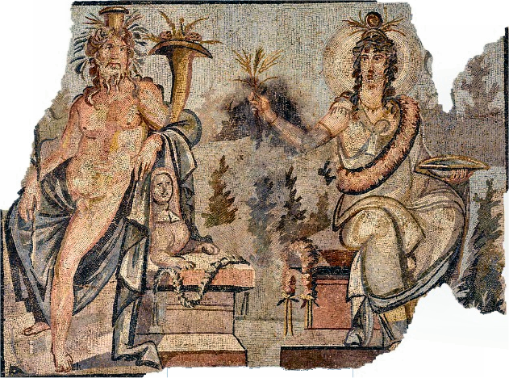
Osiris and Isis

Slide 9
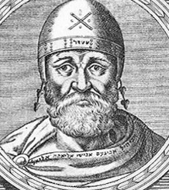
Philo of Alexandria (15 BC -50 AD)

Slide 10
Zeno of Citium (d. 264 BC)

Slide 11
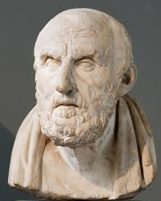
Chrysippus (279-206 BC)

Slide 12
Early Stoicism
Zeno (c. 334 – c. 262 BC)
Cleanthes (b. 330 BC)
Chrysippus (279 -206 BC)

Slide 13
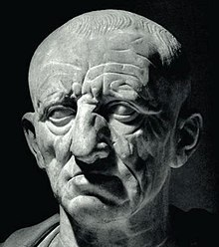
M. Porcius Cato (“Cato The Elder” (234-149 BC)

Slide 14
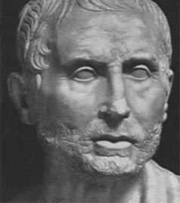
Posidonius (135 – 51 BC)

Slide 15
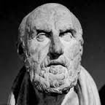
Cleanthes’ Hymn to Zeus
O God most glorious, called by many a name, Nature's great King, through endless years the same; Omnipotence, who by your just decree Controls all, hail, Zeus, for unto you Must your creatures in all lands call. We are your children, we alone, of all On earth's broad ways that wander to and fro, Bearing your image wheresoever we go. Wherefore with songs of praise your power I will proclaim. Look! yonder Heaven, that round the earth is wheeled, Follows your guidance, still to you does yield Glad homage; your unconquerable hand Such flaming minister, the heftless brand, Wields, a sword two-edged, whose deathless might Pulsates through all that Nature brings to light; Vehicle of the universal word, that flows Through all, and in the light celestial glows Of stars both great and small.

Slide 16
Cleanthes’ Hymn to Zeus
A King of Kings Through ceaseless ages, God, whose purpose brings To birth, whatever on land or in the sea Is wrought, or in high heaven's immensity; Save what the sinner works infatuate. No, but you know how to make the crooked straight: Chaos to you is order; in your eyes The unloved is lovely, who did harmonize Things evil with things good, that there should be One word through all things everlastingly. One word - whose voice alas! the wicked spurn; Insatiate for the good their spirits yearn: Yet seeing see not, neither hearing hear God's universal law, which those revere, by reason guided, happiness who win. The rest, unreasoning, diverse shapes of sin Self-prompted follow: for an idle name Vainly they wrestle in the contests of fame: Others inordinately riches court, Or dissolute, the joys of flesh pursue.

Slide 17
Cleanthes’ Hymn to Zeus
Now here, now there they wander, fruitless still, For ever seeking good and finding ill. Zeus the all-bountiful, whom darkness shrouds, Whose lightning lightens in the thunder-clouds; Your children save from error's deadly sway; Turn you the darkness from their souls away: Vouchsafe that unto knowledge they attain; For you by knowledge are made strong to reign Over all, and all things rule righteously. So by you honored, we will honor thee, Praising your works continually with songs, As mortals should; nor higher reward belongs Even to the gods, than justly to adore The universal law for evermore.

Slide 19
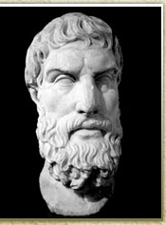
Epictetus (55 -135 AD)
There are things which are within our power, and there are things which are beyond our power. Within our power are opinion, aim, desire, aversion, and, in a word, whatever affairs are our own. Beyond our power is our body, property, reputation, office, in a word, whatever are not properly our own affairs. Now the things within our power are by nature free, unrestricted, unhindered, but those beyond our power are weak, dependent, restricted, alien.

Slide 20
Epictetus (55 -135 AD)
Remember then that if you attribute freedom to things by nature dependent, and take what belongs to other as your own, you will be hindered, you will lament, you will be disturbed, you will find fault both with God and men. But if you take for your own only that which is your own, and view what belongs to others just as it really is, then no one will ever compel you, no one will restrict you, you will find fault with no one, you will accuse no one. You will do nothing against your will. No one will hurt you. You will not have an enemy, nor will you suffer any harm.

Slide 21
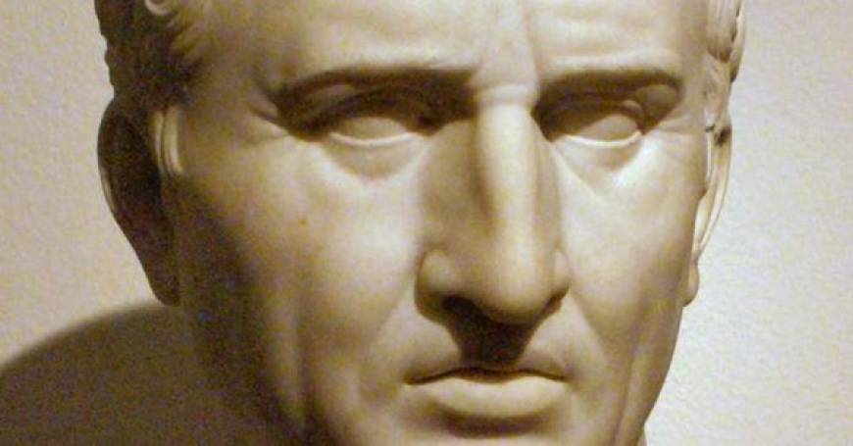
Cicero (106-43 BC)

Slide 22
Polybius (200- 118 BC)

Slide 23
Marcus Aurelius (121-180 AD)

Slide 24
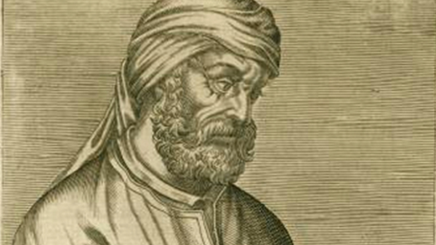
Tertullian (160-220 AD)

Slide 25
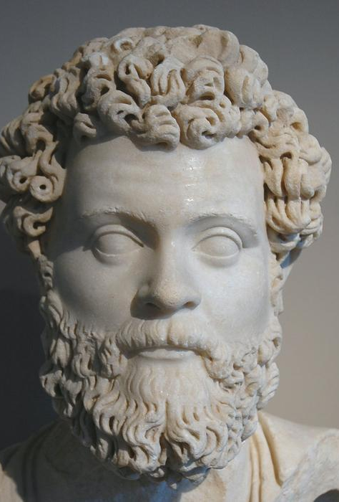
Dio Chrysostom (40-120 AD)

Slide 26
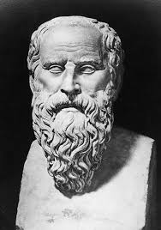
Diogenes of Sinope (412-323 BC)

Slide 27
Plato (427-347 BC)

Slide 28
Jews in the Roman Empire

Slide 29
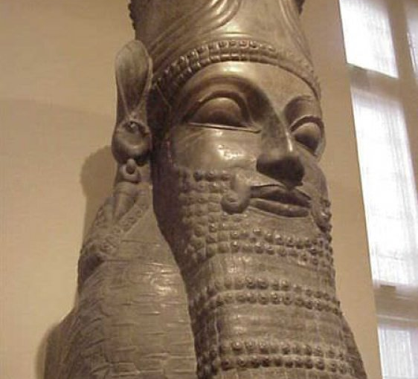
Cyrus the Great, King of Persia
(600-530 BC)

Slide 30
Sample Footer Text
1/22/2019
30

Slide 31
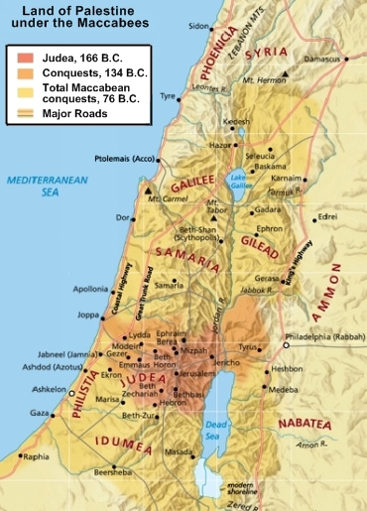

Slide 32
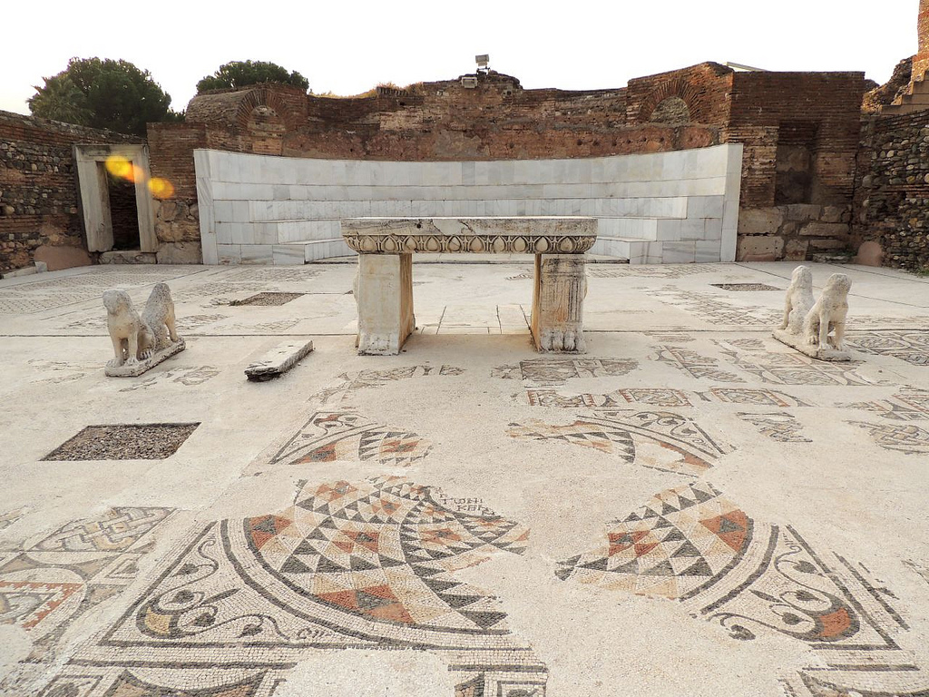
Sardis, Synagogue

Slide 35
Judas Maccaebus (191-160 BC)

Slide 36
Old Testament Prophecies about the messiah

Slide 37
A) His advent
Gen. 3:15: I will put enmity between thee and the woman, and between thy seed and her seed; it shall bruise thy head, and thou shalt bruise his heel.
Deut. 18:15: The Lord thy God will raise up unto thee a Prophet from the midst of thee, of thy brethren, like unto me; unto Him ye shall hearken.
Ps. 89:20: with my holy oil have I anointed Him.
Isaiah 9:6: For unto us a child is born, unto us a son is given: and the government shall be upon his shoulder: and his name shall be called Wonderful, Counsellor, The mighty God, The everlasting Father, The Prince of Peace.
Isaiah 28:16: Therefore thus saith the Lord GOD, Behold, I lay in Zion for a foundation a stone, a tried stone, a precious corner stone, a sure foundation: he that believeth shall not be shaken.
Isaiah 32:1: Behold, a king shall reign in righteousness, and princes shall rule in judgment.
Isaiah 35:4: Say to them that are of a fearful heart, Be strong, fear not: behold, your God will come with vengeance, even God with a recompence; He will come and save you.
Isaiah 42:6: I the Lord have called thee in righteousness, and will hold thine hand, and will keep thee, and give thee for a covenant of the people, for a light of the Gentiles.
Isaiah 49:1: Listen, O isles, unto me; and hearken, ye people, from far; The Lordhath called me from the womb; from the bowels of my mother hath he made mention of my name.
Isaiah 55:4: Behold, I have given him for a witness to the people, a leader and commander to the people.

Slide 38
A) His advent
Ezekiel 34:24: And I the Lord will be their God, and my servant David a prince among them; I the Lord have spoken it.
Daniel 2:44: And in the days of these kings shall the God of heaven set up a kingdom, which shall never be destroyed: and the kingdom shall not be left to other people, but it shall break in pieces and consume all these kingdoms, and it shall stand for ever.
Micah 4:1-3: But in the last days it shall come to pass, that the mountain of the house of the Lord shall be established in the top of the mountains, and it shall be exalted above the hills; and people shall flow unto it. And many nations shall come, and say, Come, and let us go up to the mountain of the Lord, and to the house of the God of Jacob; and he will teach us of his ways, and we will walk in his paths: for the law shall go forth of Zion, and the word of the Lord from Jerusalem. And he shall judge among many people, and rebuke strong nations afar off; and they shall beat their swords into plowshares, and their spears into pruninghooks: nation shall not lift up a sword against nation, neither shall they learn war any more.
Zechariah 3:8: Hear now, O Joshua the high priest, thou, and thy fellows that sit before thee: for they are men wondered at: for, behold, I will bring forth my servant the BRANCH.

Slide 39
A) The time of His advent
Gen. 49:10:
Numbers 24:17:
Dan. 9:24:
Malachi 3:1:

Slide 40
A) His advent
His divinity: Ps. 2:7, 11; 45:6-7 & 11, 72:8, 89: 26-27, 102:24-27, 110:1; Isaiah 9:6, 25:9, 40:10; Jeremiah 23:6; Micah 5:2; Malachi 3:1

Slide 41
A) His advent
His human generation: Gen 12:3, 18:18, 21:12, 22:18, 26:4, 28:14, 49:10; 2 Sam. 7:14; Ps. 18:4-6 & 50, 22:22-23, 29: 36; 89:4; 132:11; Isaiah 11:1; Jeremiah 23:5, 33: 15.

Slide 42
B. His forerunner
Isaiah 40:3; Malachi 3:1, 4:5

Slide 43
C. His Nativity and Early years
The fact: Genesis 3:15; Isaiah 7:14; Jeremiah 31:22

Slide 44
C. His Nativity and Early years
That His Birth will be heralded by a Star: Numbers 24:17, 19
That He will be born in Bethlehem Micah 5:2

Slide 45
C. His Nativity and Early years
That He will be adored by Magi: Psalm 72:10 & 15; Isaiah 60: 3 & 6

Slide 46
C. His Nativity and Early years
That He will descend into Egypt and return to Israel: Hosea 11:1

Slide 47
C. His Nativity and Early years
That Innocent Children will then be massacred: Jeremiah 31:15

Slide 48
d. His Mission and office
His Mission of Salvation: Genesis 12:3; 49:10; Numbers 24:19; Deuteronomy 18:18-19; Psalm 21:1; Isaiah 59:20; Jeremiah 33:16

Slide 49
d. His Mission and office
He will be a Priest like Melchizedek who sanctified Bread and Wine (Genesis 14:18-20): Psalm 110:4

Slide 50
d. His Mission and office
That He will be a prophet like Moses: Deuteronomy 18:15

Slide 51
d. His Mission and office
That the gentiles will convert and worship the God of Israel: Isaiah 11:10, 42:1, 45:23, 49:6; Hosea 1:10, 2:23; Joel 2:32; Deuteronomy 32:43; Psalms 18:49, 19:4, 117:1; Malachi 1:11.

Slide 52
d. His Mission and office
That His ministry will be in Galilee: Isaiah 9: 1, 2

Slide 53
d. His Mission and office
That He will perform miracles: Isaiah 35:5-6, 42:7; 53:4;

Slide 54
d. His Mission and office
That He will be God’s anointed: Psalm 45:7; Isaiah 11:2, 42:1, 53:9, 61:1-2

Slide 55
d. His Mission and office
That He will preach: Psalm 2:7, 78:2; Isaiah 2:3, 61:1; Micah 4:2

Slide 56
d. His Mission and office
That He will purify the Temple in Jerusalem: Psalm 69:9

Slide 57
E. His Passion
That He will be rejected by both Jews and Gentiles: Psalms 2:1, 22:12, 41:5, 56:5, 69:8, 118:22-23; Isaiah 6:9-10, 8:14; 29:13, 53:1, 65:2.

Slide 58
E. His Passion
That He will be persecuted: Psalms 22:6; 35:7, 12; 56:5, 71:10, 109:2; Isaiah 49:7; 53:3.

Slide 59
E. His Passion
That He will be persecuted: Psalms 22:6; 35:7, 12; 56:5, 71:10, 109:2; Isaiah 49:7; 53:3.

Slide 60
E. His Passion
That He will first enter triumphantly into Jerusalem riding on a donkey: Psalms 8:2, 118:25-26; Zechariah 9:9

Slide 61
E. His Passion
That He will be betrayed for thirty pieces of silver: Zechariah 13:6

Slide 62
E. His Passion
That his betrayer will die miserably
Psalms 55:15, 23
Let death seize upon him, and let him go down quick into hell.
But thou, O God, shalt bring them down into the pit of destruction: bloody and deceitful men shall not live out half their days; but I will trust in thee.
109:17-19
As he loved cursing, so let it come unto him: as he delighted not in blessing, so let it be far from him. As he clothed himself with cursing like as with his garment, so let it come into his bowels like water, and like oil into his bones. Let it be unto him as the garment which covereth him, and for a girdle wherewith he is girded continually.

Slide 63
E. His Passion
That the money gained by His betrayal will be used to purchase a Potter’s Field: Zechariah 11:13

Slide 64
E. His Passion
That He will be falsely accused: Psalms 2:1-2, 27:12; 35:11; 109:2

Slide 65
E. His Passion
That He will be silent in the face of accusations: Psalm 38:13; Isaiah 53:7

Slide 66
E. His Passion
That He will be mocked: Psalms 22:7-8 & 16, 109:25

Slide 67
E. His Passion
That He will be insulted, buffeted, spat upon, and scourged
Psalm 35:15 & 21
But in mine adversity they rejoiced, and gathered themselves together: yea, the abjects gathered themselves together against me, and I knew it not; they did tear me, and ceased not:
Yea, they opened their mouth wide against me, and said, Aha, aha, our eye hath seen it.
Isaiah 50:6
I gave my back to the smiters, and my cheeks to them that plucked off the hair: I hid not my face from shame and spitting.

Slide 68
E. His Passion
That He will patiently endure suffering
Isaiah 53:7-9
He was oppressed, and He was afflicted, yet He opened not his mouth: He is brought as a lamb to the slaughter, and as a sheep before her shearers is dumb, so He openeth not his mouth. He was taken from prison and from judgment: and who shall declare his generation? for He was cut off out of the land of the living: for the transgression of my people was He stricken. And He made his grave with the wicked, and with the rich in his death; because He had done no violence, neither was any deceit in His mouth.

Slide 69
E. His Passion
That He will be crucified:
Psalm 22:14, 17
I am poured out like water, and all my bones are out of joint: my heart is like wax; it is melted in the midst of my bowels.
I can count all my bones: they look and stare upon me.

Slide 70
E. His Passion
That He will be offered gall and vinegar to drink.
Psalm 69:21
They gave me also gall for my meat; and in my thirst they gave me vinegar to drink.

Slide 71
E. His Passion
That He will pray for His enemies: Psalm 109:4:
For my love they are my adversaries: but I give myself unto prayer.

Slide 72
E. His Passion
That He will cry out on the Cross “My God, my God, why hast Thou forsaken Me”: Psalm 22:1
Cf. Psalm 31:5
Into thine hand I commit my spirit: thou hast redeemed me, O Lord God of truth.

Slide 73
E. His Passion
That He will die in the prime of life:
Psalms 89:45
The days of his youth hast thou shortened: thou hast covered him with shame.
Psalms 102:24
I said, O my God, take me not away in the midst of my days

Slide 74
E. His Passion
That he will die with criminals: Isaiah 53:9 & 12
And he made his grave with the wicked, and with the rich in his death; because he had done no violence, neither was any deceit in his mouth.
Therefore will I divide him a portion with the great, and he shall divide the spoil with the strong; because he hath poured out his soul unto death: and he was numbered with the transgressors; and he bare the sin of many, and made intercession for the transgressors.

Slide 75
E. His Passion
That His death will be attested by convulsions of nature
Amos 5:20
Shall not the day of the Lord be darkness, and not light? even very dark, and no brightness in it?
Zechariah 14:4-6
And his feet shall stand in that day upon the mount of Olives, which is before Jerusalem on the east, and the mount of Olives shall cleave in the midst thereof toward the east and toward the west, and there shall be a very great valley; and half of the mountain shall remove toward the north, and half of it toward the south. And ye shall flee to the valley of the mountains; for the valley of the mountains shall reach unto Azal: yea, ye shall flee, like as ye fled from before the earthquake in the days of Uzziah king of Judah: and the Lord my God shall come, and all the saints with thee. And it shall come to pass in that day, that the light shall not be clear, nor dark.

Slide 76
E. His Passion
That those who killed Him will cast lots for His garments
Psalm 22:18
They part my garments among them, and cast lots upon my vesture.

Slide 77
E. His Passion
That His bones will nevertheless not be broken: Psalms 34:20
He keepeth all his bones: not one of them is broken.
Cf. Exodus 12:46:
In one house shall [the Passover lamb] be eaten; thou shalt not carry forth ought of the flesh abroad out of the house; neither shall ye break a bone thereof.

Slide 78
E. His Passion
That He will be pierced
Psalm 22:16
For dogs have compassed me: the assembly of the wicked have inclosed me: they pierced my hands and my feet.
Zechariah 12:10, 13: 6
And I will pour upon the house of David, and upon the inhabitants of Jerusalem, the spirit of grace and of supplications: and they shall look upon me whom they have pierced, and they shall mourn for him, as one mourneth for his only son, and shall be in bitterness for him, as one that is in bitterness for his firstborn.
And one shall say unto him, What are these wounds in thine hands? Then he shall answer, Those with which I was wounded in the house of my friends.

Slide 79
E. His Passion
That He will die voluntarily: Psalm 40:6-8
Sacrifice and offering thou didst not desire; mine ears hast thou opened: burnt offering and sin offering hast thou not required. Then said I, Lo, I come: in the volume of the book it is written of me, I delight to do thy will, O my God: yea, thy law is within my heart.

Slide 80
E. His Passion
That He suffers vicariously for all humanity.
Isaiah 53:4-6 & 12:
Surely he hath borne our griefs, and carried our sorrows: yet we did esteem him stricken, smitten of God, and afflicted. But he was wounded for our transgressions, he was bruised for our iniquities: the chastisement of our peace was upon him; and with his stripes we are healed. All we like sheep have gone astray; we have turned every one to his own way; and the Lord hath laid on him the iniquity of us all.
Daniel 9:26:
And after threescore and two weeks shall Messiah be cut off, but not for himself: and the people of the prince that shall come shall destroy the city and the sanctuary; and the end thereof shall be with a flood, and unto the end of the war desolations are determined.

Slide 81
E. His Passion
That He will be buried in the tomb of a rich person: Isaiah 53:9:
And he made his grave with the wicked, and with the rich in his death; because he had done no violence, neither was any deceit in his mouth.

Slide 82
F. His Resurrection
Psalm 2:7
Psalm 16:8-10
Psalm 30:3
Psalm 41:10
Psalm 118:17

Slide 83
G. His Ascension
Psalm 16:11
Psalm 24:7
Psalm 68:18
Psalm 110:1
Psalm 118:19

Slide 84
H. His Second Coming
Psalm 50:3-6
Zechariah 12:10; 14:4-8
Isaiah 9:6-7, 66:18
Daniel 7:13-14

Slide 85
I. His Universal, Everlasting Dominion
Daniel 7:14
Isaiah 9:7
Psalms 2:6-8, 8:6, 45:6 & 7, 72:8
1 Chronicles 17:11-14

Slide 88
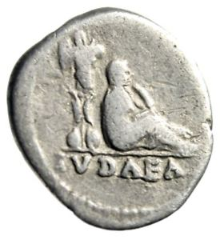
Judea Capta

Slide 89
Apamea, Syria

Slide 91
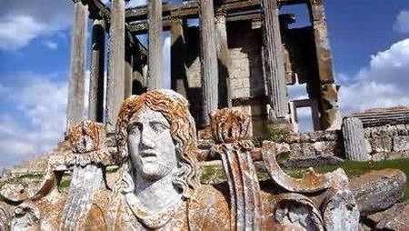
Jews Thinking Like Greeks

Slide 92
Alexander the Great (356-323 BC)

Slide 95
Fourth Book of Maccabees
PHILOSOPHICAL in the highest degree is the question I propose to discuss, namely whether the Inspired Reason is supreme ruler over the passions; and to the philosophy of it I would seriously entreat your earnest attention.
For not only is the subject generally necessary as a branch of knowledge, but it includes the praise of the greatest of virtues, whereby I mean self-control.

Slide 96
Fourth Book of Maccabees
I could bring before you many examples, drawn from various sources, where Reason has proved itself master over the passions, but the best instance by far that I can give is the noble conduct of those who died for the sake of virtue, Eleazar, and the Seven Brethren and the Mother.
For these all by their contempt of pains, yea, even unto death, proved that Reason rises superior to the passions.

Slide 97
Fourth Book of Maccabees
But we must define just what the Reason is and what passion is, and how many forms of passion there are, and whether the Reason is supreme over all of them.
Reason I take to be the mind preferring with clear deliberation the life of wisdom.

Slide 98
Fourth Book of Maccabees
Wisdom I take to be the knowledge of things, divine and human, and of their causes.

Slide 99
Fourth Book of Maccabees
This I take to be the culture (παιδεία) acquired under the Law, through which we learn with due reverence the things of God and for our worldly profit the things of man.
Now wisdom is manifested under the forms of judgement and justice, and courage, and temperance.

Slide 100
The Sententiae of Ps.-Phoyclides
These counsels of God through holy judgments (1) Phocylides, wisest of men, reveals as gifts of blessing. (1)
Neither commit adultery, nor arouse homosexual passion (3) Neither contrive deceptions, nor defile your hands with blood (4) Be not unjustly rich, but earn a living through honorable means (5) Be content with what you have, and refrain from what belongs to others (6) Do not tell lies, but always tell the truth (7) Honor God foremost, and afterwards your parents (8) Always render just decisions, and prolong no judgment for a favor (9) Do unjustly oppress a poor man; judge not by his countenance (10)

Slide 101
The Sententiae of Ps.-Phoyclides
Receive a homeless person into your house, and guide a blind man. (24)
Pity a shipwrecked person, since sailing is uncertain. (25)
To one who falls lend a hand, and save an unprotected man. (26)
Suffering is common to all; life is a wheel; prosperity is unstable (27)
From that which God has Given you, give to the needy. (29)
Let all of life be in common, and all things be in agreement. (30)
Moderation is best of all, and excesses are grievous. (69)

Slide 102
Letter of Aristeas

Slide 103
“How can one endure with equanimity what happens in life?”

Slide 104
“Only if you adopt as a basic principle that all men have been created by God to share the greatest ills, as well as the greatest blessings, and that it is impossible, being a man, to be without some of both. But God, to whom one must pray, must give courage.”

Slide 105
“I think these men excel in virtue, and have a fuller understanding, for when asked questions of this sort on unexpectedly, they give appropriate answers, all making God the basis of their argument.”

Slide 106
“Yes, indeed, O King. For since the whole universe is governed by providence, and on the correct assumption that man is creature of God, it follows that all power and beauty of argument has its origin from God.”

Slide 107
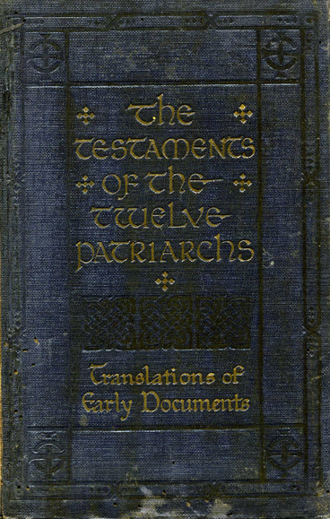

Slide 108
Testaments of the Twelve Patriarchs The Testament of Simeon
“Beware the spirit of deceit and envy, my children, for envy dominates the whole of man’s mind, and does not permit him to eat, or drink, or do anything good. Rather it keeps prodding him to destroy the one whom he envies.”

Slide 109
Testaments of the Twelve Patriarchs The Testament of Simeon
“Whenever the one who is envied flourishes,” Simeon goes on to say, “the envious one languishes.”

Slide 110
Testaments of the Twelve Patriarchs The Testament of Simeon
“The spirit of envy will depart from you, if you turn to the Lord, for that attitude makes the soul savage and corrupts the body. It foments wrath and conflict in the reason, it excites to the shedding of blood, drives the mind to distraction, arouses tumult in the soul, and trembling in the body. Even in sleep, some passion for envy fills his phantasy, and consumes him.”

Slide 111
Flavius Josephus (37-100 AD)

Slide 112
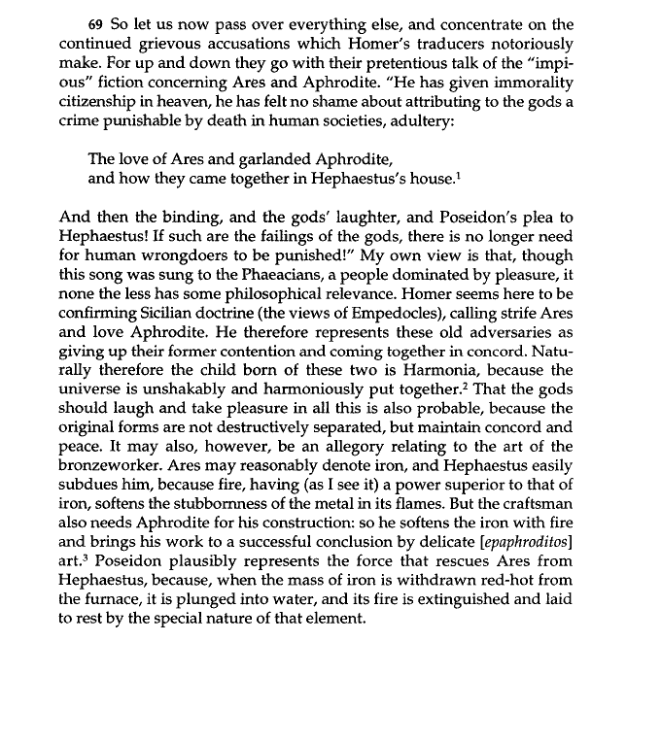

Slide 113
Aristobulus (c. 181-124 BC)

Slide 114
Philo of Alexandria (15 BC -50 AD)

Slide 115
The Migration of Abraham (89-93)
There are some men, who, looking upon written laws as symbols of things appreciable by the intellect, have studied some things with superfluous accuracy, and have treated others with neglectful indifference; whom I should blame for their levity; for they ought to attend to both classes of things, applying themselves both to an accurate investigation of invisible things, and also to an irreproachable observance of those laws which are notorious. (90) But now men living solitarily by themselves as if they were in a desert, or else as if they were mere souls unconnected with the body, and as if they had no knowledge of any city, or village, or house, or in short of any company of men whatever, overlook what appears to the many to be true, and seek for plain naked truth by itself, whom the sacred scripture teaches not to neglect a good reputation, and not to break through any established customs which divine men of greater wisdom than any in our time have enacted or established. (91) For although the seventh day is a lesson to teach us the power which exists in the uncreated God, and also that the creature is entitled to rest from his labours, it does not follow that on that account we may abrogate the laws which are established respecting it, so as to light a fire, or till land, or carry burdens, or bring accusations, or conduct suits at law, or demand a restoration of a deposit, or exact the repayment of a debt, or do any other of the things which are usually permitted at times which are not days of festival. (92) Nor does it follow, because the feast is the symbol of the joy of the soul and of its gratitude towards God, that we are to repudiate the assemblies ordained at the periodical seasons of the year; nor because the rite of circumcision is an emblem of the excision of pleasures and of all the passions, and of the destruction of that impious opinion, according to which the mind has imagined itself to be by itself competent to produce offspring, does it follow that we are to annul the law which has been enacted about circumcision. Since we shall neglect the laws about the due observance of the ceremonies in the temple, and numbers of others too, if we exclude all figurative interpretation and attend only to those things which are expressly ordained in plain words. (93) But it is right to think that this class of things resembles the body, and the other class the soul; therefore, just as we take care of the body because it is the abode of the soul, so also must we take care of the laws that are enacted in plain terms: for while they are regarded, those other things also will be more clearly understood, of which these laws are the symbols, and in the same way one will escape blame and accusation from men in general.

Slide 116
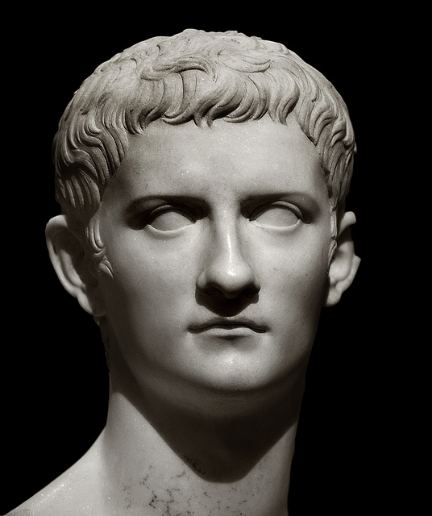
Emperor Gaius (Caligula) (12-41 AD)

Slide 117
On the Decalogue (20-31)
In the first place one must at once admire the number, inasmuch as they are completed in the perfect number of ten, which contains every variety of number, both those which are even, and those which are odd, and those which become odd when divided, the even numbers being such as two, the odd numbers such as three, the even-odd such as six, and it also comprehends all the varieties of the multiplication of numbers, and of those numbers which contain a whole number and a fraction, and of those which contain several fractional parts. it comprehends likewise all the proportions; the arithmetical, which exceeds and it exceeded by an equal number: as in the case of the numbers one, and two, and three; and the geometrical, according to which, as the proportion of the first number is to the second, the same is the ratio of the second to the third, as is the case in the numbers one, two and four; and also in multiplication, which double, or triple, or in short multiply figures to any extent; also in those which are half as much again as the numbers first spoken of, or one third greater, and so on. It also contains the harmonic proportion, in accordance with which that number which is in the middle between two extremities, is exceeded by the one, and exceeds the other by an equal part; as is the case with the numbers three, four, and six… Consequently, it is in reference to this fact that the first philosophers appear to me to have affixed the names to things which they have given them. For they were wise men, and therefore they very speciously called the number ten the decade, as being that which received everything, from receiving and containing every kind of number, and ratio connected with number, and every proportion, and harmony, and symphony.

Slide 118
On the Contemplative Life (78)
These explanations of the sacred scriptures are delivered by mystic expressions in allegories, for the whole of the law appears to these men to resemble a living animal, and its express commandments seem to be the body, and the invisible meaning concealed under and lying beneath the plain words resembles the soul, in which the rational soul begins most excellently to contemplate what belongs to itself, as in a mirror, beholding in these very words the exceeding beauty of the sentiments, and unfolding and explaining the symbols, and bringing the secret meaning naked to the light to all who are able by the light of a slight intimation to perceive what is unseen by what is visible.

Slide 119
Genesis (1:26-28)
26 And God said, Let us make man in our image, after our likeness: and let them have dominion over the fish of the sea, and over the fowl of the air, and over the cattle, and over all the earth, and over every creeping thing that creepeth upon the earth.
27 So God created man in his own image, in the image of God created he him; male and female created he them.
28 And God blessed them, and God said unto them, Be fruitful, and multiply, and replenish the earth, and subdue it: and have dominion over the fish of the sea, and over the fowl of the air, and over every living thing that moveth upon the earth.

Slide 120
Genesis (2:16-18, 21-22)
16 But there went up a mist from the earth, and watered the whole face of the ground.
17 And the Lord God formed man of the dust of the ground, and breathed into his nostrils the breath of life; and man became a living soul.
¹⁸ Then the Lord God said, “It is not good that the man should be alone; I will make him a helper fit for him.” ²¹ So the Lord God caused a deep sleep to fall upon the man, and while he slept took one of his ribs and closed up its place with flesh. ²² And the rib that the Lord God had taken from the man he made into a woman and brought her to the man.

Slide 121
Questions and Answers on Genesis
There are two types of men; for one is the heavenly man, and the other the earthly man. Now the heavenly man, as being born in the image of God, has no participation in any corruptible or earthlike essence. But the earthly man is made of loose material, which he calls a lump of clay. On which account he says, not that the heavenly man was made, but that he was stamped with the image of God; but the earthly man he calls a thing made, and not begotten by the maker.

Slide 122
Questions and Answers on Genesis
And we must consider that the man who was formed of earth, means the mind which is to be infused into the body, but which has not yet been so infused. And this mind would be really earthly and corruptible, if it were not that God had breathed into it the spirit of genuine life; for then it "exists," and is no longer made into a soul; and its soul is not inactive, and incapable of proper formation, but a really intellectual and immortal one. "For man," says Moses, "became a living soul."

Slide 123
On the Creation (69-70)
Moses says that man was made in the image and likeness of God. And he says well; for nothing that is born on the earth is more resembling God than man. And let no one think that he is able to judge of this likeness from the characters of the body: for neither is God a being with the form of a man, nor is the human body like the form of God; but the resemblance is spoken of with reference to the most important part of the soul, namely, the mind: for the mind which exists in each individual has been created after the likeness of that one mind which is in the universe as its archetype, being in some sort the God of that body which carries it about and bears its image within it. In the same rank that the great Governor occupies in the universal world, that same as it seems does the mind of man occupy in man; for it is invisible, though it sees everything itself; and it has an essence which is undiscernible, though it can discern the essences of all other things, and making for itself by art and science all sorts of roads leading in divers directions, and all plain; it traverses land and sea, investigating everything which is contained in either element. (70) And again, being raised up on wings, and so surveying and contemplating the air, and all the commotions to which it is subject, it is borne upwards to the higher firmament, and to the revolutions of the heavenly bodies. And also being itself involved in the revolutions of the planets and fixed stars according to the perfect laws of music, and being led on by love, which is the guide of wisdom, it proceeds onwards till, having surmounted all essence intelligible by the external senses, it comes to aspire to such as is perceptible only by the intellect:

Slide 124
On the Creation (71)
and perceiving in that, the original models and ideas of those things intelligible by the external senses which it saw here full of surpassing beauty, it becomes seized with a sort of sober intoxication like the zealots engaged in the Corybantian festivals, and yields to enthusiasm, becoming filled with another desire, and a more excellent longing, by which it is conducted onwards to the very summit of such things as are perceptible only to the intellect, till it appears to be reaching the great King himself. And while it is eagerly longing to behold Him pure and unmingled, rays of divine light are poured forth upon it like a torrent, so as to bewilder the eyes of its intelligence by their splendour.

Slide 125
On the Posterity of Cain (1)
Now we may raise the question whether we are to take the expressions which occur in the books that have been handed down to us by Moses and to interpret them in a somewhat metaphorical sense, while the ideas which readily present themselves as derived from the names are very deficient in truth.

Slide 126
On the Posterity of Cain (2-4)
For if the living God has a face, and if he who desires to leave it can with perfect ease rise up and depart to another place, why do we repudiate the impiety of the Epicureans, or the godlessness of the Egyptians, or the mythical suggestions of which life is full? (3) For the face is a portion of an animal; but God is a whole, not a part: so that it becomes necessary to invent for him other parts also, a neck, and a chest, and hands, and moreover a belly, feet, and generative organs, and all the rest of the countless number of internal and external faculties. (4) And the fact of God's having passions like unto those of man follows of necessity from the fact of his having a form like that of man: since all those limbs are not superfluous and mere exuberances, but have been made by nature as assistants of the weakness of those who possess them, and she has adapted them in a manner suitable to and consistent with their natural necessities and offices. But the living God has need of nothing; so that as he does not at all require the assistance to be derived from the parts of the body, he cannot possibly have such parts at all.

Slide 127
On Providence (6-7)
So in the same manner, God, how is the father of all rational understanding, takes care of all those beings who are endowed with reason, and exercises a providential power for the protection even of those who are living in a culpable manner, giving them at the same time opportunity of correcting their errors, and nevertheless not violating the dictates of his own merciful nature, of which virtue and humanity are the regular attendants, being willing to have their dwelling in the God-created world; (7) this one argument now, do thou, O my soul, take to thyself, and store up within thyself as a sacred deposit, and this other also as consistent with and in perfect harmony with it. Do not ever be so deceived and wander from the truth to such a degree as to think any wicked man happy, even though he may be richer than Croesus, and more sharp-sighted than Lyceus, and more powerful than Milo of Crotena, and more beautiful than Ganymede.

Slide 128
The Life of Moses (148)
Moses was elected the leader; receiving the authority and sovereignty over them, not having gained it like some men who have forced their way to power and supremacy by force of arms and intrigue, and by armies of cavalry and infantry, and by powerful fleets, but having been appointed for the sake of his virtue and excellence and that benevolence towards all men which he was always feeling and exhibiting; and, also, because God, who loves virtue, and piety, and excellence, gave him his authority as a well-deserved reward.

Slide 129
The Life of Moses (158-159)
What more shall I say? Has he not also enjoyed an even greater communion with the Father and Creator of the universe, being thought unworthy of being called by the same appellation? For he also was called the god and king of the whole nation, and he is said to have entered into the darkness where God was; that is to say, into the invisible, and shapeless, and incorporeal world, the essence, which is the model of all existing things, where he beheld things invisible to mortal nature; for, having brought himself and his own life into the middle, as an excellently wrought picture, he established himself as a most beautiful and Godlike work, to be a model for all those who were inclined to imitate him. And happy are they who have been able to take, or have even diligently laboured to take, a faithful copy of this excellence in their own souls; for let the mind, above all other parts, take the perfect appearance of virtue, and if that cannot be, at all events let it feel an unhesitating and unvarying desire to acquire that appearance.

