Slide 1
The Christian Transformation of Classical Learning in the Greek East
Saints Basil the Great, Gregory the Theologian, and Gregory of Nyssa

Slide 2
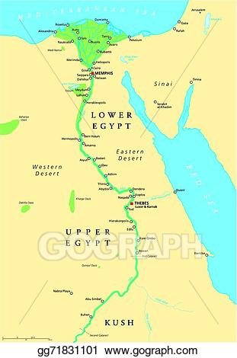
Alexandria, Egypt

Slide 3
Cappadocia, Asia Minor

Slide 4
Saint Basil the Great (330 – 379)

Slide 5
St. Gregory Nazianzus (329-390 AD)

Slide 6
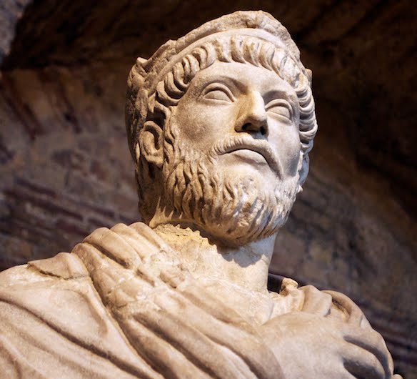
Julian the Apostate (330-363 AD)
O thou mother of gods and of men, who sharest the throne of the great Zeus…O life-giving goddess, who art the wisdom and the providence and the creator of our very souls…grant to all men happiness, and that highest happiness of all which is the knowledge of the gods; and grant to the Roman people that they may cleanse themselves of the stain of impiety.
—Julian, Hymn to Cybele, Mother of the Gods

Slide 7
St. Macrina (324-379 AD)

Slide 8
St. Justin Martyr The Philosopher (100-165 AD)

Slide 9
St. Gregory of Nyssa (335-394 AD)

Slide 10
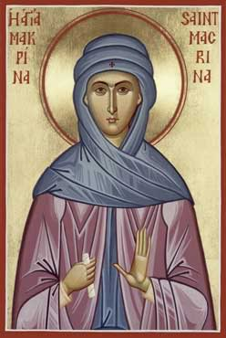
St. Macrina (324-379 AD)
Basil returned after his long period of education, already a practiced rhetorician. He was puffed up beyond measure with the pride of oratory and looked down on the local dignitaries, excelling in his own estimation all the men of leading and position. Nevertheless, Macrina took him in hand, and with such speed did she draw him also toward the mark of philosophy that he forsook the glories of this world and despised famed gained by speaking, and deserted it for this busy life where one toils with one’s hands.
—St. Gregory of Nyss, Life of Macrina 27-28

Slide 11
Saint Basil the Great (330 – 379)
I had wasted much time on follies and spent nearly all my youth in vain labors, and devotion to the teachings of a wisdom that God had made foolish (I Cor. 1:20). Suddenly, I awokeas out of a deep sleep. I beheld the wonderful light of the Gospel truth, and I recognized the nothingness of the wisdom of the princes of this world that was to come to naught (I Cor. 2:6). I shed a flood of tears over my wretched life, and I prayed for a guide who might form in me the pricniples of piety.
— St. Basil, Letter 223.2

Slide 12
St. Athanasius (296-373 AD)

Slide 13
St. Gregory Nazianzus (329-390 AD)

Slide 14
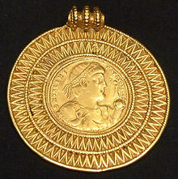
Emperor Valens (328-378 AD)

Slide 15
Hexameron

Slide 16
Saint Basil the Great (330 – 379)
You refuse to give on the pretext that you have not enough for your own need. But while your tongue makes excuses, your hand convicts you — that ring shining on your finger silently declares you to be a liar! How many debtors could be released from prison with one of those rings? How many shivering people could be clothed from only one of your wardrobes? And yet you turn the poor away empty-handed.
— St. Basil, Sermon on the Rich 4, c. 369 AD

Slide 17
“Where God is endangered and exposed, there all other things are considered to be nothing. Him alone do we look to. Fire, swords, beasts, and instruments for tearing the flesh are wished for by us as delights more than horrors. Afflict us with such tortures, threaten, do all that you can now devise, enjoy your power. Also, let the Emperor hear this, that at all events you will not persuade us nor win us over to the impious doctrine [Arianism], though you threaten with cruel deeds.” When Modestus, taken aback, remarked that no one had ever spoken to him like that, Basil responded, “Perhaps you have never met a bishop before.” — St. Gregory Nazianzus recounts this dialogue in his Oration 43, 49-50

Slide 18
St. Gregory of Nyssa (335-394 AD)

Slide 19
Homoousios ≠ Homoiousios

Slide 20
Tertullian (160-220 AD)

Slide 21
Hypostasis

Slide 22
Emperor Valens (328-378 AD)

Slide 23
St. Athanasius (296-373 AD)

Slide 24
Saint Basil the Great (330 – 379)
An intelligent being, boundless in power, of unlimited greatness, generous in goodness, whom time cannot measure. All things thirsting for holiness turn to Him; everything living in virtue never turns away from Him. He waters them with His lifegiving breath and helps them reach their proper fulfillment. He perfects all other things, and Himself lacks nothing; He gives life to all things, and is never depleted. He does not increase by additions, but is always complete, self-established, and present everywhere. He is the source of sanctification, spiritual light, who gives illumination to everyone using His power to search for the truth — and the illumination He gives is Himself.
— St. Basil, On the Holy Spirit 22, c. 375 AD

Slide 25
Saint Basil the Great (330 – 379)
Concerning the teachings of the Church, whether publicly proclaimed (kerygma) or reserved to members of the household of faith (dogmata), we have received some from written sources, while others have been given to us secretly, through apostolic tradition. Both sources have equal force in true religion. No one would deny either source — no one, at any rate, who is even slightly familiar with the ordinances of the Church. If we attacked unwritten customs, claiming them to be of little importance, we would fatally mutilate the Gospel, no matter what our intentions — or rather, we would reduce the Gospel teachings to bare words.
— St. Basil, On the Holy Spirit 66, c. 375 AD

Slide 26
Saint Basil the Great (330 – 379)
For instance (to take the first and most common example), where is the written teaching that we should sign with the sign of the Cross those who, trusting in the name of our Lord Jesus Christ, are to be enrolled as catechumens? Which book teaches us to pray facing East? Have any saints left for us in writing the words to be used in the invocation over the Eucharistic Bread and the Cup of blessing? As everyone knows, we are not content in the Liturgy simply to recite the words recorded by St. Paul or the Gospels, but we add other words both before and after, words of great importance for this mystery. We have received these words from unwritten teaching.
— St. Basil, On the Holy Spirit 66, c. 375 AD

Slide 27
Saint Basil the Great (330 – 379)
We bless baptismal water and the oil for chrismation as well as the candidate approaching the font. By what written authority do we do this, if not from secret and mystical tradition? Even beyond blessing the oil, what written command do we have to anoint with it? What about baptizing a man with three immersions, or other baptismal rites, such as the renunciation of Satan and his angels? Are not all these things found in unpublished and unwritten teachings, which our fathers guarded in silence, safe from meddling and petty curiosity? They had learned their lesson well; reverence for the mysteries is best encouraged in silence.
— St. Basil, On the Holy Spirit 66, c. 375 AD

Slide 28
Emperor Valens (328-378 AD)

Slide 30
Basil and I were both in Athens. We had come, like streams of a river, from the same source in our native land, had separated from each other in pursuit of learning, and were now united again as if by plan, for God so arranged it. Such was the prelude to our friendship, the kindling of that flame that was to bind us together. In this way we began to feel affection for each other. When, in the course of time, we acknowledged our friendship and recognized that our ambition was a life of true wisdom, we became everything to each other: we shared the same lodging, the same table, the same desires, the same goal. Our love for each other grew daily warmer and deeper. — St. Gregory Nazianzus Oration 43, 15-17, 19-21

Slide 31
The same hope inspired us: the pursuit of learning. This is an ambition especially subject to envy. Yet between us, there was no envy. On the contrary, we made capital out of our rivalry. Our rivalry consisted, not in seeking the first place for oneself, but in yielding it to the other, for we each looked on the other’s success as his own. We seemed to be two bodies with a single spirit. Though we cannot believe those who claim that everything is contained in everything, yet you must believe that in our case each of us was in the other and with the other. — St. Gregory Nazianzus Oration 43, 15-17, 19-21

Slide 32
2 Corinthians 4:7
But we have this treasure in earthen vessels, that the excellency of the power may be of God, and not of us.

Slide 33
St. Gregory the Theologian (329-390 AD)

Slide 34
John 15:26
But when the Comforter is come, whom I will send unto you from the Father, even the Spirit of truth, which proceedeth from the Father, he shall testify of me.

Slide 35
The Old Testament proclaimed the Father clearly, but the Son more darkly; the New Testament plainly revealed the Son, but only indicated the deity of the Spirit. Now the Holy Spirit lives among us and makes the manifestation of Himself more certain to us; for it was not safe, so long as the divinity of the Father was still unrecognized, to proclaim openly that of the Son; and so long as this was still not accepted, to impose the burden of the Spirit, if so bold a phrase may be allowed. — St. Gregory Nazianzus Oration 31, 26

Slide 36
We believe in the Holy Spirit, the Lord, the Giver of life, Who proceeds from the Father, Who with the Father and the Son is jointly worshipped and jointly glorified, Who spoke through the prophets.

Slide 37
If my tenure of the see of Constantinople is leading to disturbance, I am willing, like Jonas, to be thrown into the waves to still the tempest, although I did not raise it. If all followed my example, the Church would enjoy tranquility. This dignity I never desired; I assumed the charge much against my will. If you think fit, I am most ready to depart.

Slide 38
St. Gregory of Nyssa (335-394 AD)

