Slide 1
Pagans and Christians Lecture Three
The Accounts of Christ in Suetonius, Tacitus , and Josephus
Archaeological Evidence
The historicity of the New Testament scriptures
The argument regarding Christian plagiarism from ancient mystery cults

Slide 2
Early non-Christian confirmation of new testament history
“It is, of course, historically prejudicial to exclude automatically all Christian evidence, as if no one who became a follower of Jesus Christ could ever report accurately about His life and teachings, or to assume that all non-Christian evidence was necessarily more ‘objective.’”
—Blomberg, C.L. (2011) “Jesus of Nazareth: How historians can know him and why it matters,” in Christian Apologetics, pg. 439

Slide 3
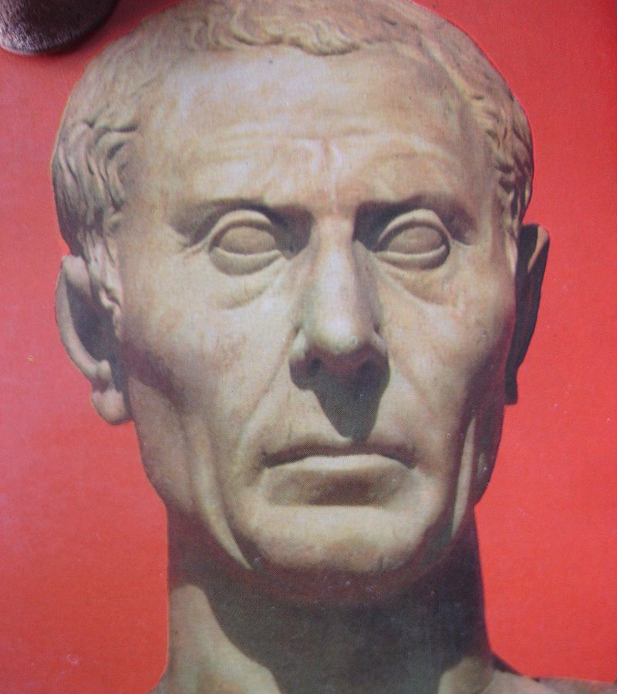
Suetonius (c. 69 – 122 AD)
Chief secretary to Emperor Hadrian (reigned AD 117-138)

Slide 4
Suetonius (c. 69 – 122 AD)
Divi Claudii 25.4
He [Claudius] expelled from Rome the Jews perpetually tumultuating under the influence of Chrestus . (Iudaeos impulsore Chresto assidue tumultuantis Roma expulit)
Acts 18:2
And [Paul] found a certain Jew named Aquila, born in Pontus, lately come from Italy, with his wife Priscilla; (because that Claudius had commanded all Jews to depart from Rome:) and came unto them. (καὶ εὑρών τινα Ἰουδαῖον ὀνόματι Ἀκύλαν, Ποντικὸν τῷ γένει, προσφάτως ἐληλυθότα ἀπὸ τῆς Ἰταλίας καὶ Πρίσκιλλαν γυναῖκα αὐτοῦ, διὰ τὸ διατεταχέναι Κλαύδιον χωρίζεσθαι πάντας τοὺς Ἰουδαίους ἀπὸ τῆς Ῥώμης, προσῆλθεν αὐτοῖς.)

Slide 5
Tertullian Apologeticum III.5
Well now, if there is this dislike of the name, what blame can you attach to names? What accusation can you bring against mere designations, save that something in the word sounds either barbarous, or unlucky, or scurrilous, or unchaste? But Christian, so far as the meaning of the word is concerned, is derived from anointing. Yes, and even when it is wrongly pronounced by you Chrestianus (for you do not even know accurately the name you hate), it comes from sweetness and benignity.
Nunc igitur, si nominis odium est, quis nominum reatus, quae accusatio vocabulorum, nisi si aut barbarum sonat aliqua vox nominis aut infaustum aut maledicum aut impudicum? "Christianus" vero, quantum interpretatio est, de unctione deducitur. Sed et cum perperam "Chrestianus" pronuntiatur a vobis — nam nec nominis certa est notitia penes vos —, de suavitate vel benignitate compositum est. Oditur itaque in hominibus innocuis etiam nomen innocuum.

Slide 6
Iotacism
Χριστός ≠ Χρήστος

Slide 7
Suetonius (c. 69 – 122 AD)
Nero 16.2
Punishment was inflicted on the Christians, a body of people addicted to a novel and mischievous superstition. (afflicti suppliciis Christiani, genus hominum superstitionis novae ac maleficae).

Slide 8
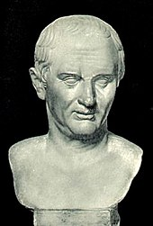
Non-Christian sources
1. Tacitus (c. 56 -120 AD)

Slide 9
Tacitus, Annales 15:44
ergo abolendo rumori Nero subdidit reos et quaesitissimis poenis adfecit, quos per flagitia invisos vulgus Chrestianos appellabat. auctor nominis eius Christus Tibero imperitante per procuratorem Pontium Pilatum supplicio adfectus erat; repressaque in praesens exitiablilis superstitio rursum erumpebat, non modo per Iudaeam, originem eius mali, sed per urbem etiam, quo cuncta undique atrocia aut pudenda confluunt celebranturque.
Therefore to squelch the rumor [that he had started the Great Fire of Rome], Nero created scapegoats and subjected to the most refined tortures those whom the common people called “Christians,” (a group) hated for their vices. Their name comes from Christ, who, during the reign of Tiberius, had been executed by the procurator Pontius Pilate. Suppressed for the moment, the deadly superstition broke out again, not only in Judea, the land which originated this evil, but also in the city of Rome, where all sorts of horrendous and shameful practices from every part of the world converge and are fervently cultivated.

Slide 10
Potential Objections: Forgery?
“No Christian would have described his fellows in Rome as a foreign cult needing to be checked, a ‘disease’ belonging to the ‘horrible and shameful things of the world’ that gravitate to Rome, a people ‘hated for their vices,’ who have a ‘hatred of the human race’ and whose terrible punishment under Nero is justified.” — Barnett, P. (2009) Finding the Historical Christ, pg. 57

Slide 11
Possible Objections: Procurator or Prefect?
“Regarding the ascription itself, it is entirely possible that Tacitus was intentionally anachronistic for the sake of clarity. Since “procurator” was the accepted title of Pilate’s position among Tacitus’s audience, he may have used the term knowing full well that the position used to be titled “prefect.” But it is even more likely that we are making too much of the distinction between “procurator” and “prefect” in the ancient world, for the evidence suggests that these terms were rather fluid in the first century.
For example, though the “Pilate stone” discovered at Caesarea Maritima gives Pilate the title ‘prefect,’ both Philo (Legat. 38) and Josephus (Jewish War 2.9.2.169) refer to him as ‘procurator’ (Greek epitropos), just as Tacitus does. In fact, Josephus sometimes uses the two terms interchangeably.”
—Boyd, G.A. and P.R. Eddy, The Jesus Legend, pgs. 181-182

Slide 12
Potential objections: Christ or Jesus?
“No compelling case can be made that Tacitus is relying on hearsay in this passage simply because he referred to the founder of the Christian movement as ‘Christ’ rather than by His proper name. For one thing, it is improbable that Tacitus, who elsewhere proves himself to be a reliable historian who routinely consults sources, would at this point rely solely on the hearsay of a group he himself identifies as a ‘pernicious superstition’ and as ‘evil.’ Moreover, by the early second century, ‘Christ’ and ‘Jesus’ could be used interchangeably, both by Christians and non-Christians. Thus we need not suppose that Tacitus’s use of the title ‘Christ’ reflects a sole dependency on Christians as his source of information.” —Boyd, G.A. and P.R. Eddy, The Jesus Legend, pg. 182

Slide 13
Potential objections: Christ or Jesus?
“In fact, three considerations lead us to conclude that, if anything, Tacitus would have been more motivated than usual to check out his sources on this topic.
First, the subject of the passage is an official action taken by a Roman emperor. Second, Tacitus consistently reflects an unusual fascination with, and animosity toward, ‘pretenders’ and superstitions, particularly those connected with claims of having been raised from the dead. And third, throughout his work Tacitus is very concerned with the happenings of members of the royal court, and there is some indication that several members of the royal family had aligned themselves with this ‘cult.’
All of this explains why Tacitus speaks so acrimoniously about the ‘pernicious superstition’ of the Christian movement, even though he is clearly moved by the horrendous pain Nero inflicted on them. But it also suggests that, if ever Tacitus would have been concerned to check out his information, it would have been in a context such as the one we are considering.”
—Boyd, G.A. and P.R. Eddy, The Jesus Legend, pg. 183

Slide 14
Potential objections: Christ or Jesus?
‘To say where he did not get his information is easier than to show where he did. First, Tacitus certainly did not draw, directly or indirectly, on writings that came from the New Testament. No literary or oral dependence can be demonstrated between his description and the Gospel accounts. The wording is too different; the only commonality is the name Pontius Pilate, and this could easily come from elsewhere. Nor did Tacitus likely draw his information from another Christian document, if his contempt for Christianity is any indication. Second, Tacitus does not seem to have drawn on general hearsay.’ —Van Voorst, R.E. (2000) Jesus Outside the New Testament, pg. 49

Slide 15
the value of tacitus

Slide 16
“All these considerations suggest Tacitus is an independent — and thus important — non-Christian source about Jesus. Tacitus’ report demonstrated that a mere thirty years after Jesus died (hence while many living witnesses of the Founder were still alive) His followers were willing to be put to death for their faith, and in ways that were so barbaric it moved a very unsympathetic Roman historian to pity them. Thus Tacitus’s report provides solid, independent, non-Christian evidence for the life and death of Jesus, the remarkable resolve of His earliest followers, and the astounding growth of the movement He founded.”
—Boyd, G.A. and P.R. Eddy, The Jesus Legend, pg. 184

Slide 17
Flavius Josephus (37-100 AD)

Slide 18
Jewish antiquities 20.199-200
Ananus…was a bold man in his temper, and very insolent; he was also of the sect of the Sadducees, who are very rigid in judging offenders, above all the rest of the Jews, as we have already observed; when, therefore, Ananus was of this disposition, he thought he had now a proper opportunity [to exercise his authority]. Festus was now dead, and Albinus was but upon the road; so he assembled the Sanhedrin of judges, and brought before them the brother of Jesus, who was called Christ, whose name was James, and some others, [or, some of his companions]; and when he had formed an accusation against them as breakers of the law, he delivered them to be stoned.

Slide 19
Flavius Josephus (37-100 AD)

Slide 20
“First, it appears in all of the Greek manuscripts of Jewish Antiquities 20 ‘without any notable variation.’ Second, the text provides a passing and blasé reference to James, who is here of little consequence, since Josephus is more interested in the illegal behavior of Ananus (and Jesus is even less of a subject, only inserted to identify James). Thus it fits well in the context of Ananus’s removal from the office of high priest. Third, no New Testament or early Christian writer wrote of James in a matter-of-fact way as ‘the brother of Jesus’ (ho adelphos Iesou), but rather — with the reverence we would expect — ‘the brother of the Lord’ (ho adelphos tou Kyriou, as in Galatians 1:19). The words tou legomenou Christou (‘the one called Christ’) are neutral and appear to be employed to distinguish Jesus from others in his writings by the same name.
Fourth, Josephus’s account of James’s execution differs significantly in its time and manner from that offered by the second-century Christian author Hegesippus and, in the third century, Clement of Alexandria. If Josephus’s account was invented by a Christian, we would expect it to better reflect the Christian accounts. Fifth, Josephus’s account is short and matter of fact compared to the Christian accounts by Hegesippus and Clement of Alexandria.
In short, this text gives no indication of tampering by Christians and the large majority of scholars regard the entire passage as the authentic words of Josephus.”
—Licona, M.R. (2010) The Resurrection of Jesus, 236-237.

Slide 21
1) There is little manuscript evidence for Jewish Antiquities. However, it is not less so than for other ancient works.
Josephus only mentions “Christos” in connection with Jesus, even though he writes about other messianic figures. Josephus mentions twenty-one other people named Jesus. This makes it likely Josephus simply mentions that James’s brother “was called Christ” in order to identify which James was killed.
Some argue the term legomenos can be translated as “called” or “said to be.” As it is used of Jesus in this passage and that gives it a link with the New Testament, it could mean a Christian wrote. However, if a Christian had made a later addition they likely would have referred to Jesus as “the Christ” not “called Christ.”
Jesus is mentioned before James in the passage, which raises the question in the minds of some skeptics as to why Josephus would choose to structure the passage in this way. The structure does not elevate Jesus in a drastic way as to make Him the focus of the passage. This appears to be a simple construction used by Josephus for clarity.
This passage involves a negative view of Ananus the high priest, even though in Jewish Wars Josephus presents a positive view of him. Tessa Rajak finds this difference “startling” (Rajak, Josephus, 131). However, given the fact that we often find tension between accounts of the same event as they appear in Jewish Wars and Antiquities, this is not a strong argument. Also there is a shift between those two works in the way Josephus writes about Jewish leaders between those two works.

Slide 22
6) The third-century theologian Origen wrote that Josephus believed the fall of Jerusalem was God’s punishment of the Jews for killing James. However, no existing text of Antiquities contains this. Skeptics may argue against the authenticity of the Antiquities passage because if Christians had tampered with it by the time of Origen, then how can we trust what we currently have? However, Origen would likely not have asserted this haphazardly unless it was in other manuscripts because they were freely available in the Roman public library at the time he wrote.
7) The flow of the passage would not be interrupted if the information about Jesus was removed. While this may be true, it is hardly proof of a later Christian insertion.

Slide 23
“The authenticity of this passage is not in doubt and does not require emending.”
— Barnett, P. (2009) Finding the Historical Christ, pg. 52.

Slide 24
Jewish antiquities 18.63
At this time there appeared Jesus, a wise man, if it be lawful to call him a man; for he was a doer of startling deeds, a teacher of such men as receive the truth with pleasure. He drew over to him both many of the Jews and many of the Gentiles. He was the Messiah. And when Pilate, at the suggestion of the principal men amongst us, had condemned him to the cross, those that loved him at the first did not forsake him; for he appeared to them alive again the third day; as the divine prophets had foretold these and ten thousand other wonderful things concerning him. And the tribe of Christians, so named from him, are not extinct at this day.

Slide 25
Jewish antiquities 18.63-64
Γίνεται δὲ κατὰ τοῦτον τὸν χρόνον Ἰησοῦς σοφὸς ἀνήρ, εἴγεἄνδρα αὐτὸν λέγειν χρή: ἦν γὰρ παραδόξων ἔργων ποιητής, διδάσκαλος ἀνθρώπων τῶν ἡδονῇ τἀληθῆ δεχομένων, καὶ πολλοὺς μὲν Ἰουδαίους, πολλοὺ ς δὲ καὶ τοῦ Ἑλληνικοῦ ἐπηγάγετο: ὁ χριστὸς οὗτος ἦν. καὶ αὐτὸν ἐνδείξει τῶν πρώτων ἀνδρῶν παρ᾽ ἡμῖν σταυρῷἐπιτετιμηκότος Πιλάτου οὐκ ἐπαύσαντο οἱ τὸ πρῶτονἀγαπήσαντες: ἐφάνη γὰρ αὐτοῖς τρίτην ἔχων ἡμέραν πάλιν ζῶν τῶν θείων προφητῶν ταῦτά τε καὶ ἄλλα μυρία περὶ αὐτοῦ θαυμάσια εἰρηκότων. εἰς ἔτι τε νῦν τῶνΧριστιανῶν ἀπὸ τοῦδε ὠνομασμένον οὐκ ἐπέλιπε τὸ φῦλον.

Slide 26
i) The textual Challenge
“The text leads one to believe that Josephus must have converted to Christianity. However, in the early third century, Origen claimed that Josephus was not a Christian. This creates a problem. If Origen is correct, it would be odd that a non-Christian Jew would say some of the things reported in this passage. Three parts stand out as candidates for interpolations: (1) ‘if indeed one should call him a man,’ (2) ‘He was the Messiah’ and (3) “for He appeared to them on the third day, living again, just as the divine prophets had spoken of these and countless other wondrous things about Him’.
—Licona, M.R. (2010) The Resurrection of Jesus, 238.

Slide 27
ii) Textual options
At this time there appeared Jesus, a wise man. For He was a doer of startling deeds, a teacher of people who receive the truth with pleasure. And he gained a following both among many Jews and among many Jews and among many of Greek origin. And when Pilate, because of an accusation made by the leading men among us, condemned Him to the Cross, those who had loved him previously did not cease to do so. And up until this day, the tribe of Christians (named after Him) has not died out.
— Meier, J.P. (1991) A Marginal Jew, pg. 61.

Slide 28
ii) Textual options
“First, the passage appears in every Greek and Latin manuscript of Jewish Antiquities 18. It must be admitted that there are only three Greek manuscripts, the earliest of which appears to have been written in the eleventh century. However, there are numerous Latin manuscripts dating to the sixth century. It must also be noted that the passage is not mentioned by any church fathers prior to Eusebius of Caesarea in the fourth century. Second, given Josephus’s later mention of “Jesus who was called Christ,” some earlier reference to Jesus becomes likely, since he does not pause to explain more about Jesus.
Third, the vocabulary and grammar of Meier’s modified passage ‘cohere well with Josephus’ style and language; the same cannot be said when the text’s vocabulary and grammar are compared with that of the NT…In fact, most of the vocabulary turns out to be characteristic of Josephus.’ Meier also contends that his modified Testimonium is a simpler move than omitting it in its entirety, which to him is ‘sometimes on flimsy grounds.’ For him, ‘A basic rule of method is that, all things being equal, the simplest explanation that also covers the largest amount of data is to be preferred.’” —Licona, M.R. (2010) The Resurrection of Jesus, 239-240.

Slide 29
And when Pilate, because of an accusation made by the leading men among us, condemned Him to the Cross, those who had loved him previously did not cease to do so. For they reported that he appeared to them alive. And up until this very day the tribe of Christians (named after Him) has not died out.
—Licona, M.R. (2010) The Resurrection of Jesus, 240

Slide 30
“It is more closely represented in all of the extant manuscripts while maintaining neutrality toward Jesus and His followers. Moreover, it provides an insight concerning why the “tribe” of Christians had not died out: they were convinced that their spiritual leader had risen from the dead.”
—Licona, M.R. (2010) The Resurrection of Jesus, 241.

Slide 31
At this time there appeared Jesus, a wise man, if it be lawful to call him a man; for he was a doer of surprising works, (and) a teacher of such men as receive the truth with pleasure. He drew over to him both many of the Jews and many of the Gentiles. He was the Messiah. And when Pilate, at the suggestion of the principal men amongst us, had condemned Him to the Cross, those that loved him at the first did not forsake him; for he appeared to them alive again the third day; as the divine prophets had foretold these and ten thousand other wonderful things concerning him. And the tribe of Christians, so named from him, are not (yet?) extinct at this day.
—Charlesworth, J. (2008) The Historical Jesus: An Essential Guide, pg. 34.

Slide 32
“First, there is no reason to doubt why a scribe who was a Christian would feel the need to elevate the reference and evaluation of Jesus. Perhaps these additions were first placed in the margins and subsequent scribes imagined the notes were parts of the texts that should not be left out.
Second, no Christian would have written this testimony to Jesus as it is preserved. No Christian would have categorized Jesus’ miracles as ‘surprising works,’ or reported that Jesus was condemned because he was ‘accused by the first-rate men among us.’ That statement implies that Jesus was rightly condemned to crucifixion. Also the final sentence implies that this ‘tribe’ will not endure.
The reader should read the testimony [the amended alternative] two more times: once without the italicized words, observing how the statement flows with grammatical accuracy and with historical clarity, and another time stressing only the Christian additions. The intent of the Jew Josephus and then of the Christian scribes should be become more obvious.”
—Charlesworth, J. (2008) The Historical Jesus: An Essential Guide, pg. 34.

Slide 33
Conclusion regarding Josephus's accounts
“A number of careful, respected scholars have concluded that this passage, minus a few obvious interpolations, is authentic, demonstrating that Josephus…was well aware that Jesus was the founder of the Christian movement and that He had been condemned by the ruling priests and crucified by the Roman governor Pontius Pilate. The testimony of Josephus is in fact very important, even if it is not crucial.” —Evans, C.A. (2012) Jesus and His World: The Archaeological Evidence, pg. 9.

Slide 34
“The testimonies of ancient historians offer strong evidence against a purely mythical reading of Jesus. In contrast to those who have denied the historical existence of Jesus altogether, judging him merely to have been a mythological construct of early Christian thought, the testimonies of the ancient historians reveal how even those outside the early church regarded Jesus to have been a historical person. It remains difficult, therefore, if not impossible, to deny the historical existence of Jesus when the earliest Christian, Jewish, and pagan evidence mention Him. —Elledge, C. (2014) Josephus, Tacitus, and Suetonius, pg. 717

Slide 35
“The references to Jesus by a Roman historian and a Jewish historian disprove the absurd contention that Jesus never lived.”
—Charlesworth, J. (2008) The Historical Jesus: An Essential Guide, pg. 35

Slide 36
Reliability of the Gospels for the Historical Existence of Jesus Christ
“We affirm that the Synoptic Gospel writers would have wanted to preserve accurate history according to the standards of their day, that they had every likelihood of being able to do so, and that the overall pattern of widespread agreement on the essential contours of Jesus’ life and ministry coupled with enough variation of details to demonstrate at least some independent sources and tradents on which each drew makes it very probable that they did in fact compose trustworthy historical and biographical documents.”
--Blomberg (2011) “Jesus of Nazareth: How Historians Can Know Him and Why it Matters,” in Christian Apologetics: A Comprehensive Case for Biblical Faith, pg. 456.

Slide 37
Reliability of the Gospels for the Historical Existence of Jesus Christ
“The Gospels were written within living memory of the events they recount. Mark’s Gospel was written well within the lifetime of many of the eyewitnesses, while the other three canonical Gospels were written in the period when living eyewitnesses were becoming scarce, exactly at the point in time when their testimony would perish with them were it not put in writing. This is a highly significant fact, entailed not by unusually early datings of the Gospels but by the generally accepted ones.” – R. Bauckham (2006) Jesus and the Eyewitness: The Gospels as Eyewitness Testimony, pg. 7.

Slide 38
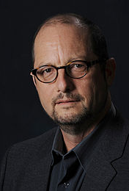
Reliability of the Gospels for the Historical Existence of Jesus Christ
“We are not dealing with just one Gospel that reports what Jesus said and did from sometime near the end of the first century—I named seven—[Ehrman considers noncanonical gospels in his study] that are either completely independent of one another or independent in a large number of their traditions. These all attest to the existence of Jesus. Moreover, these independent witnesses corroborate many of the same basic sets of data—for example, that Jesus not only lived but that he was a Jewish teacher who was crucified by the Romans at the instigation of Jewish authorities in Jerusalem…The vast network of these traditions, numerically significant, widely dispersed, and largely independent of one another, makes it almost certain that whatever one wants to say about Jesus, at the very least one must that he existed.”—Bart Ehrman (2012) Did Jesus Exist: The Historical Argument for Jesus of Nazareth, pgs. 92-93.

Slide 39
Reliability of the Gospels for the Historical Existence of Jesus Christ
“It would be foolish to continue to foster the illusion that the Gospels are merely fictional stories like the legends of Hercules and Asclepius. The theologies in the New Testament are grounded on interpretation of real historical events, especially the crucifixion of Jesus, at a particular place and time.”
—James Charlesworth (2006) “The Historical Jesus and Biblical Archaeology,” in Jesus and Archaeology, pg. 694.

Slide 40
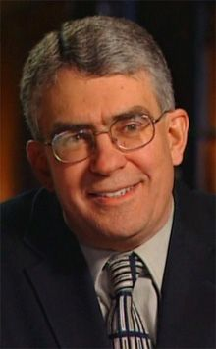
Reliability of the Gospels for the Historical Existence of Jesus Christ
“If the New Testament Gospels were nothing more than fictions and fables about a man who never lived, one must wonder how it is they possess so much verisimilitude and why they talk so much about people we know lived and about so many things we know happened. After all, the Gospels say Jesus was condemned to the cross by a Roman governor named Pontius Pilate. Not only is this man mentioned by historical sources outside the New Testament, but we have found an inscribed stone on which his name appears. Indeed, we may have found the name of the Jewish high priest who condemned Jesus inscribed on a bone box. It seems these people were real—I suspect Jesus was too.”
—Craig Evans (2012) Jesus and His World, pg. 10.

Slide 41
Archaeology helps to confirm the historicity of the bible
“Luke is a historian of the first rank; not merely are his statements of fact trustworthy…this author should be placed along with the very greatest historians.”
—Ramsay, W.M. (1915) The Bearing of Recent Discovery on the Trustworthiness of the New Testament, pg. 222

Slide 42
Archaeology helps to confirm the historicity of the bible
“Luke’s history is unsurpassed in respect of its trustworthiness.”
—Ramsay, W.M. (1915) The Bearing of Recent Discovery on the Trustworthiness of the New Testament, pg. 222

Slide 43
Luke 2:1-3
2 And it came to pass in those days, that there went out a decree from Caesar Augustus that all the world should be taxed.
² (And this taxing was first made when Quirinius was governor of Syria.)
³ And all went to be taxed, every one into his own city.

Slide 45
Papyrus from Egypt
Because of the approaching census it is necessary that all those residing for any cause away from their homes should at once prepare to return to their own governments in order that they may complete the family registration of the enrollment and that the tilled lands may retain those belonging to them.
— Elder, J. (1960) Prophets, Idols, and Diggers, pgs. 159-160

Slide 46
Luke 2:1-3
“Several problems are involved in the statement that Augustus conducted a census of the whole empire during the reign of both Quirinius and Herod. For one, there is no record of such a census, but we now know that regular censuses were taken in Egypt, Gaul, and Cyrene. It is quite likely that Luke’s meaning is that censuses were taken throughout the empire at different times, and Augustus started this process. The present tense that Luke uses points strongly toward understanding this as a repeated event. Now Quirinius did take a census, but that was in AD 6, too late for Jesus’ birth, and Herod died before Quirinius became governor.
Was Luke confused? No; in fact, he mentions Quirinius’s later census in Acts 5:37. Its is most likely that Luke is distinguishing this census in Herod’s time from the more well-known census of Quirinius: ‘This census took place before Quirinius was governor of Syria.’ There are several New Testament parallels for this translation.”
—N. Geisler (2006) Baker Encyclopedia of Christian Apologetics, pgs. 46-47.

Slide 47
In Acts 16:11, the pronoun “we” begins to be used, and in 2 Timothy 4:11 we learn that St. Luke was St. Paul’s travelling companion.
“For Acts the confirmation of historicity is overwhelming…Any attempt to reject its basic historicity must now appear absurd. Roman historians have long taken it for granted.” —Sherwin-White, A.N. (1963) Roman Society and Roman Law in the New Testament, pg. 189.

Slide 48
Geography
“In all, Luke names thirty-two countries, fifty-four cities, and nine islands without error.” —N. Geisler (2006) Baker Encyclopedia of Christian Apologetics, 47.

Slide 49
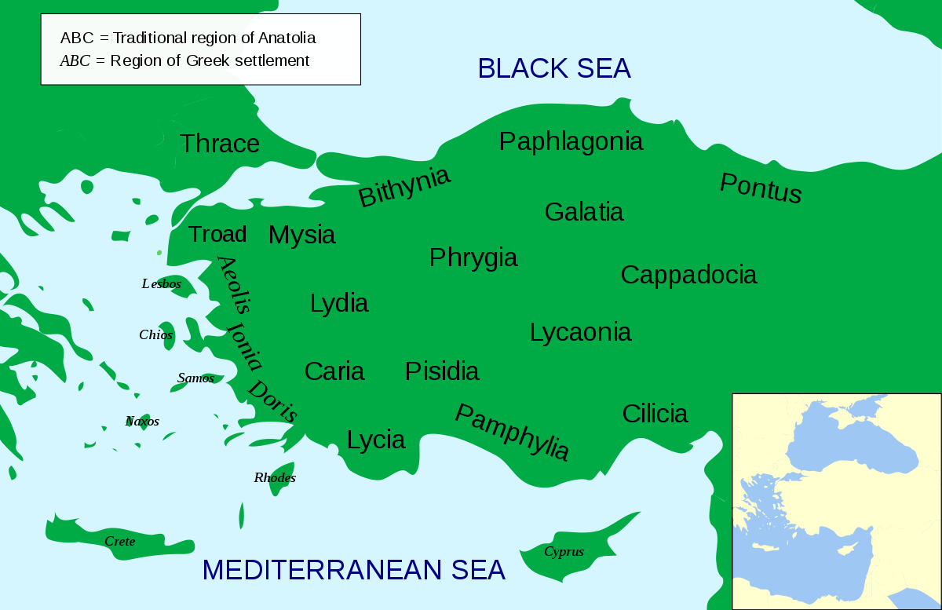
Geography
Acts 14:6: They became aware of it and fled to Lystra and Derbe, cities of Lycaonia, and to the surrounding region.

Slide 50
Geography

Slide 51
People
Luke 3:1:
3 Now in the fifteenth year of the reign of Tiberius Caesar, Pontius Pilate being governor of Judaea, and Herod being tetrarch of Galilee, and his brother Philip tetrarch of Ituraea and of the region of Trachonitis, and Lysanias the tetrarch of Abilene,
² Annas and Caiaphas being the high priests, the word of God came unto John the son of Zacharias in the wilderness.

Slide 52
F.f. Bruce (1969) “Archaeological Confirmation of the New Testament,” in revelation and the bible, pg. 321; CIG 4521

Slide 53
Erastus
Romans 16:23: Gaius mine host, and of the whole church, saluteth you. Erastus the treasurer of the city saluteth you, and Quartus a brother.

Slide 54
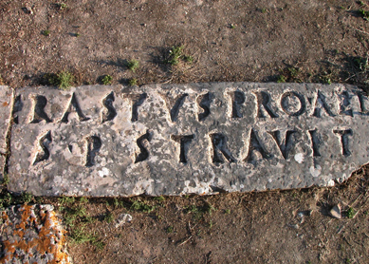
Erastus inscription

Slide 55
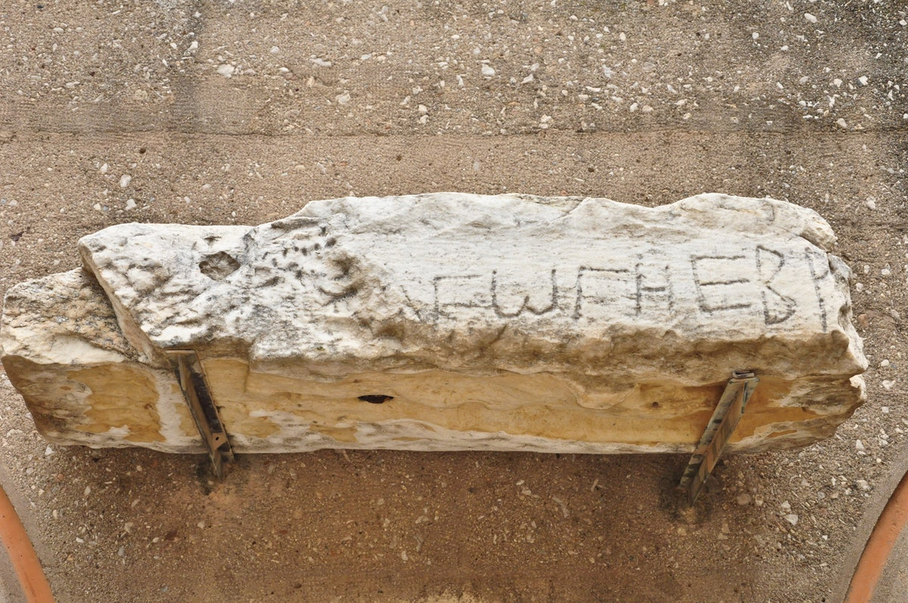
Synagogue of the Hebrews, Corinth

Slide 56
Acts 18:4-7
⁴ And he reasoned in the synagogue every sabbath, and persuaded the Jews and the Greeks.
⁵ And when Silas and Timotheus were come from Macedonia, Paul was pressed in the spirit, and testified to the Jews that Jesus was Christ.
⁶ And when they opposed themselves, and blasphemed, he shook his raiment, and said unto them, Your blood be upon your own heads; I am clean; from henceforth I will go unto the Gentiles.
⁷ And he departed thence, and entered into a certain man's house, named Justus, one that worshipped God, whose house joined hard to the synagogue.

Slide 57
Meat market (macellum), Corinth

Slide 58
1 Corinthians 10:25
Whatsoever is sold in the meat market, that eat, asking no question for conscience's sake.

Slide 59
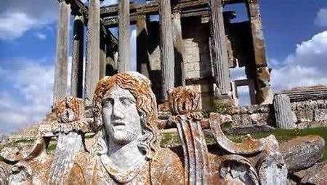

Slide 60
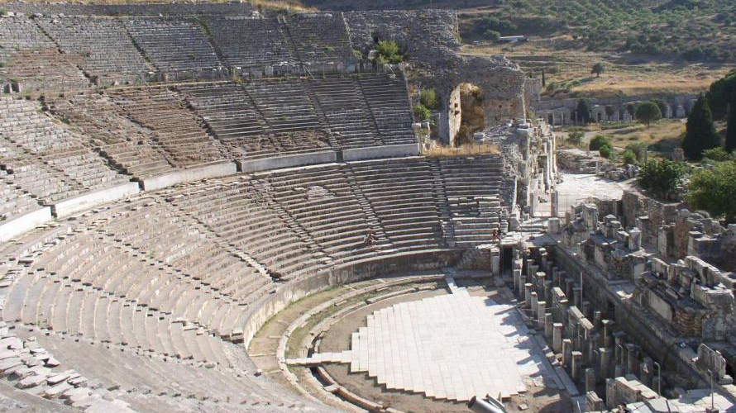
Acts 19:23-29

Slide 61
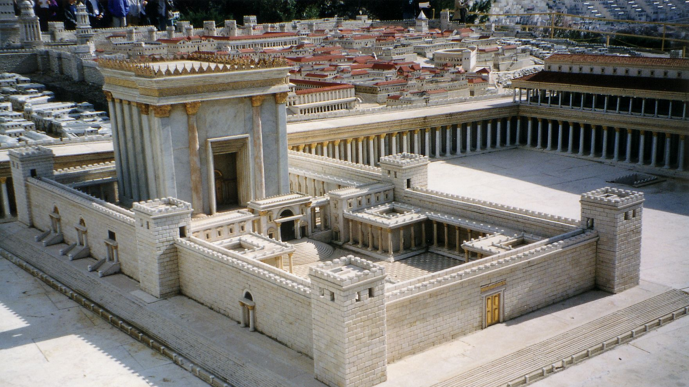
Acts 21:28
“No foreigner may enter within the barrier which surrounds the temple and enclosure. Anyone who is caught doing so will be personally responsible for his ensuing death.”
—Bruce, F.F. (1969) Archaeological Confirmation of the New Testament, pg. 326

Slide 62
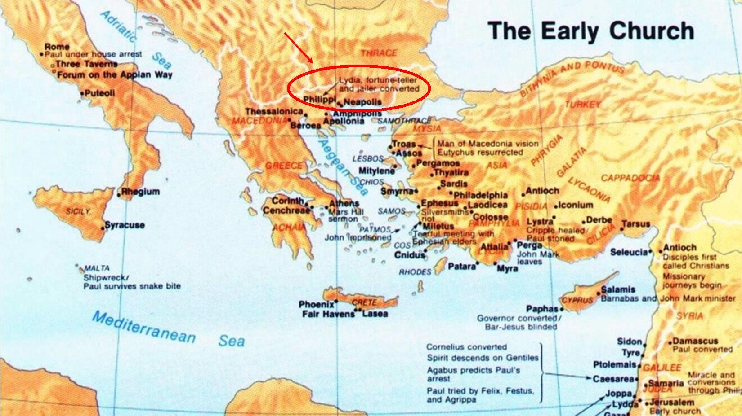
terminology
Free, J.P. (1969) Archaeology and Bible History, pg. 320

Slide 63
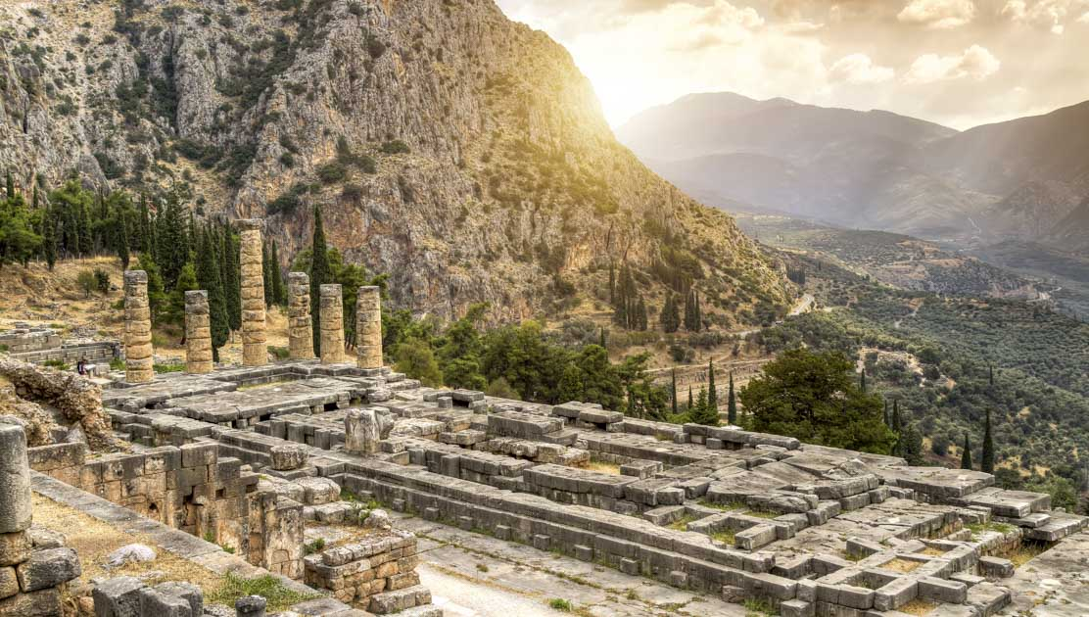
Acts 18:12-13
¹² And when Gallio was the proconsul of Achaia, the Jews made insurrection with one accord against Paul, and brought him to the judgment seat,
¹³ Saying, This fellow persuadeth men to worship God contrary to the law.

Slide 64
Gallio inscription (IG, VII, 1676; SIG, II, 801d)
As Lucius Junius Gallio, my friend, and the Proconsul of Asia…

Slide 65
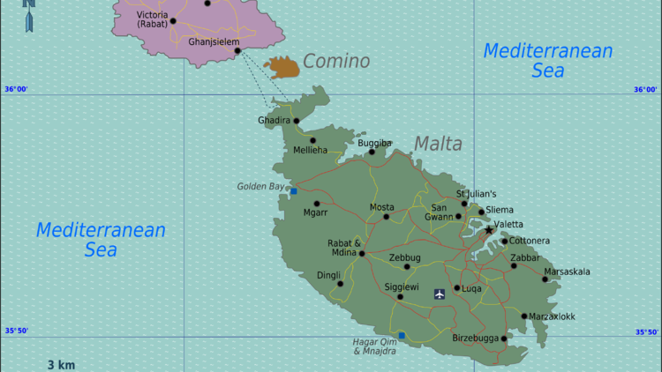
Acts 28:7
In the same quarters were possessions of the chief man of the island, whose name was Publius; who received us, and lodged us three days courteously.
Bruce, F.F. (1969) Archaeological Confirmation of the New Testament, pg. 325

Slide 66
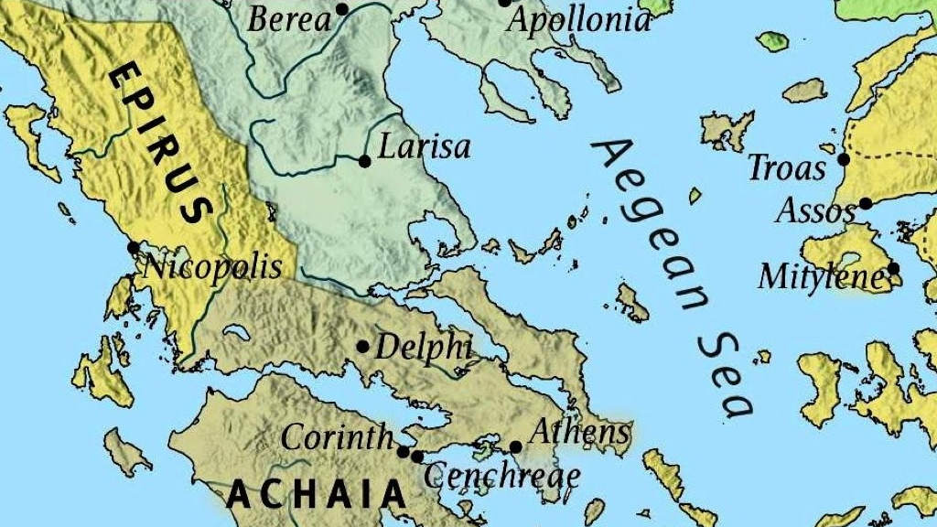
Acts 17:6
And when they found them not, they drew Jason and certain brethren unto the rulers of the city (πολιτάρχαι/politarchs), crying, These that have turned the world upside down are come hither also.
Bruce, F.F. (1969) Archaeological Confirmation of the New Testament, pgs. 325, 360; see also Graves, D.E. (2014) Biblical Archaeology, pgs. 215-16.

Slide 67
“Politarch” Inscription

Slide 69
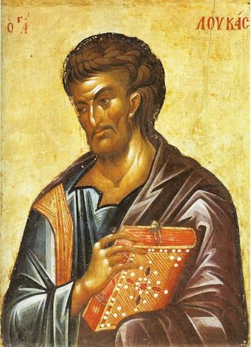
Colin Hemer (1990) The Book of Acts in the Setting of Hellenistic History, pgs. 104-107.

Slide 70
Colin Hemer (1990) The Book of Acts in the Setting of Hellenistic History, pgs. 104-107.
Specialized details, which would not have been widely known except to a contemporary researcher such as the Apostle Luke who traveled widely. These details include exact titles of officials, identification of army units, and information about major routes.
1
Details archeologists know are accurate but cannot verify as to the precise time period. Some of these are unlikely to have been known except to a writer who had visited the districts.
2
Correlation of dates of known kings and governors with the chronology of the narrative.
3
Facts appropriate to the date of St. Paul, or his immediate contemporary in the Church, but not to a date earlier of later.
4

Slide 71
5) “Undesigned coincidences” between Acts and the Pauline Epistles
Internal correlations within Acts
Off-hand geographical references that bespeak familiarity with common knowledge
Differences in formulation within Acts that indicate the different categories of sources used
Peculiarities in the selection of detail, as in theology, that are explainable in the context of what is now known of first-century church life
Materials the “immediacy” of which suggests that the author was recounting a recent experience, rather than shaping or editing a text long after it had been written
Cultural or idiomatic items now known to be peculiar to the first-century atmosphere

Slide 72
Blaiklock, E.m. (1968) Acts of the Apostles, pg. 89
“Luke is a consummate historian, to be ranked in his own right with the great writers of the Greeks.”
—Blaiklock, E.M. (1968) Acts of the Apostles, pg. 89

Slide 73
Other important archaeological discoveries that help confirm the new testament
Two ossuary inscriptions discovered in Talpioth, a southern suburb of Jerusalem, have been called some of the “earliest records of Christianity.” A coin of Agrippa I and pottery indicate that the ossuaries belong to the period before A.D. 50. The two ossuaries bear the enigmatic inscriptions in Greek: IESOU IOU and IESOU ALOTH. Also present were four crosses.

Slide 74
The pavement

Slide 75
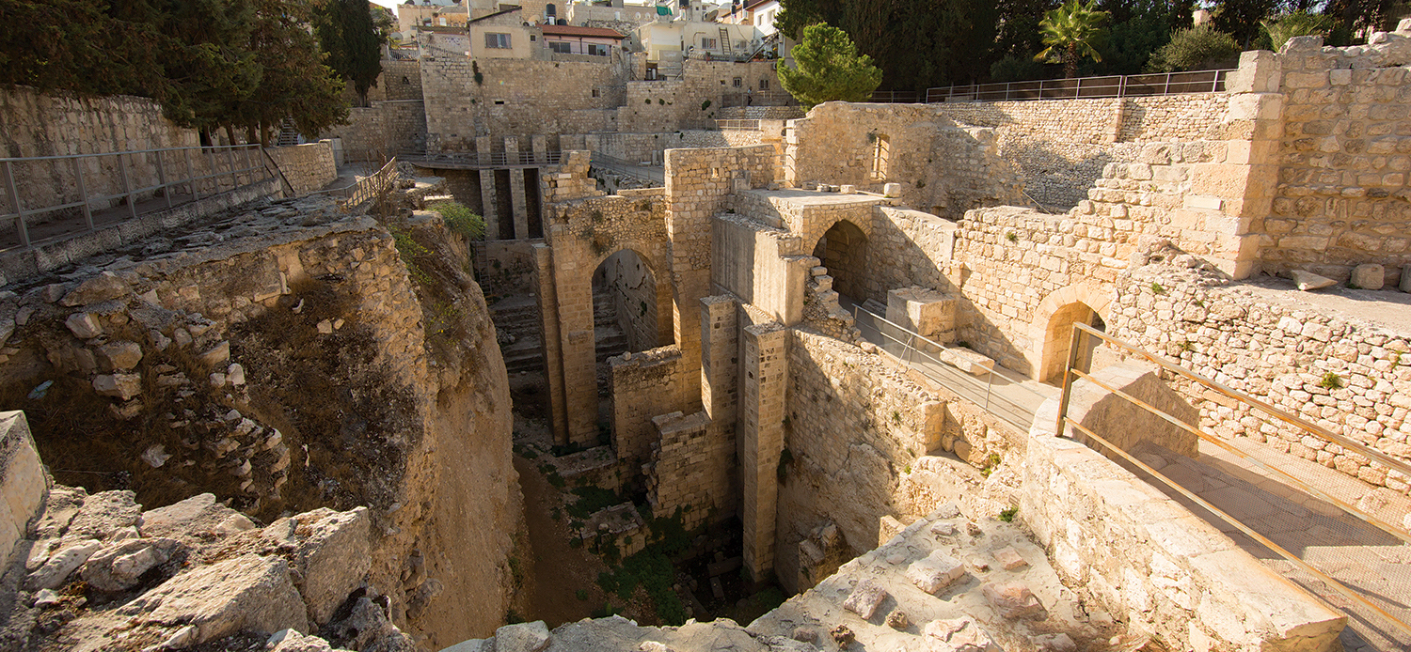
The pool of bethesda

Slide 76
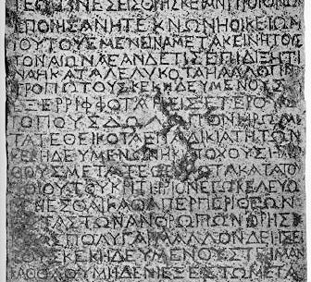
The Nazareth decree
“…the offender [shall] be sentenced to capital punishment on [the] charge of violation of [a] sepulcher.”
—Colin Hemer (1990) The Book of Acts in the Setting of Hellenistic History, pg. 155

Slide 77
The Nazareth decree
“Other notices warned of a fine, but death for disturbing graves? A likely explanation is that Claudius, having heard of the Christian doctrine of resurrection and Jesus’ empty tomb while investigating the riots of AD 49, decided not to let any such report surface again. This would make sense in light of the Jewish argument that the Body had been stolen (Matt. 28:11-15). This is early testimony to the strong and persistent belief that Jesus rose from the dead.”
—N. Geisler (2006) Baker Encyclopedia of Christian Apologetics, pg. 48

Slide 78
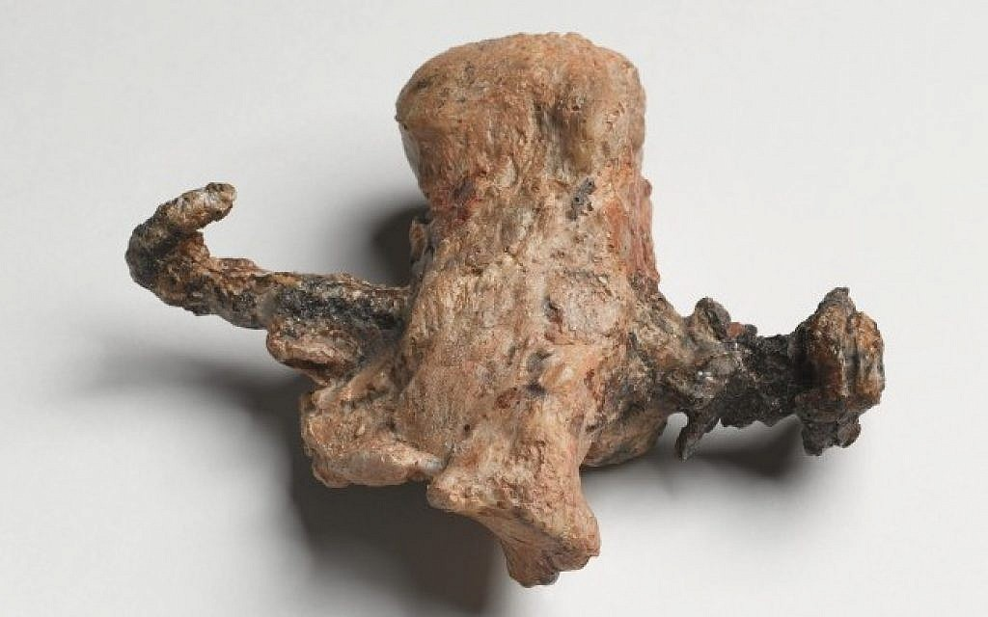
Yehohanan — A Crucifixion victim
“The discovery in 1968 of an ossuary (ossuary no. 4 in Tomb 1, at Giv’at ha-Mitvar) of a Jewish man named Yehohanan, who had obviously been crucified, provided archaeological evidence and insight into how Jesus Himself may have been crucified. The ossuary and its content date to the late 20s AD, that is during the administration of Pilate, the very Roman governor who condemned Jesus to the Cross. The remains of an iron spike (11.5 cm in length) are plainly seen still encrusted in the right heel bone…Those who took down the body of Yehohanan apparently were unable to remove the spike, with the result that a piece of wood (from an oak tree) remained affixed to the spike. Later, the skeletal remains of the body —spike, fragment of wood, and all — were placed in the ossuary…Yehohanan’s leg bones were broken, but there is disagreement over how and when they were broken.”
—Evans, C.A. (2014) “Getting the Burial Traditions and Evidences Right,” in How God Became Jesus: A Response to Bart Ehrman, pgs. 83-84

Slide 79
John 19:31-36
³¹ The Jews therefore, because it was the preparation, that the bodies should not remain upon the cross on the sabbath day, (for that sabbath day was an high day,) besought Pilate that their legs might be broken, and that they might be taken away.
³² Then came the soldiers, and brake the legs of the first, and of the other which was crucified with him.
³³ But when they came to Jesus, and saw that he was dead already, they brake not his legs:
³⁴ But one of the soldiers with a spear pierced his side, and forthwith came there out blood and water.
³⁵ And he that saw it bare record, and his record is true: and he knoweth that he saith true, that ye might believe.
³⁶ For these things were done, that the scripture should be fulfilled, A bone of him shall not be broken.

Slide 80
Exodus 12:1-3, 43, 46
1 And the Lord spake unto Moses and Aaron in the land of Egypt saying,
² This month shall be unto you the beginning of months: it shall be the first month of the year to you.
³ Speak ye unto all the congregation of Israel, saying, In the tenth day of this month they shall take to them every man a lamb, according to the house of their fathers, a lamb for an house:
43 This is the ordinance of the passover:
⁴⁶ In one house shall it be eaten; thou shalt not carry forth ought of the flesh abroad out of the house; neither shall ye break a bone thereof.

Slide 81
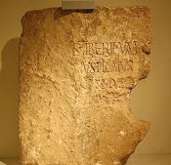
The Pilate Inscription
Tiberium
Pontius Pilate
Prefect of Judea

Slide 82
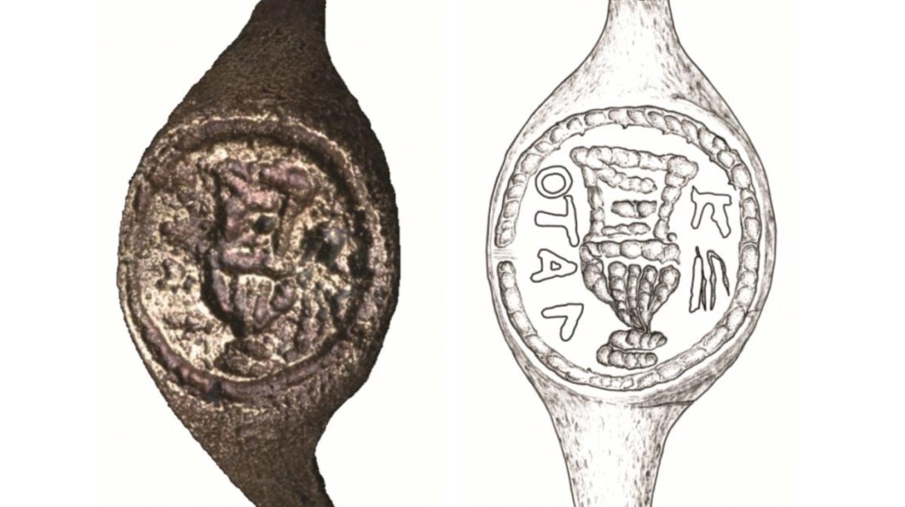
Pontius Pilate’s Ring

Slide 83
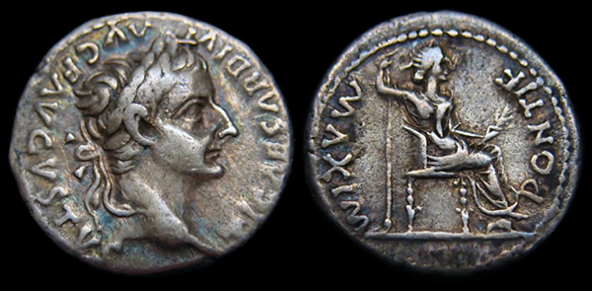
New Testament Coins: “The tribute penny”

Slide 84
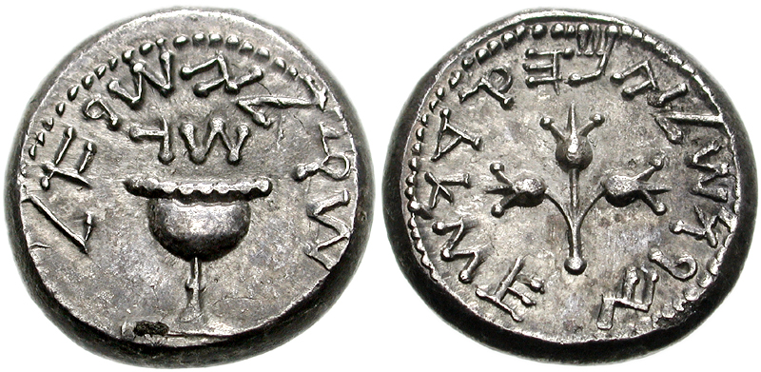
New Testament Coins: “The Thirty pieces of silver”

Slide 85
New Testament Coins: “The widow’s mite”
^{Mark:41-44}
⁴¹ And Jesus sat over against the treasury, and beheld how the people cast money into the treasury: and many that were rich cast in much.
⁴² And there came a certain poor widow, and she threw in two mites, which make a farthing.
⁴³ And he called unto him his disciples, and saith unto them, Verily I say unto you, That this poor widow hath cast more in, than all they which have cast into the treasury:
⁴⁴ For all they did cast in of their abundance; but she of her want did cast in all that she had, even all her living.

Slide 86
New Testament Coins: “The Widow’s mite”

Slide 87
F.f. Bruce, The new testament documents: Are they reliable?, pgs. 7-8
“The Christian gospel is not primarily a code of ethics or a metaphysical system; it is first and foremost good news, and as such it was proclaimed by its earliest preachers…And this good news is intimately bound up with the historical order, for it tells how for the world’s redemption, God entered into history, the eternal came into time, the kingdom of heaven invaded the realm of earth, in the great events of the incarnation, crucifixion, and resurrection of Christ…This historical once-for-allness of Christianity…makes the reliability of the writings which purport to record this revelation a question of first-rate importance.”

Slide 88
Five Reasons the Mystery Religions Did Not Influence Christianity
Reason #1: True to its Jewish roots, Christianity did not accept others gods

Slide 89
Jews Were Committed to an Exclusive Faith
But now Pilate, the procurator of Judea, removed the army from Cesarea to Jerusalem, to take their winter quarters there, in order to abolish the Jewish laws. So he introduced Caesar’s effigies, which were upon the ensigns, and brought them into the city; whereas our law forbids us the very making of images; on which account the former procurators were wont to make their entry into the city with such ensigns as had not those ornaments. Pilate was the first who brought those images to Jerusalem, and set them up there; which was done without the knowledge of the people, because it was done in the nighttime; but as soon as they knew it, they came in multitudes to Cesarea, and interceded with Pilate many days, that he would remove the images; and when he would not grant their requests, because it would tend to the injury of Caesar, while yet they persevered in their request, on the sixth day he ordered his soldiers to have their weapons privately, while he came and sat upon his judgment seat, which seat was so prepared in the open place of the city, that it concealed the army that lay ready to oppress them: and when the Jews petitioned him again, he gave a signal to the soldiers to encompass them round, and threatened that their punishment should be no less than immediate death, unless they would leave off disturbing him, and go their ways home. (59) But they threw themselves upon the ground, and laid their necks bare, and said they would take their death very willingly, rather than the wisdom of their laws should be transgressed; upon which Pilate was deeply affected with their firm resolution to keep their laws inviolable, and presently commanded the images to be carried back from Jerusalem to Cesarea.
—Josephus, Antiquities of the Jews, 18.55-59

Slide 90
Jews Were Committed to an Exclusive Faith
“The first-century Jewish mind-set loathed syncretism. Unlike the Gentiles of this era, Jews refused to blend their religion with other religions. Gentile religions were not exclusive; one could be a follower of several different gods at one time. But Judaism was strictly monotheistic, as was Christianity. As the Gospel spread beyond the borders of Israel, the apostles not only found themselves introducing people to the strange idea of a Man risen from the dead; they also came face-to-face with a polytheistic culture. But they made no accommodation on this front.”
—Komoszewski, J. ed., M.J. Sawyer, and D. Wallace (2006) Reinventing Jesus, pg. 220.

Slide 91
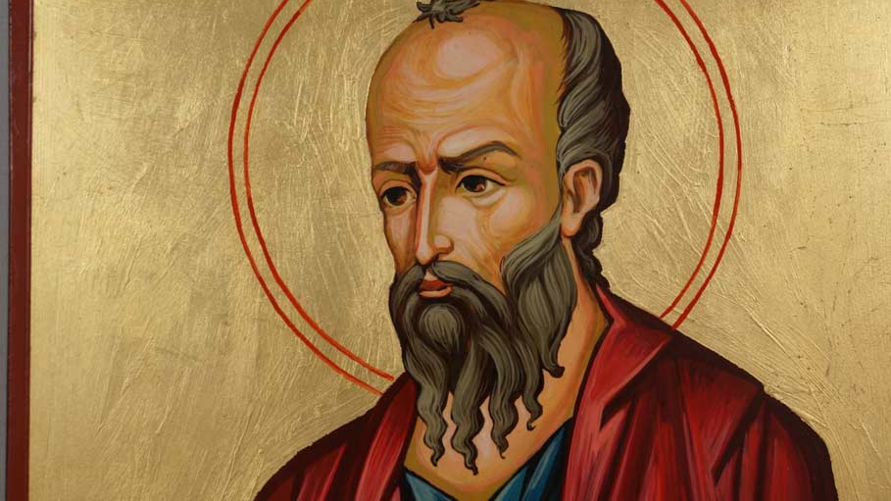
Apostle Paul Maintained and Taught Devotion to the One True God Both Before and After His Dramatic Conversion
Circumcised on the eighth day, of the stock of Israel, of the tribe of Benjamin, an Hebrew of the Hebrews; as touching the law, a Pharisee;
Concerning zeal, a persecutor of the Church; touching the righteousness which is in the law, blameless.
But what things were gain to me, those I counted loss for Christ.
—Philippians 3:5-7

Slide 92
Apostle Paul Maintained and Taught Devotion to the One True God Both Before and After His Dramatic Conversion
And I was advancing in Judaism beyond many of my own age among my people, so extremely zealous was I for the traditions of my fathers.
—Galatians 1:14, ESV

Slide 93
Five Reasons the Mystery Religions Did Not Influence Christianity
Reason #2: The Differences Between Christianity and the Mystery Cults are Greater than the Similarities

Slide 94
Boyd, G.A., and P.R. Eddy, The Jesus Legend, pg. 142
“[As] soon as we become critical of reading parallels into the evidence, we discover that differences between Christianity and the mystery religions are far more pronounced than any similarities. While there are certainly parallel terms used in early Christianity and the mystery religions, there is little evidence for parallel concepts. For example, as we have noted, both Christianity and the mystery religions spoke of salvation — as do many religions throughout history. But what early Christians meant by this term had little in common with what devotees of mystery religions meant by it. To cite just one difference, there was in the mystery religions nothing similar to Paul’s death and resurrection of their Savior and are adopted as God’s children by placing their trust in Him.”

Slide 95
Machen, J.G. (1921) Origin of Paul’s Religion, pgs. 227-228
“The myth of Cybele is narrated in various forms. According to the most characteristic form, the youthful Attis, beloved by Cybele, is struck with madness by the jealous goddess, deprives himself of his virility, does through his own mad act, and is mourned by the goddess. The myth contains no account of a resurrection; all that Cybele is able to obtain is that the body of Attis should be preserved, that his hair should continue to grow, and that his little finger should move.”

Slide 96
Five Reasons the Mystery Religions Did Not Influence Christianity
Reason #3: Parallels Comparing the Two Prove Nothing

Slide 97
McDowell, J. and S. McDowell (2017) Evidence that Demands a Verdict, pg. 311
“What if we told you about a British ocean liner that was about eight hundred feet long, weighed more than sixty thousand tons, and could carry about three thousand passengers? The ship had a top cruising speed of twenty-four knots, had three propellers, and about twenty lifeboats. What if I told you that this ocean liner hit an iceberg on its maiden voyage in the month of April, tearing an opening in the starboard side, forward portion of the ship, sinking it along with about two thousand passengers? Would you recognize the event from history? You might say, “Hey, that’s the Titanic!” Well, believe it or not, you would be wrong. It’s the Titan, a fictional ship described in Morgan Robertson’s 1898 book called The Wreck of the Titan, or Futility. This book was written fourteen years before the disaster took place, and several years before construction began on the Titanic!”

Slide 98
Five Reasons the Mystery Religions Did Not Influence Christianity
Reason #4: Mystery Religions Seem to be Influenced by Christianity, not the Other Way Around

Slide 99
Boyd, G.A., and P.R. Eddy, The Jesus Legend, pgs. 139-140
“A second obstacle to any attempt to understand first-century Christianity in light of ancient Greco-Roman mystery religions is that virtually all of our evidence for these religions comes from the second to fourth centuries…Trying to explain a first-century religious movement by appealing to evidence for a “parallel” phenomenon a century or more later is questionable, to say the least. True, it is not unreasonable to assume that there were first century precursors to the mystery cults of the second century and beyond. But this is an argument from silence, and in any case we are left with nothing conclusive about these precursor movements. Hence, any argument that Christianity was influenced by, let alone modeled after, these precursors must be judged as unwarranted speculation grounded in anachronism.”

Slide 100
Nash, R.H. (2003) The Gospel and the Greeks: Did the New Testament Borrow from Pagan Thought, pg.143
“[During this ritual,] initiates would stand or recline in a pit as a bull was slaughtered on a platform above them. The initiate would then be bathed in the warm blood of the dying animal. The taurobolium has been alleged to a source for Christian language about being washing the Blood of the Lamb (Rev. 7:14) or sprinkled with the Blood of Jesus (1 Peter 1:2).”

Slide 101
Boyd, G.A., and P.R. Eddy, The Jesus Legend, pg.140
“The crucial point here is that if there was any line of influence, it would seem more reasonable to argue that it was from Christianity to the mystery religions rather than the other way around.”

Slide 102
Mettinger, T. (2013) The Riddle of Resurrection: Dying and Rising Gods in the Ancient Near East, pg. 221
“There is, as far as I am aware, no prima facie evidence that the death and resurrection of Jesus is a mythological construct, drawing on the myths and rites of the dying and rising gods of the surrounding world. While studied with profit against the background of Jewish resurrection belief, the faith in the death and resurrection of Jesus retains its unique character in the history of religions. The riddle remains.”

Slide 103
Five Reasons the Mystery Religions Did Not Influence Christianity
Reason #5: The Death of Jesus Christ is Unique

Slide 104
Nash, R.H. (2003) The Gospel and the Greeks: Did the New Testament Borrow from Pagan Thought, pg.160
“None of the so-called savior gods died for someone else. The notion of the Son of God dying in place of His creatures is unique to Christianity.”

Slide 105
Christ Died for the Sins of Everyone
Jesus Christ did far more than just die on behalf of His friends. He specifically died for the sins of His immediate friends and followers, and all those who would believe in Him in the future (see Rom. 3:23-26; 1 Cor. 15:3; 2 Cor. 5:14, 15, 17-19; Gal. 1:3, 4). Nash provides the contrast: “Only Jesus died for sin. It is never claimed that any of the pagan deities died for sin.”
—Nash, R.H. (2003) The Gospel and the Greeks: Did the New Testament Borrow from Pagan Thought, pg. 160.

Slide 106
The Death of Jesus Christ was a Historical Event
“Jesus’ death was an actual event in history. The death of the god described in the pagan cults is a mythical drama with no historical ties; its continued rehearsal celebrates the recurring death and rebirth of nature. The incontestable fact that the early church believed that its proclamation of Jesus’ death and resurrection was grounded upon what actually happened in history makes absurd any attempt to derive this belief from the mythical, non-historical stories of pagan cults.”
—Nash, R.H. (2003) The Gospel and the Greeks: Did the New Testament Borrow from Pagan Thought, pg. 161.

Slide 107
The Death of Jesus Christ was Voluntary
And there were certain Greeks among them that came up to worship at the feast:
The same came therefore to Philip, which was of Bethsaida of Galilee, and desired him, saying, Sir, we would see Jesus.
Philip cometh and telleth Andrew: and again Andrew and Philip tell Jesus.
And Jesus answered them, saying, The hour is come, that the Son of man should be glorified.
Verily, verily, I say unto you, Except a corn of wheat fall into the ground and die, it abideth alone: but if it die, it bringeth forth much fruit.
He that loveth his life shall lose it; and he that hateth his life in this world shall keep it unto life eternal.
If any man serve me, let him follow me; and where I am, there shall also my servant be: if any man serve me, him will my Father honour.
Now is my soul troubled; and what shall I say? Father, save me from this hour: but for this cause came I unto this hour.
Father, glorify thy name. Then came there a voice from heaven, saying, I have both glorified it, and will glorify it again.
The people therefore, that stood by, and heard it, said that it thundered: others said, An angel spake to him.
Jesus answered and said, This voice came not because of me, but for your sakes.
Now is the judgment of this world: now shall the prince of this world be cast out.
And I, if I be lifted up from the earth, will draw all men unto me.
This he said, signifying what death he should die.
—John 12:20-33

Slide 108
The Death of Jesus Christ was Voluntary
“Unlike the mystery gods, Jesus died voluntarily. Nothing like the voluntary death of Jesus can be found in the mystery cults.”
—Nash, R.H. (2003) The Gospel and the Greeks: Did the New Testament Borrow from Pagan Thought, pg. 161)

Slide 109
The Death of Jesus Christ was Voluntary
“One difference, of course, is perfectly obvious and is indeed generally recognized — the Pauline Christ is represented as dying voluntarily, and dying for the sake of men. He ‘loves me’ says Paul, “and gave Himself for me.” There is absolutely nothing like that conception in the case of the pagan religions. Osiris, Adonis, and Attis were overtaken by their fate; Jesus gave His life freely away. The difference is stupendous; it involves the very heart of the religion of Paul.”
—Machen, J.G. (1921) Origin of Paul’s Religion, pg. 315.

Slide 110
The Death of Jesus Christ Ended in Victory, Not Defeat
“And finally, Jesus’ death was not a defeat but a triumph. Christianity stands entirely apart from the pagan mysteries in that its report of Jesus’ death is a message of triumph. Even as Jesus was experiencing the pain and humiliation of the Cross, He was the Victor. The New Testament’s mood of exultation contrasts sharply with that of the mystery religions, whose followers wept and mourned for the terrible fate that overtook their gods.”
—Nash, R.H. (2003) The Gospel and the Greeks: Did the New Testament Borrow from Pagan Thought, pg. 161.

Slide 111
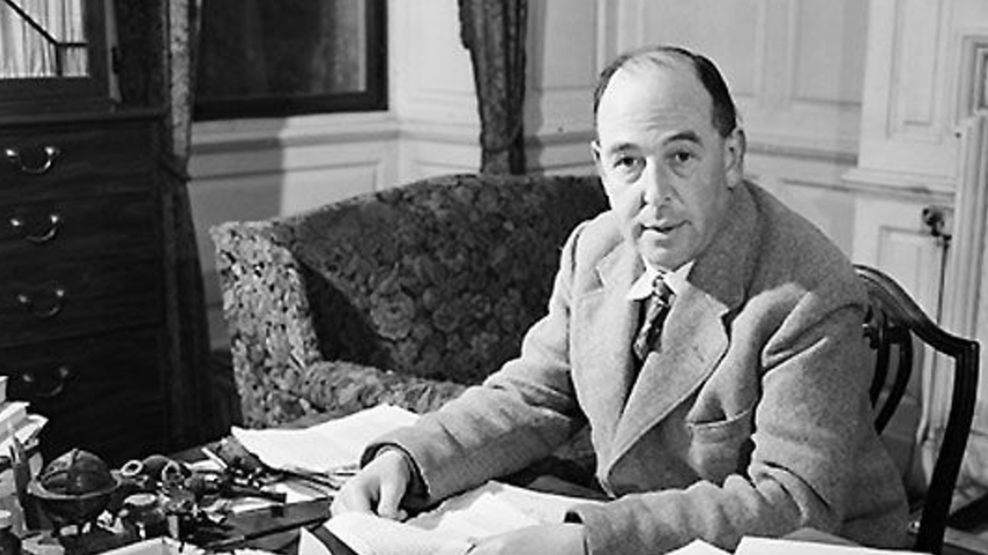
Humphrey Carpenter (1978) The Inklings, 42-45
On Saurday night, September 19, 1931, in Oxford, England, J.R.R. Tolkien and C.S. Lewis went walking with a friend (Hugo Dyson) and discussed these myths when ‘a sudden rush of wind’ prompted Tolkien to remark that the trees and the stars revealed how people once imagined a world that was alive, ‘myth-woven.’ Lewis, not yet a Christian but no longer an atheist, responded that myths are lies, powerfully written and crucial to the history of language and literature, but not for believing. Tolkien argued that even when humans lie, our human thoughts and imaginations must reflect something of our Creator — that the myth-making storyteller is “fulfilling God’s purpose, and reflecting a splintered fragment of the true light.” That led to a conversation on Christianity. Lewis knew well the mythical emphasis on sacrifice and blood, and ‘indeed he had examined the historicity of the Gospels’ enough to be ‘nearly certain that it really happened’ and to recognize that the New Testament centered on words such as ‘sacrifice’ and the ‘Blood of the Lamb.’ But, he wondered, ‘What was the point of it all? How could the death and resurrection of Christ have “saved the world”?’

Slide 112
Humphrey Carpenter (1978) The Inklings, 42-45
Tolkien’s response was that the old pagan stories of a dying god provided a clue: They were in fact ‘God…using the images of their “mythopoeia” [story-making] to express fragments of His eternal truth.’ But with Christianity, ‘the enormous difference [was] that the poet who invented it was God Himself, and the images He used were real mean and actual history…Here is a real Dying God, with a precise location in history and definite historical consequences. The old myth has become fact.’

Slide 113
Humphrey Carpenter, The Inklings, 42-45
Within two weeks, Lewis wrote, ‘I have just passed on from believing in God to definitely believing in Christ — in Christianity…My long night talk with Dyson and Tolkien has a good deal to do with it.’”

Slide 114
C.S. Lewis (1980) “Is Theology Poetry” in The Weight of Glory, pgs. 128-129
“We should, therefore, expect to find in the imagination of the great pagan teachers and myth makers some glimpse of that theme which we believe to be the very plot of the whole cosmic story — the theme of incarnation, death, and rebirth. And the differences between the Pagan Christs (Balder, Osiris, etc.) and the Christ Himself is much what we should expect to find. The Pagan stories are all about someone dying and rising, either every year, or else nobody knows where and nobody knows when. The Christian story is about a historical personage, whose execution can be dated pretty accurately, under a named Roman magistrate, and with whom the society that He founded is in a continuous relation down to the present day. It is the difference between a real event on the one hand and dim dreams or premonitions of that same event on the other.”

Slide 116
