Slide 1
Pagans and Christians Lecture Ten
Julian the Apostate
Sallustius, On the Gods and the Cosmos
Saint Ephraim the Syrian, Hymns against Julian

Slide 2
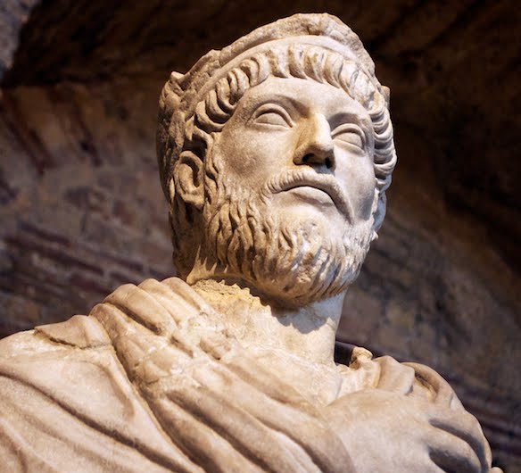
Julian the Apostate (330-363 AD)
O thou mother of gods and of men, who sharest the throne of the great Zeus…O life-giving goddess, who art the wisdom and the providence and the creator of our very souls…grant to all men happiness, and that highest happiness of all which is the knowledge of the gods; and grant to the Roman people that they may cleanse themselves of the stain of impiety.
—Julian, Hymn to Cybele, Mother of the Gods

Slide 3
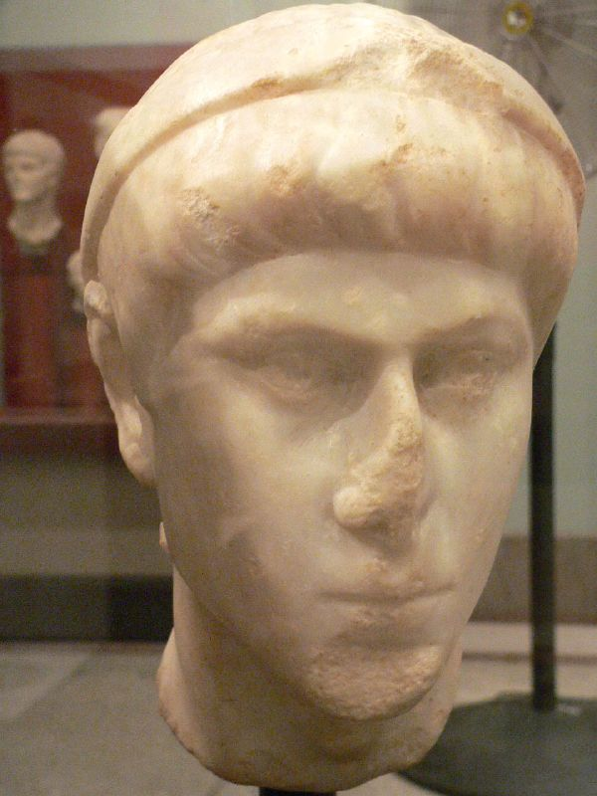
Constantius II (324-361 AD)

Slide 4
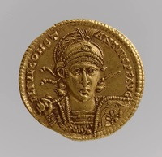
Julius Constantius (289-337 AD) & Flavius Dalmatius (320-337 AD)

Slide 6
Magnentius (303-353 AD)

Slide 8
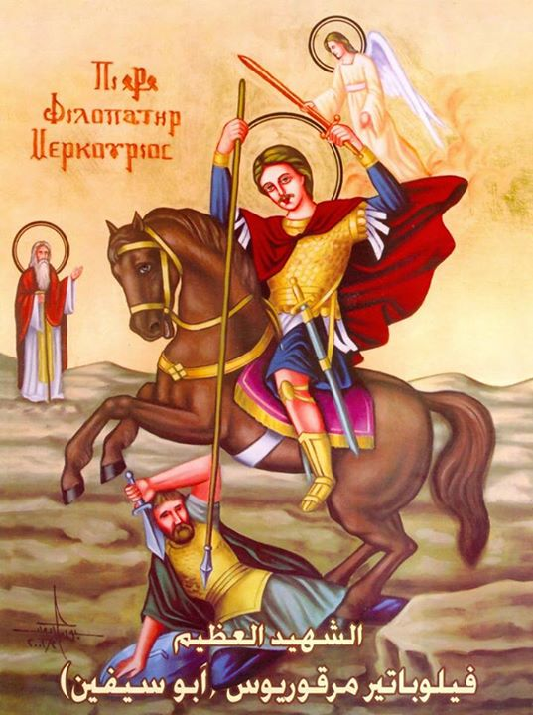

Slide 9
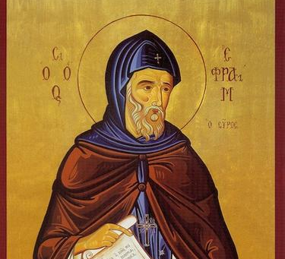
Saint Ephraim the Syrian (306-373 AD)
Saint Ephraim lived in the far eastern reaches of the Roman Empire, where the language of daily life was Syriac (a dialect of Aramaic, related to Hebrew). Until 363 AD, St. Ephraim was a teacher and hymnographer for the church in Nisibis.

Slide 10
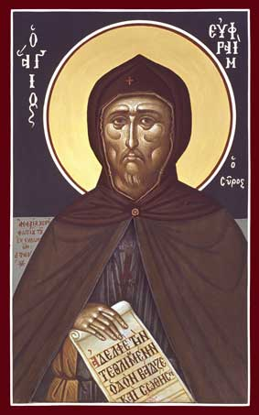

Slide 11
Saint Ephraim the Syrian (306-373 AD)
Following Julian’s disastrous campaign against the Persians and the surrender of Julian’s successor Jovian (in 363), Nisibis was ceded to the Persian Empire. St. Ephraim, along with other Christian refugees, found himself transplanted to the city of Edessa. There St. Ephraim served as a deacon, and directed choirs that chanted his compositions.

Slide 12
Saint Ephraim the Syrian (306-373 AD)

Slide 13
Saint Ephraim the Syrian (306-373 AD)
There are four hymns explicitly against emperor Julian, and one hymn On the Church that was composed in anticipation of the apostate’s arrival in Nisibis soon after his accession to the throne.

Slide 14
Saint Ephraim the Syrian (306-373 AD)
From the beginning of this hymn, St. Ephraim sets forth his central theological theme: there is no reason to fear that God has abandoned His Church; the true Christian must not lose hope, but persevere under conditions of duress. St. Ephraim uses the examples of prophets Elijah and Daniel to show that the courage to rebuke idolstrous tyrants is required of us by our Creator, and that we will be vindicated for it.

Slide 15
Saint Ephraim the Syrian (306-373 AD)
The hymn is particularly rich in vineyard imagery. The present time is a transitory period of trial in which the true fruits will cling to the True Vine. The Incarnation Itself is symbolic of the fact that God does not ever forget us, for Christ the True Vine bent down to rescue us. The present time is a transitory period of trial in which the true fruits will cling to the True Vine while the wild grapes are cast away.

Slide 16
Saint Ephraim the Syrian (306-373 AD)
Now that the plentitude of summer has been replaced by winter, true Christians will continue to love the Vinedresser. Or, alternatively, now that the refreshing shade of the Christian emperors has been withdrawn “to make us mindful of our drought,” we have an opportunity to show fidelity and perseverance.

Slide 19
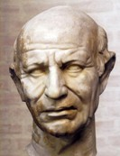
Sallustius (4th century AD)
On the Gods and the Cosmos

Slide 20
The gods are immutable, without generation, eternal, incorporeal, and are not fixed in any place.
The essences of the gods are neither generated; for eternal natures are without generation; and those beings are eternal who possess a first power, and are naturally void of passivity. Nor are their essences composed from bodies; for even the powers of bodies are incorporeal: nor are they comprehended in place; for this is the property of bodies: nor are they separated from the first cause, or from each other; in the same manner as intellections are not separated from intellect, nor sciences from the soul.

Slide 21
Myths are true, and divinely inspired
On what account then the ancients, neglecting such discourses as these, employed myths, is a question not unworthy our investigation. And this indeed is the first utility arising from fables, that they excite us to inquiry, and do not suffer our cogitative power to remain in indolent rest. It will not be difficult therefore to show that fables are divine, from those by whom they are employed: for they are used by poets agitated by divinity, by the best of philosophers, and by such as disclose initiatory rites. In oracles also fables are employed by the gods; but why fables are divine is the part of philosophy to investigate. Since therefore all beings rejoice in similitude, and are averse from dissimilitude, it is necessary that discourses concerning the gods should be as similar to them as possible, that they may become worthy of their essence, and that they may render the gods propitious to those who discourse concerning them; all which can only be effected by fables. Fables therefore imitate the gods, according to effable and ineffable, unapparent and apparent, wise and ignorant; and this likewise extends to the goodness of the gods; for as the gods impart the goods of sensible natures in common to all things, but the goods resulting from intelligibles to the wise alone, so fables assert to all men that there are gods; but who they are, and of what kind, they alone manifest to such as are capable of so exalted a knowledge. In fables too, the energies of the gods are imitated; for the world may very properly be called a fable, since bodies, and the corporeal possessions which it contains, are apparent, but souls and intellects are occult and invisible. Besides, to inform all men of the truth concerning the gods, produces contempt in the unwise, from their incapacity of learning, and negligence in the studious; but concealing truth in fables, prevents the contempt of the former, and compels the latter to philosophize. But you will ask why adulteries, thefts, paternal bonds, and other unworthy actions are celebrated in fables? Nor is this unworthy of admiration, that where there is an apparent absurdity, the soul immediately conceiving these discourses to be concealments, may understand that the truth which they contain is to be involved in profound and occult silence.

Slide 22
There are Five Types of Myths
Of fables, some are theological, others physical, others animastic, (or belonging to soul,) others material, and lastly, others mixed from these. Fables are theological which employ nothing corporeal, but speculate the very essences of the gods; such as the fable which asserts that Saturn devoured his children: for it obscurely intimates the nature of an intellectual god, since every intellect returns into itself. But we speculate fables physically when we speak concerning the energies of the gods about the world; as when considering Saturn the same as Time, and calling the parts of time the children of the universe, we assert that the children are devoured by their parents.

Slide 23
There are Five Types of Myths
But we employ myths in an animistic mode when we contemplate the energies of the soul; because the intellections of our souls, though by a discursive energy they proceed into other things, yet abide in their parents. Lastly, fables are material, such as the Egyptians ignorantly employ, considering and calling corporeal natures divinities; such as Isis, earth; Osiris, humidity; Typhon, heat: or again, denominating Saturn, water; Adonis, fruits; and Bacchus, wine. And, indeed, to assert that these are dedicated to the gods, in the same manner as herbs, stones, and animals, is the part of wise men; but to call them gods is alone the province of mad men; unless we speak in the same manner as when, from established custom, we call the orb of the Sun and its rays the Sun itself.

Slide 24
There are Five Types of Myths
But we may perceive the mixed kind of myths, as well in many other particulars, as in the fable which relates, that Discord at a banquet of the gods threw a golden apple, and that a dispute about it arising among the goddesses, they were sent by Jupiter to take the judgement of Paris, who, charmed with the beauty of Venus, gave her the apple in preference to the rest. For in this fable the banquet denotes the supermundane powers of the gods; and on this account they subsist in conjunction with each other: but the golden apple denotes the world, which, on account of its composition from contrary natures, is not improperly said to be thrown by Discord, or strife.

Slide 25
There are Five Types of Myths
But again, since different gifts are imparted to the world by different gods, they appear to contest with each other for the apple. And a soul living according to sense, (for this is Paris) not perceiving other powers in the universe, asserts that the contended apple subsists alone through the beauty of Venus. But of these species of fables, such as are theological belong to philosophers; the physical and animastic rites (teleteïs:) since the intention of all mystic ceremonies is, to conjoin us with the world and the gods. But if it be requisite to relate another fable, we may emply the following with advantage. It is said that the mother of the gods perceiving Attis by the river Gallus, became in love with him, and having placed on him a starry had, lived afterwards with him in intimate familiarity; but Attis falling in love with a Nymph, deserted the mother of the gods, and entered into association with the Nymph. Through this the mother of the gods caused Attis to become insane, who cutting off his genital parts, left them with the nymph, and then returning again to his pristine connection with the Goddess.

Slide 26
There are Five Types of Myths
The mother of the gods then is the vivific goddess, and on this account is called mother: but Attis is the Demiurgus of natures conversant with generation and corruption; and hence his is said to be found by the river Gallus; for Gallus denotes the Galaxy, or milky circle, from which a passive body descends to the earth. But since primary gods perfect such as are secondary, the mother of the gods falling in love with Attis imparts to him celestial powers; for this is the meaning of the starry hat. But Attis loves a nymph, and nymphs preside over generation; for every thing in generation flows. But because it is necessary that the flowing nature of generation should be stopped, lest something worse than things last should be produced; in order to accomplish this, the Demiurgus of generable and corruptible natures, sending prolific powers into the realms of generation, is again conjoined with the gods. But these things indeed never took place at any particular time, because they have a perpetuity of subsistence: and intellect contemplates all things as subsisting together; but discourse considers this thing as first, and that as second, in the order of existence.

Slide 27
There are Five Types of Myths
Hence, since a myth most aptly corresponds to the world, how is it possible that we, who are imitators of the world, can be more gracefully ornamented than by the assistance of myth? For through this we observe a festive Day. And, in the first place, we ourselves falling from the celestial regions, and associating with a nymph, the symbol of generation, live immersed in sorrow, abstaining from corn and other gross and sordid aliment; since every thing of this kind is contrary to the soul: afterwards, the incisions of a tree and fasting succeed, as if we would amputate from our nature all farther progress of generation: at length we employ the nutriment of milk, as if passing by this means into a state of regeneration: and lastly, festivity and crowns, and a re-ascent, as it were, to the gods succeed. But the truth of all this is confirmed by the time in which these ceremonies take place; for they are performed about spring and the equinoctial period, when natures in generation cease to be any longer generated, and the days are more extended than the nights, because this period is accommodated to ascending souls. But the rape of Proserpine is a story thought to have taken place about the opposite equinoctial; and this rape alludes to the descent of souls. And thus much concerning the mode of considering fables; to our discourse on which subject, may both the gods and the souls of the writers of fables be propitious.

Slide 28
Concerning the super-mundane and mundane Gods
But of the gods some are mundane and others super-mundane. I call those mundane who fabricate the world: but of the super-mundane, some produce essences, others intellect, and others soul; and on this account they are distinguished into three orders, in discourses concerning which orders, it is easy to discover all the gods. But of the mundane gods, some are the causes of the world’s existence, other animate the world; others again harmonize it, thus composed from different natures; and others, lastly, guard and preserve it when harmonically arranged. And since these orders are four, and each consists from things first, middle, and last, it is necessary that the disposers of these should be twelve: hence Jupiter, Neptune, and Vulcan, fabricate the world; Ceres, Juno, and Diana, animate it; Mercury, Venus, and Apollo, harmonize it; and, lastly, Vesta, Minerva, and Mars, preside over it with a guarding power. But the truth of this may be seen in statues as in ænigmas: for Apollo harmonizes the lyre, Pallas is invested with arms, and Venus is naked; since harmony generates beauty, and beauty is not concealed in objects of sensible inspection. But since these gods primarily possess the world, it is necessary to consider the other gods as subsisting in these; as Bacchus in Jupiter, Esculapius in Apollo, and the Graces in Venus. We may likewise behold the orbs with which they are connected; i.e. Vesta with earth, Neptune with water, Juno with air, and Vulcan with fire. But the six superior gods we denominate from general custom; for we assume Apollo and Diana for the sun and moon; but we attribute the orb of Saturn to Ceres, æther to Pallas; and we assert that heaven is common to them all. The orders, therefore, powers, and spheres of the twelve gods, are thus unfolded by us, and celebrated as in a sacred hymn.

Slide 29
How the gods who are immutable are said to be angry and appeased
But if any one thinking agreeable to reason and truth, that the gods are immutable, doubts how they rejoice in the good, but are averse from the evil; and how they become angry with the guilty, but are rendered propitious by proper cultivation; we reply, that divinity neither rejoices; for that which rejoices is also influenced by sorrow: nor is angry; for anger is a passion: nor is appeased with gifts; for then he would be influenced by delight. Nor is it lawful that a divine nature should be well or ill affected from human concerns; for the divinities are perpetually good and profitable, but are never noxious, and ever subsist in the same uniform mode of being. But we, when we are good, are conjoined with the gods through similitude; but when evil, we are separated from them through dissimilitude. And while we live according to virtue, we partake of the gods, but when we become evil we cause them to become our enemies; not that they are angry, but because guilt prevents us from receiving the illuminations of the gods, and subjects us to the power of avenging dæmons. But if we obtain pardon of our guilt through prayers and sacrifices, we neither appease nor cause any mutation to take place in the gods; but by methods of this kind, and by our conversion to a divine nature, we apply a remedy to our vices, and again become partakers of the goodness of the gods. So that it is the same thing to assert that divinity is turned from the evil, as to say that the sum is concealed from those who are deprived of sight.

