Slide 1
Pagans and Christians Lecture six
The third century crisis
Decian Persecutions
Emperors Valerian and Gallienus
St. Cyprian of Carthage
St. Hippolytus of rome

Slide 2
The history of the decline and fall of the roman empire — Edward gibbon
“In the second century of the Christian era, the empire of Rome comprehended the fairest part of the earth, and the most civilized portion of mankind. The frontiers of that extensive monarchy were guarded by ancient renown and disciplined valor. The gentle but powerful influence of laws and manners had gradually cemented the union of the provinces. Their peaceful inhabitants enjoyed and abused the advantages of wealth and luxury. The image of a free constitution was preserved with decent reverence: the Roman senate appeared to possess the sovereign authority, and devolved on the emperors all the executive powers of government…If a man were called to fix the period in the history of the world, during which the condition of the human race was most happy and prosperous, he would, without hesitation, name that which elapsed from the death of Domitian to the accession of Commodus.”

Slide 3
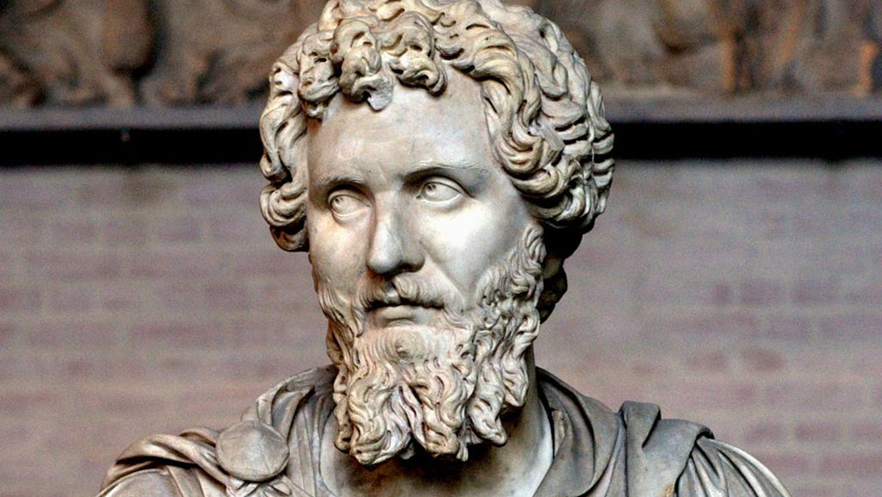
Contradictory evidence for persecution under Septimius severus (145-211 AD)
“[In 202, Septimius Severus promoted] his eldest son, and appointed him consul as a colleague to himself; and without further delay, while still in Syria, the two entered upon their consulship. After this, having first raised his soldiers’ pay, he turned his steps toward Alexandria, and while on his way thither, he conferred numerous rights upon communities of Palestine. He forbade conversion to Judaism under heavy penalties, and enacted a similar law in regard to the Christians. He then gave the Alexandrians the privilege of a local senate, for they were still without any public council.”
—Scriptores Historiae Augustae, Vita Semptimii Severi 17

Slide 4
Contradictory evidence for persecution under Septimius severus (145-211 AD)
“Even Severus himself, the father of Antoninus [Caracalla], was graciously mindful of the Christians; for he sought out the Christian Proclus, surnamed Torpacion, the business agent of Euhodias, and in gratitude for his having once cured him by anointing, he kept him in his palace till the day of his death. Antoninus, too, brought up as he was on Christian milk, was intimately acquainted with this man. Both women and men of the highest rank, whom Severus knew well to be Christians, were not merely permitted by him to remain uninjured; but he even bore distinguished testimony in their favor and gave them publicly back to us from the hands of a raging populace.”
—Tertullian, To Scapula 4

Slide 5
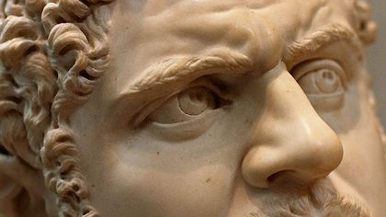
Constitutio antoniniana
“The Emperor Caesar Marcus Aurelius Severus Antoninus Augustus [Caracalla] declares: […] I may show my gratitude to the immortal gods for preserving me in such[…]Therefore I consider that in this way I can […] render proper service to their majesty […] by bringing with me to the worship [?] of the gods all who enter into the number of my people. Accordingly, I grant Roman citizenship to all [aliens] throughout the world, with no one remaining outside the citizen bodies except the dediticii. For it is proper that the multitude should not only help carry [?] all the burdens, but should also now be included in my victory. This edict […] the majesty of the Roman people […]”
—Giessen Papyrus No. 40 col.1 (212 AD)

Slide 6
Novack, r.m. (2001) Christianity and the roman empire, pg. 116.
“Regardless of the motive for Caracalla’s grant of citizenship, one effect of the grant was to make it more difficult for Christians to avoid those civic obligations of citizenship that were related to the worship and honor of the pagan gods and emperor. Much of public office revolved around the financing, organizing, an holding of various public religious festivals, and most urban social life centered on these festivals. The Christian refusal to participate in these events only accentuated the distinctive differences between Christians and their neighbors at a time when Christianity was still seeking wider acceptance. At the same time, many, but not all, Christians sought to avoid military duty because a soldier’s life in arms not only violated the moral teachings held by many Christians, but was deeply intertwined with pagan religious worship, pagan symbols, and the emperor’s cult. As in the days of Marcus Aurelius, remaining separate from the social life of the larger community and avoiding governmental and military service in an age of increasing threat to the Roman Empire could only have served to make Christians unpopular among the more conservative elments of both the imperial administration and the general population.”

Slide 7
Religious Syncretism of Severus Alexander (208-235 AD)
“Before I tell of his [Severus Alexander, Emperor 222-235 AD] wars and his campaign and victories, I will relate a few details of his private everyday life. His manner of living was as follows: First of all, if it were permissible, that is to say, if he had not lain with his wife, in the early morning hours he would worship in the sanctuary of his Lares, in which he kept statues of the deified emperors — of whom, however, only the best had been selected — and also of certain holy souls, among them Apollonius, and according to a contemporary writer, Christ, Abraham, Orepheus, and others of this same character, and, besides, the portraits of his ancestors. If this act of worship were not possible, he would ride about, or fish, or walk, or hunt, according to the character of the place in which he was.”
—Scriptores Historiae Augustae, Vita Severi Alexandri 29.1-3

Slide 8
Rhine and Danube Frontiers

Slide 9
Severus Alexander (208 -- 235 AD)

Slide 10
Maximinus Thrax (173 – 238 AD)

Slide 11
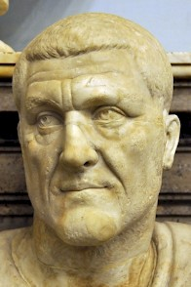
Maximinus Thrax (173 – 238 AD)
“When [Severus] Alexander the Emperor of the Romans [ruled 222-235 AD] had brought his principate to an end after thirteen years, he was succeeded by Maximin Caesar [Maximinus Thrax, ruled 235-238]. He, through ill-will towards the house of Alexander, since it consisted for the most part of believers, raised a persecution, ordering the leaders of the Church alone to be put to death, as being responsible for the teaching of the Gospel.”
—Eusebius of Caesarea, Ecclesiastical History 6.28.1

Slide 12
Gordian I (159 –238 AD)

Slide 14
Gordian II (192 –238 AD)

Slide 15
Marcus Julius Philippus (“Philip the Arab”) (204 – 249 AD)

Slide 16
Marcus Julius Philippus (“Philip the Arab”) (204 – 249 AD)
“When after six whole years Gordian [Gordian III, ruled 238-244 AD], brought his government of the Romans to an end, Philip [ruled 244-249 AD] along with his son Philip, succeeded to the principate. It is recorded that he, being a Christian, wished on the day of the last paschal vigil to share along with the multitude the prayers at the church, but was not permitted to enter by him who was then presiding, until he confessed and numbered himself among those who were reckoned to be in sin, and were occupying the place of penitence; for that otherwise, had he not done so, he would never have been received by [the presiding clergy] on account of the many charges made concerning him. And it is said that he obeyed readily, displaying by his actions how genuine and pious was his disposition toward the fear of God.”
—Eusebius of Caesarea, Ecclesiastical History 6.34

Slide 17
C. Messius Quintus Decius Valerinus (201 – 251)

Slide 18
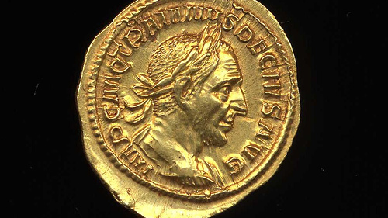
A certificate of sacrifice (june 26, 250 AD)
To the Commissioners of Sacrifices in the Village of Alexander’s Island, from Aurelius Diogenes, Son of Satabus, of the Village of Alexander’s Island, Aged 72; Scar on Right Eyebrow
I have always sacrificed to the gods, and now in your presence, in accordance with the terms of the edict, I have done sacrifice and poured libations and tasted the sacrifices, and I request you to certify to this effect. Farewell.
Presented by me, Aurelius Diogenes: I certify that I witnessed his sacrifice, Aurelius Syrus. (In different handwriting)
Dated the first year of the emperor Caesar Gaius Messipus Quintus Trajanus Decius, Pius, Felix, Augustus, the Second of Epiph. (June 26, 250 AD)

Slide 19
Dionysius, letter to fabius, bishop of Antioch (c.250 AD) quoted by Eusebius in his Ecclesiastical history 6.41.1,8-13
“It was not with the imperial edict that the persecution began amongst us, but it preceded it by a whole year…And this state of things continued at its height for a long time. But strife and civil war came upon wretched men and turned on themselves the fury of which we had been the object; and for a brief space we breathed again, since they had no time to indulge their anger against us.
Straightway, however, the news passed abroad of the change from that rule that had been more kindly to us, and great was the fear of threatened punishment that hung over us. And, what is more, the edict arrived, and it was almost like that which was predicted by our Lord, well nigh the most terrible of all, so as, if possible, to cause to stumble even the elect. Howsoever, that be, all cowered with fear. And of many of the more eminent persons, some came forward immediately through fear, others in public positions were compelled to do so by their business, and others were dragged by those around them. Called by name, they approached the impure and unholy sacrifices, some pale and trembling, as if they were not for sacrificing, but rather to be themselves the sacrifices and victims to the idols, so that the large crowd that stood around heaped mockery upon them, and it was evident that they were by nature cowards in everything, cowards both to die and to sacrifice.

Slide 20
Dionysius, letter to fabius, bishop of Antioch (c.250 AD) quoted by Eusebius in his Ecclesiastical history 6.41.1,8-13
But others ran eagerly towards the altars, affirming by their forwardness that they had not been Christians even formerly; concerning whom the Lord very truly predicted that they shall hardly be saved. Of the rest, some followed one or other of these, others fled; some were captured, and of these some went as far as bonds and imprisonment, and certain, when they had been shut up for many days, then forswore themselves even before coming into court, while others, who remained firm for a certain time under tortures, subsequently gave in.”

Slide 21
Publius Licinius Valerianus Augustus (“Valerian”) (200 – 260 AD)

Slide 22
Gallienus (218 – 268 AD)

Slide 23
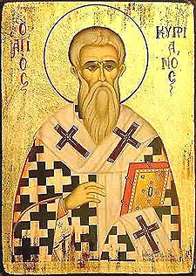
Epistle 81 of Saint Cyprian of carthage (c. 257 AD)
“Valerian had sent a rescript to the Senate, to the effect that bishops and presbyters and deacons should immediately be punished; but that senators, and men of importance, and Roman knights, should lose their dignity, and moreover be deprived of their property; and if, when their means were taken away, they should persist in being Christians, then they should also lose their heads; but that matrons should be deprived of their property, and sent into banishment. Moreover, people of Caesar's household, whoever of them had either confessed before, or should now confess, should have their property confiscated, and should be sent in chains by assignment to Caesar's estates. The Emperor Valerian also added to this address a copy of the letters which he sent to the presidents of the provinces concerning us; which letters we are daily hoping will come, waiting according to the strength of our faith for the endurance of suffering, and expecting from the help and mercy of the Lord the crown of eternal life. But know that Xistus was martyred in the cemetery on the eighth day of the Ides of August, and with him four deacons. Moreover, the prefects in the City are daily urging on this persecution; so that, if any are presented to them, they are martyred, and their property claimed by the treasury.”

Slide 24
Epistle 81 of Saint Cyprian of carthage (c. 257 AD)
“I beg that these things may be made known by your means to the rest of our colleagues, that everywhere, by their exhortation, the brotherhood may be strengthened and prepared for the spiritual conflict, that every one of us may think less of death than of immortality; and, dedicated to the Lord, with full faith and entire courage, may rejoice rather than fear in this confession, wherein they know that the soldiers of God and Christ are not slain, but crowned. I bid you, dearest brother, ever heartily farewell in the Lord.”

Slide 25
Saint Dionysius, bishop of Alexandria, letter to hermammon (257 AD) quoted in eusebius’ ecclesiastical history 7.10.1-4
“And to John also it is likewise revealed: ‘and there was given to him,’ says he, ‘a mouth speaking great things and blasphemy, and there was given to him authority and forty and two months.’ One may wonder at both of these things under Valerian, and of them note especially the nature of his previous conduct, how mild and friendly he was to the men of God. For not a single one of the emperors before him was so kindly and favorably disposed towards them, not even those who were said to have been openly Christians, as he manifestly was, when he received them at the beginning of in the most intimate and friendly manner; indeed, all his house had been filled with godly persons, and was a church of God. But the master and ruler of the synagogue of the Egyptian magicians [Macrianus, one of Valerian’s ablest generals] persuaded him to get rid of them, bidding him slay and pursue the pure and holy men, as being rivals and hinderers of his abominable and disgusting incantations (for indeed they are and were capable by their presence and sight, and by merely breathing on them and uttering words, of scattering the designs of the baneful demons). And he advised him to perform unhallowed rites, and abominable juggleries and ill-omened sacrifices, such as cutting the throats of wretched boys and sacrificing children of hapless parents and opening up entrails of new-born babes, and cutting up and mincing the handiwork of God, as if all this would bring them divine favor.”

Slide 26
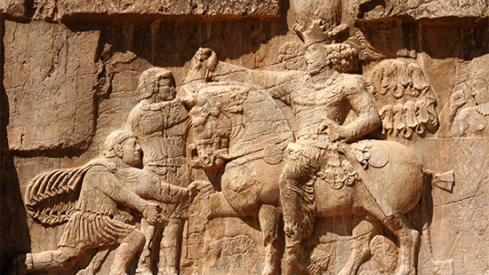
De Mortibus persecutorum —Lactantius
“Presently Valerian also, in a mood alike, frantic, lifted up his impious hands to assault God, and, although his time was short, shed much righteous blood. But God punished him in a new and extraordinary manner, that it might be a lesson to future ages that the adversaries of Heaven always receive the just recompense of their iniquities. He, having been made prisoner by the Persians, lost not only that power which he had exercised without moderation, but also the liberty of which he had deprived others; and he wasted the remainder of his days in the vilest condition of slavery: for Shapur, the king of the Persians, who had made him prisoner, whenever he chose to get into his carriage or to mount on horseback, commanded the Roman to stoop and present his back; then, setting his foot on the shoulders of Valerian, he said, with a smile of reproach, ‘This is true, and not what the Romans delineate on board or plaster.’”

Slide 28
De Mortibus persecutorum —Lactantius
“Valerian lived for a considerable time under the well-merited insults of his conqueror; so that the Roman name remained long the scoff and derision of the barbarians: and this also was added to the severity of his punishment, that although he had an emperor for his son, he found no one to revenge his captivity and most abject and servile state; neither indeed was he ever demanded back. Afterward, when he had finished this shameful life under so great dishonor, he was flayed, and his skin, stripped from the flesh, was dyed with vermilion, and placed in the temple of the gods of the barbarians, that the remembrance of a triumph so signal might be perpetuated, and that this spectacle might always be exhibited to our ambassadors, as an admonition to the Romans, that, beholding the spoils of their captive emperor in a Persian temple, they should not place too great confidence in their own strength.”

Slide 29
Novack, r.m. (2001) Christianity and the roman empire, pg. 127.
“Valerian’s persecution was the earliest known attempt by the Roman government to attack Christianity as an institution rather than merely as a collection of individuals; the Roman officials closed the churches and persecuted the clergy as leaders of the faith, rather than merely as Christians. Moreover, as Saint Cyprian’s letter indicates, the persecution also seems to have been the first official instance of refusing to pardon in full those Christians who recanted. Thus Valerian’s persecution reflected a growing perception that Christianity was becoming a potentially serious political and social threat to the Roman government and the emperor’s authority.
The edicts of Valerian were widely evaded by Christians through bribery and the cooperation of local officials, many of whom refused to enforce the edicts. Saint Cyprian himself was able to hide from the authorities during the first wave of persecution. However, Cyprian, who was familiar with the yearly circuit that the Roman governor traveled through the province of Africa, was merely waiting until the governor came to Carthage before surrendering, in order that his martyrdom might occur before his own congregation.”

Slide 30
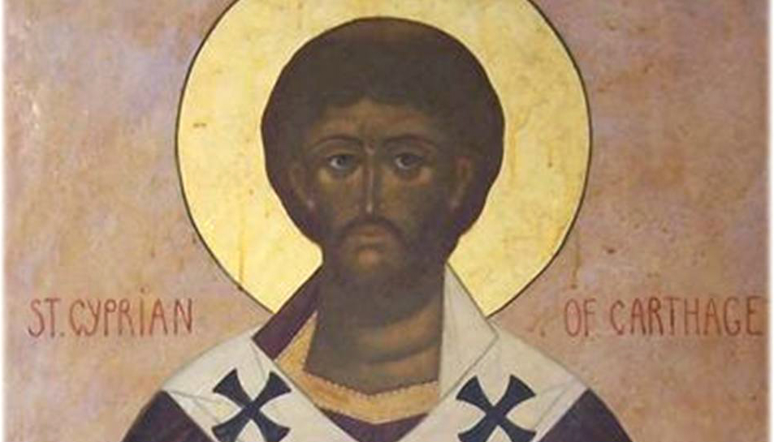
Saint Cyprian, Epistle 82 (257 AD)
Cyprian to the presbyters and deacons, and all the people, greeting. When it had been told to us, dearest brethren, that the jailers had been sent to bring me to Utica, and I had been persuaded by the counsel of those dearest to me to withdraw for a time from my gardens, as a just reason was afforded I consented. For the reason that it is fit for a bishop, in that city in which he presides over the Church of the Lord, there to confess the Lord, and that the whole people should be glorified by the confession of their prelate in their presence. For whatever, in that moment of confession, the confessor-bishop speaks, he speaks in the mouth of all, by inspiration of God. But the honour of our Church, glorious as it is, will be mutilated if I, a bishop placed over another church, receiving my sentence or my confession at Utica, should go thence as a martyr to the Lord, when indeed, both for my own sake and yours, I pray with continual supplications, and with all my desires entreat, that I may confess among you, and there suffer, and thence depart to the Lord even as I ought. Therefore here in a hidden retreat I await the arrival of the proconsul returning to Carthage, that I may hear from him what the emperors have commanded upon the subject of Christian laymen and bishops, and may say what the Lord will wish to be said at that hour.
But do you, dearest brethren, according to the discipline which you have ever received from me out of the Lord's commands, and according to what you have so very often learned from my discourse, keep peace and tranquillity; nor let any of you stir up any tumult for the brethren, or voluntarily offer himself to the Gentiles. For when apprehended and delivered up, he ought to speak, inasmuch as the Lord abiding in us speaks in that hour, who willed that we should rather confess than profess. But for the rest, what it is fitting that we should observe before the proconsul passes sentence on me for the confession of the name of God, we will with the instruction of the Lord arrange in common. May our Lord make you, dearest brethren, to remain safe in His Church, and condescend to keep you. So be it through His mercy.

Slide 31
Acts of Cyprian (Corpus Scriptorum Ecclesiasticorum Latinorum III.3, pp. 110-114)
On the morning of 14 September a huge crowd gathered at Villa Sexti as the proconsul Galerius Maximus had ordered. The proconsul commanded that Bishop Cyprian be brought to trial before him as he sat in judgement in the court called Sauciolum. When the bishop appeared the proconsul asked him: ‘Are you Thascius Cyprian?’
The bishop replied: ‘I am.’
‘And have you acted as leader in a community of impious men?’
‘I have.’
‘The sacred emperors have ordered you to sacrifice.’
‘I will not sacrifice.’
‘Consider your position.’
‘Do what is required of you. I have no need to deliberate; the issues are clear.’
Galerius consulted briefly with his advisers and reluctantly pronounced sentence in the following words: ‘You have lived in an irreligious manner for a long time now and have gathered about you a large congregation of criminals and unbelievers. You have shown yourself hostile to the gods of Rome and the rites by which they are worshipped. The pious and sacred emperors Valerian and his son, Gallienus, and the right noble Caesar, Valerian, have been unable to recall you to the practice of the official religion. Furthermore you are the instigator of abominations, a veritable standard-bearer for criminals and as such you have been brought before me. Your death will be an example to those whom you have gathered into your criminal conspiracy. Your blood will uphold the law.’

Slide 32
Acts of Cyprian (Corpus Scriptorum Ecclesiasticorum Latinorum III.3, pp. 110-114)
He then pronounced the following sentence from his wax tablet: ‘It is our decision that Thascius Cyprian be put to death by the sword.’ Bishop Cyprian simply said, ‘Thanks be to God.’
When sentence had been passed the assembled brethren cried out: ‘Let us be beheaded with him!’, and followed him in a huge and tumultuous crowd. Cyprian was brought to the plain of Sextus. There he removed his cloak and kneeling down he humbled himself in prayer to God. He disrobed and gave his dalmatic to the deacons. Clad only in his linen tunic he awaited his executioner.
When the executioner arrived Cyprian told his followers to give him twenty-five gold pieces. His brethren spread before him linen cloths and towels. The blessed Cyprian blindfolded his eyes with his own hands. The presbyter Julian and the subdeacon Julian tied the ends of the handkerchief since he was unable to do so himself. So died blessed Cyprian.
His body was exposed nearby to satisfy the curiosity of the pagans. During the night the body was removed by the light of wax candles and torches, and with prayer and great pomp it was brought for burial to a piece of open ground belonging to the procurator Macrobius Candidianus near the reservoirs on the Mappalian Way. A few days later the proconsul Galerius Maximus died.

Slide 33
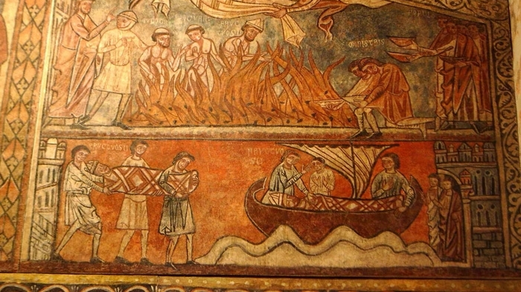
Saint Fructuosus, Bishop of Tarragona (d. 259 AD)
It was on the Lord’s day, 16 January, in the year that Aernilianus and Bassus were consuls [AD 259], that Bishop Fructuosus and his deacons Augurius and Eulogius were arrested. Bishop Fructuosus had retired to his chamber when a group of orderlies made their way to his house: they were Aurelius, Festucius, Aelius Pollentius, Donatus, and Maximus. When the bishop heard their step, he immediately got up and went out to meet them in his slippers.
‘Come along,’ the soldiers said to him, ‘The governor summons you with your deacons.’
Fructuosus said to them: ‘Let us go; or, if you will allow me, I shall put my sandals on.’
The soldiers said to him: ‘Put on your sandals as you like’
As soon as they arrived they were put in prison.Fructuosus, however, was calm and glad that he would receive the Lord’s crown to which he had been called. He prayed constantly, and there were Christians with him, comforting him and begging him to remember them.
The next day in prison he baptized our brotherRogatianus. After spending six days in jail, they were brought out for a hearing on Friday, 21 January.
The governor Aemilianus said: ‘Bring in the bishopFructuosus, Augurius, and Eulogius.’ A court official said, ‘They are present.’

Slide 34
Saint Fructuosus, Bishop of Tarragona (d. 259 AD)
The governor Aemilianus said to Fructuosus: ‘Were you aware of the emperor’s orders?’
Fructuosus said: ‘I do not know their orders. I am a Christian.’
The governor Aemilianus said: ‘They have ordered you to worship the gods.’
Fructuosus said: ‘I worship the one God Who has made heaven and earth and all that is in them’ [Acts 4:4].
The governor Aemilianus said: ‘Do you know that the gods exist?’
‘No, I do not,’ said Fructuosus.
Aemilianus said: ‘You will know later.’Fructuosus looked up to the Lord and began to pray within himself. T
Then Aemilianus said: ‘These are obeyed, these are feared, and these are adored; if the gods are not worshipped, then the images of the emperors are not adored.’
The governor Aemilianus said to Augurius: ‘Do not listen to the words of Fructuosus.’
Augurius said: ‘I worship God almighty.’

Slide 35
Saint Fructuosus, Bishop of Tarragona (d. 259 AD)
The governor Aemilianus said to Eulogius: ‘Do you not also worship Fructuosus?’
‘No,’ said Eulogius, ‘I do not worship Fructuosus, but I worship the One Whom he worships.’
Aemilianus the governor said Fructuosus: ‘You are a bishop?’
‘Yes, I am,’ said Fructuosus.
‘You were,’ said Aemilianus. And he sentenced them to be burnt alive.
As Bishop Fructuosus was being taken to the amphitheatre with his deacons, the people began to sympathize with him, for he was much beloved of pagans and Christians alike. For he was all that the Holy Spirit, through Paul, the vessel of election [Acts 9:15] and the teacher of the Gentiles [2 Tim. 1:11], declared that a bishop should be. For this reason his brothers, who knew that he was going on to such great glory, were happy rather than sad.

Slide 37
Gallienus (218 – 268 AD)

Slide 38
Marcus Cassianus Latinius Postumus (d. 269 AD)

Slide 39
Imperium Galliarum

Slide 40
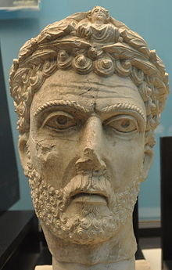
Odenathus (220-267 AD)

Slide 41
Zenobia Augusta (240 – c. 275)

Slide 42
Regalianus (d. 260 AD)

Slide 43
Macrianus

Slide 44
Aureolus (220-268 AD)

Slide 45
E.R. Dodds (1851-1930)
Pagan and Christian in an age of Anxiety (1965)

Slide 46
Ultimately, for the Neo-Platonic philosopher Plotinus, philosophy is about what he would call “the flight of the alone to the Alone.”
Acquaintance with philosophy must come after a long period of attendance on instruction in the subject itself, and of close companionship, when, suddenly, like a blaze kindled by a leaping spark, it is generated in the soul and at once becomes self-sustaining.
—Plato, Epistle VII 341d

Slide 47
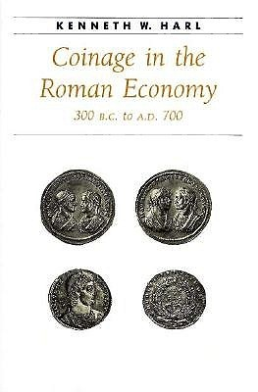

Slide 48
Glycon

Slide 49
W.H.C. Frend (1916-2005)
Martyrdom and Persecution in the Early Church

Slide 50
Martyrdom of Polycarp in Eusebius’ Ecclesiastical History IV.15.36-39
When he had offered up his Amen and had finished his prayer, the firemen lighted the fire and as a great flame blazed out, we, to whom it was given to see, saw a wonder, and we were preserved that we might relate what happened to the others.
For the fire presented the appearance of a vault, like the sail of a vessel filled by the wind, and made a wall about the body of the martyr, and it was in the midst not like flesh burning, but like gold and silver refined in a furnace. For we perceived such a fragrant odor, as of the fumes of frankincense or of some other precious spices. So at length the lawless men, when they saw that the body could not be consumed by the fire, commanded an executioner to approach and pierce him with the sword. And when he had done this there came forth a quantity of blood so that it extinguished the fire; and the whole crowd marveled that there should be such a difference between the unbelievers and the elect, of whom this man also was one, the most wonderful teacher in our times, apostolic and prophetic, who was bishop of the Catholic Church in Smyrna. For every word which came from his mouth was accomplished and will be accomplished.

Slide 51
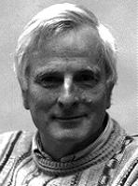
Keith Hopkins (1934-2004)
Murderous Games

Slide 52
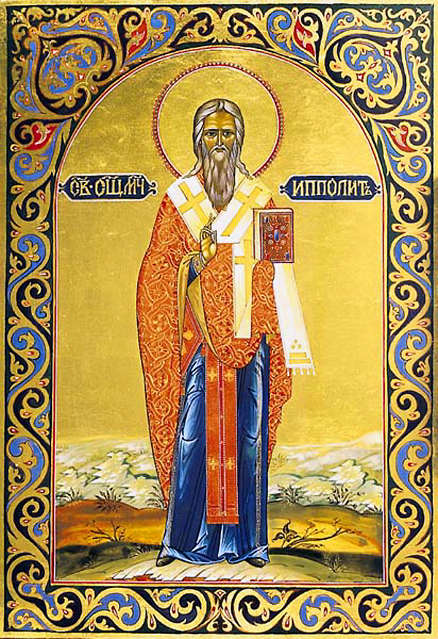
St Hippolytus of rome

Slide 53
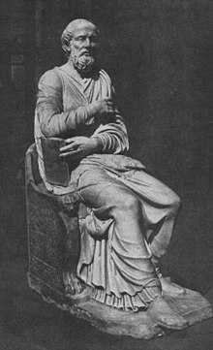
St. Hippolytus of rome

Slide 54
On the apostolic tradition

Slide 55
On the apostolic tradition 2-3
Pour out now the power that comes from you, the Spirit of headship, which you gave to your Beloved Child Jesus Christ, and whom he handed on to the Apostles who built the Church, your sanctuary for the glory and ceaseless praise of your name…May he always make you merciful to us and offer You the Gifts of Your Holy Church. In virtue of the Spirit of high priesthood, may he have the power to forgive sins as You have commanded.

Slide 56
On the apostolic tradition 4
BISHOP: The Lord be with you!
PEOPLE: And with your spirit!
BISHOP: Let us lift up our hearts.
PEOPLE: We life them up unto the Lord.
BISHOP: Let us give thanks (εὐχαριστοῦμεν) unto the Lord!
PEOPLE: It is meet and right!

Slide 57
Ruth 2:4: And, behold, Boaz came from Bethlehem, and said unto the reapers, The Lord be with you. And they answered him, The Lord bless thee.
1 Chronicles 22:11, 16: Now, my son, the LORD be with thee; and prosper thou, and build the house of the LORD thy God, as he hath said of thee.
2 Timothy 4:22: The Lord Jesus Christ be with thy spirit. Grace be with you. Amen.
Philippians 4:23: The grace of our Lord Jesus Christ be with you all. Amen.

Slide 58
On the apostolic tradition 9
It is not necessary, however, that he repeat the same words we provided, as though he had to try to say them from memory in his thanksgiving to God. Let each one pray according to his ability. If he is capable of praying at length and offering a solemn prayer, well and good. But if he prays differently and pronounces a shorter and simpler prayer, he is not to be prevented, provided that his prayer be sound and orthodox.

Slide 59
On the apostolic tradition 14
If anyone makes the claim: “I have received the gift of healing through a revelation,” do not impose hands on him. The facts themselves will show whether or not he is speaking the truth.

Slide 60
On the apostolic tradition 20
When those to be baptized have been selected, their life is to be examined: Have they lived uprightly during their catechumenate? Have they respected widows, visited the sick, practiced all the good works?
If any one of them is not a good man or is not pure, he is to be rejected, for he has not heard the word with faith.

Slide 61
On the apostolic tradition 21
The children are to be baptized first. All of them who can, are to give answer for themselves. If they cannot, let their parents or someone in the family answer for them.

Slide 62
On the apostolic tradition 21
Do you believe in God, the Father Almighty?
The one being baptized is to answer: “I believe.”
Let him baptize him then a first time, keeping his hand on the person’s head. He then asks him:
Do you believe in Christ Jesus, the Son of God, born by the Holy Spirit of the Virgin Mary, Who was crucified under Pontius Pilate, who died, was raised on the third day, living from among the dead, Who ascended to the heavens, who sits at the right hand of the Father, Who will come to judge the living and the dead?
When he has answered: “I believe,” he is to baptize him a second time. He is to ask him again:
Do you believe in the Holy Spirit, in the Holy Church, in the resurrection of the flesh?
The one being baptized is to answer: “I believe.” Then he baptizes him a third time.

Slide 63
St. Hippolytus of rome

Slide 64
St Hippolytus of rome
Acts 20:7: And upon the first day of the week, when the disciples came together to break bread, Paul preached unto them, ready to depart on the morrow; and continued his speech until midnight.

Slide 65
On the apostolic tradition 42
If you are tempted , hasten to sign yourself on the forehead in a worthy manner. For this sign manifests the Passion which stands against the devil, provided you make it with faith, not for men to see but knowing how to use it like a breastplate. Then the adversary, seeing the power that comes from the heart, will flee. This is what Moses imaged forth through the Passover lamb that was sacrificed, when he sprinkled the thresholds and sealed the doorposts with its blood. He was pointing to the faith that we now have in the perfect Lamb. By signing our forehead and eyes with our hand, we repulse him who seeks to destroy us.

Slide 66
Lex orandi, lex credendi
I counsel all prudent men to observe these traditions. For if everyone follows and observes the tradition of the apostles, no heretic, and indeed no human being at all, will be able to lead you astray. The reason why heresies have increased is that leaders have been unwilling to make their own the teachings of the apostles and have acted as they pleased and not as they should have.
—On the Apostolic Tradition 42

Slide 67
Maximinus Thrax (173 – 238 AD)

Slide 68
Clement of Alexandria (c.150-c.215)
Protrepticus
Paedogogus
Miscellanies

Slide 69
Clement of Alexandria (c.150-c.215)
“[Philosophy] was a schoolmaster to bring the Greek mind to Christ, as the Law of Moses was for the Hebrews. Philosophy was a preliminary education (propaideia) preparing the way for him who is to be perfected in Christ” (Strom. 5.5).
By a happy utterance of divination, not without divine help, concurring in certain prophetic declarations, and, seizing the truth in portions and aspects, in terms not obscure, and not going beyond the explanation of the things, [the philosophers] honored it as pertaining the appearance of relation with the truth. Whence the Hellenic philosophy is like the torch of wick which men kindle, artificially stealing the light from the sun. But on the proclamation of the Word all that holy light shone forth. In this way, in houses by night the stolen light is useful; but by day the fire blazes, and all the night is illuminated by such a sun of intellectual light.

Slide 70
Clement of Alexandria (c.150-c.215)
In his Paedogogus, Clement aims at Greek culture, the Hellenic paideia. In his book he portrays Christ in His role as the divine educator who transcends anything of this kind that has appeared before in human history. Thus Clement’s is an attempt to face the cultural idea of the Greeks as a whole, and an attempt to see Christianity in the light of the supreme concept of what the Greeks had contributed to the higher life of the human race. Clement does not deny the value of that Hellenic tradition, but rather claims that the Christian faith fulfills the paideutic mission of mankind to a higher degree than had been achieved before.
Considering the importance of this overarching idea of paideia for the evolution of a unified culture in the Greek intellectual world, this step in the discussion between Christianity and the Hellenistic tradition marks the beginning of a decisive development in the aspiration toward the goal of a Christian civilization.

Slide 71
Origen (c. 184-c. 253)
Origen, Clement’s more brilliant student, took up his teacher’s ideas and developed them with stronger consistency and in greater detail.
The intrinsic unity of Origen’s diffused and vast theological thought is to be found not in his adherence to any single philosophical system such as Platonism or Stoicism, or in an eclectic mixture of these, but in the basic view of history emerging from the constellation of an age that saw classical Greek culture and the Christian Church undergo a process of mutual adaptation.

Slide 72
Diocletian (244 – 311 AD)

Slide 73
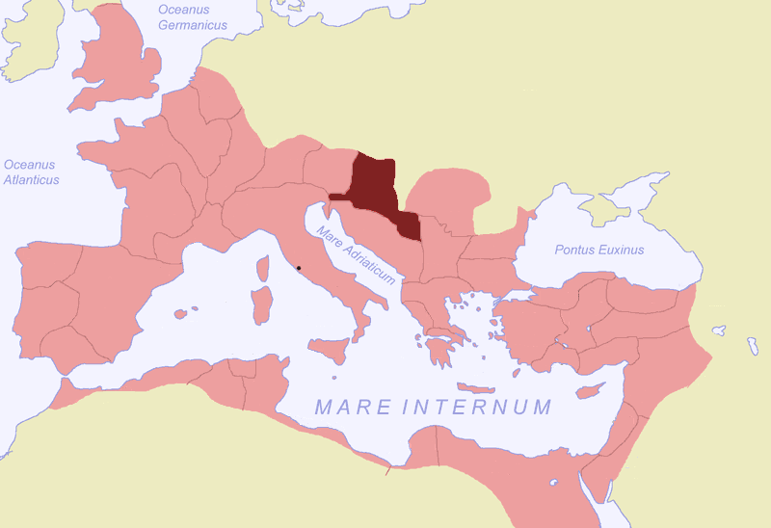
P a nnon I a

Slide 74
Saint Cyprian of carthage (c. 200-258 AD)

