Slide 1
Pagans and Christians — Lecture Seven
Beginnings of Christian Theology
Neoplatonism: Plotinus, Porphyry & Iamblichus
Manichaeism
Emperor Aurelian and the Cult of “Sol Invictus”

Slide 2
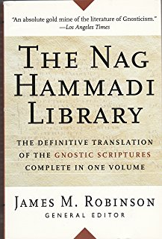
Nag Hammadi Library

Slide 3
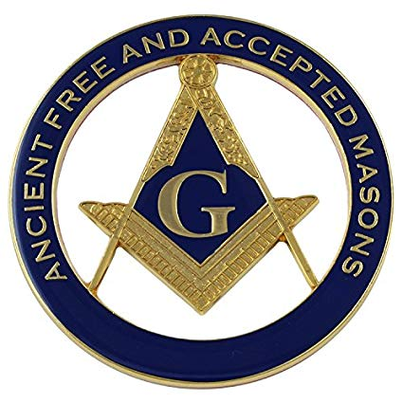
Gnosis (γνῶσις) = Knowledge

Slide 4
Nag Hammadi Library

Slide 5
Revelations 2:6, 14
But this thou hast, that thou hatest the deeds of the Nicolatians, which I also hate.
But I have a few things against thee, because thou hast there them that hold the doctrine of Balaam, who taught Balac to cast a stumblingblock before the children of Israel, to eat things sacrificed unto idols, and to commit fornication.

Slide 6
1 Corinthians 2:6
Howbeit we speak wisdom among them that are perfect, but not the wisdom of this world.

Slide 7
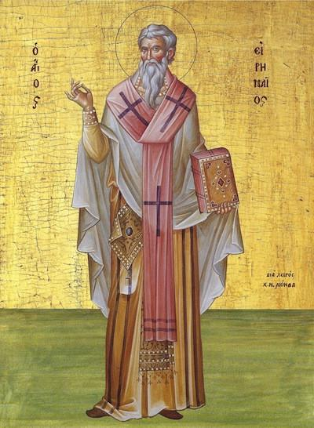
St. Irenaeus of Lyons (130 - c. 205 AD)

Slide 8
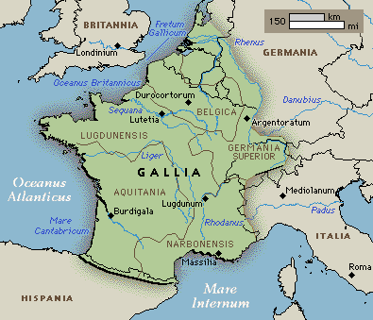
Lyons = Ancient Lugdunum

Slide 9
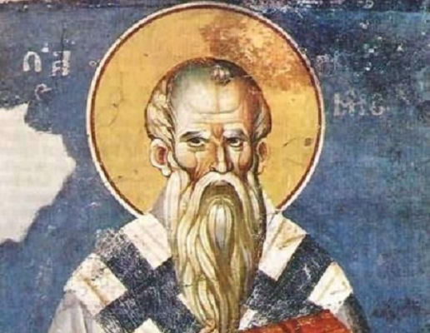
Against Heresies

Slide 10
St. Irenaeus of Lyons, Against Heresies III.2.1
When, however, they are confuted from the Scriptures, they turn round and accuse these same Scriptures, as if they were not correct, nor of authority, and [assert] that they are ambiguous, and that the truth cannot be extracted from them by those who are ignorant of Tradition. For [they allege] that the truth was not delivered by means of written documents, but viva voce: wherefore Paul also declared: Howbeit we speak wisdom among them that are perfect, but not the wisdom of this world. (1 Cor. 2:6)

Slide 11
St. Irenaeus of Lyons, Against Heresies III.3.1
For every church must be in harmony with this church because of its outstanding preeminence, that is, those faithful from everywhere, since the apostolic tradition is preserved in it by those from everywhere. (Ad hanc enim ecclesiam propter potentiorem principalitatem necesse est omnem convenire ecclesiam, hoc est eos qui sunt undique fideles, in qua semper ab his qui sunt undique conservata est ea, quae est ab apostolis traditio).

Slide 12
St. Irenaeus of Lyons, Against Heresies III.3.1
Ad hanc enim ecclesiam propter potentiorem principalitatem necesse est omnem convenire ecclesiam, hoc est eos qui sunt undique fideles, in qua semper ab his qui sunt undique conservata est ea, quae est ab apostolis traditio.
‘With this church, because of its higher rank, every church must agree, that is, the faithful of all places (and it is in her — in qua, Rome — that is, by communion with her) that the faithful of all countries have conserved the Apostolic tradition.’
Or, as some interpreted it, in qua refers to the Church diffused throughout the world, and therefore, “Each church in which (in qua) the Apostolic tradition is maintained, must be in accord with Rome.”
In either translation, the value of the phrase is not lost.

Slide 13
Hammell, P.J. (1968) Handbook of Patristics, pp. 54-55.
“Most probably ‘must agree’ here does not refer to moral obligation but to a fact, and the context suggests this. Irenaeus wants to show that the Gnostic claim to a special knowledge 9not given to the apostles or to the general body, but revealed only to the perfect) is foreign to the apostolic tradition. So this passage will not refer to ecclesiastical constitution, but to the faith common to the churches. The primacy of Rome is the reason why her faith is to be consulted; she has a ‘potior principalitas,’ and her doctrine is conclusive proof on Christian faith”

Slide 14
St. Irenaeus of Lyons, Against Heresies III.4.2
We ought to…love with the greatest zeal the things of the Church, and so to lay hold of the tradition of the truth. What if there should be a dispute about some matter of moderate importance? Should we not turn to the oldest churches, where the apostles themselves were known, and find out from them the clear and certain answer to the problem now being raised? Even if the apostles had not left their writings to us, ought we not to follow the rule of the tradition which they handed down to those to whom they committed the churches?

Slide 15
St. Irenaeus of Lyons, Against Heresies IV.18.5
Then, again, how can they say that the flesh, which is nourished with the body of the Lord and with His blood, goes to corruption, and does not partake of life? Let them, therefore, either alter their opinion, or cease from offering the things just mentioned. But our opinion is in accordance with the Eucharist, and the Eucharist in turn establishes our opinion. For we offer to Him His own, announcing consistently the fellowship and union of the flesh and Spirit. For as the bread, which is produced from the earth, when it receives the invocation of God, is no longer common bread, but the Eucharist, consisting of two realities, earthly and heavenly; so also our bodies, when they receive the Eucharist, are no longer corruptible, having the hope of the resurrection to eternity.

Slide 16
St. Irenaeus of Lyons, Against Heresies V.19.1
And thus as the human race fell into bondage to death by means of a virgin, so it is rescued by a virgin; virginal disobedience having been balanced in the opposite scale by virginal obedience.
(This is connected to the doctrine of Recapitulation [’Ανακεφαλαίοσις] which states that whereas sin and death passed to mankind through Adam, humanity’s head [caput/κέφαλος], Jesus Christ, the new Adam, recapitulates in Himself all mankind and thus reconciles it with His Father).

Slide 17
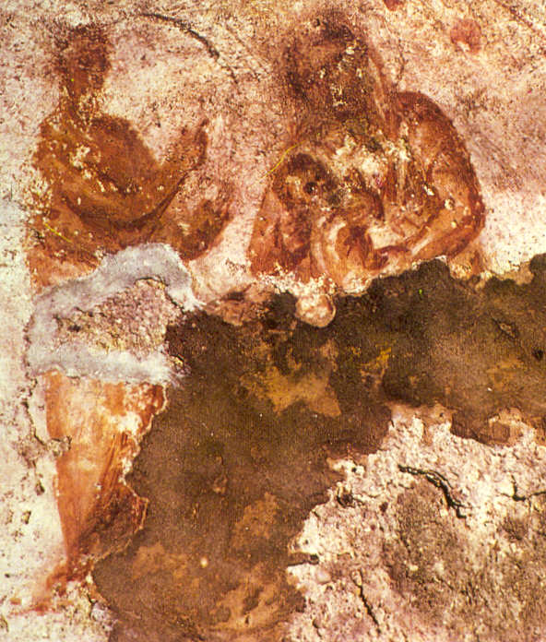
Catacumbae Priscillae, Rome, c. 225 AD

Slide 18
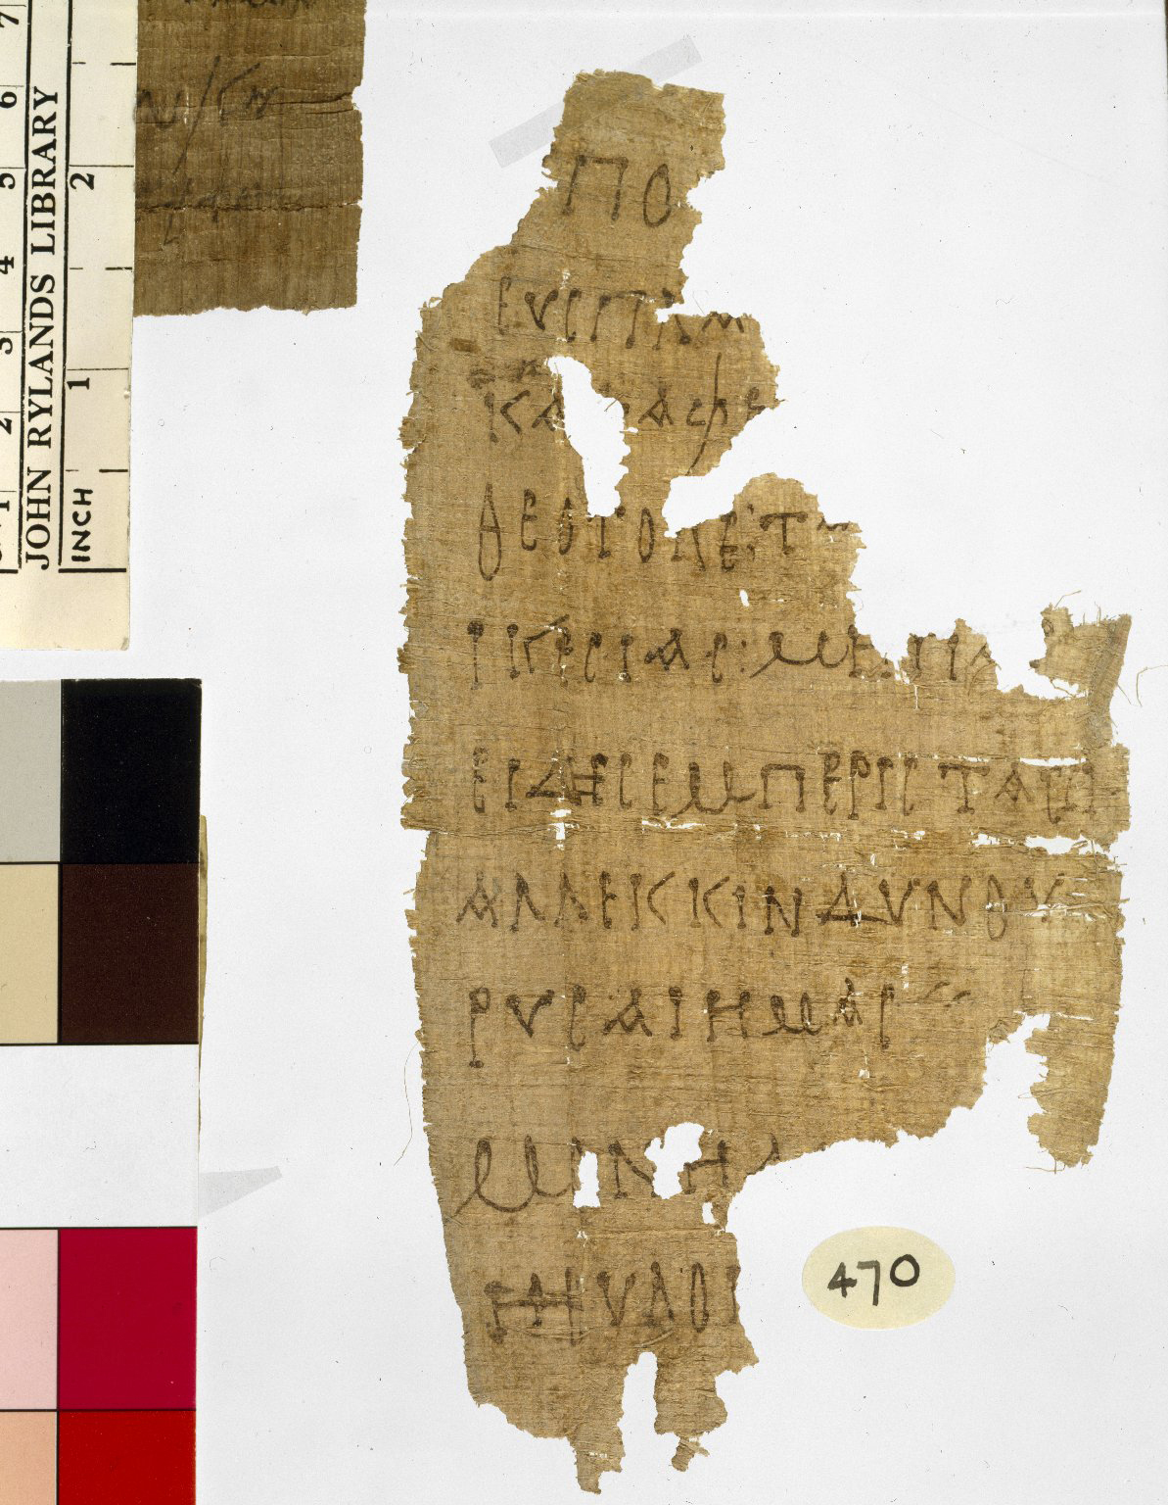
Oldest Known Papyrus Containing a prayer to the Mother of God, Egypt c. 250
On the papyrus, we can read: .ΠΟ ΕΥCΠΑ ΚΑΤΑΦΕ ΘΕΟΤΟΚΕΤ ΙΚΕCΙΑCΜΗΠΑ ΕΙΔΗCΕΜΠΕΡΙCTAC AΛΛΕΚΚΙΝΔΥΝΟΥ …ΡΥCΑΙΗΜΑC MONH …HEΥΛΟΓ

Slide 19
Oldest Known Papyrus Containing a prayer to the Mother of God, Egypt c. 250
Beneath thy compassion, We take refuge, O Mother of God: do not despise our petitions in time of trouble: but rescue us from dangers, O only pure, only blessed one.

Slide 20
Lyons = Ancient Lugdunum

Slide 21
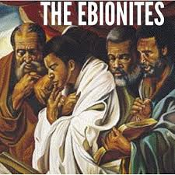

Slide 22
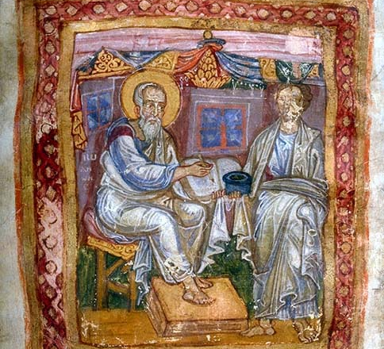
Marcion of Sinope

Slide 23
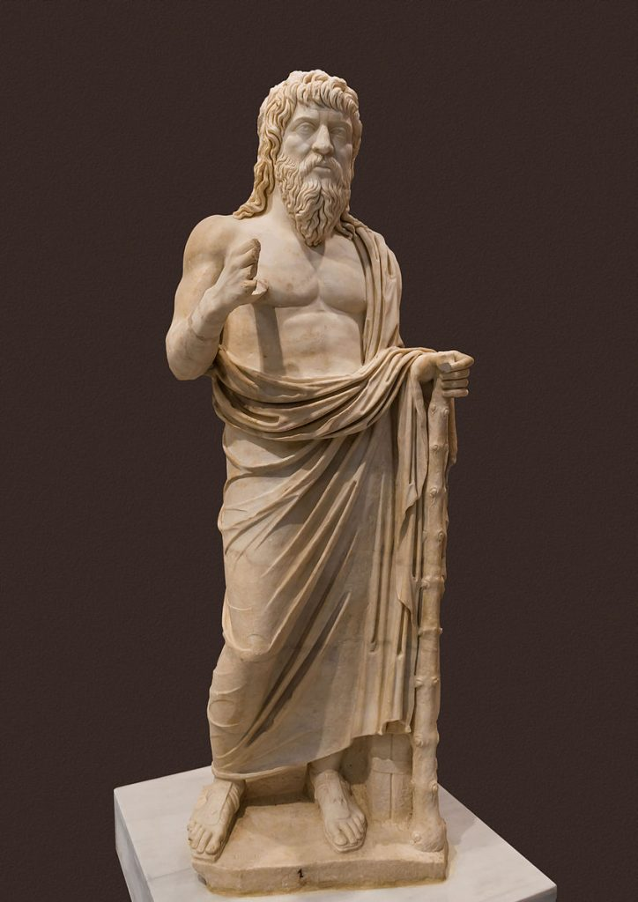
Montanus

Slide 24
St. Irenaeus of Lyons, Against Heresies I.10.3
One may bring out the meaning of those things which have been spoken in parables, and accommodate them to the general scheme of the faith.

Slide 25
St. Irenaeus of Lyons, Against Heresies IV.14.2-3
Thus it was, too, that God formed man at the first, because of His munificence; but chose the patriarchs for the sake of their salvation; and prepared a people beforehand, teaching the headstrong to follow God; and raised up prophets upon earth, accustoming man to bear His Spirit [within him], and to hold communion with God: He Himself, indeed, having need of nothing, but granting communion with Himself to those who stood in need of it, and sketching out, like an architect, the plan of salvation to those that pleased Him. And He did Himself furnish guidance to those who beheld Him not in Egypt, while to those who became unruly in the desert He promulgated a law very suitable [to their condition]. Then, on the people who entered into the good land He bestowed a noble inheritance; and He killed the fatted calf for those converted to the Father, and presented them with the finest robe. Thus, in a variety of ways, He adjusted the human race to an agreement with salvation.

Slide 26
St. Irenaeus of Lyons, Against Heresies IV.14.2-3
Moreover, He instructed the people, by repeated appeals to persevere and to serve Himself, calling them to the things of primary importance by means of those which were secondary; that is, through foreshadowings to the things that are real; through things temporal, to the eternal; through the carnal to the spiritual; and through the earthly to the heavenly…Through foreshadowings of the future, they were learning reverence for God and perseverance in His service. The law was therefore a school of instruction for them, and a prophecy of what was to come.

Slide 27
St. Irenaeus of Lyons, Against Heresies III.1.1
Matthew also issued a written Gospel among the Hebrews in their own dialect, while Peter and Paul were preaching at Rome, and laying the foundations of the Church. After their departure, Mark, the disciple and interpreter of Peter, did also hand down to us in writing what had been preached by Peter. Luke also, the companion of Paul, recorded in a book the Gospel preached by him. Afterwards, John, the disciple of the Lord, who also had leaned upon His breast, did himself publish a Gospel during his residence at Ephesus in Asia.

Slide 28
St. Irenaeus of Lyons, Against Heresies III.11.8
The Gospels could not possibly be either more or less in number than they are. Since there are four zones of the world in which we live, and four principal winds, while the Church is spread over all the earth, and the pillar and foundation of the Church is the gospel, and the Spirit of life, it fittingly has four pillars…a gospel fourfold in form but held together by one Spirit.

Slide 29
Clement of Alexandria (c.150-c.215)

Slide 30
Alexandria, Egypt

Slide 31
Clement of Alexandria (c.150-c.215)
Protrepticus
Paedogogus
Miscellanies (Stromata)

Slide 32
Clement of Alexandria Stromateis VI.80
The multitude are scared of Greek philosophy, as children are of masks, fearing that it will lead them astray.

Slide 33
Clement of Alexandria Stromateis I.18
I am well aware of what is said by some who stupidly take fright at any noise. They assert that one must concern oneself only with what is necessary and is bound up with faith, that we ought not to pass by anything outside this as superfluous because it distracts us to no purpose and absorbs our energies in studies which are of no help towards our ultimate end. There are others who even think that philosophy was introduced into human life by some evil inventor for the ruin of men.

Slide 34
Celsus (late second century AD)

Slide 35
Galen (129 — c. 210 AD)

Slide 36
Clement of Alexandria Stromateis I.20.100
The Hellenic philosophy does not, by its approach, make the truth more powerful; but by rendering powerless the assault of sophistry against it, and frustrating the treacherous plots laid against the truth, is said to be the proper fence and wall of the vineyard.

Slide 37
Clement of Alexandria (c.150-c.215)
“[Philosophy] was a schoolmaster to bring the Greek mind to Christ, as the Law of Moses was for the Hebrews. Philosophy was a preliminary education (propaideia) preparing the way for him who is to be perfected in Christ” (Strom. 5.5).
“By a happy utterance of divination, not without divine help, concurring in certain prophetic declarations, and, seizing the truth in portions and aspects, in terms not obscure, and not going beyond the explanation of the things, [the philosophers] honored it as pertaining the appearance of relation with the truth. Whence the Hellenic philosophy is like the torch of wick which men kindle, artificially stealing the light from the sun. But on the proclamation of the Word all that holy light shone forth. In this way, in houses by night the stolen light is useful; but by day the fire blazes, and all the night is illuminated by such a sun of intellectual light.”

Slide 38
St. Irenaeus of Lyons, Against Heresies IV.20.5-7
The glory of God is man fully alive!

Slide 39
Clement of Alexandria Stromateis VII.3.13
This, therefore, is the life-work of the perfected gnostic, namely to hold communion with God through the great High Priest, being made like the Lord, as far as may be…and in being thus assimilated to God, the gnostic is making and fashioning himself and also forming those who hear him.

Slide 40
Clement of Alexandria Stromateis VII.7.43
And since the east symbolizes the day of birth, and it is from thence that the light spreads, after it has first “shone forth out of darkness,” indeed, and from thence that the day of the knowledge of the truth dawned like the sun upon those who were lying in ignorance, therefore our prayers are directed towards the rise of dawn.

Slide 41
Clement of Alexandria Stromateis VII.11.75
[The gnostic] understands too the hidden meanings of the fasting of these days, I mean of Wednesday and Friday; for the one is dedicated to Hermes, the other to Aphrodite. At any rate, he makes his life a fast both from love of money and love of pleasure, which are the springs of all the vices.

Slide 42
Philippians 4: 6 In every situation by prayer and supplication with thanksgiving let your requests be made known unto God. 1 Thessalonians 5:17 Pray without ceasing

Slide 43
Clement of Alexandria Stromateis VII.7.35
Accordingly, all our life is a festival: being persuaded that God is everywhere present on all sides, we praise Him as we till the ground, we sing hymns as we sail the sea, we feel His inspiration in all that we do. And the gnostic enjoys a still closer intimacy with God, being at once serious and cheerful in everything, serious owing to his thoughts being turned towards heaven, and cheerful, as he reckons up the blessings with which God has enriched our human life.

Slide 44
Clement of Alexandria Stromateis VII.11.64
So in every difficulty the soul of the gnostic proves its strength, being in first-rate condition and vigour, like the body of an athlete.

Slide 45
Clement of Alexandria Stromateis VII.9.52
But the dignity of the Christian gnostic is carried to an even further pitch by him who has undertakenthe direction of the teaching of others, assuming the management in word and deed of that which is the greatest blessing on earth, by virtue of which he becomes a mediator to bring about a close union and fellowship with God.

Slide 46
Clement of Alexandria Paedogogus I.4
The virtue of man and woman is the same. For if the God of both is one, the master of both is also one; one Church, one temperance, one modesty; their food is common, marriage an equal yoke; respiration, sight, hearing, knowledge, hope, obedience, love all alike. And those whose life is common, have common graces and a common salvation; common to them are love and asceticism.

Slide 47
Clement of Alexandria (c.150-c.215)
In his Paedogogus, Clement aims at Greek culture, the Hellenic paideia. In his book he portrays Christ in His role as the divine educator who transcends anything of this kind that has appeared before in human history. Thus Clement’s is an attempt to face the cultural idea of the Greeks as a whole, and an attempt to see Christianity in the light of the supreme concept of what the Greeks had contributed to the higher life of the human race. Clement does not deny the value of that Hellenic tradition, but rather claims that the Christian faith fulfills the paideutic mission of mankind to a higher degree than had been achieved before.
Considering the importance of this overarching idea of paideia for the evolution of a unified culture in the Greek intellectual world, this step in the discussion between Christianity and the Hellenistic tradition marks the beginning of a decisive development in the aspiration toward the goal of a Christian civilization.

Slide 48
J. Quasten (1983) Patrology, Vol. II: p. 7
“We owe it above all to him if scholarly thinking and research are recognized in the Church. He proved that the faith and philosophy, Gospel and secular learning, are not enemies but belong together.”

Slide 49
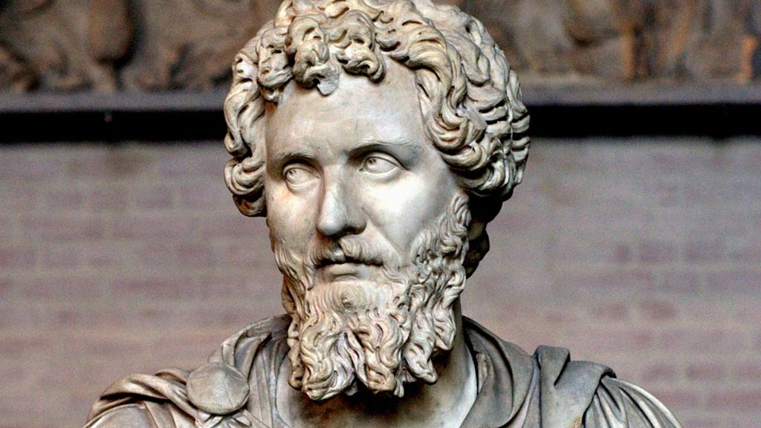
Persecution under Septimius Severus beginning 202 AD

Slide 50
Origen (c. 184-c. 253)
Origen, Clement’s more brilliant student, took up his teacher’s ideas and developed them with stronger consistency and in greater detail.
The intrinsic unity of Origen’s diffused and vast theological thought is to be found not in his adherence to any single philosophical system such as Platonism or Stoicism, or in an eclectic mixture of these, but in the basic view of history emerging from the constellation of an age that saw classical Greek culture and the Christian Church undergo a process of mutual adaptation.

Slide 51
Matthew 19:12
For there are some eunuchs, which were so born from their mother's womb: and there are some eunuchs, which were made eunuchs of men: and there be eunuchs, which have made themselves eunuchs for the kingdom of heaven's sake. He that is able to receive it, let him receive it.

Slide 52
Matthew 19:12
Eusebius simply accepts this as fact. But he wrote seventy years after the events he was recording, and could very well have uncritically accepted as true a bit of slander spread by Origen’s enemies. There is no record of Origen either affirming or denying this allegation. However, when he interprets Matthew 19:12 in his writings, he encourages people not to take the Lord’s words literally and do what he was accused of doing.

Slide 53
Caesarea Maritima

Slide 54
De Principiis (On First Principles)

Slide 55
Origen Homily 16 on Luke
I want to be a man of the Church. I do not want to be called the name of some founder of a heresy, but by the name of Christ, and to bear that name which is blessed on earth. It is my desire, in deed as in spirit, to be called a Christian.

Slide 56
Origen Homily on Joshua 7.6
If I who seem to be your right hand, and am called presbyter and seem to preach the Word of God, if I do something against the discipline of the Church, then may the whole Church in unanimous resolve, cut me, its right hand, off, and throw me away.

Slide 57
Origen Homilies on Exodus 13.3
You who are wont to assist at the Divine Mysteries =, know how, when you receive the body of the Lord, you take reverent care, lest any particle of it should fall to the ground and a portion of the consecrated gift (consecrati muneris) escape you. You consider it a crime — and rightly so — if any particle thereof fall down through negligence.

Slide 58
1 Corinthians 2:10-16 ¹⁰ But God hath revealed them unto us by his Spirit: for the Spirit searcheth all things, yea, the deep things of God. ¹¹ For what man knoweth the things of a man, save the spirit of man which is in him? even so the things of God knoweth no man, but the Spirit of God. ¹² Now we have received, not the spirit of the world, but the spirit which is of God; that we might know the things that are freely given to us of God. ¹³ Which things also we speak, not in the words which man's wisdom teacheth, but which the Holy Ghost teacheth; comparing spiritual things with spiritual. ¹⁴ But the natural man receiveth not the things of the Spirit of God: for they are foolishness unto him: neither can he know them, because they are spiritually discerned. ¹⁵ But he that is spiritual judgeth all things, yet he himself is judged of no man. ¹⁶ For who hath known the mind of the Lord, that he may instruct him? but we have the mind of Christ.

Slide 59
Origen Homilies on Exodus 12.4
It is therefore not enough to be zealous for the study of the sacred Scriptures, but we must beseech the Lord and implore him day and night that the Lamb of the tribe of Judah might come who, taking the sealed scroll, will deign to open it.

Slide 60
Origen Homilies on Genesis 8.6-9
The careful yet loving response of Abraham moves me greatly. I do not know what he saw in spirit, because he did not speak of the present but of the future: God will provide for Himself a sheep. His reply concerns the future, yet his son inquires about the present. Indeed, the Lord Himself provided a sheep for Himself in Christ.

Slide 61
Origen Homilies on Genesis 8.6-9
Isaac said to Abraham his father: “Father!” This plea from the son was at that instant the voice of temptation. For do you not think the voice of the son who was about to be sacrificed struck a responsive chord in the heart of the father? Although Abraham did not waver because of his faith, he responded with a voice full of affection and asked: “What is it, my son?” Isaac answered him: “Here are the fire and the wood, but where is the sheep for the sacrifice?” And Abraham replied: “God will provide for himself a sheep for the sacrifice, my son.”

Slide 62
Origen Homilies on Genesis 8.6-9
Abraham extended his hand to take the sword and slay his son, and the angel of the Lord called to him from heaven, and said: “Abraham, Abraham.” And he responded: “Here I am.” And the angel said: “Do not put your hand upon the boy, or do anything to him, for now I know that you fear God.” Compare these words to those of the Apostle when he speaks of God: “He did not spare hos own Son, but gave him up for us all.” God emulates man with magnificent generosity. Abraham offered to God his mortal son who did not die, and God gave up His Immortal Son Who died for all of us.

Slide 63
Origen Exhortation to Martyrdom 41-42
God says through the prophet: “At an acceptable time I heard you; in the day of salvation, I helped you.” What time could be more acceptable than when, for our fidelity to God in Christ, we are made a public spectacle and led away under guard, not defeated but triumphant?
In Christ, and with Christ, the martyrs disarm the principalities and powers and share in his triumph over them, for their share in Christ’s sufferings makes them sharers also in the mighty deeds those sufferings accomplished. What could more appropriately be called the day of salvation than the day of such a glorious departure from this world?

Slide 64
Eusebius Ecclesiastical History VI.3.13
By giving such evidences of a philosophic life to those who saw him, he aroused many of his pupils to similar zeal; so that prominent men even of the unbelieving heathen and men that followed learning and philosophy were led to his instruction. Some of them having received from him into the depth of their souls faith in the Divine Word, became prominent in the persecution then prevailing; and some of them were seized and suffered martyrdom.

Slide 65
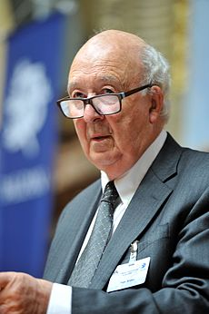
Peter Brown (b.1935)

Slide 66
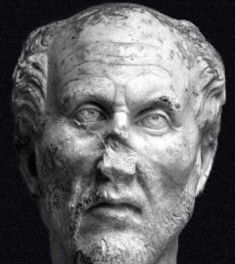
Plotinus (204—270 AD)

Slide 67
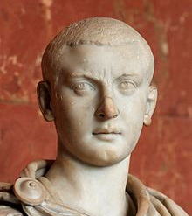
Gordion III

Slide 68
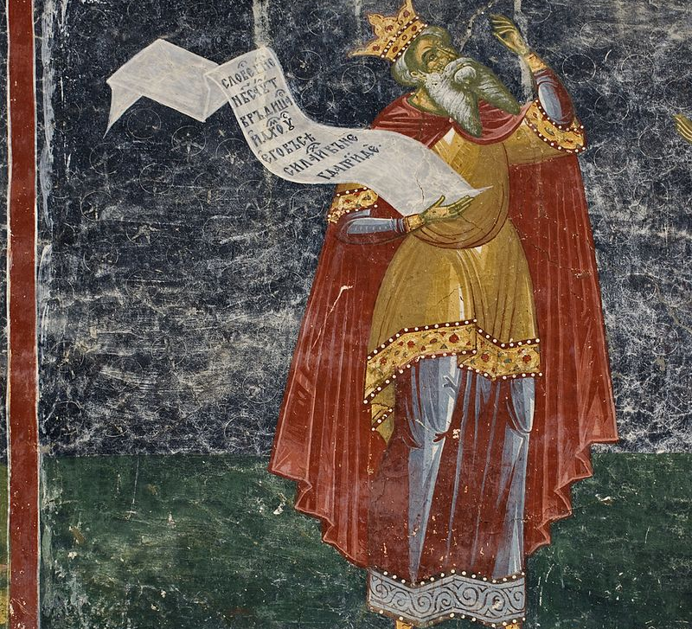
Porphyry (232—310 AD)

Slide 69
Rufinus of Aquileia (340-410 AD)

