Slide 1
Pagans and Christians
LECTURE ONE
Religious Conflict in the Roman World
Gods and their Cities in the Roman Empire
The Roman Imperial Cult
The Mystery Cults

Slide 2
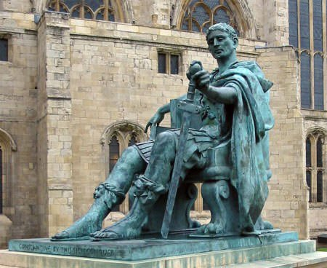
Emperor Constantine (272-337 AD)

Slide 3
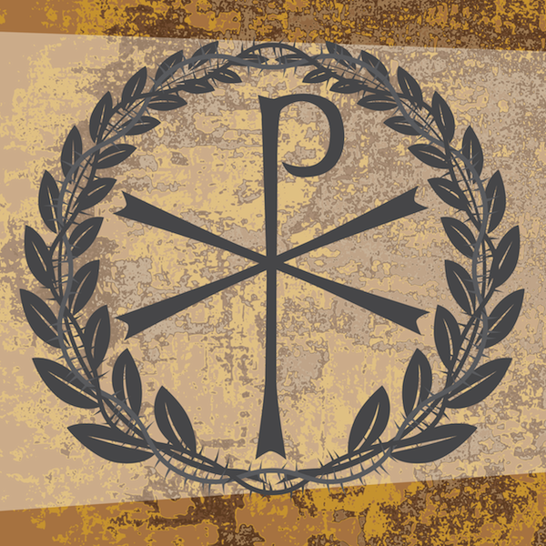
Chi-Rho, or Christogram

Slide 4
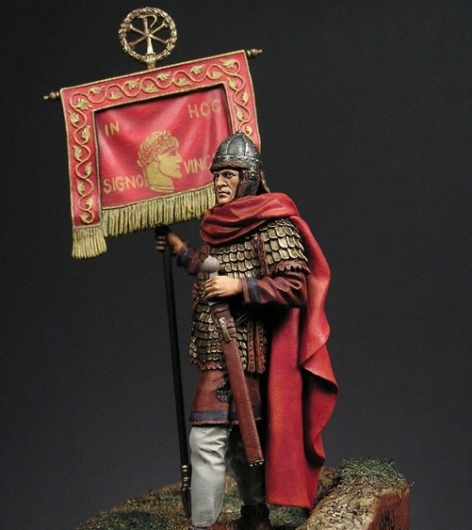
Labarum
In Hoc Signo Vinces
By this sign, Thou Shalt Conquer

Slide 6
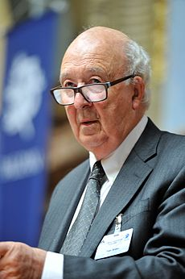
Peter Brown (b.1935)

Slide 7
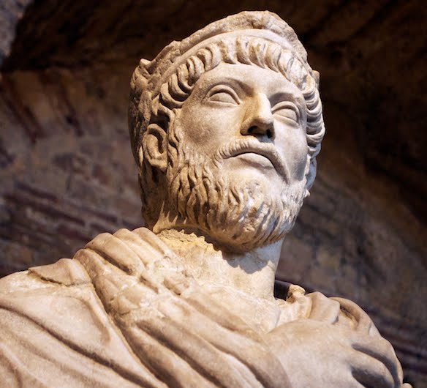
Julian the Apostate (330-363 AD)
O thou mother of gods and of men, who sharest the throne of the great Zeu…O life-giving goddess, who art the wisdom and the providence and the creator of our very souls…grant to all men happiness, and that highest happiness of all which is the knowledge of the gods; and grant to the Roman people that they may cleanse themselves of the stain of impiety.
—Julian, Hymn to Cybele, Mother of the Gods

Slide 8
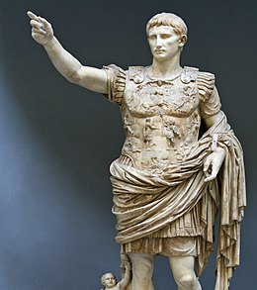
Augustus (63 BC-14 AD)

Slide 10
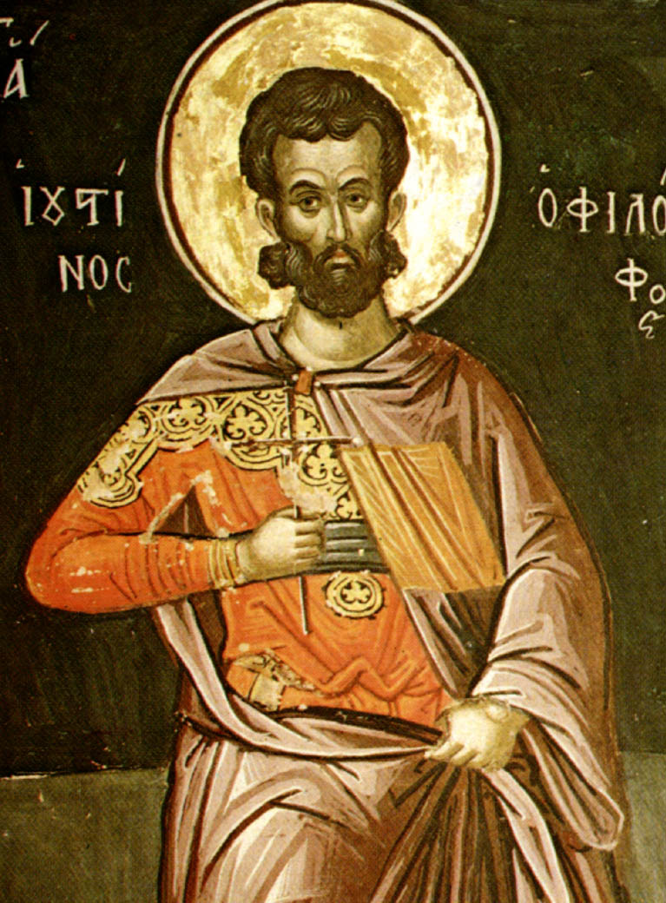
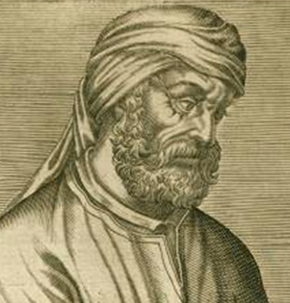
Tertullian (160-220 AD)
St. Justin Martyr (100-165 AD)

Slide 11
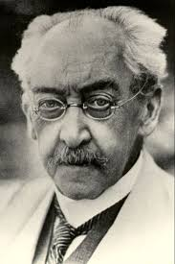
Adolf von Harnack (1851-1930)
The Mission and Expansion of Christianity in the First Three Centuries (1902)

Slide 12
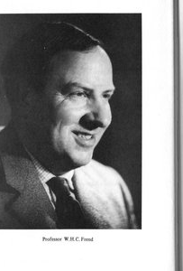
W.H.C. Frend (1916-2005)
Martyrdom and Persecution in the Early Church

Slide 13
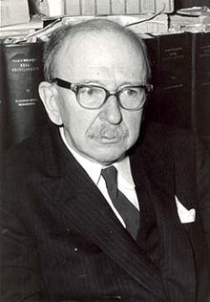
Arthur Darby Nock (1902-1963)
Conversion (1933)

Slide 14
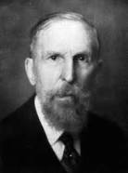
Franz Cumont (1868-1947)
The Mysteries of Mithra (1894)

Slide 15
Mithras

Slide 16
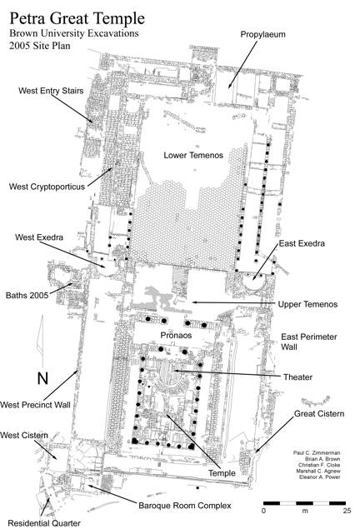
Temenos

Slide 17
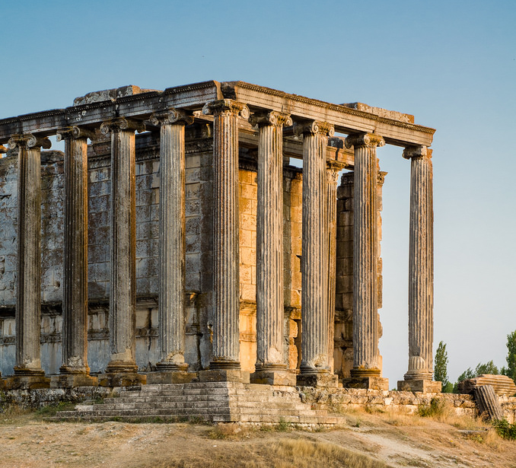
Aezanis, Asia Minor (Çavdarhisar, Turkey)

Slide 19
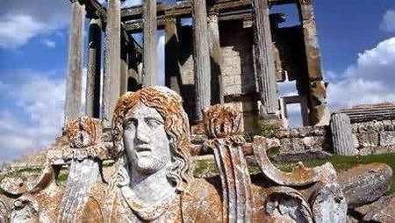
Thamagaudi (Timgad, Algeria)

Slide 20
Tipasa, Algeria

Slide 22
Baalbek (Heliopolis) Lebanon

Slide 23
Baalbek (Heliopolis) Lebanon

Slide 24
Aezanis, Asia Minor (Çavdarhisar, Turkey)

Slide 26
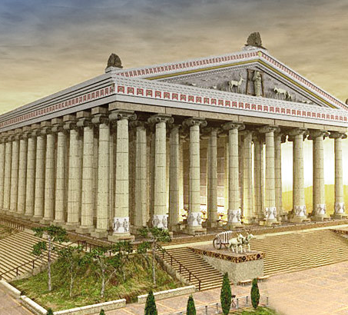
Temple of Artemis at Ephesus

Slide 27
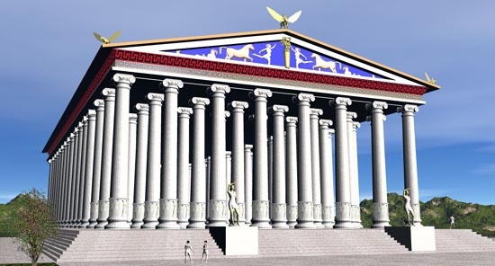
Artemis at Ephesus

Slide 30
Stratonicea, Asia Minor (Eskihisar, Turkey)

Slide 31
M.C. Sahin (1976) Stratonikea in Caria, No. 701
Tiberius Claudius Aristeas Menander and his wife Aelia Glycinna instituted a festival for the entire city, and they carefully gave to each of the citizens assembled in the theater two denarii apiece, summoning them by deme. They also served as gymnasiarchs in the city during the two-day procession, conveying the sacred image of Hecate from her shrine at Lagina, and then during the peripolios [i.e. the feast days when the image is paraded around the city]. In addition, in the same year of the festival, they gave 1,000 denarii for the construction and upkeep of the public bath, whereupon the grandfather of Aristeas, Flavius Aeneas, erected this honorary monument to the city at his own expense.

Slide 32
Coins of Stratonicea, Struck under Ti. Claudius Aristeas

Slide 33
Oenoanda, Asia Minor

Slide 34
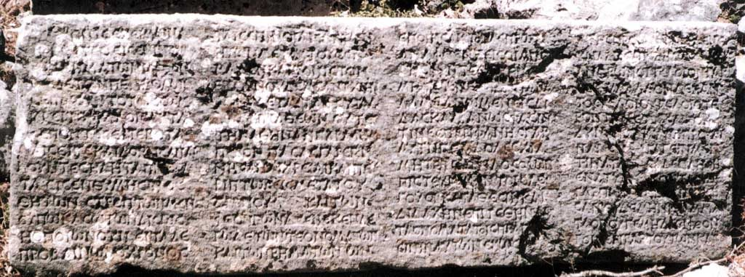
Wörrle M., “Stadt und Fest im kaiserzeitlichen Kleinasien,” Vestigia vol. 39 (Munich, 1988) Demostheneia Festival inscription

Slide 35
Theater at Oenoanda

Slide 36
Imbriogon, Asia Minor

Slide 37
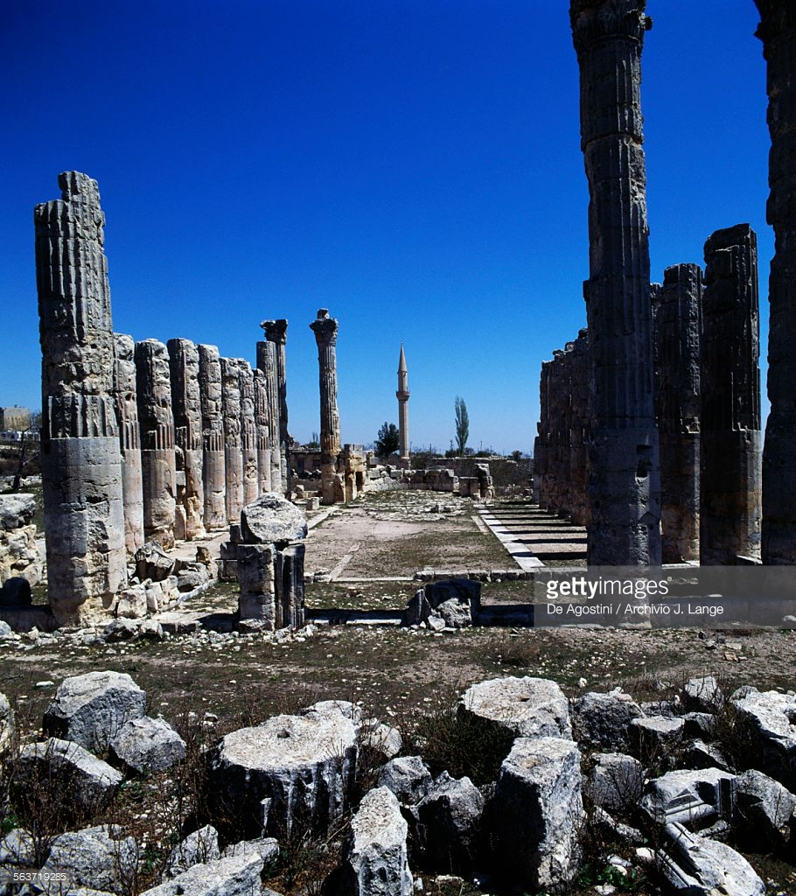
Olba, Asia Minor

Slide 38
Palsi, Asia Minor

Slide 39
Religious Syncretism
Religious syncretism is the blending of two or more religious belief systems into a new system, or the incorporation into a religious tradition of beliefs from unrelated traditions.

Slide 40
Aezanis, Asia Minor (Çavdarhisar, Turkey)

Slide 41
Augustus (63 BC-14 AD)

Slide 42
Alexander the Great (356-323 BC)

Slide 43
Hellenistic Kingdoms

Slide 44
Augustus (63 BC-14 AD)

Slide 45
Marcus Aurelius (121-180 AD)

Slide 46
Trajan (53-117 AD)

Slide 47
Commodus (161-192 AD)

Slide 48
Macrinus (165-218 AD)

Slide 49
Trajan Decius (201-251 AD)

Slide 51
Emperor Domitian (51-96 AD)

Slide 52
Pergamum, Asia Minor

Slide 53
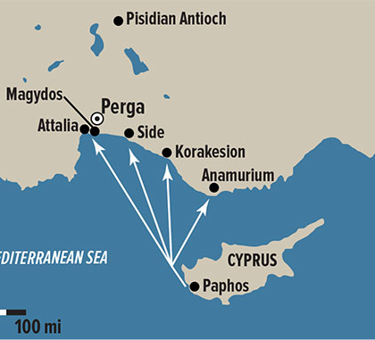
Pisidian Antioch, Asia Minor

Slide 55
Sardis, Asia Minor

Slide 56
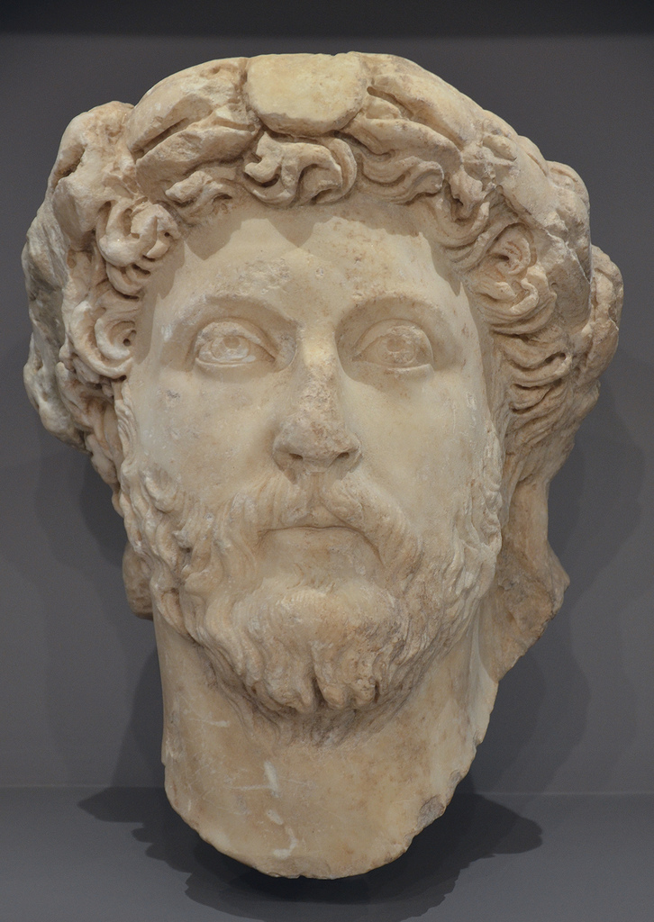
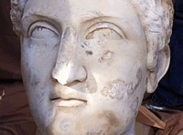
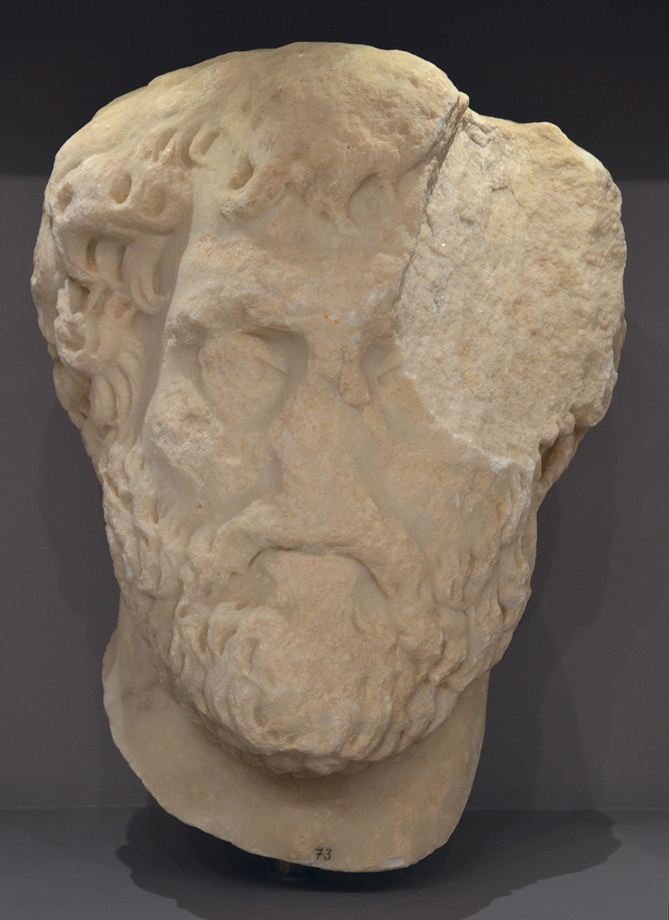
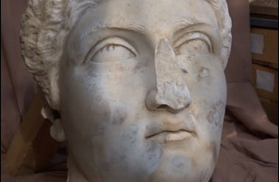

Slide 57
Seneca the Younger (4 BC -65 AD)

Slide 58
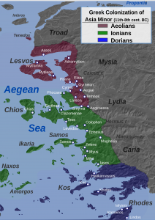
Assos, Asia Minor

Slide 59
Inscription Classification IAssos 26 = IMT 573 = PHI 288053 = ID# 6555
ἐπὶ ὑπάτων Γναίου Ἀκερρωνίου ǀ Πρόκλου καὶ Γαΐου Ποντίου Πετρωǀνίου Νιγρίνου ǀ ψήφισμα Ἀσσίων γνώμηι τοῦ δήμου ǀǀ ἐπεὶ ἡ κατ’ εὐχὴν πᾶσιν ἀνθρώποις ἐλπισθεῖσα Γαΐου ǀ Καίσαρος Γερμανικοῦ Σεβαστοῦ ἡγεμονία κατήνγελται, ǀ οὐδὲν δὲ μέτρον χαρᾶς εὕρηκε ὁ κόσμος, πᾶσα δὲ πόλις ǀ καὶ πᾶν ἔθνος ἐπὶ τὴν τοῦ θεοῦ ὄψιν ἔσπευκεν, ὡς ἂν τοῦ ǀ ἡδίστου ἀνθρώποις αἰῶνος νῦν ἐνεστῶτος, ǀǀ ἔδοξεν τῆι βουλῆι καὶ τοῖς πραγματευομένοις παρ’ ἡμῖν ǀ Ῥωμαίοις καὶ τῶι δήμωι τῶι Ἀσσίων κατασταθῆναι πρεσǀβείαν ἐκ τῶν πρώτων καὶ ἀρίστων Ῥωμαίων τε καὶ Ἑλλήǀνων τὴν ἐντευξομένην καὶ συνησθησομένην αὐτῶι, ǀ δεηθησομένην τε ἔχειν διὰ μνήμης καὶ κηδεμονίας ǀǀ τὴν πόλιν, καθὼς καὶ αὐτὸς μετὰ τοῦ πατρὸς Γερμανικοῦ ǀ ἐπιβὰς πρώτως τῆι ἐπαρχείαι τῆς ἡμετέρας πόλεως ǀ ὑπέσχετο· ǀ ὅρκος Ἀσσίων ǀ ὄμνυμεν Δία Σωτῆρα καὶ θεὸν Καίσαρα Σεβαστὸν καὶ τὴν ǀǀ πάτριον ἁγνὴν Παρθένον εὐνοήσειν Γαΐωι Καίσαρι Σεβασǀτῶι καὶ τῶι σύμπαντι οἴκωι αὐτοῦ, καὶ φίλους τε κρίνειν, ǀ οὓς ἂν αὐτὸς προαιρῇται, καὶ ἐχθρούς, οὓς ἂν αὐτὸς προβάǀληται· εὐορκοῦσιν μὲν ἡμῖν εὖ εἴη, ἐφιορκοῦσιν δὲ τὰ ἐνανǀτία· ǀǀ πρεσβευταὶ ἐπηνγείλαντο ἐκ τῶν ἰδίων ǀ Γάϊος Οὐάριος Γαΐου υἱὸς Οὐολτινία Κάστος ǀ Ἑρμοφάνης Ζωΐλου ǀ Κτῆτος Πισιστράτου ǀ Αἰσχρίων Καλ<λ>ιφάνους ǀǀ Ἀρτεμίδωρος Φιλομούσου ǀ οἵτινες καὶ ὑπὲρ τῆς Γαΐου Καίσαρος Σεβαστοῦ Γερμανικοῦ ǀ σωτηρίας εὐξάμενοι Διὶ Καπιτωλίωι ἔθυσαν τῶι τῆς πόλεǀως ὀνόματι.

Slide 60
IAssos 26 = IMT 573 = PHI 288053 = ID# 6555
Since the rule of Gaius Caesar Germanicus Augustus, which all men had hoped and prayed for, has been proclaimed and the joy of the world knows no bounds, and since every city (polis) and every people has been eager for the sight of the god, as if the happiest age of humanity had now begun, it was resolved by the Council, the Romans engaged in business among us, and the People of Assos to arrange an embassy consisting of the foremost distinguished Romans and Greeks to visit him (i.e. Caligula) and express joy, and to beg him to remember and care for the city, just as he also promised our city on his first visit to the province with his father Germanicus.
We swear to Zeus Soter (“Saviour”), god Caesar Augustus, and the ancestral holy Maiden (i.e. Athena) to have good will towards Gaius Caesar Augustus and his whole household and to consider as friends whomever he may choose as friends and to consider as enemies whomever he accuses. If we swear truly, may it go well for us, but if we swear falsely, the opposite will happen. The ambassadors offered themselves at their own expense: Gaius Varius Castus son of Gaius of Voltinia tribe, Hermophanes son of Zoilos, Ktetos son of Pisistratos, Aischrion son of Kalliphanes, and Artemidoros son of Philomousos. The ambassadors prayed to Capitolinian Zeus (i.e. Jupiter) for the safety of Gaius Caesar Augustus Germanicus and they sacrificed in the name of the city.

Slide 63
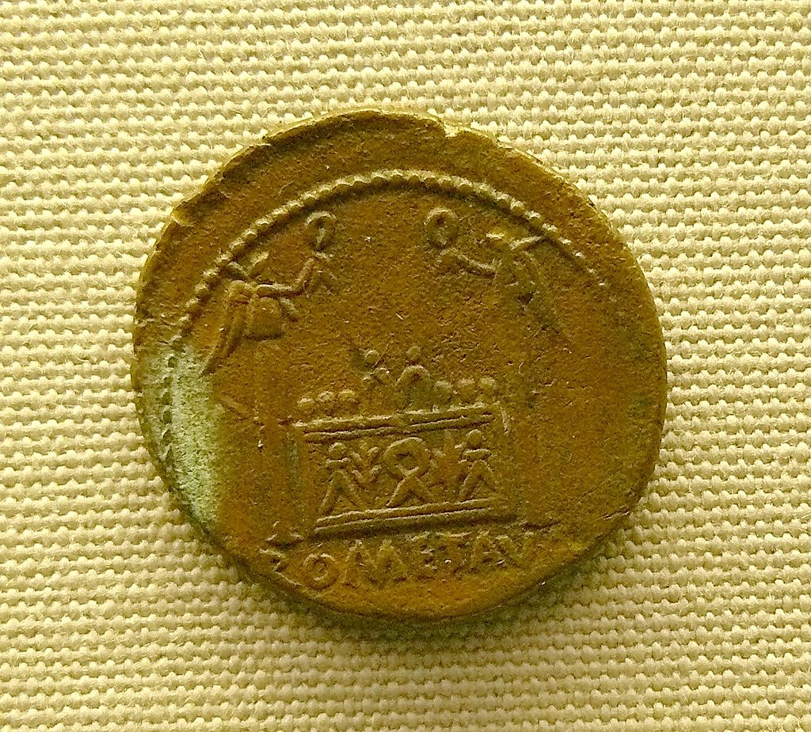
Lugdunum, “Sanctuary of the Three Gauls”

Slide 64
Mystery Cults

Slide 65
Taurobolium

Slide 66
Taurobolium

Slide 67
Franz Cumont (1868-1947)
The Mysteries of Mithra (1894)

Slide 68
E.R. Dodds (1851-1930)
The Greeks and the Irrational (1951)
Pagan and Christian in an age of Anxiety (1965)

Slide 69
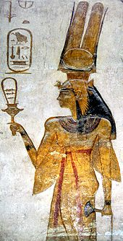
Sistrum

Slide 70
Franz Cumont (1868-1947)
The Mysteries of Mithra (1894)

Slide 71
Mithras

Slide 72
Persephone

Slide 73
Bacchantes

Slide 74
Mithras

Slide 75
Cybele

Slide 76
Pessinus, Phrygia, Asia Minor

Slide 77
Cybele

Slide 78
Serapis and Isis

Slide 79
Serapis and Horus

Slide 80
Kızıl Avlu

Slide 81
Villa of the Mysteries, Pompeii, Italy

Slide 82
Franz Cumont (1868-1947)
The Mysteries of Mithra (1894)

Slide 83
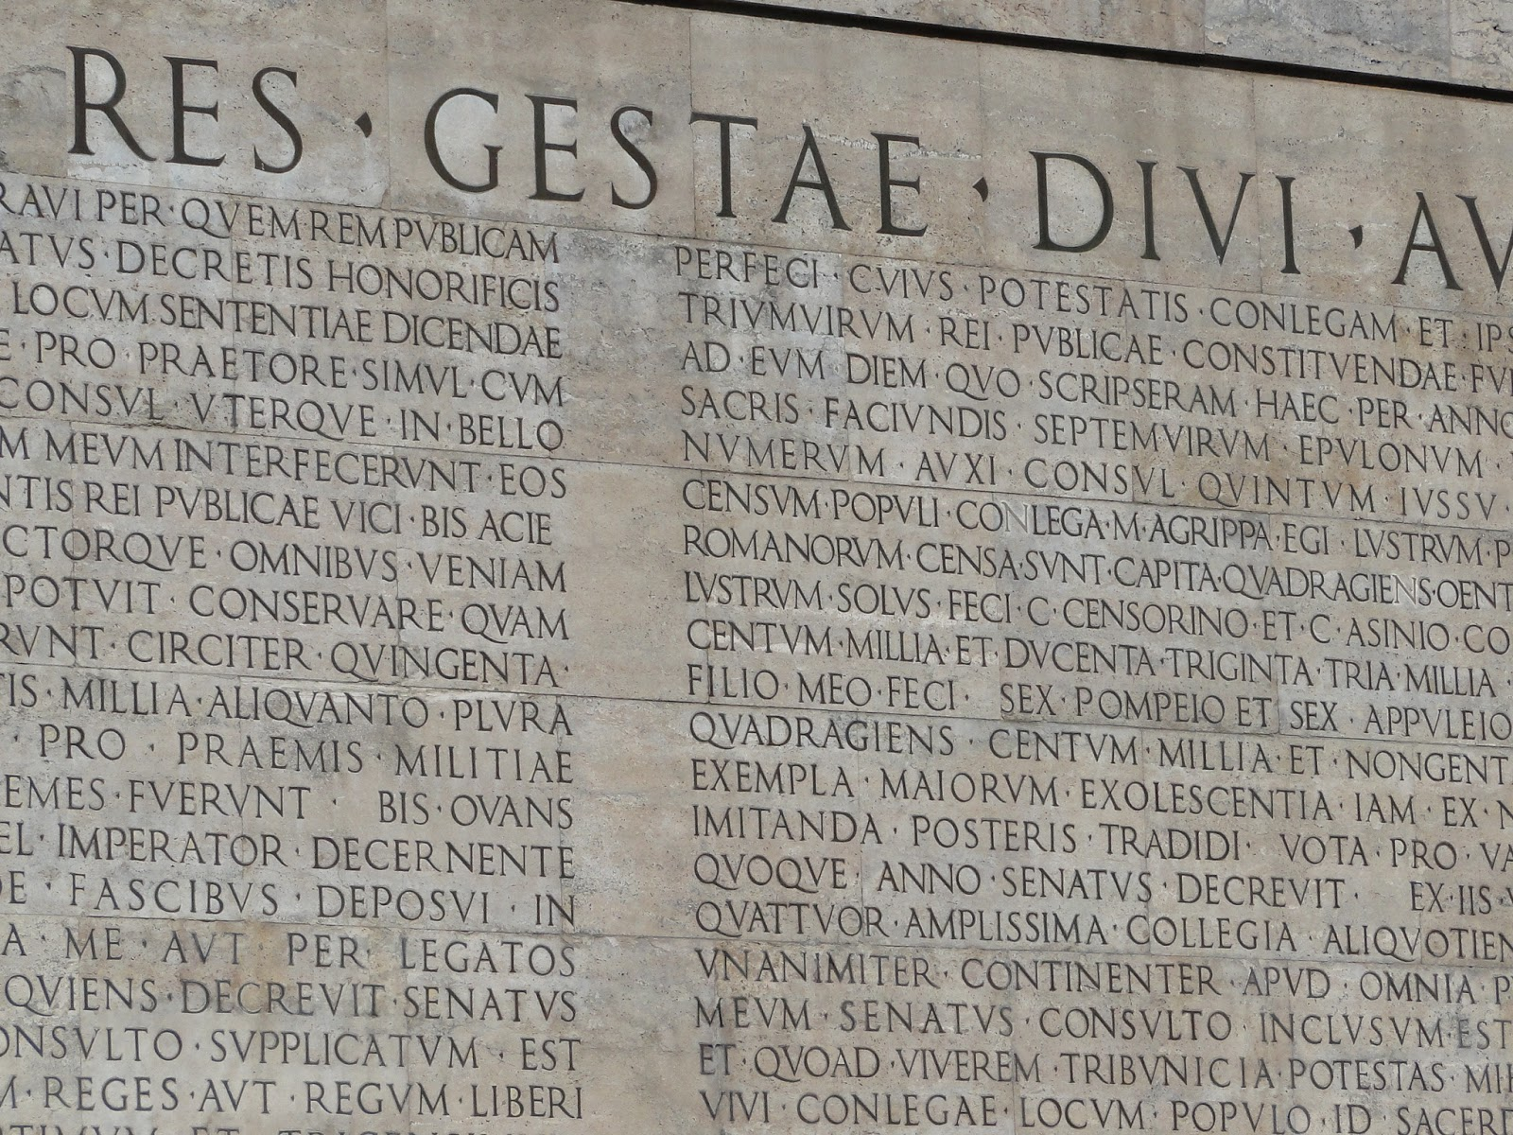
Res Gestae Divi Augusti

Slide 84
E.R. Dodds (1851-1930)
The Greeks and the Irrational (1951)
Pagan and Christian in an age of Anxiety (1965)

Slide 85
Glycon

Slide 86
Nash, R.H. (2003) The Gospel and the Greeks: Did the New Testament Borrow from Pagan Thought, pg. 1
“During the period of time running roughly from about 1890-1940, scholars often alleged that primitive Christianity had been heavily influenced by Platonism, Stoicism, the pagan mystery religions, or other movements in the Hellenistic world. Largely as a result of a series of scholarly books and articles written in rebuttal, allegations of early Christianity’s dependence on its Hellenistic environment began to appear much less frequently in the publications of Bible scholars and classical authors. Today most Bible scholars regard the question as a dead issue.”

Slide 87
Key Feature of Mystery Religions: Cyclical View of Time
“Central to the mysteries was their use of the annual vegetation cycle, in which life renews each spring and dies each fall. Followers of the mystery cults found deep symbolic significance in the natural process of growth, death, decay, and rebirth.”
—Nash, R.H. (2003) The Gospel and the Greeks: Did the New Testament Borrow from Pagan Thought, pg. 113.

Slide 88
Key Feature of Mystery Religions: Secret Ceremonies
“[Each] mystery religion made important use of secret ceremonies, often in connection with an initiation rite. The mystery rites tied the initiates together at the same time they separated them from outsiders…Whatever place particular mysteries allowed knowledge to have in their cult, it was a secret, or esoteric, knowledge, attainable only by the initiated and never revealed to those outside the circle of the religion. While several cults did stress the role of knowledge (gnosis) in achieving redemption, the term referred not so much to the cognizance of a set of truths as to a “higher knowledge” associated with their secret ceremonies.”
—Nash, R.H. (2003) The Gospel and the Greeks: Did the New Testament Borrow from Pagan Thought, pg. 113.

Slide 89
Key Feature of Mystery Religions: Doctrine Minimized
“Thus the Mysteries, with the exception of the Hermetic theology and Orphism, were never conspicuously doctrinal or dogmatic: they were weak intellectually and theologically.”
—Angus, S. (1975) The Mystery Religions: A Study in the Religious Background of Early Christianity, pg. 61

Slide 90
Key Feature of Mystery Religions: Doctrine Minimized
“The mysteries had little if any use for doctrine or correct belief. They were primarily concerned with the emotional state of their followers…The mysteries used many different means to affect the emotions and imaginations of their followers in order to quicken their union with the god: processions, fasting, a play, acts of purification, blazing lights, and esoteric liturgies.”
—Nash, R.H. (2003) The Gospel and the Greeks: Did the New Testament Borrow from Pagan Thought, pg. 114.

Slide 91
Key Feature of Mystery Religions: Doctrine Minimized
“The immediate goal of the initiates was a mystical experience that led them to feel that they had achieved union with their god. But beyond this quest for a mystical union were two more ultimate goals: some kind of redemption, or salvation, and immortality. The initiation ceremony was supposed to end the alienation of the mystes (initiate) from his god, making possible communion with the deity and eventual triumph over death.”
—Nash, R.H. (2003) The Gospel and the Greeks: Did the New Testament Borrow from Pagan Thought, pg. 114.

Slide 92
Key Feature of Mystery Religions: Doctrine Minimized
“A Mystery-Religion was a religion of Redemption which professed to remove estrangement between man and God, to procure forgiveness of sins, to furnish mediation. Means of purification and formulae of access to God, and acclamations of confidence and victory were part of the apparatus of every Mystery…These redemption-religions thus promised salvation and provided the worshiper with a patron deity in life and death. This salvation consisted in release from the tyranny of Fate, alleviation from burdens and limitations of existence, comfort in the sorrows of man’s lot, a real identification with his god guaranteeing palingenesia (rebirth), and hope beyond.”
—Angus, S. (1975) The Mystery Religions: A Study in the Religious Background of Early Christianity, pgs. 50, 52

Slide 93
Contrast with Christianity: Historically Based
“What makes Christianity unique among world religions is that it is grounded in history. More specifically, the Christian faith rests on the person of Jesus Christ as a real, historical man. The notion that God became man in space-time history, that He lived among us, that He died on a Roman Cross, and rose from the dead is the core of the Christian proclamation. Indeed, one implication of the Incarnation — of God becoming man — is that the Incarnation invites us and even requires us to examine its historical credibility. The Gospels go to great lengths to speak to the where, who, and when of Jesus’ ministry. They practically beg the reader to check out the data, to see if these things are so.”
—Komoszewski, J. ed., M.J. Sawyer, and D. Wallace (2006) Reinventing Jesus, pg. 220.

Slide 94
Contrast with Christianity: Historically Based
Now in the fifteenth year of the reign of Tiberius Caesar, Pontius Pilate being governor of Judaea, and Herod being tetrarch of Galilee, and his brother Philip tetrarch of Ituraea and of the region of Trachonitis, and Lysanias the tetrarch of Abilene,
Annas and Caiaphas being the high priests, the word of God came unto John the son of Zacharias in the wilderness.
And he came into all the country about Jordan, preaching the baptism of repentance for the remission of sins.
—Luke 3:1-3

Slide 95
Contrast with Christianity: Historically Based
And if Christ be not risen, then is our preaching vain, and your faith is also vain.
Yea, and we are found false witnesses of God; because we have testified of God that he raised up Christ: whom he raised not up, if so be that the dead rise not.
For if the dead rise not, then is not Christ raised:
And if Christ be not raised, your faith is vain; ye are still in your sins.
—1 Corinthians 15:14-17

Slide 96
Contrast with Christianity: Public Proclamation
Ye men of Israel, hear these words; Jesus of Nazareth, a man approved of God among you by miracles and wonders and signs, which God did by him in the midst of you, as ye yourselves also know:
Him, being delivered by the determinate counsel and foreknowledge of God, ye have taken, and by wicked hands have crucified and slain:
Whom God hath raised up, having loosed the pains of death: because it was not possible that he should be held by it.
—Acts 2:22-24

Slide 97
Contrast with Christianity: Public Proclamation
Whosoever therefore shall confess Me before men, him will I confess also before my Father which is in heaven.
But whosoever shall deny Me before men, him will I also deny before My Father which is in heaven.
—Matthew 10:32-33

Slide 98
Contrast with Christianity: Public Proclamation
For we have not followed cunningly devised fables, when we made known unto you the power and coming of our Lord Jesus Christ, but were eyewitnesses of his majesty.
—2 Peter 1:16

Slide 99
Contrast with Christianity: Doctrine Matters
Therefore shall ye lay up these my words in your heart and in your soul, and bind them for a sign upon your hand, that they may be as frontlets between your eyes.
And ye shall teach them your children, speaking of them when thou sittest in thine house, and when thou walkest by the way, when thou liest down, and when thou risest up.
And thou shalt write them upon the door posts of thine house, and upon thy gates:
That your days may be multiplied, and the days of your children, in the land which the Lord sware unto your fathers to give them, as the days of heaven upon the earth.
For if ye shall diligently keep all these commandments which I command you, to do them, to love the Lord your God, to walk in all his ways, and to cleave unto him;
Then will the Lord drive out all these nations from before you, and ye shall possess greater nations and mightier than yourselves.
—Deuteronomy 11:18-23

Slide 100
Contrast with Christianity: Doctrine Matters
And Jesus came and spake unto them, saying, All power is given unto me in heaven and in earth.
Go ye therefore, and teach all nations, baptizing them in the name of the Father, and of the Son, and of the Holy Spirit:
Teaching them to observe all things whatsoever I have commanded you: and, lo, I am with you always, even unto the end of the world. Amen.
—Matthew 28:18-20

Slide 101
Contrast with Christianity: Doctrine Matters
He must hold firm to the trustworthy word as taught, so that he may be able to give instruction in sound doctrine and also to rebuke those who contradict it.
—Matthew 28:18-20, ESV

Slide 102
Five Reasons the Mystery Religions Did Not Influence Christianity
Reason #1: True to its Jewish roots, Christianity did not accept others gods

Slide 103
Jews Were Committed to an Exclusive Faith
But now Pilate, the procurator of Judea, removed the army from Cesarea to Jerusalem, to take their winter quarters there, in order to abolish the Jewish laws. So he introduced Caesar’s effigies, which were upon the ensigns, and brought them into the city; whereas our law forbids us the very making of images; on which account the former procurators were wont to make their entry into the city with such ensigns as had not those ornaments. Pilate was the first who brought those images to Jerusalem, and set them up there; which was done without the knowledge of the people, because it was done in the nighttime; but as soon as they knew it, they came in multitudes to Cesarea, and interceded with Pilate many days, that he would remove the images; and when he would not grant their requests, because it would tend to the injury of Caesar, while yet they persevered in their request, on the sixth day he ordered his soldiers to have their weapons privately, while he came and sat upon his judgment seat, which seat was so prepared in the open place of the city, that it concealed the army that lay ready to oppress them: and when the Jews petitioned him again, he gave a signal to the soldiers to encompass them round, and threatened that their punishment should be no less than immediate death, unless they would leave off disturbing him, and go their ways home. (59) But they threw themselves upon the ground, and laid their necks bare, and said they would take their death very willingly, rather than the wisdom of their laws should be transgressed; upon which Pilate was deeply affected with their firm resolution to keep their laws inviolable, and presently commanded the images to be carried back from Jerusalem to Cesarea.
—Josephus, Antiquities of the Jews, 18.55-59

Slide 104
Jews Were Committed to an Exclusive Faith
“The first-century Jewish mind-set loathed syncretism. Unlike the Gentiles of this era, Jews refused to blend their religion with other religions. Gentile religions were not exclusive; one could be a follower of several different gods at one time. But Judaism was strictly monotheistic, as was Christianity. As the Gospel spread beyond the borders of Israel, the apostles not only found themselves introducing people to the strange idea of a Man risen from the dead; they also came face-to-face with a polytheistic culture. But they made no accommodation on this front.”
—Komoszewski, J. ed., M.J. Sawyer, and D. Wallace (2006) Reinventing Jesus, pg. 220.

Slide 105
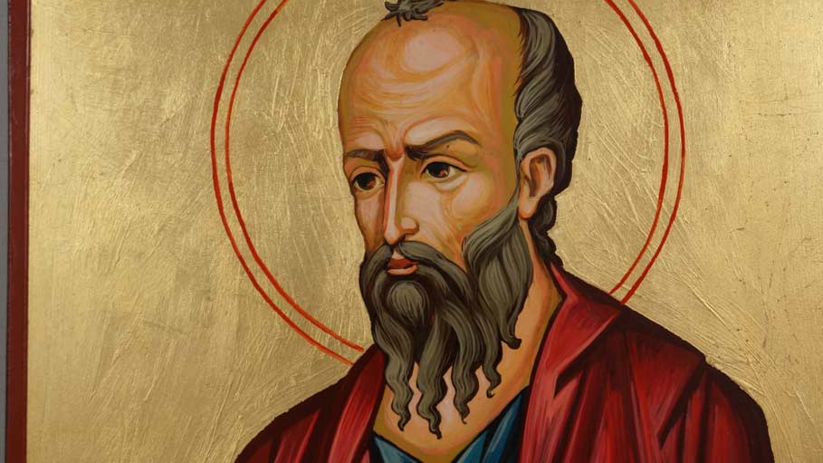
Apostle Paul Maintained and Taught Devotion to the One True God Both Before and After His Dramatic Conversion
Circumcised on the eighth day, of the stock of Israel, of the tribe of Benjamin, an Hebrew of the Hebrews; as touching the law, a Pharisee;
Concerning zeal, a persecutor of the Church; touching the righteousness which is in the law, blameless.
But what things were gain to me, those I counted loss for Christ.
—Philippians 3:5-7

Slide 106
Apostle Paul Maintained and Taught Devotion to the One True God Both Before and After His Dramatic Conversion
And I was advancing in Judaism beyond many of my own age among my people, so extremely zealous was I for the traditions of my fathers.
—Galatians 1:14, ESV

Slide 107
Five Reasons the Mystery Religions Did Not Influence Christianity
Reason #2: The Differences Between Christianity and the Mystery Cults are Greater than the Similarities

Slide 108
Boyd, G.A., and P.R. Eddy, The Jesus Legend, pg. 142
“[As] soon as we become critical of reading parallels into the evidence, we discover that differences between Christianity and the mystery religions are far more pronounced than any similarities. While there are certainly parallel terms used in early Christianity and the mystery religions, there is little evidence for parallel concepts. For example, as we have noted, both Christianity and the mystery religions spoke of salvation — as do many religions throughout history. But what early Christians meant by this term had little in common with what devotees of mystery religions meant by it. To cite just one difference, there was in the mystery religions nothing similar to Paul’s death and resurrection of their Savior and are adopted as God’s children by placing their trust in Him.”

Slide 109
Machen, J.G. (1921) Origin of Paul’s Religion, pgs. 227-228
“The myth of Cybele is narrated in various forms. According to the most characteristic form, the youthful Attis, beloved by Cybele, is struck with madness by the jealous goddess, deprives himself of his virility, does through his own mad act, and is mourned by the goddess. The myth contains no account of a resurrection; all that Cybele is able to obtain is that the body of Attis should be preserved, that his hair should continue to grow, and that his little finger should move.”

Slide 110
Five Reasons the Mystery Religions Did Not Influence Christianity
Reason #3: Parallels Comparing the Two Prove Nothing

Slide 111
McDowell, J. and S. McDowell (2017) Evidence that Demands a Verdict, pg. 311
“What if we told you about a British ocean liner that was about eight hundred feet long, weighed more than sixty thousand tons, and could carry about three thousand passengers? The ship had a top cruising speed of twenty-four knots, had three propellers, and about twenty lifeboats. What if I told you that this ocean liner hit an iceberg on its maiden voyage in the month of April, tearing an opening in the starboard side, forward portion of the ship, sinking it along with about two thousand passengers? Would you recognize the event from history? You might say, “Hey, that’s the Titanic!” Well, believe it or not, you would be wrong. It’s the Titan, a fictional ship described in Morgan Robertson’s 1898 book called The Wreck of the Titan, or Futility. This book was written fourteen years before the disaster took place, and several years before construction began on the Titanic!”

Slide 112
Five Reasons the Mystery Religions Did Not Influence Christianity
Reason #4: Mystery Religions Seem to be Influenced by Christianity, not the Other Way Around

Slide 113
Boyd, G.A., and P.R. Eddy, The Jesus Legend, pgs. 139-140
“A second obstacle to any attempt to understand first-century Christianity in light of ancient Greco-Roman mystery religions is that virtually all of our evidence for these religions comes from the second to fourth centuries…Trying to explain a first-century religious movement by appealing to evidence for a “parallel” phenomenon a century or more later is questionable, to say the least. True, it is not unreasonable to assume that there were first century precursors to the mystery cults of the second century and beyond. But this is an argument from silence, and in any case we are left with nothing conclusive about these precursor movements. Hence, any argument that Christianity was influenced by, let alone modeled after, these precursors must be judged as unwarranted speculation grounded in anachronism.”

Slide 114
Nash, R.H. (2003) The Gospel and the Greeks: Did the New Testament Borrow from Pagan Thought, pg.143
“[During this ritual,] initiates would stand or recline in a pit as a bull was slaughtered on a platform above them. The initiate would then be bathed in the warm blood of the dying animal. The taurobolium has been alleged to a source for Christian language about being washing the Blood of the Lamb (Rev. 7:14) or sprinkled with the Blood of Jesus (1 Peter 1:2).”

Slide 115
Boyd, G.A., and P.R. Eddy, The Jesus Legend, pg.140
“The crucial point here is that if there was any line of influence, it would seem more reasonable to argue that it was from Christianity to the mystery religions rather than the other way around.”

Slide 116
Mettinger, T. (2013) The Riddle of Resurrection: Dying and Rising Gods in the Ancient Near East, pg. 221
“There is, as far as I am aware, no prima facie evidence that the death and resurrection of Jesus is a mythological construct, drawing on the myths and rites of the dying and rising gods of the surrounding world. While studied with profit against the background of Jewish resurrection belief, the faith in the death and resurrection of Jesus retains its unique character in the history of religions. The riddle remains.”

Slide 117
Five Reasons the Mystery Religions Did Not Influence Christianity
Reason #5: The Death of Jesus Christ is Unique

Slide 118
Nash, R.H. (2003) The Gospel and the Greeks: Did the New Testament Borrow from Pagan Thought, pg.160
“None of the so-called savior gods died for someone else. The notion of the Son of God dying in place of His creatures is unique to Christianity.”

Slide 119
Christ Died for the Sins of Everyone
Jesus Christ did far more than just die on behalf of His friends. He specifically died for the sins of His immediate friends and followers, and all those who would believe in Him in the future (see Rom. 3:23-26; 1 Cor. 15:3; 2 Cor. 5:14, 15, 17-19; Gal. 1:3, 4). Nash provides the contrast: “Only Jesus died for sin. It is never claimed that any of the pagan deities died for sin.”
—Nash, R.H. (2003) The Gospel and the Greeks: Did the New Testament Borrow from Pagan Thought, pg. 160.

Slide 120
The Death of Jesus Christ was a Historical Event
“Jesus’ death was an actual event in history. The death of the god described in the pagan cults is a mythical drama with no historical ties; its continued rehearsal celebrates the recurring death and rebirth of nature. The incontestable fact that the early church believed that its proclamation of Jesus’ death and resurrection was grounded upon what actually happened in history makes absurd any attempt to derive this belief from the mythical, non-historical stories of pagan cults.”
—Nash, R.H. (2003) The Gospel and the Greeks: Did the New Testament Borrow from Pagan Thought, pg. 161.

Slide 121
The Death of Jesus Christ was Voluntary
And there were certain Greeks among them that came up to worship at the feast:
The same came therefore to Philip, which was of Bethsaida of Galilee, and desired him, saying, Sir, we would see Jesus.
Philip cometh and telleth Andrew: and again Andrew and Philip tell Jesus.
And Jesus answered them, saying, The hour is come, that the Son of man should be glorified.
Verily, verily, I say unto you, Except a corn of wheat fall into the ground and die, it abideth alone: but if it die, it bringeth forth much fruit.
He that loveth his life shall lose it; and he that hateth his life in this world shall keep it unto life eternal.
If any man serve me, let him follow me; and where I am, there shall also my servant be: if any man serve me, him will my Father honour.
Now is my soul troubled; and what shall I say? Father, save me from this hour: but for this cause came I unto this hour.
Father, glorify thy name. Then came there a voice from heaven, saying, I have both glorified it, and will glorify it again.
The people therefore, that stood by, and heard it, said that it thundered: others said, An angel spake to him.
Jesus answered and said, This voice came not because of me, but for your sakes.
Now is the judgment of this world: now shall the prince of this world be cast out.
And I, if I be lifted up from the earth, will draw all men unto me.
This he said, signifying what death he should die.
—John 12:20-33

Slide 122
The Death of Jesus Christ was Voluntary
“Unlike the mystery gods, Jesus died voluntarily. Nothing like the voluntary death of Jesus can be found in the mystery cults.”
—Nash, R.H. (2003) The Gospel and the Greeks: Did the New Testament Borrow from Pagan Thought, pg. 161)

Slide 123
The Death of Jesus Christ was Voluntary
“One difference, of course, is perfectly obvious and is indeed generally recognized — the Pauline Christ is represented as dying voluntarily, and dying for the sake of men. He ‘loves me’ says Paul, “and gave Himself for me.” There is absolutely nothing like that conception in the case of the pagan religions. Osiris, Adonis, and Attis were overtaken by their fate; Jesus gave His life freely away. The difference is stupendous; it involves the very heart of the religion of Paul.”
—Machen, J.G. (1921) Origin of Paul’s Religion, pg. 315.

Slide 124
The Death of Jesus Christ Ended in Victory, Not Deafeat
“And finally, Jesus’ death was not a defeat but a triumph. Christianity stands entirely apart from the pagan mysteries in that its report of Jesus’ death is a message of triumph. Even as Jesus was experiencing the pain and humiliation of the Cross, He was the Victor. The New Testament’s mood of exultation contrasts sharply with that of the mystery religions, whose followers wept and mourned for the terrible fate that overtook their gods.”
—Nash, R.H. (2003) The Gospel and the Greeks: Did the New Testament Borrow from Pagan Thought, pg. 161.

Slide 125
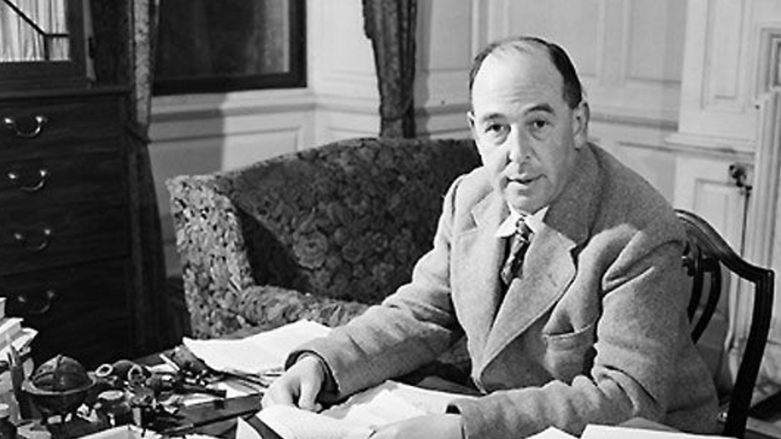
Humphrey Carpenter (1978) The Inklings, 42-45
On Saurday night, September 19, 1931, in Oxford, England, J.R.R. Tolkien and C.S. Lewis went walking with a friend (Hugo Dyson) and discussed these myths when ‘a sudden rush of wind’ prompted Tolkien to remark that the trees and the stars revealed how people once imagined a world that was alive, ‘myth-woven.’ Lewis, not yet a Christian but no longer an atheist, responded that myths are lies, powerfully written and crucial to the history of language and literature, but not for believing. Tolkien argued that even when humans lie, our human thoughts and imaginations must reflect something of our Creator — that the myth-making storyteller is “fulfilling God’s purpose, and reflecting a splintered fragment of the true light.” That led to a conversation on Christianity. Lewis knew well the mythical emphasis on sacrifice and blood, and ‘indeed he had examined the historicity of the Gospels’ enough to be ‘nearly certain that it really happened’ and to recognize that the New Testament centered on words such as ‘sacrifice’ and the ‘Blood of the Lamb.’ But, he wondered, ‘What was the point of it all? How could the death and resurrection of Christ have “saved the world”?’

Slide 126
Humphrey Carpenter (1978) The Inklings, 42-45
Tolkien’s response was that the old pagan stories of a dying god provided a clue: They were in fact ‘God…using the images of their “mythopoeia” [story-making] to express fragments of His eternal truth.’ But with Christianity, ‘the enormous difference [was] that the poet who invented it was God Himself, and the images He used were real mean and actual history…Here is a real Dying God, with a precise location in history and definite historical consequences. The old myth has become fact.’

Slide 127
Humphrey Carpenter, The Inklings, 42-45
Within two weeks, Lewis wrote, ‘I have just passed on from believing in God to definitely believing in Christ — in Christianity…My long night talk with Dyson and Tolkien has a good deal to do with it.’”

Slide 128
C.S. Lewis (1980) “Is Theology Poetry” in The Weight of Glory, pgs. 128-129
“We should, therefore, expect to find in the imagination of the great pagan teachers and myth makers some glimpse of that theme which we believe to be the very plot of the whole cosmic story — the theme of incarnation, death, and rebirth. And the differences between the Pagan Christs (Balder, Osiris, etc.) and the Christ Himself is much what we should expect to find. The Pagan stories are all about someone dying and rising, either every year, or else nobody knows where and nobody knows when. The Christian story is about a historical personage, whose execution can be dated pretty accurately, under a named Roman magistrate, and with whom the society that He founded is in a continuous relation down to the present day. It is the difference between a real event on the one hand and dim dreams or premonitions of that same event on the other.”

Slide 130
