Slide 1
Pagans and Christians Lecture Nine
Christianizing the Roman world
The Council of Nicea
The Birth of Christian Aesthetics and Letters

Slide 2
Edict of Milan, 313 AD

Slide 3
When I, Constantine Augustus, as well as I Licinius Augustus d fortunately met near Mediolanurn (Milan), and were considering everything that pertained to the public welfare and security, we thought -, among other things which we saw would be for the good of many, those regulations pertaining to the reverence of the Divinity ought certainly to be made first, so that we might grant to the Christians and others full authority to observe that religion which each preferred; whence any Divinity whatsoever in the seat of the heavens may be propitious and kindly disposed to us and all who are placed under our rule And thus by this wholesome counsel and most upright provision we thought to arrange that no one whatsoever should be denied the opportunity to give his heart to the observance of the Christian religion, of that religion which he should think best for himself, so that the Supreme Deity, to whose worship we freely yield our hearts) may show in all things His usual favor and benevolence. Therefore, your Worship should know that it has pleased us to remove all conditions whatsoever, which were in the rescripts formerly given to you officially, concerning the Christians and now any one of these who wishes to observe Christian religion may do so freely and openly, without molestation. We thought it fit to commend these things most fully to your care that you may know that we have given to those Christians free and unrestricted opportunity of religious worship. When you see that this has been granted to them by us, your Worship will know that we have also conceded to other religions the right of open and free observance of their worship for the sake of the peace of our times, that each one may have the free opportunity to worship as he pleases ; this regulation is made we that we may not seem to detract from any dignity or any religion.

Slide 4
Moreover, in the case of the Christians especially we esteemed it best to order that if it happens anyone heretofore has bought from our treasury from anyone whatsoever, those places where they were previously accustomed to assemble, concerning which a certain decree had been made and a letter sent to you officially, the same shall be restored to the Christians without payment or any claim of recompense and without any kind of fraud or deception, Those, moreover, who have obtained the same by gift, are likewise to return them at once to the Christians. Besides, both those who have purchased and those who have secured them by gift, are to appeal to the vicar if they seek any recompense from our bounty, that they may be cared for through our clemency,. All this property ought to be delivered at once to the community of the Christians through your intercession, and without delay. And since these Christians are known to have possessed not only those places in which they were accustomed to assemble, but also other property, namely the churches, belonging to them as a corporation and not as individuals, all these things which we have included under the above law, you will order to be restored, without any hesitation or controversy at all, to these Christians, that is to say to the corporations and their conventicles: providing, of course, that the above arrangements be followed so that those who return the same without payment, as we have said, may hope for an indemnity from our bounty. In all these circumstances you ought to tender your most efficacious intervention to the community of the Christians, that our command may be carried into effect as quickly as possible, whereby, moreover, through our clemency, public order may be secured. Let this be done so that, as we have said above, Divine favor towards us, which, under the most important circumstances we have already experienced, may, for all time, preserve and prosper our successes together with the good of the state. Moreover, in order that the statement of this decree of our good will may come to the notice of all, this rescript, published by your decree, shall be announced everywhere and brought to the knowledge of all, so that the decree of this, our benevolence, cannot be concealed.

Slide 5
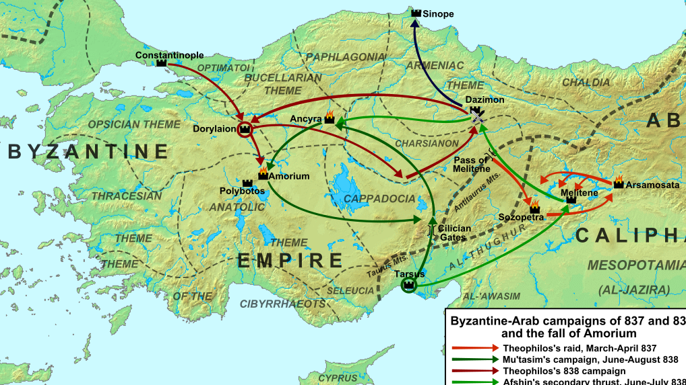
Orcistus, Asia Minor

Slide 6
Lee, A.D. (2000) Pagans and Christians in Late Antiquity. Routledge. Pg. 90.
“Orcistus was a community in Phrygia, Asia Minor, which at some point in the preceding century, for some reasons unknown, had been demoted from the status of an independent city to that of a village governed — and exploited — by the neighboring city of Nacolea. Soon after his defeat of Licinius (324) and acquisition of the eastern provinces, Emperor Constantine received a petition from the Orcistans seeking restoration of their former status. The emperor’s response to this and a subsequent petition concerning continuing financial obligations to Nacolea shed light on many aspects of Roman administration and society, but are of particular interest because the arguments deployed by the Orcistans in their efforts to regain their status as an independent city included an appeal on the basis of their Christianity. The community claims to be wholly Christian and is aware that this is likely to carry weight in the emperor’s deliberations — an expectation that proves to be fully justified. Although the claim to be wholly Christian should not be taken literally, there must be have been substantial numbers of Christians in the community, while their appeal to this feature implies that it was unusual compared with other communities in central Asia Minor at this time.”

Slide 7
Chastagnol, A. (1981) “L’inscription constantinienne d’Orcistus,” MEFRA 93: 381-416.
Chastagnol (410-11) has raised the possibility that Orcistus may be the unnamed Christian community in Phrygia with which Diocletian dealt severely during his persecution (Eusebius Ecclesiastical History 8.11.1; Lactantius Divine Institutes 5.11.10), which would then be a likely context for Orcistus to lose its city status.

Slide 8
Monumenta Asia Minoris Antiqua 7.305: Imperial Response to the Praetorian Prefect Ablabius (c. 328-330 AD)
Greetings, Ablabius, most dear to us. The inhabitants of Orcistus, henceforth a town and city, have presented a pleasing opportunity for our munificence, most dear and pleasing Ablabius. For to those [like us] who are eager to establish new cities, to improve long established ones or to restore lifeless ones, what they were seeking was most welcome. For they declared that their village flourished with the splendor of a town in the period of a former age so that it was adorned with the symbols of authority (fasces) of annual magistrates, had numerous city-councilors, and was filled with a multitude of citizens. Its location is said to be so fortunate in terms of position and natural attributes that roads converge on it from four directions, from which it may be said to be advantageous and suitable as a resting point (mansio) for all those on public business. An abundance of waters flows there, there are baths public and private, a forum decorated with statues of leading citizens of old, a population of inhabitants so numerous that the seating which is in this same place is easily filled. Moreover, due to the downward rush of excess water there is an abundant number of water mills.

Slide 9
Monumenta Asia Minoris Antiqua 7.305: Imperial Response to the Praetorian Prefect Ablabius (c. 328-330 AD)
Although it is stated that the aforementioned place abounds in all these things, it came about, that have declared, that the Nacoleans demanded before the present time that they be annexed to them. It is unworthy of our times that so fortunate a location should lose the title of city and it serves no good purpose for those dwelling there that they should lose all their benefits and advantages through being plundered by a more powerful people. Added to all these considerations, the crowning detail, as it were, is the fact that all the inhabitants of this same place are said to be followers of the most holy religion (sectatores santissimae religionis).

Slide 10
Monumenta Asia Minoris Antiqua 7.305: Imperial Response to the Praetorian Prefect Ablabius (c. 328-330 AD)
Since they beseeched that the ancient right and name of the city be granted to them by our clemency, we have given the following decision, as shown by the copies of annotated response (annotatio) and their request appended below. For that which they have proposed in their petition — the re-establishment of their name and status — they have rightly sought to obtain. Accordingly, by the intercession of Your Gravity, we have decided that those things which were damaged should be restored to the wholeness of their former honor so that they and their town, protected by their diligence, may enjoy the splendor of the laws and the name which they have sought. For it is right that Your Sincerity should hasten to fulfill for these supplicants that which we have promptly granted in accordance with the dignity of our times. Farewell, Ablabius, most dear and pleasing to us.

Slide 11
Monumenta Asia Minoris Antiqua 7.305: Imperial Response to Orcistus (331 AD)
Written on the day before the Kalends of July [30 June] at Constantinople. The Emperor Caesar Constantine Maximus, conqueror and victor over the Goths, Augustus, and Flavius Claudius Constantine, victor over the Alamanns, and Flavius Julius Constantius, most noble Caesars, send greetings to the town council of Orcistus. It has been decided by the gift of our indulgence to protect not only your right to city status, granted to you as an honor, but also the privilege of freedom. And so in this present response we remove the injustice of the Nacoleans, of longer standing than the benefits of our indulgence, and we grant your prayers and request, so that hereafter you no longer pay any of the money which you used to contribute previously to their cults. Our leniency has therefore written this to the most eminent treasurer (rationalis) of the diocese of Asia who, in accordance with the purport of the favor granted to you, will ensure that the money is not hereafter with the purport of the favor granted to you, will ensure that the money is not hereafter sought and demanded from you for the above-stated purpose. We wish you well. In the consulates of Bassus and Ablabius (331 AD).

Slide 12
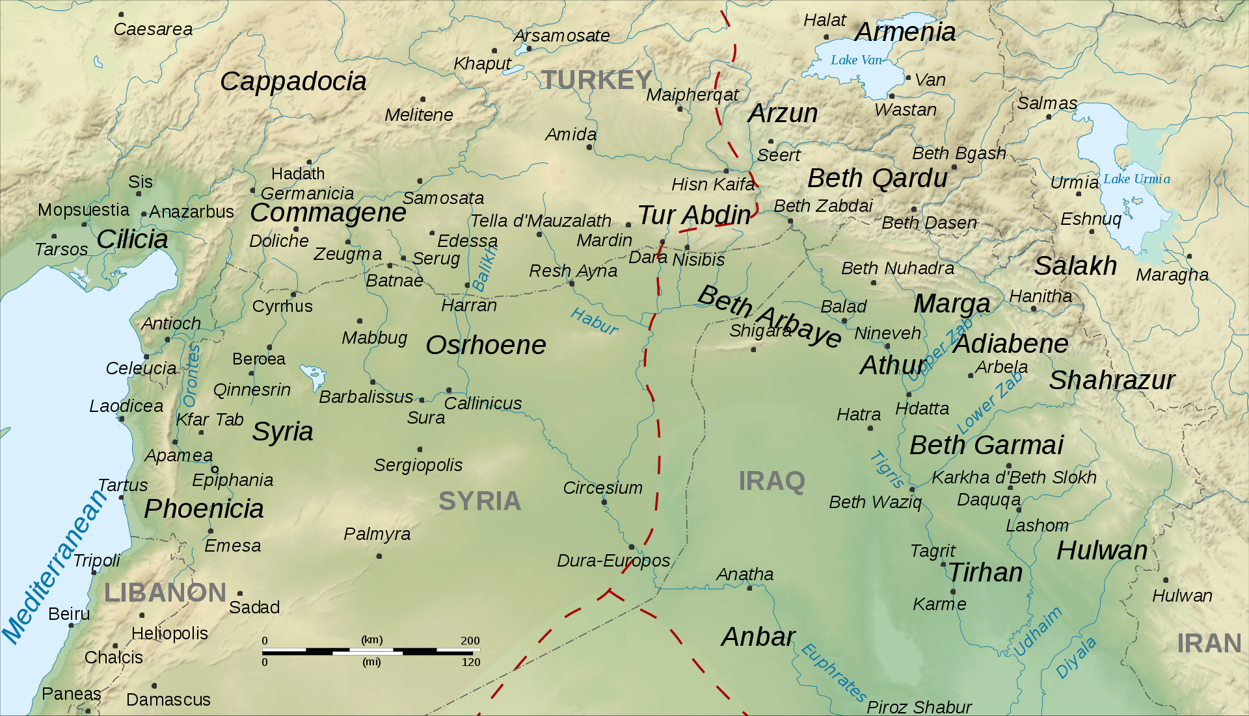
Edessa, Mesopotamia (Modern Day Urfa, Turkey)

Slide 13
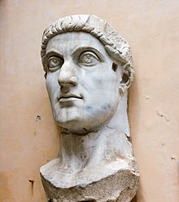
Saint Constantine

Slide 14
Roman North Africa

Slide 15
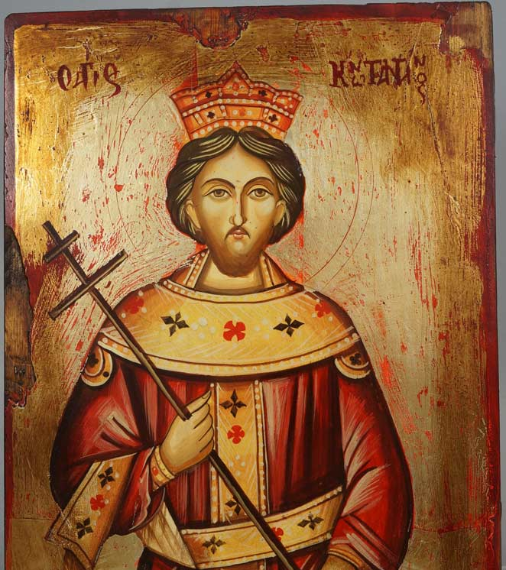
Saint Constantine

Slide 16
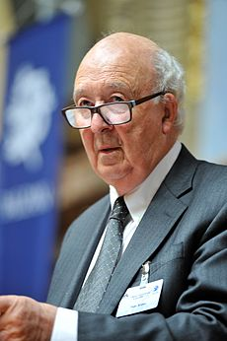
Peter Brown (b.1935)

Slide 17
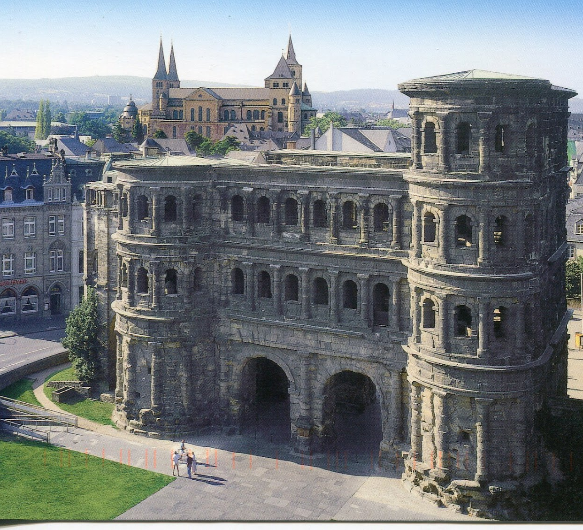
Treveri (Trier, Germany)

Slide 18
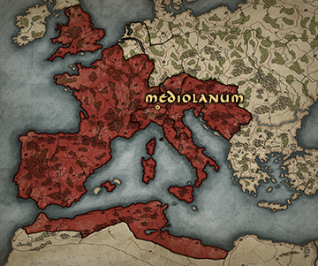
Mediolanum (Milan, Italy)

Slide 19
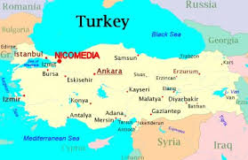
Nicomedia (Izmit, Turkey)

Slide 20
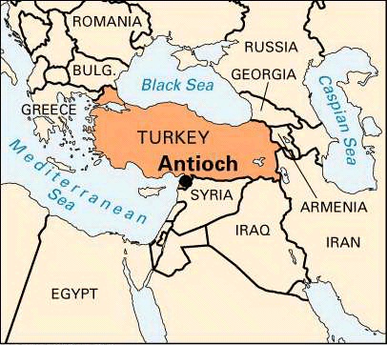
Antioch (Antakya, Turkey)

Slide 23
Hippodrome

Slide 24
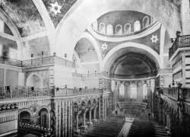
Hagia Irene, Constantinople

Slide 25
Church of the Theotokos, Ephesus

Slide 27
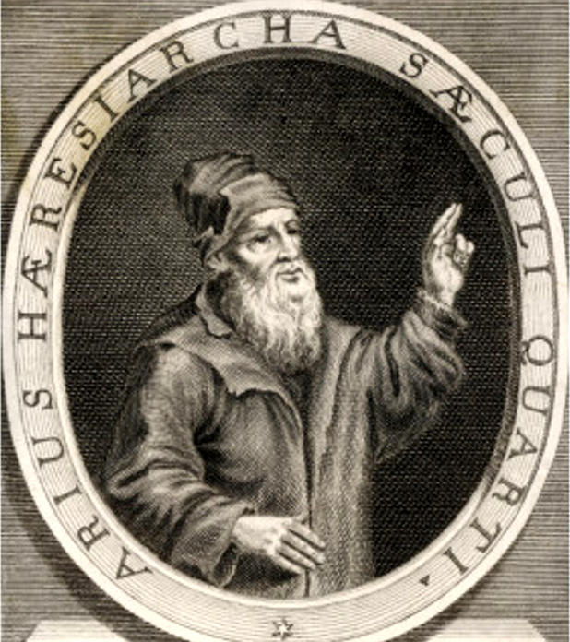
Arius (256-336)

Slide 28
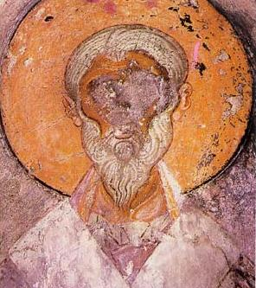
St. Alexander, Bishop of Alexandria (d. 326/28)

Slide 29
Origen Homily 16 on Luke
I want to be a man of the Church. I do not want to be called the name of some founder of a heresy, but by the name of Christ, and to bear that name which is blessed on earth. It is my desire, in deed as in spirit, to be called a Christian.

Slide 30
Origen Homily on Joshua 7.6
If I who seem to be your right hand, and am called presbyter and seem to preach the Word of God, if I do something against the discipline of the Church, then may the whole Church in unanimous resolve, cut me, its right hand, off, and throw me away.

Slide 31
St. Alexander, Bishop of Alexandria (d. 326/28)

Slide 32
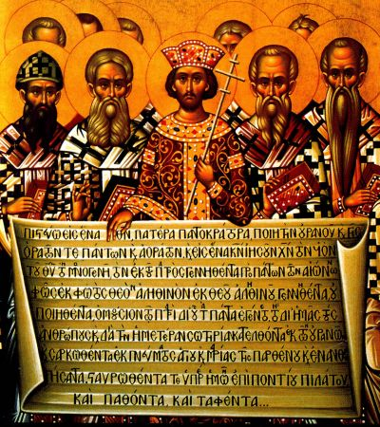
First Ecumenical Council, Nicea, Asia Minor (325)

Slide 33
First Ecumenical Council, Nicea, Asia Minor (325)
And when Abram heard that his brother was taken captive, he armed his trained servants, born in his own house, three hundred and eighteen, and pursued them unto Dan. (Gen. 14:14)

Slide 34
First Ecumenical Council, Nicea, Asia Minor (325)
We believe in One God, the Father Almighty, Maker of all things visible and invisible; and in one Lord Jesus Christ, the Son of God, begotten of the Father, only begotten, that is, from the essence (ousia) of the Father.
God from God, Light from Light, True God from True God, Begotten, not made, of one essence [homoousios] with the Father, by Whom all things were made.
Who for us men and for our salvation cam down and became incarnate, and was made man, suffered and rose on the third day, and ascended into heaven, and shall come again with glory to judge both the living and the dead;
And in the Holy Spirit;
But those who say, There was a point when the Son of God was not, and before He was begotten He was not, and that He came into being from things that are not, or that He is of different hypostasis or essence [ousia], or that he is mutable or alterable — the Universal and Apostolic Church anathematizes.

Slide 35
Saint Constantine
That which has commended itself to the judgement of three hundred bishops cannot be other than the judgement of God; seeing that the Holy Spirit dwelling in the minds of persons of such character and dignity has effectually enlightened then respecting the Divine Will. Wherefore, let no one vacillate or linger, but let all with alacrity return to the undoubted path of truth; that when I shall arrive among you, which will be as soon as possible, I may with you return due thanks to God, the inspector of all things, for having revealed the pure faith, and restored to you that love for which we have prayed.

Slide 36
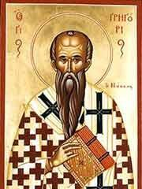
St Gregory the Theologian

Slide 37
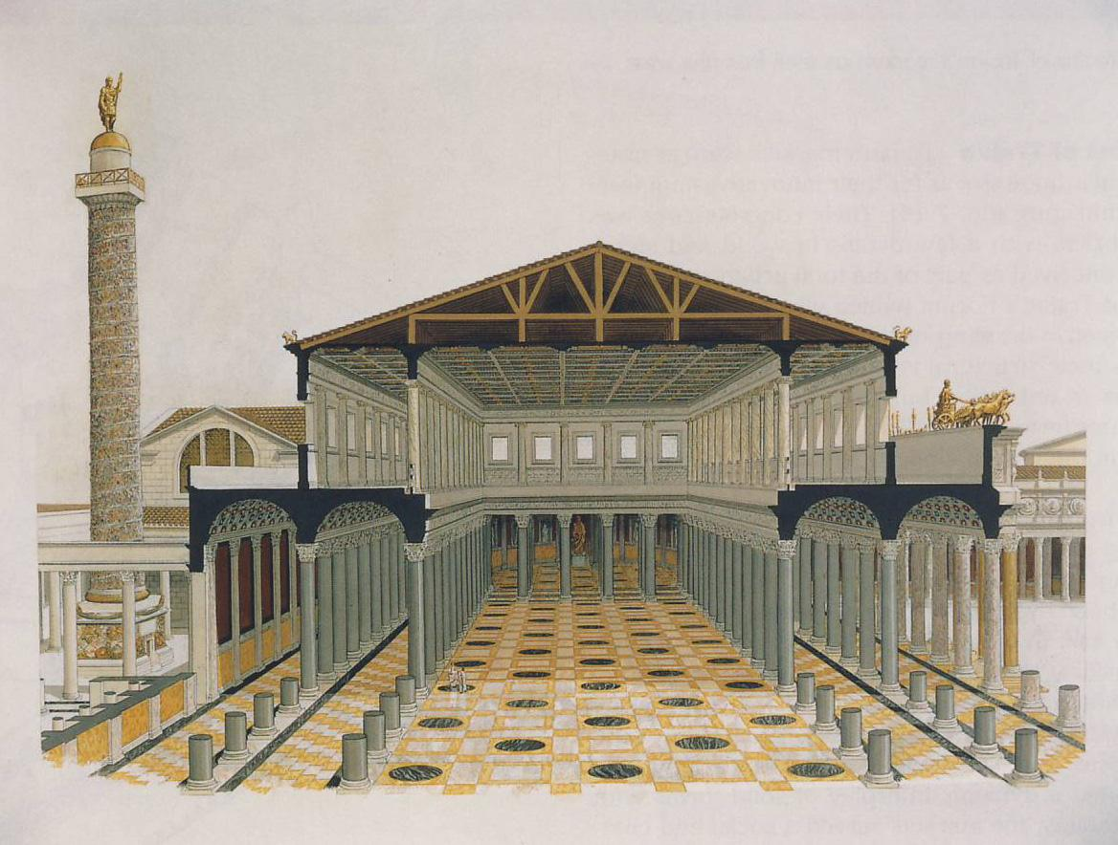
Classical Roman Basilica

Slide 38
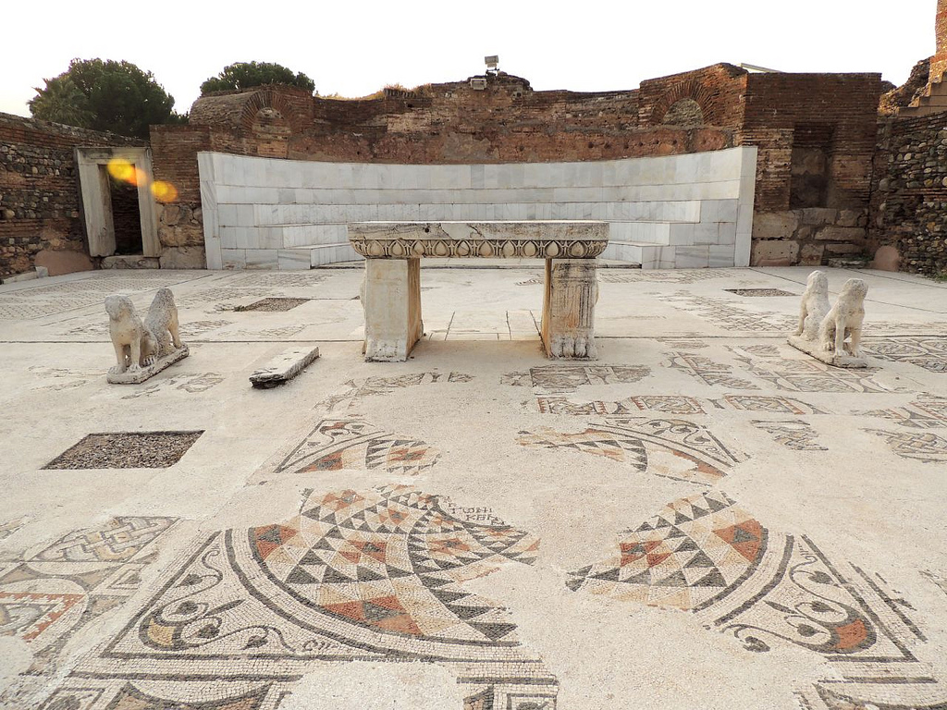
Sardis, Synagogue

Slide 39
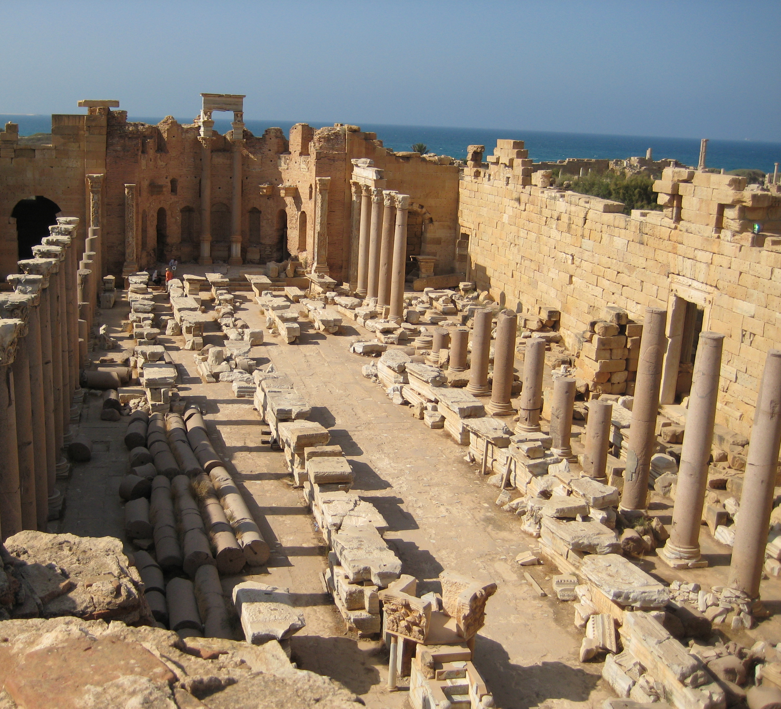
Severan Basilica

Slide 40
Church of the Theotokos, Ephesus

Slide 41
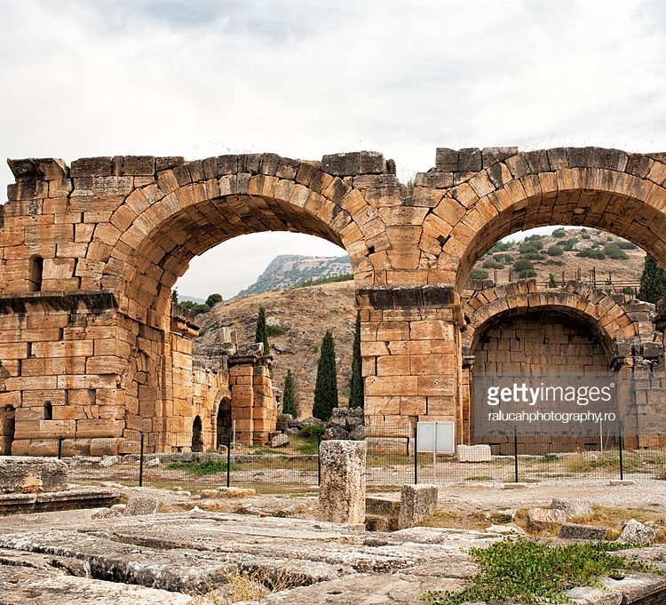
Hieropolis, Asia Minor (Pamukkale, Turkey)

Slide 42
Aphrodisias, Asia Minor

Slide 43
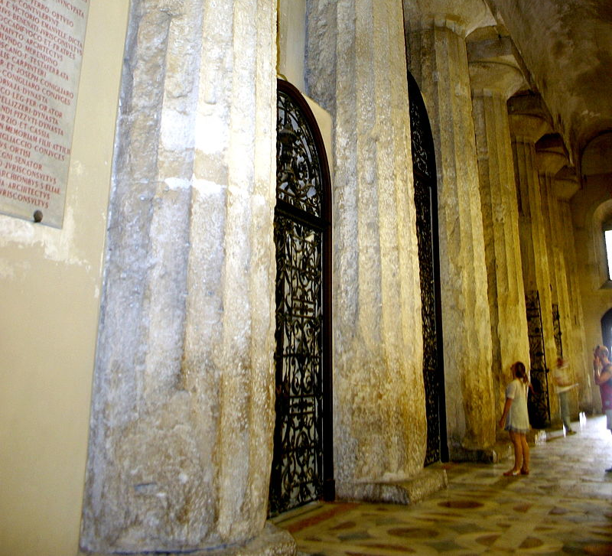
Cathedral Duomo di Siracusa

Slide 44
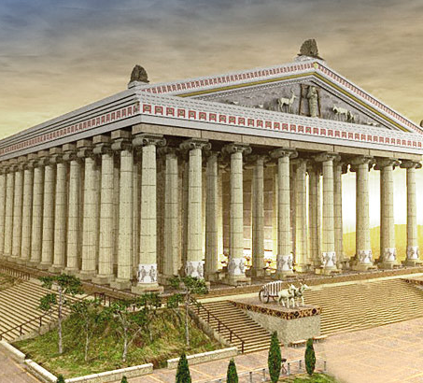
Temple of Artemis at Ephesus

Slide 45
Lee, A.D. (2000) Pagans and Christians in Late Antiquity. Routledge. Pg. 214
“This inscription presents the interesting case history of a bishop in Asia Minor during the fourth century. Significantly, his family background was in the local elite. He spent a period of time in imperial service — most scholars assume in the army, though since militia could mean service in the civilian administration in Late Antiquity, this is an alternative possibility…By this stage he was a Christian…and he duly suffered persecution at the hands of Maximinus Daia’s associates. Subsequently he went to live in the city of Laodicea in Phrygia (his place of origin may have been a village in its territory) where he was appointed bishop. In this capacity he engaged in — and advertised — construction activities analogous to those which his non-Christian forbears might have been expected to do on behalf of their city in times past.”

Slide 46
Monumenta Asiae Minoris Antiqua 1.170
I, Marcus Julius Eugenius, son Cyrillus Celer Kouessa, town councilor (bouleutes), did military service in the office of the governor of Pisidia, and married Flavia Julia Flaviana, the daughter of the senator Gaius Nestorianus. I served with distinction, and during the period when the order was issued by Maximinus [Daia] for the Christians to sacrifice and not be released from the army, I stood firm through very many tortures at the hands of the governor Diogenes. I was eager to be released from the army and defend the faith of the Christians. After spending a short time in the city of the Laodiceans, I was appointed bishop by the will of almighty God, and served with great distinction as bishop for twenty-five whole years. I rebuilt the whole church from its foundations and all the adornments around it — porticos, four-sided porticos, paintings, mosaics, a fountain, a gateway — and I put up all the stone work — in a word, everything. When I was about to depart this human life, I made a tomb and sarcophagus for myself on which I had these words inscribed for the enhancement of the church and of my family.

Slide 47
Peter Brown (b.1935)
Poverty and Leadership in the Later Roman Empire,
(University Press of New England, Hanover, 2002);
Through the Eye of a Needle: Wealth, the Fall of
Rome, and the Making of Christianity in the West,
350-550 AD, (Princeton University Press, Princeton, 2012).
Treasure in Heaven. The Holy Poor in Early Christianity,
(University of Virginia Press, Charlottesville; London, 2016).

Slide 48
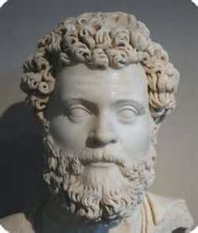
Dio Chrysostom (40-120 AD)

Slide 49
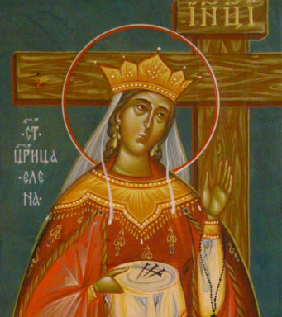
St. Helen (250-330 AD)

Slide 50
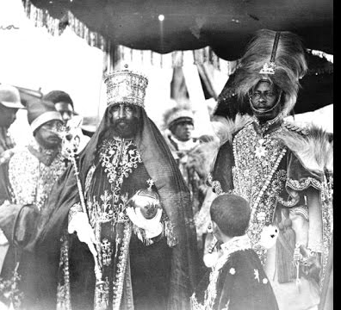
Axum, Ethiopia

Slide 51
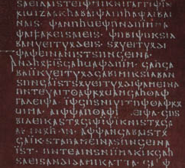
Gothic Script

Slide 52
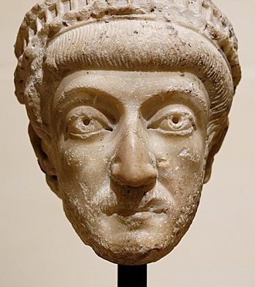
Theodosius II (408-450 AD)

Slide 53
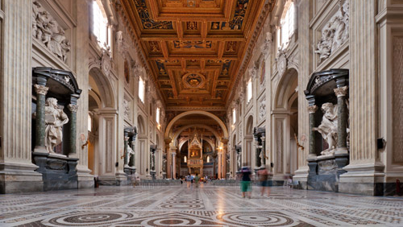
Christian Basilica

Slide 54
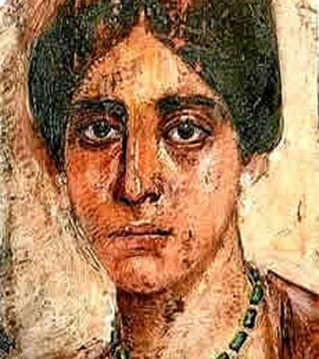
Egeria (wrote early 380s AD)

Slide 55
Arius (256-336)

Slide 56
St. Alexander, Bishop of Alexandria (d. 326/28)

Slide 57
Origen Homily 16 on Luke
I want to be a man of the Church. I do not want to be called the name of some founder of a heresy, but by the name of Christ, and to bear that name which is blessed on earth. It is my desire, in deed as in spirit, to be called a Christian.

Slide 58
Origen Homily on Joshua 7.6
If I who seem to be your right hand, and am called presbyter and seem to preach the Word of God, if I do something against the discipline of the Church, then may the whole Church in unanimous resolve, cut me, its right hand, off, and throw me away.

Slide 59
St. Alexander, Bishop of Alexandria (d. 326/28)

Slide 60
First Ecumenical Council, Nicea, Asia Minor (325)

Slide 61
First Ecumenical Council, Nicea, Asia Minor (325)
And when Abram heard that his brother was taken captive, he armed his trained servants, born in his own house, three hundred and eighteen, and pursued them unto Dan. (Gen. 14:14)

Slide 62
First Ecumenical Council, Nicea, Asia Minor (325)
We believe in One God, the Father Almighty, Maker of all things visible and invisible; and in one Lord Jesus Christ, the Son of God, begotten of the Father, only begotten, that is, from the essence (ousia) of the Father.
God from God, Light from Light, True God from True God, Begotten, not made, of one essence [homoousios] with the Father, by Whom all things were made.
Who for us men and for our salvation cam down and became incarnate, and was made man, suffered and rose on the third day, and ascended into heaven, and shall come again with glory to judge both the living and the dead;
And in the Holy Spirit;
But those who say, There was a point when the Son of God was not, and before He was begotten He was not, and that He came into being from things that are not, or that He is of different hypostasis or essence [ousia], or that he is mutable or alterable — the Universal and Apostolic Church anathematizes.

Slide 63
Saint Constantine
That which has commended itself to the judgement of three hundred bishops cannot be other than the judgement of God; seeing that the Holy Spirit dwelling in the minds of persons of such character and dignity has effectually enlightened then respecting the Divine Will. Wherefore, let no one vacillate or linger, but let all with alacrity return to the undoubted path of truth; that when I shall arrive among you, which will be as soon as possible, I may with you return due thanks to God, the inspector of all things, for having revealed the pure faith, and restored to you that love for which we have prayed.

