Slide 1
Pagans and Christians Lecture Fourteen
Struggle Over Faith and Culture
Emergence of Monasticism
Emperor Theodosius I

Slide 2
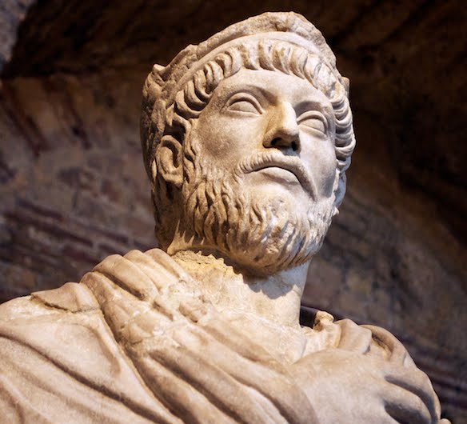
Julian the Apostate (330-363 AD)
O thou mother of gods and of men, who sharest the throne of the great Zeu…O life-giving goddess, who art the wisdom and the providence and the creator of our very souls…grant to all men happiness, and that highest happiness of all which is the knowledge of the gods; and grant to the Roman people that they may cleanse themselves of the stain of impiety.
—Julian, Hymn to Cybele, Mother of the Gods

Slide 3
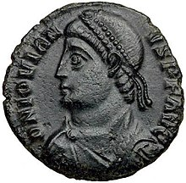
Emperor Jovian (331-364 AD)

Slide 4
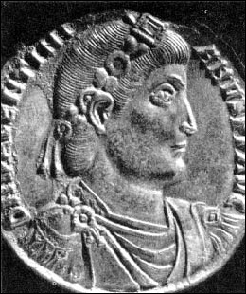
Emperors Valentinian (321-375) & Valens (328-378)

Slide 5
Caesaria, Asia Minor (Kayseri, Turkey)

Slide 6
Emperor Valentinian I (321-375 AD)

Slide 7
Emperor Theodosius I (347-395 AD)

Slide 8
Emperors Valentinian (321-375) & Valens (328-378)

Slide 9
Aphrodisias

Slide 10
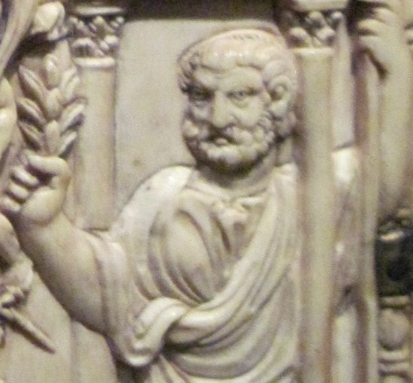
Symmachus (345-402 AD)

Slide 11
Aphrodisias

Slide 12
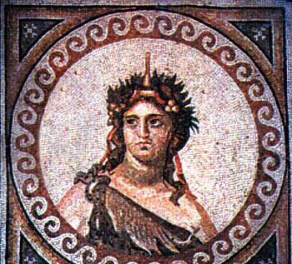
Nonnus (Νόννος ὁ Πανοπολίτης) Late Fourth/Early Fifth Century

Slide 13
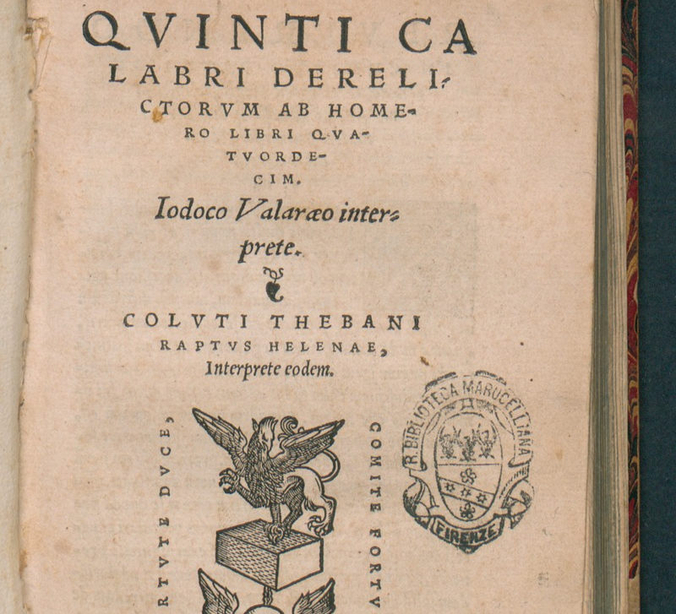
Quintus Smyrnaeus (Κόϊντος Σμυρναῖος)

Slide 14
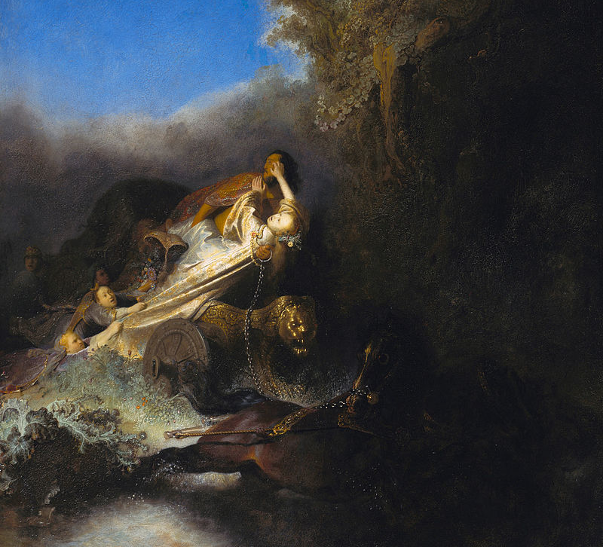
Claudian (370-404 AD)

Slide 15
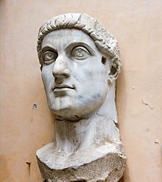
Zosimus (fl. 490s-510 AD)

Slide 16
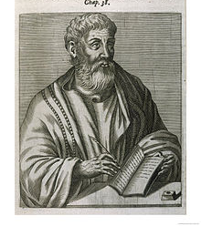
Libanius (314-394 AD)

Slide 17
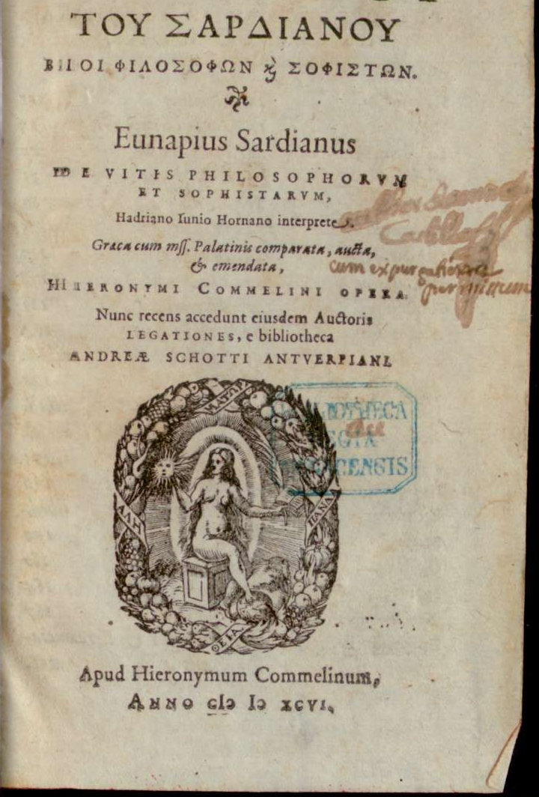
Eunapius (346-410?)

Slide 18
A.D. Lee (2000) Pagans and Christians in Late Antiquity, pg.111
“Although their resolve was weakening , there remained a substantial body of senators who were committed to paganism, as attested by a number of inscriptions.”
In particular, two inscriptions, dating from 376 and 378 AD, respectively, illustrate a distinctive feature of this body of inscriptions compared with earlier periods, namely, the multiple priesthoods and initiations in a wide range of cults of Roman, Greek, and near eastern origin. This distinctive feature has been seen as reflecting the determination of these pagan senators “to stand for the potential unity of the old religion…now that the emperor was a Christian” (G. Fowden [1998] “Polytheist religion and philosophy,” pg. 552, in A. Cameron and P. Garnsey [eds.] The Cambridge Ancient History, vol. 13: The Late Empire AD 337-425, Cambridge)

Slide 19
CIL 6.510 (= ILS 4152)
To the great gods, to the mother of the gods [Cybele] and to Attis, Sextilius Agesilaus Aedesius — a man of senatorial tank, a not undistinguished legal advocate in the African courts and in the imperial council, also magister libellorum et cognitionum sacrarum, magister epistularum, magister memoriae [all senior legal posts at the imperial court], deputy of the [praetorian] prefects in the Spanish provinces with responsibility for imperial appeals, father of fathers of the invincible sun god Mithras, priest (hierofanta) of Hecate, chief priest (archibucolus) of the god Liber ([Bacchus] — dedicated this altar after being reborn into eternity (renatus in aeternum) through the sacrifice of a bull (taurobolium) and the sacrifice of a ram (criobolium), when our lord Valens was consul for the fifth time, and our lord the younger Valentinian [II] for the first, on the Ides of August.

Slide 20
CIL 6.1779 (= ILS 1259)
“To the eternal shades. Vettius Praetextatus [was] augur, priest of Vesta, priest of the Sun, member of the Board of Fifteen, curial priest of Hercules, consecrated to Liber [Baccus] and in the Eleusinian mysteries, priest (hierophanta) [of Hecate], temple warden (neocorus) [of Serapis], initiated with bull’s blood (tauroboliatus) father of fathers [in the cult of Mithras] . In political affairs, [he was] imperial candidate for quaestor, urban praetor, governor of Tuscia and Umbria [in Italy], governor of Lusitania [in Spain], governor of Achaea [in Greece, 362-4], prefect of the city [of Rome], an envoy sent by the senate on five occasions, praetorian prefect of Italy and Illyricum twice, consul designate [for 385]. Also Aconia Fabia Paulina, a lady of senatorial rank, consecrated to Ceres and in the Eleusinian mysteries, consecrated at Aegina to Hecate, initiated with bull’s blood (tauroboliata), priestess (hierophantia) [of Hecate]. These [two] lived together in unity for forty years.”

Slide 21
Emperor Theodosius I (347-395 AD)

Slide 22
Emperor Jovian (331-364 AD)

Slide 23
Emperors Valentinian (321-375) & Valens (328-378)

Slide 24
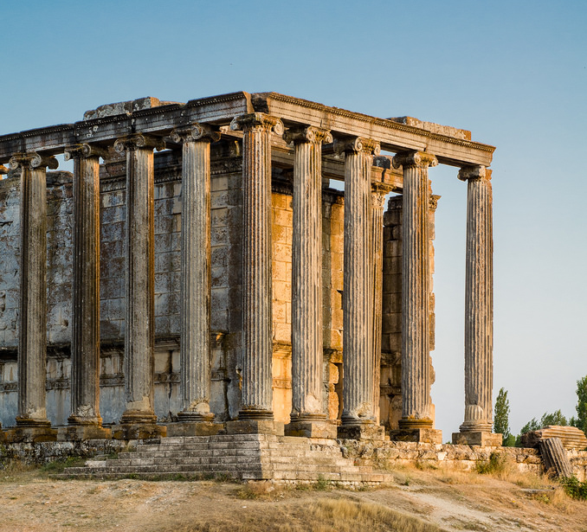
Aezanis, Asia Minor (Çavdarhisar, Turkey)

Slide 26
St. Athanasius (296-373 AD)

Slide 27
Emperors Valentinian (321-375) & Valens (328-378)

Slide 28
Cappadocia, Asia Minor

Slide 29
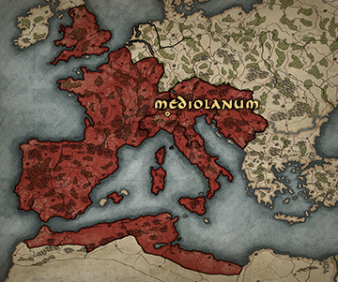
Mediolanum (Milan, Italy)

Slide 30
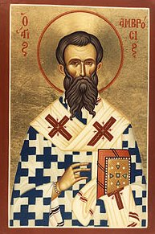
Saint Ambrose of Milan (337-397)

Slide 31
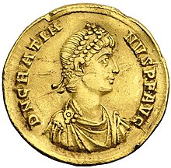
Emperor Gratian

Slide 32
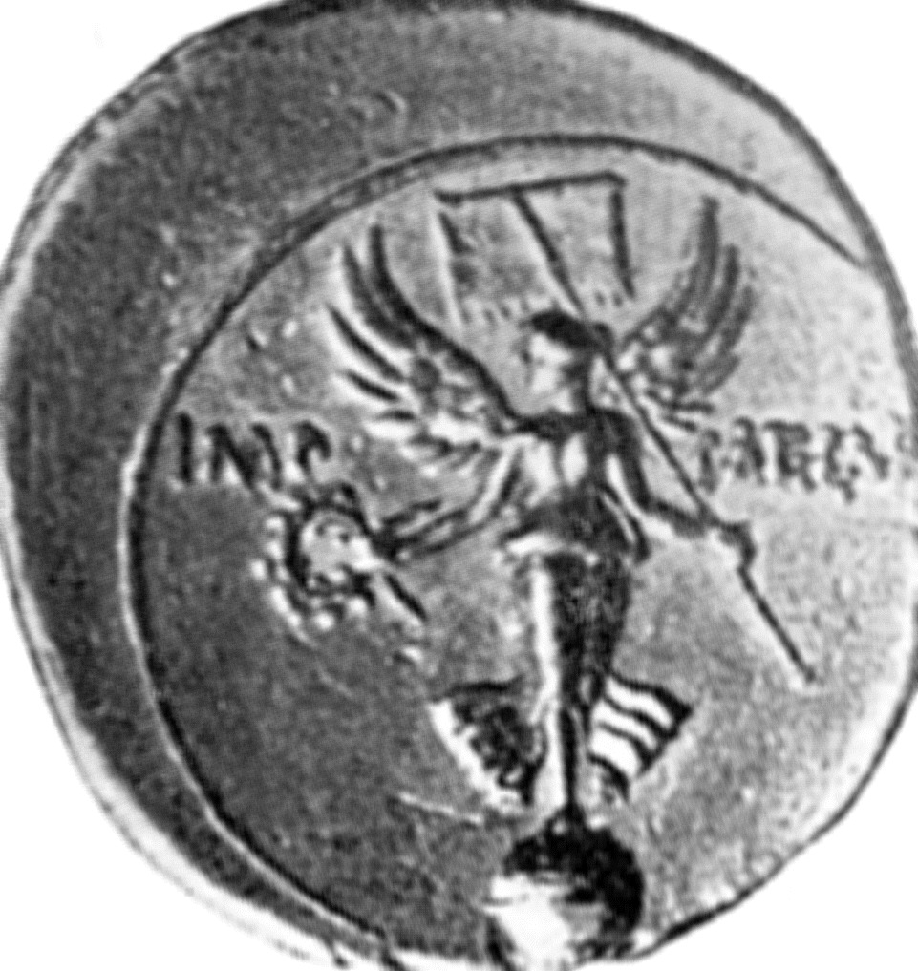
The Altar of Victory
This substantial body of senators committed to paganism became focused in their contentions in the early 380s around a particular symbol: the altar of Victory in the senate house.
Placed in the senate house by Augustus after the battle of Actium in 31 BC, offerings were made it at the start of senatorial sessions ever afterwards.
Constantius removed it from the senate house in 357, but it was soon reinstated, presumably by Julian.
Gratian then removed it once more in 382, and attempts by pagan senators to induce first Gratian, and then his brother and successor Valentinian II (ruled 383-392), to restore it (and by implication, state subsidies for traditional rites) proved vain.

Slide 33
Symmachus (345-402 AD)

Slide 34
Saint Ambrose of Milan (337-397)
When pagan senators tried to approach the emperor Gratian about its restoration to the senate house in 382, their delegation was prevented from presenting its request to the emperor, due to the intervention of Saint Ambrose, bishop of Milan. After Gratian’s death in 383, they decided to try again by approaching the emperor now responsible for the western half of the empire, Valentinian II, then aged only 13.

Slide 35
Symmachus (345-402 AD)
This is the occasion for Symmachus’ Memorandum 3, which owes its bureaucratic title to the the fact that Symmachus was then prefect of Rome (in which capacity he submitted a whole series of memoranda to the emperor on a variety of matters).

Slide 36
Symmachus Memorandum 3.3-4
3. We demand then the restoration of that condition of religious affairs which was so long advantageous to the state. Let the rulers of each sect and of each opinion be counted up; a late one practised the ceremonies of his ancestors, a later did not put them away. If the religion of old times does not make a precedent, let the connivance of the last do so.
4. Who is so friendly with the barbarians as not to require an Altar of Victory? We will be careful henceforth, and avoid a show of such things. But at least let that honour be paid to the name which is refused to the goddess — your fame, which will last for ever, owes much and will owe still more to victory. Let those be averse to this power, whom it has never benefited. Do you refuse to desert a patronage which is friendly to your triumphs? That power is wished for by all, let no one deny that what he acknowledges is to be desired should also be venerated.

Slide 37
Symmachus Memorandum 3.5-6
5. But even if the avoidance of such an omen were not sufficient, it would at least have been seemly to abstain from injuring the ornaments of the Senate House. Allow us, we beseech you, as old men to leave to posterity what we received as boys. The love of custom is great. Justly did the act of the divine Constantius last but for a short time. All precedents ought to be avoided by you, which you know were soon abolished. We are anxious for the permanence of your glory and your name, that the time to come may find nothing which needs correction.
6. Where shall we swear to obey your laws and commands? By what religious sanction shall the false mind be terrified, so as not to lie in bearing witness? All things are indeed filled with God, and no place is safe for the perjured, but to be urged in the very presence of religious forms has great power in producing a fear of sinning. That altar preserves the concord of all, that altar appeals to the good faith of each, and nothing gives more authority to our decrees than that the whole of our order issues every decree as it were under the sanction of an oath. So that a place will be opened to perjury, and this will be determined by my illustrious Princes, whose honour is defended by a public oath.

Slide 38
Symmachus Memorandum 3.7-8
7. But the divine Constantius is said to have done the same. Let us rather imitate the other actions of that Prince, who would have undertaken nothing of the kind, if any one else had committed such an error before him. For the fall of the earlier sets his successor right, and amendment results from the censure of a previous example. It was pardonable for your Grace's ancestor in so novel a matter to fail in guarding against blame. Can the same excuse avail us if we imitate what we know to have been disapproved?
8. Will your Majesties listen to other actions of this same Prince, which you may more worthily imitate? He diminished none of the privileges of the sacred virgins, he filled the priestly offices with nobles, he did not refuse the cost of the Roman ceremonies, and following the rejoicing Senate through all the streets of the eternal city, he contentedly beheld the shrines with unmoved countenance, he read the names of the gods inscribed on the pediments, he enquired about the origin of the temples, and expressed admiration for their builders. Although he himself followed another religion, he maintained its own for the empire, for everyone has his own customs, everyone his own rites. The divine Mind has distributed different guardians and different cults to different cities. As souls are separately given to infants as they are born, so to peoples the genius of their destiny. Here comes in the proof from advantage, which most of all vouches to man for the gods. For, since our reason is wholly clouded, whence does the knowledge of the gods more rightly come to us, than from the memory and evidence of prosperity? Now if a long period gives authority to religious customs, we ought to keep faith with so many centuries, and to follow our ancestors, as they happily followed theirs.

Slide 39
Symmachus Memorandum 3.9-10
9. Let us now suppose that Rome is present and addresses you in these words: Excellent princes, fathers of your country, respect my years to which pious rites have brought me. Let me use the ancestral ceremonies, for I do not repent of them. Let me live after my own fashion, for I am free. This worship subdued the world to my laws, these sacred rites repelled Hannibal from the walls, and the Senones from the capitol. Have I been reserved for this, that in my old age I should be blamed? I will consider what it is thought should be set in order, but tardy and discreditable is the reformation of old age.
10. We ask, then, for peace for the gods of our fathers and of our country. It is just that all worship should be considered as one. We look on the same stars, the sky is common, the same world surrounds us. What difference does it make by what pains each seeks the truth? We cannot attain to so great a secret by one road; but this discussion is rather for persons at ease, we offer now prayers, not conflict.

Slide 40
Saint Ambrose of Milan (337-397)
When Saint Ambrose’s court contacts alerted him to the general import of Symmachus’ memorandum, he promptly wrote to the emperor presenting general arguments against acceding to Symmachus’ request and asking that he be sent a copy of the memorandu so that he could respond to Symmachus’ arguments point by point.

Slide 41
Saint Ambrose of Milan, Letter 17.3-4
3. Since, then, most Christian Emperor, there is due from you to the true God both faith and zeal, care and devotion for the faith, I wonder how the hope has risen up to some, that you would feel it a duty to restore by your command altars to the gods of the heathen, and furnish the funds requisite for profane sacrifices; for whatsoever has long been claimed by either the imperial or the city treasury you will seem to give rather from your own funds, than to be restoring what is theirs.
4. And they are complaining of their losses, who never spared our blood, who destroyed the very buildings of the churches. And they petition you to grant them privileges, who by the last Julian law denied us the common right of speaking and teaching, and those privileges whereby Christians also have often been deceived; for by those privileges they endeavoured to ensnare some, partly through inadvertence, partly in order to escape the burden of public requirements; and, because all are not found to be brave, even under Christian princes, many have lapsed.

Slide 42
Saint Ambrose of Milan, Letter 17.10
10. But this cannot be decreed without sacrilege, wherefore I implore you not to decree or order it, nor to subscribe to any decrees of that sort. I, as a priest of Christ, call upon your faith, all of us bishops would have joined in calling upon you, were not the report so sudden and incredible, that any such thing had been either suggested in your council, or petitioned for by the Senate. But far be it from the Senate to have petitioned this, a few heathen are making use of the common name. For, nearly two years ago, when the same attempt was being made, holy Damasus, Bishop of the Roman Church, elected by the judgment of God, sent to me a memorial, which the Christian senators in great numbers put forth, protesting that they had given no such authority, that they did not agree with such requests of the heathen, nor give consent to them, and they declared publicly and privately that they would not come to the Senate, if any such thing were decreed. Is it agreeable to the dignity of your, that is Christian, times, that Christian senators should be deprived of their dignity, in order that effect should be given to the profane will of the heathen? This memorial I sent to your Clemency's brother, and from it was plain that the Senate had made no order about the expenses of superstition.

Slide 43
Saint Ambrose of Milan, Letter 17.13
13. If it were a civil cause the right of reply would be reserved for the opposing party; it is a religious cause, and I the bishop make a claim. Let a copy of the memorial which has been sent be given me, that I may answer more fully, and then let your Clemency's father be consulted on the whole subject, and vouchsafe an answer. Certainly if anything else is decreed, we bishops cannot contentedly suffer it and take no notice; you indeed may come to the church, but will find either no priest there, or one who will resist you.

Slide 44
Saint Ambrose of Milan, Letter 17.14-15
14. What will you answer a priest who says to you, The church does not seek your gifts, but you have adorned the heathen temples with gifts. The Altar of Christ rejects your gifts, because you have made an altar for idols, for the voice is yours, the hand is yours, the subscription is yours, the deed is yours. The Lord Jesus refuses and rejects your service, because you have served idols, for He said to you: 'You cannot serve two masters.' The Virgins consecrated to God have no privileges from you, and do the Vestal Virgins claim them? Why do you ask for the priests of God, to whom you have preferred the profane petitions of the heathen? We cannot take up a share of the errors of others.
15. What will you answer to these words? That you who have fallen are but a boy? Every age is perfect in Christ, every age is full of God. No childhood is allowed in faith, for even children have confessed Christ against their persecutors with fearless mouth.

Slide 45
Saint Ambrose of Milan, Letter 17.17
17. Wherefore, O Emperor, since you see that if you decree anything of that kind, injury will be done, first to God, and then to your father and brother, I implore you to do that which you know will be profitable to your salvation before God.

Slide 46
Saint Ambrose of Milan,
Having received a copy of Symmachus’ memorandum, Saint Ambrose responded with Letter 18.

Slide 47
Saint Ambrose of Milan, Letter 18, 3-4
3. The illustrious Prefect of the city has in his Memorial set forth three propositions which he considers of force: that Rome, as he says, asks for her rites again, that pay be given to her priests and Vestal Virgins, and that a general famine followed upon the refusal of the priests' stipends.
4. In his first proposition Rome complains with sad and tearful words, asking, as he says, for the restoration of the rites of her ancient ceremonies. These sacred rites, he says, repulsed Hannibal from the walls, and the Senones from the Capitol. And so at the same time that the power of the sacred rites is proclaimed, their weakness is betrayed. So that Hannibal long insulted the Roman rites, and while the gods were fighting against him, arrived a conqueror at the very walls of the city. Why did they suffer themselves to be besieged, for whom their gods were fighting in arms?

Slide 48
Saint Ambrose of Milan, Letter 18, 5-6
5. And why should I say anything of the Senones, whose entrance into the inmost Capitol the remnant of the Romans could not have prevented, had not a goose by its frightened cackling betrayed them? See what sort of protectors the Roman temples have. Where was Jupiter at that time? Was he speaking in the goose?
6. But why should I deny that their sacred rites fought for the Romans? For Hannibal also worshipped the same gods. Let them choose then which they will. If these sacred rites conquered in the Romans, then they were overcome in the Carthaginians; if they triumphed in the Carthaginians, they certainly did not benefit the Romans.

Slide 49
Saint Ambrose of Milan, Letter 18, 7
7. Let, then, that invidious complaint of the Roman people come to an end. Rome has given no such charge. She speaks with other words. Why do you daily stain me with the useless blood of the harmless herd? Trophies of victory depend not on the entrails of the flocks, but on the strength of those who fight. I subdued the world by a different discipline. Camillus was my soldier, who slew those who had taken the Tarpeian rock, and brought back the standards taken from the Capitol; valour laid those low whom religion had not driven off. What shall I say of Attilius [Regulus], who gave the service of his death?

Slide 50
Saint Ambrose of Milan, Letter 18, 7
Africanus found his triumphs not among the altars of the Capitol, but among the lines of Hannibal. Why do you bring forward the rites of our ancestors? I hate the rites of Neros. Why should I speak of the Emperors of two months, and the ends of rulers closely joined to their commencements. Or is it perchance a new thing for the barbarians to cross their boundaries? Were they, too, Christians in whose wretched and unprecedented cases, the one, a captive Emperor, and, under the other, the captive world made manifest that their rites which promised victory were false. Was there then no Altar of Victory?

Slide 51
Saint Ambrose of Milan, Letter 18, 7
I mourn over my downfall, my old age is tinged with that shameful bloodshed. I do not blush to be converted with the whole world in my old age. It is undoubtedly true that no age is too late to learn. Let that old age blush which cannot amend itself. Not the old age of years is worthy of praise but that of character. There is no shame in passing to better things. This alone was common to me with the barbarians, that of old I knew not God. Your sacrifice is a rite of being sprinkled with the blood of beasts. Why do you seek the voice of God in dead animals? Come and learn on earth the heavenly warfare; we live here, but our warfare is there. Let God Himself, Who made me, teach me the mystery of heaven, not man, who knew not himself. Whom rather than God should I believe concerning God? How can I believe you, who confess that you know not what you worship?

Slide 52
Saint Ambrose of Milan, Letter 18, 8
8. By one road, says he, one cannot attain to so great a secret. What you know not, that we know by the voice of God. And what you seek by fancies, we have found out from the very Wisdom and Truth of God. Your ways, therefore, do not agree with ours. You implore peace for your gods from the Emperors, we ask for peace for the Emperors themselves from Christ. You worship the works of your own hands, we think it an offense that anything which can be made should be esteemed God. God wills not that He should be worshipped in stones. And, in fine, your philosophers themselves have ridiculed these things.

Slide 53
Magnus Maximus

Slide 54
Emperor Theodosius I (347-395 AD)

Slide 55
Libanius (314-394 AD)

Slide 57
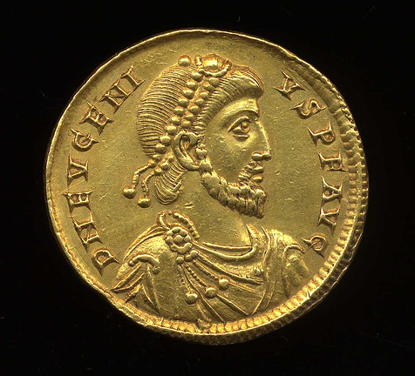
Emperor Eugenius

Slide 58
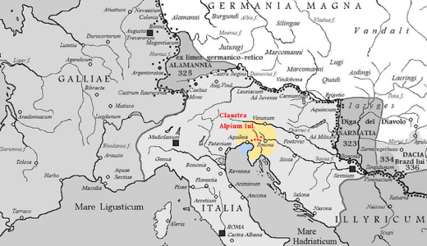

Slide 59
Emperor Theodosius I (347-395 AD)

Slide 60
Saint Ambrose of Milan (337-397)

Slide 61
Saint Ambrose of Milan (337-397)
Now the shrill cock proclaims the day,
And calls the sun’s awakening ray,
The wandering pilgrim’s guiding light,
That marks the watches night by night.
Roused at the note, the morning star
Heaven’s dusky veil uplifts afar:
Night’s vagrant bands no longer roam,
But from their dark ways hie them home
The encouraged sailor’s fears are o’er,
The foaming billows rage no more:

Slide 62
Saint Ambrose of Milan (337-397)
Lo! E’en the very Church’s Rock
Melts at the crowing of the cock.
O let us then like men arise;
The cock rebukes our slumbering eyes,
Bestirs who still in sleep would lie,
And shames who would their Lord deny.
—Aeterne rerum Conditor

Slide 63
Saint Ambrose of Milan (337-397)
If you demand my person, I am ready to submit: carry me to prison or to death, I will not resist; but I will never betray the Church of Christ. I will not call upon the people to protect me; I will die at the foot of the altar rather than desert it.
—Letter 20 to Marcellina

Slide 64
Saint Ambrose of Milan (337-397)
What has been done at Thessalonica is unparalleled in the memory of man…You are human, and temptation has overtaken you. Overcome it, I counsel, I beseech you, I implore you to penance. You, who have so often been merciful and pardoned the guilty, have now caused many innocent to perish. The devil wished to wrest from you the crown of piety which was your chiefest glory. Drive him from you while you can…I write this to you with my own hand that you also may read it alone.
—Letter to Emperor Theodosius

Slide 65
Saint Ambrose of Milan (337-397)
He stripped himself of every sign of royalty and bewailed his sin openly in church. He, an emperor, was not ashamed to do the public penance which lesser individuals shrink from, and to the end of his life he never ceased to grieve for his error.
—St. Ambrose funeral oration in honor of Emperor Theodosius

