Slide 1
Pagans and Christians Lecture Fifteen
Saint Augustine and the City of God

Slide 2
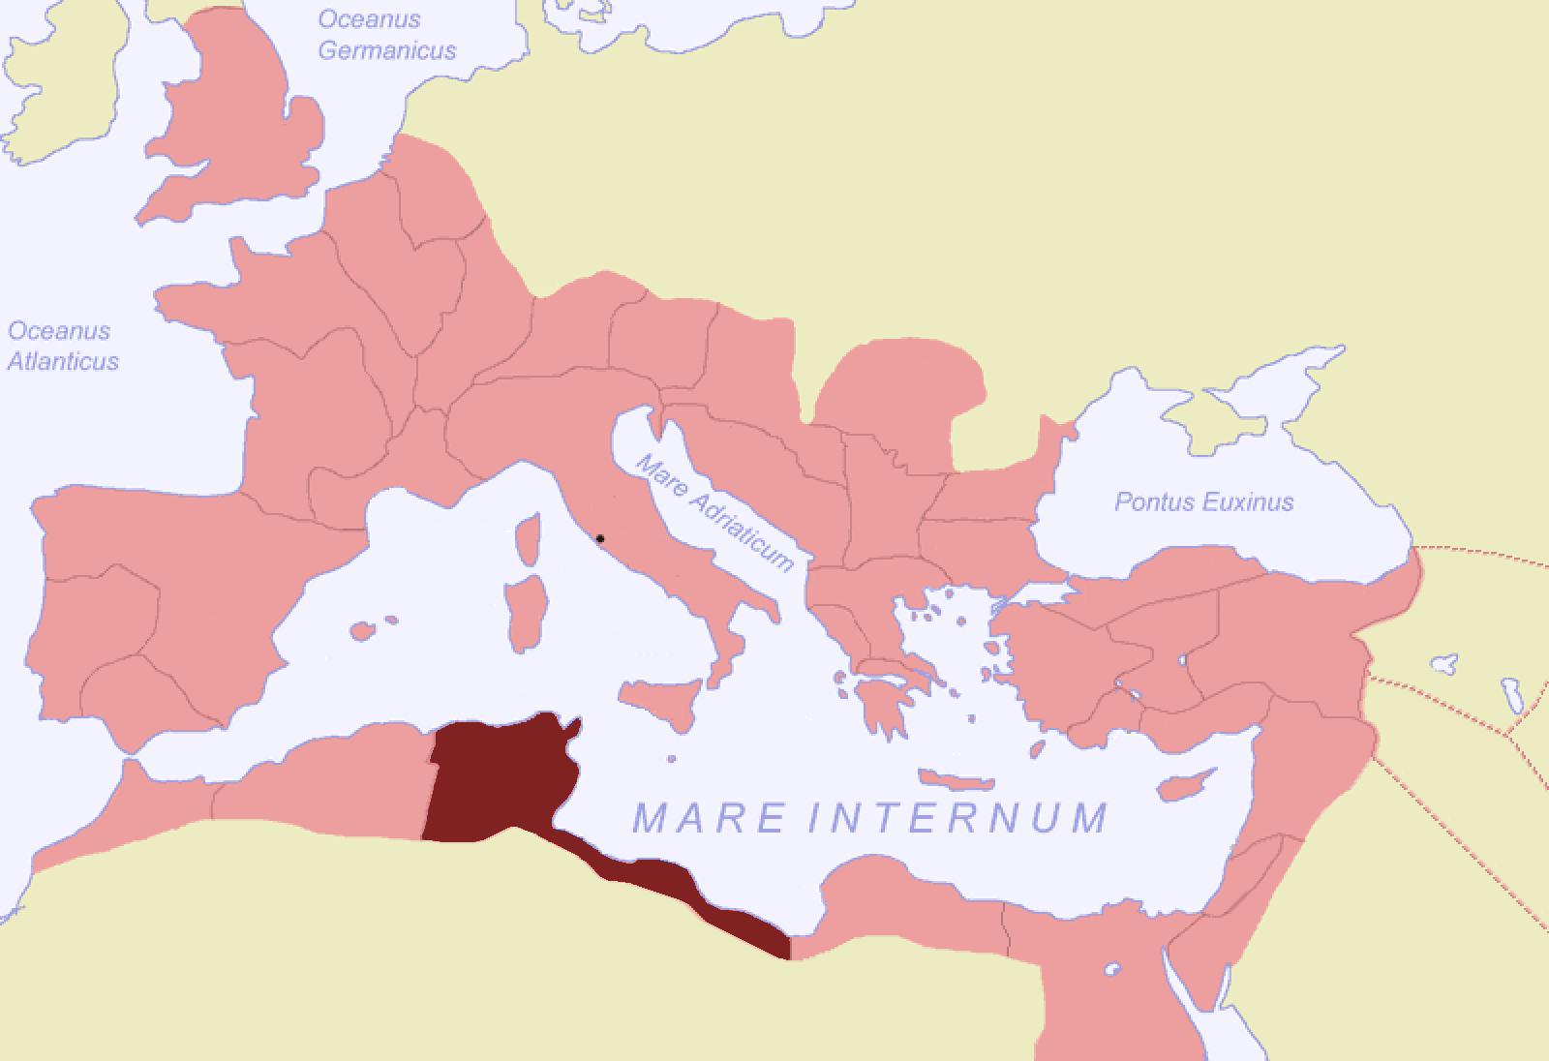
Roman North Africa

Slide 3
Thagaste (Algeria)

Slide 4
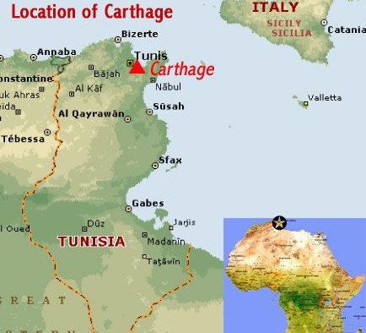
Confessions 3.1.1
“I came to Carthage and all around me hissed a cauldron of illicit loves.”
veni Carthaginem, et circumstrepebat me undique sartago flagitiosorum amorum.

Slide 5
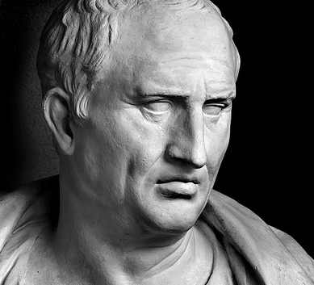
Marcus Tullius Cicero (106-43 BC)

Slide 6
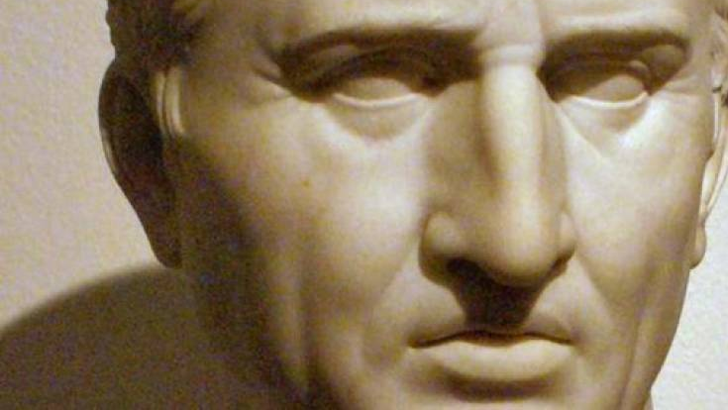

Slide 7
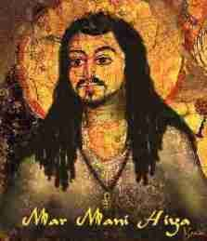
Manicheism

Slide 8
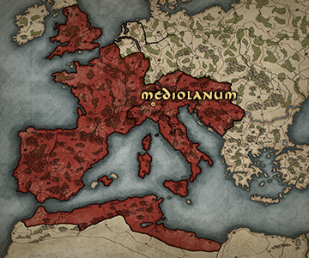
Mediolanum (Milan, Italy)

Slide 9
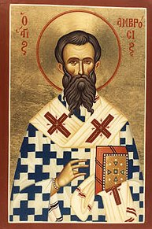
Saint Ambrose of Milan (337-397)

Slide 10
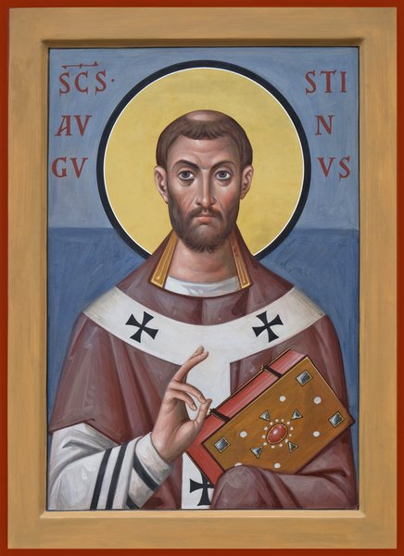
Confessions 5.14.23
“By his eloquent sermons in those days he zealously provided your people with the fat of your wheat, the gladness of your oil, and the sobering intoxication of your wine. All unknowing, I was led to him by You, so that through him I might be led, while fully knowing it, to you. That man of God received me in fatherly fashion, and as an exemplary bishop he welcomed my pilgrimage. I began to love him, at first not as a teacher of the truth, which I utterly despaired of finding of finding in Your Church, but as a man who was kindly disposed towards me. I listened carefully to him as he preached to the people, not with the intention I should have had, but to try out his eloquence, as it were, and to see whether it came up to its reputation.”

Slide 11
2 Corinthians 3:6
The letter killeth, but the Spirit giveth life.

Slide 12
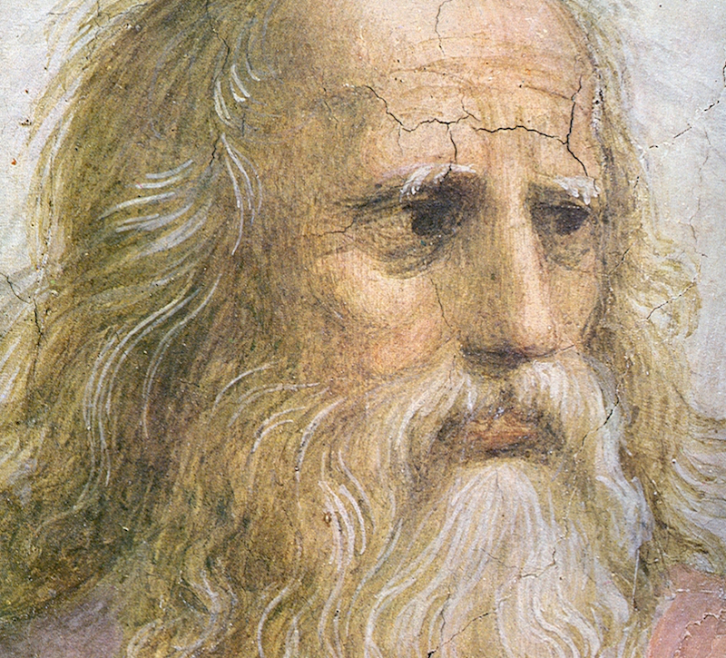
Plato (427-347 BC)

Slide 13
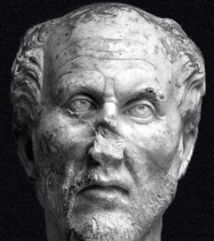
Plotinus (204—270 AD)

Slide 14
Confessions 8.7.17
I was a very unhappy young man, wretched as at the beginning of my adolescence itself when I had prayed to You for chastity, and had said: “Grant me chastity and continence, but not yet!”
at ego adulescens miser valde, miser in exordio ipsius adulescentiae, etiam petieram a te castitatem et dixeram, 'da mihi castitatem et continentiam, sed noli modo.'

Slide 15
Confessions 8.9.21
“What is wrong with us?...Uneducated people are rising up and capturing heaven [Matthew 11:12], and we with our high culture without any heart — see where we roll in the mud of flesh and blood.”
exclamo, 'quid patimur? quid est hoc? quid audisti? surgunt indocti et caelum rapiunt, et nos cum doctrinis nostris sine corde, ecce ubi volutamur in carne et sanguine!

Slide 17
Romans 13:13-14
Let us walk honestly, as in the day; not in rioting and drunkenness, not in chambering and wantonness, not in strife and envying.
But put ye on the Lord Jesus Christ, and make not provision for the flesh, to fulfil the lusts thereof.

Slide 18
Confessions 8.12.29
It was as if a light of relief from all anxiety flooded into my heart.
nec ultra volui legere nec opus erat. statim quippe cum fine huiusce sententiae quasi luce securitatis infusa cordi meo omnes dubitationis tenebrae diffugerunt.

Slide 19
Confessions 8.12.29
It was as if a light of relief from all anxiety flooded into my heart.
nec ultra volui legere nec opus erat. statim quippe cum fine huiusce sententiae quasi luce securitatis infusa cordi meo omnes dubitationis tenebrae diffugerunt.

Slide 20
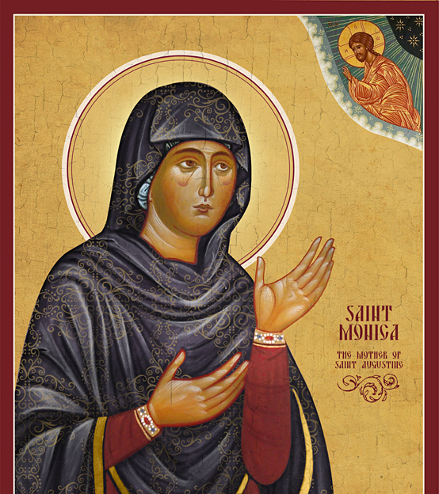
Confessions 5.9.16
I cannot speak enough of the love she had for me. She suffered greater pains in my spiritual birth than when she bore me in the flesh.
non enim satis eloquor quid erga me habebat animi, et quanto maiore sollicitudine me parturiebat spiritu quam carne pepererat.

Slide 21
Hippo Regius, North Africa

Slide 22
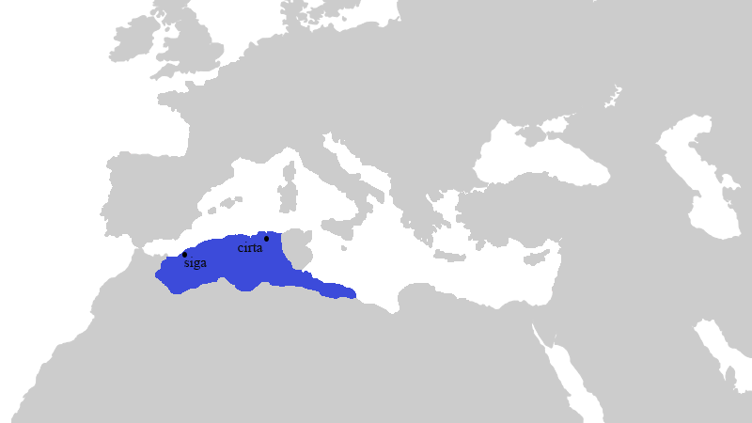
Possidius, Vita Augustini 22.6-7
Whoever thinks that he is able,
To nibble at the life of absent friends,
Must know that he is unworthy of this table.

Slide 23
Confessions 10.27.38
Late have I loved you, O Beauty never ancient, ever new, late have I loved you! You were with me, but I was outside, and it was there that I searched for You. In my unloveliness, I plunged into the lovely things which You created. You were with me, but I was not with You. Created things kept me from you; yet if they had not been in You they would not have been at all. You called, You shouted, and You broke through my deafness. You flashed, You shone, and You dispelled my blindness. You breathed Your fragrance on me; I drew in breath and now I pant for You. I have tasted You, now I hunger and thirst for more. You touched me, and I burned for Your peace.
sero te amavi, pulchritudo tam antiqua et tam nova, sero te amavi! et ecce intus eras et ego foris, et ibi te quaerebam, et in ista formosa quae fecisti deformis inruebam. mecum eras, et tecum non eram. ea me tenebant longe a te, quae si in te non essent, non essent. vocasti et clamasti et rupisti surditatem meam; coruscasti, splenduisti et fugasti caecitatem meam; fragrasti, et duxi spiritum et anhelo tibi; gustavi et esurio et sitio; tetigisti me, et exarsi in pacem tuam.

Slide 25
Exposition on the Psalms 95.11
The clouds roll with thunder, that the House of the Lord shall be built throughout the earth; and these frogs sit in their marsh and croak — “we are the only Christians!”

Slide 27
On Nature and Grace 30.34
It is the easiest thing in the world to change your will by an act of the will.
—Pelagius

Slide 28
Saint Ambrose of Milan (337-397)

Slide 30
“…the manner in which the hidden ways of God had caused the most reasonable policies to miscarry” Peter Brown (2000) Augustine of Hippo, 427-428.

Slide 31
Vergil Aeneid I.278-279.
I set no limits, space or time,
but make the gift of empire with end.
His ego nec metas rerum nec tempora pono; imperium sine fine dedi.

Slide 32
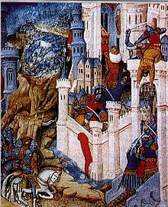
Sack of Rome August 24, 410 AD

Slide 33
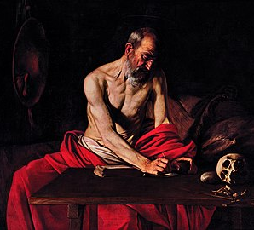
St. Jerome (347-420 AD) Letter 127.12
…a dreadful rumour came from the West. Rome had been besieged and its citizens had been forced to buy their lives with gold. Then thus despoiled they had been besieged again so as to lose not their substance only but their lives. My voice sticks in my throat; and, as I dictate, sobs choke my utterance. The City which had taken the whole world was itself taken; nay more famine was beforehand with the sword and but few citizens were left to be made captives. In their frenzy the starving people had recourse to hideous food; and tore each other limb from limb that they might have flesh to eat. Even the mother did not spare the babe at her breast. In the night was Moab taken, in the night did her wall fall down. (Isaiah 15:1) O God, the heathen have come into your inheritance; your holy temple have they defiled; they have made Jerusalem an orchard. The dead bodies of your servants have they given to be meat unto the fowls of the heaven, the flesh of your saints unto the beasts of the earth. Their blood have they shed like water round about Jerusalem; and there was none to bury them.

Slide 36
De Civitate Dei The City of God

Slide 37
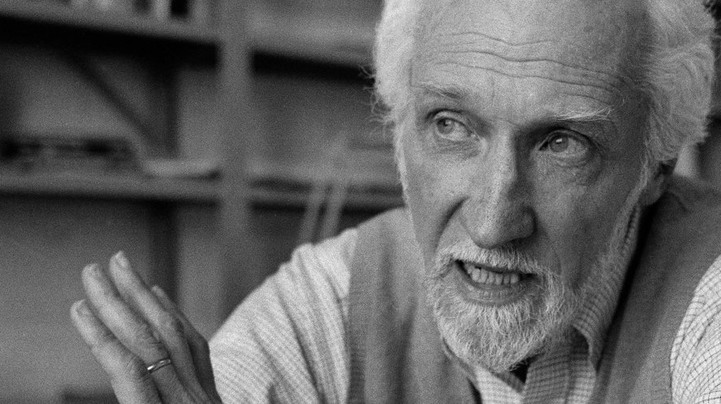
Sheldon Wolin (2016) Politics and Vision: Continuity and Innovation in Western Political Thought, pg. 87.
“The significance of Christian thought for the western political tradition lies not so much in what it had to say about the political order, but primarily in what it had to say about the religious order. The attempt of Christians to understand their own group life provided a new and sorely needed source of idea for Western political thought. Christianity succeeded where the Hellenistic and late classical philosophies had failed, because it forward a new and powerful idea of community which recalled men [and women] to a life of meaningful participation.”

Slide 38
St. Augustine initially cites three passages from the Psalms
“Glorious things are spoken of you, O city of God.” (Psalm 87:3)
“Great is the Lord and greatly to be praised in the city of our God.”
(Psalm 48:1)
There is a river whose streams make glad the city of God, the holy habitation of the Most High. God is in the midst of her, she shall not be moved.”
(Psalm 46:4-5)

Slide 39
Marcus Tullius Cicero (106-43 BC)
A state is a “community of people associated by a common sense of law and common interest.”
De Republica

Slide 40
The City of God XIX.12
Anyone who joins me in an examination, however slight, of human affairs, and the human nature we all share, recognizes that just as there is no man who does not wish for joy, so there is no man who does not wish for peace.
Quod mecum quisquis res humanas naturamque communem utcumque intuetur agnoscit; sicut enim nemo est qui gaudere nolit, ita nemo est qui pacem habere nolit.

Slide 41
The City of God
Now a man’s house ought to be the beginning, or rather a small component part of the city, and every beginning is directed to some end of its own kind, and every component part contributes to the completeness of the whole of which it forms a part. The implication is quite apparent, that domestic peace contributes to the peace of the city — that is, the ordered harmonyof those who live together in a house in the matter of giving and obeying orders, contributes to the ordered harmony concerning authority and obedience obtaining among the citizens.

Slide 42
1 Corinthians 4:5
[The Lord] will both bring to light the hidden things of darkness, and will make manifest the counsels of the hearts.

Slide 43
The City of God
The attitudes and movements of the body, when they are graceful and harmonious, are reckoned among the primary gifts of nature. But what if some illness makes the limbs shake and tremble? What if a man’s spine is so curved as to bring his hands to the ground, turning the man into a virtual quadruped? Will not this destroy all beauty and grace of body whether in repose or in motion?

Slide 44
The City of God
In view of the darkness that attends the life of hu m an society, will our wise man take his seat on the judge’s bench, or will he lack the heart to do so?
He will sit. For the claims of human society constrain him, and draw him to this duty; and it is unthinkable to him that he should shirk it.

Slide 45
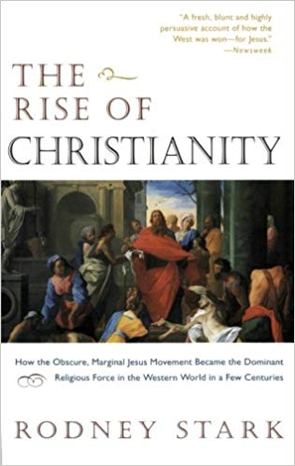
Rodney Stark, The Rise of Christianity (199)7

Slide 46
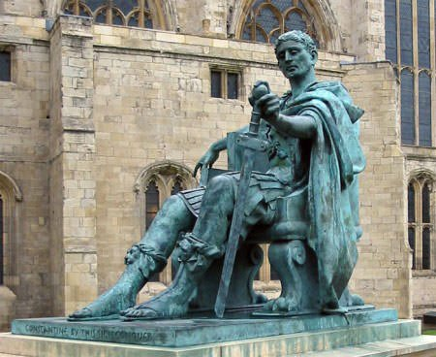
Emperor Constantine (272-337 AD)

Slide 47
The City of God
[This is the reason] for the power of the king, the power of the sword exercised by a judge, the talon of the executioner, the weapons of the soldier, the discipline of a lord, and the firmness of a good father. All these have their their methods, their causes, their reasons, their usefulness. While these are feared, the wicked are kept within their bonds and the good live more peacefully among the wicked.

Slide 48
The City of God
[The City of God] neither annuls nor abolishes [the institutions of the society in which she lives] provided no obstacles are put in the way of the form of devotion that teaches the one supreme God is to be worshipped.

Slide 49
Marcus Tullius Cicero (106-43 BC)
A state is a “community of people associated by a common sense of law and common interest.”
De Republica

Slide 50
The City of God
The same God whose prophets foretold the events we now see happening. He is the God from whom Abraham received the message, ‘In your descendants all nations will be blessed.’ And this promise was fulfilled in Christ, who sprang from that line by physical descent.

Slide 51
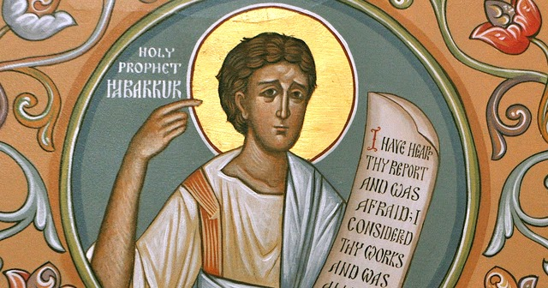
Habbakuk 2:4
The just man shall live by faith.
Iustus vivit ex fide.

Slide 52
The City of God
A people is the association of a multitude of rational beings united by a common agreement on the objects of their love.

Slide 53
Matthew 6:21
Where your treasure is, there will your heart be also.

Slide 54
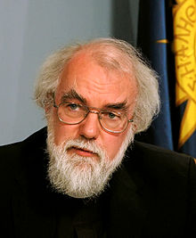
Rowan Williams
The City of God is a book about the “optimal form of corporate human life” in light of its “last end.”

Slide 55
The lust for domination
Libido dominandi

Slide 56
The City of God
The reward of virtue will be God Himself, who gave the virtue, together with the promise of Himself, the best and greatest of all possible promises. For what did he mean when he said, in the words of the prophet, “I shall be their God, and they will be my people”? Did He not mean, “I shall be the source of their satisfaction; I shall be everything that men can honorably desire; life, health, food, wealth, glory, honor, peace and every blessing”? For that is also the correct interpretation of the Apostle’s words, “so that God may be all in all.” [God] will be the goal of all our longings; and we shall see Him for ever; we shall love him without satiety; we shall praise Him without wearying. This will be the duty, the delight, the activity of all, shared by all who share the life of eternity.

Slide 57
The City of God
It is we ourselves — we, His City — who are His best, His most glorious sacrifice. The mystic symbol for this sacrifice we celebrate in our oblations familiar to the faithfull…It follows that justice is found where God, the one supreme God, rules an obedient City according to His grace, forbidding sacrifice to any being save Himself alone…Where this justice does not exist, there is certainly no “association of men united by a common sense of right and by a community of interest.” Therefore, there is no commonwealth, for where there is no “people,” there is no “weal of the people.”

Slide 58
Roman North Africa

Slide 59
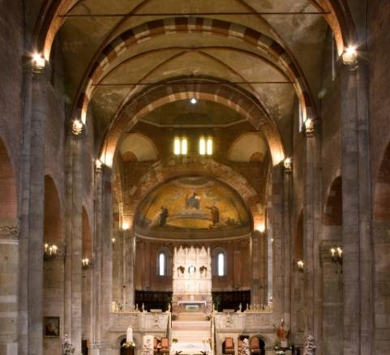
Basilica of San Pietro, Ciel d’Oro

Slide 60
Romulus Augustulus, the last Roman Emperor in the West — Deposed 476 AD

Slide 61
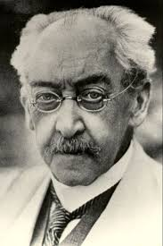
Adolf von Harnack (1851-1930)
“The history of church doctrine in the West is a much-disguised struggle against Augustinianism.”

Slide 62
Decretum Gratiani

