Slide 1
Pagans and Christians Lecture Eight
Imperial Recovery Under the Tetrarchs
The Great Persecutions
The rise to power and Conversion of Emperor Constantine the great

Slide 2
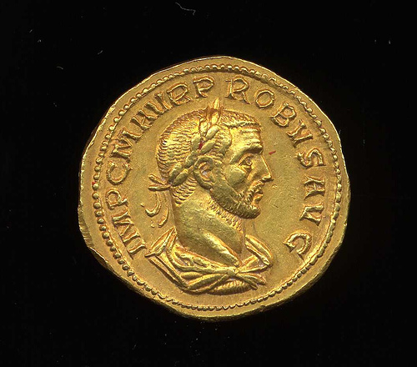
Probus (232-282 AD)

Slide 3
Diocletian (244 – 311 AD)

Slide 4
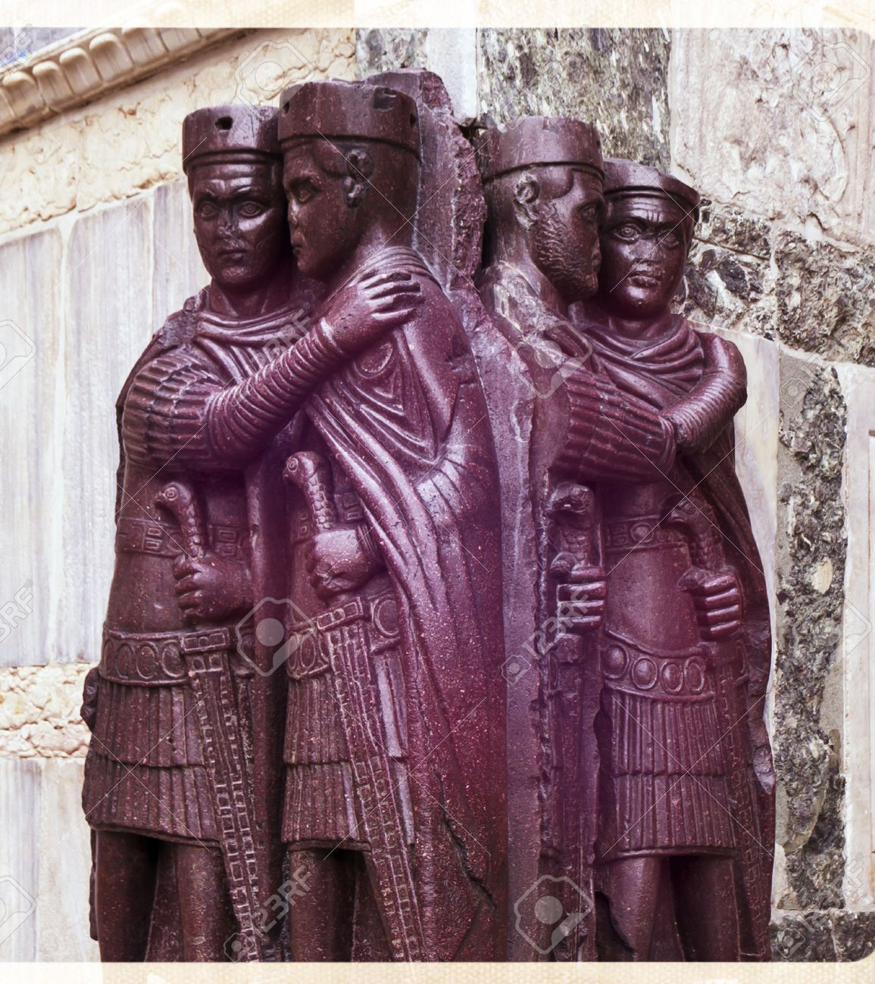
Tetrarchy

Slide 5
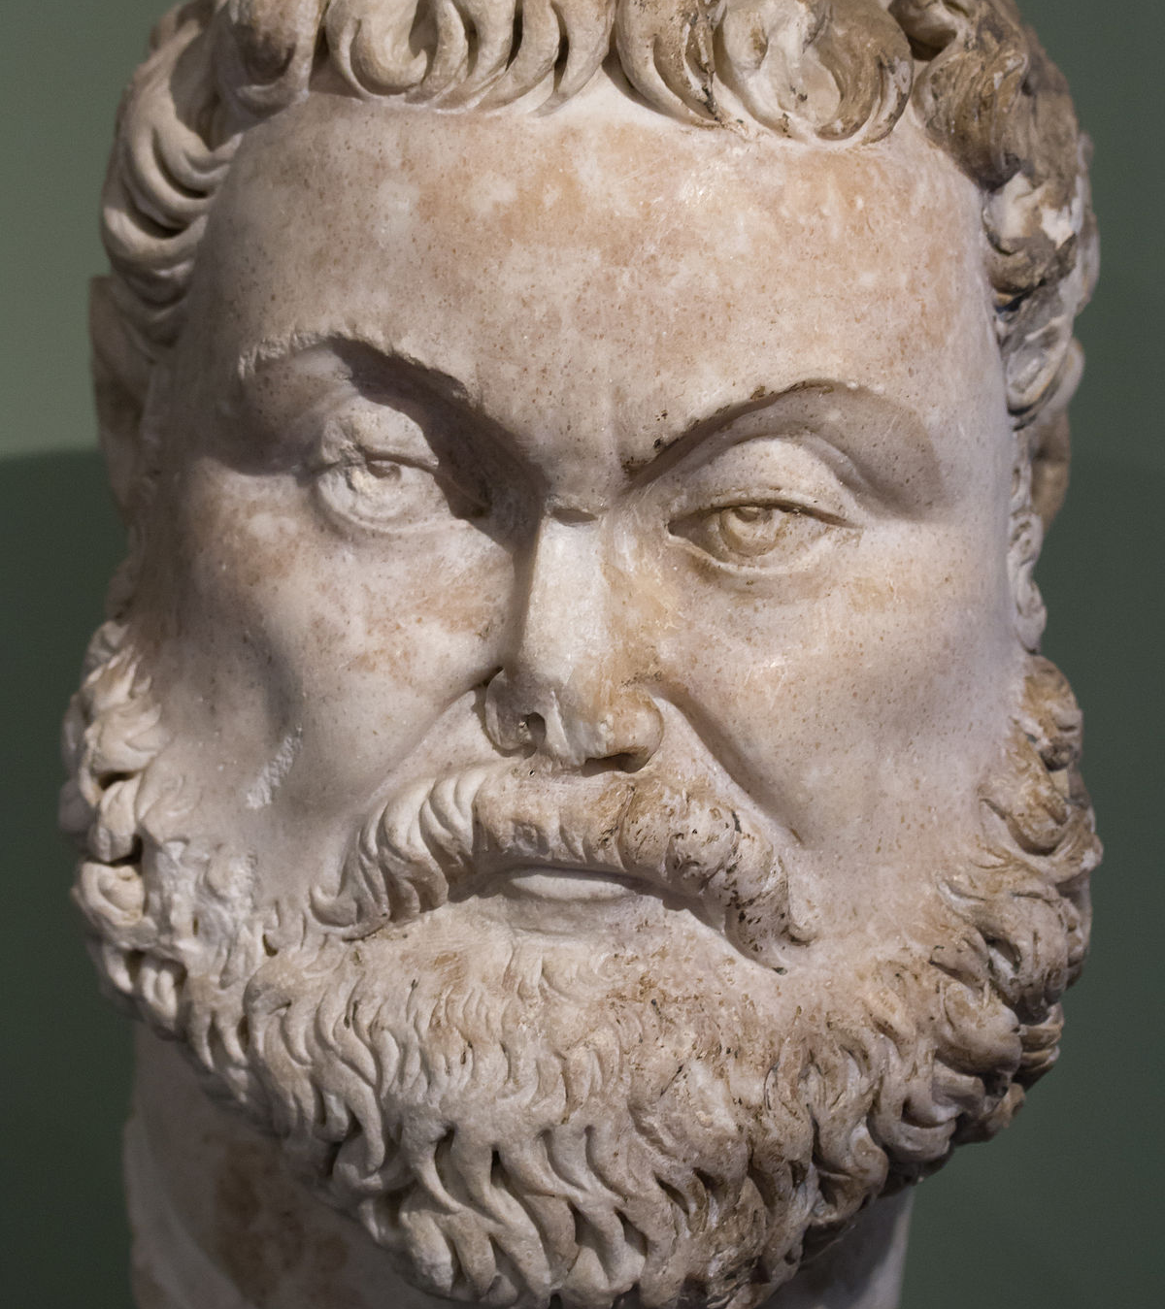
Maximianus (250—310 AD)

Slide 6
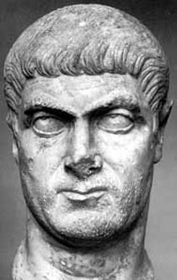
Galerius (260—311 AD)

Slide 7
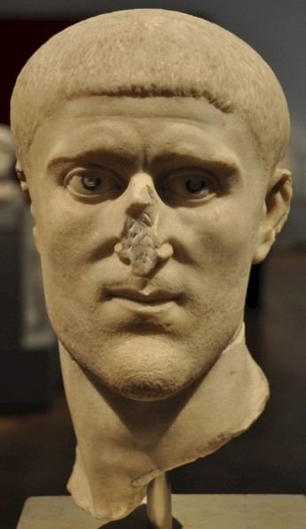
Constantius Chlorus (d. 306)

Slide 8
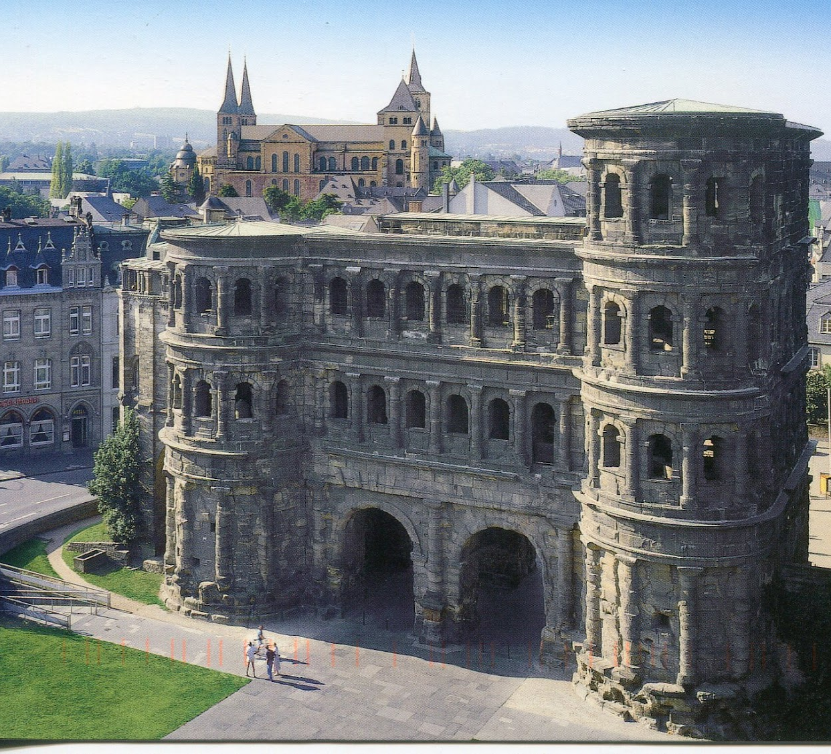
Treveri (Trier, Germany)

Slide 9
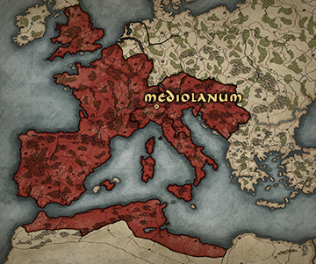
Mediolanum (Milan, Italy)

Slide 10
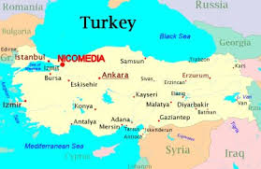
Nicomedia (Izmit, Turkey)

Slide 11
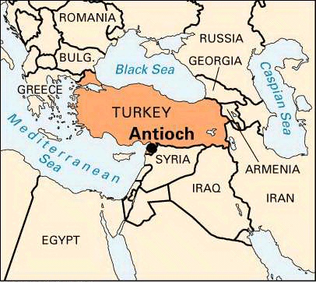
Antioch (Antakya, Turkey)

Slide 12
Tetrarchy

Slide 13
Maximianus (250—310 AD)

Slide 14
Galerius & Constantius Chlorus

Slide 15
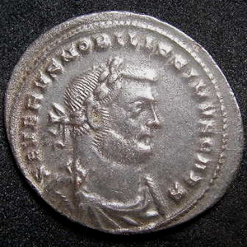
Severus (d. 307 AD)

Slide 16
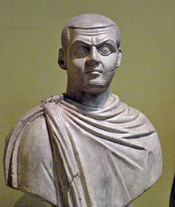
Maximinus Daia (270-313 AD)

Slide 17
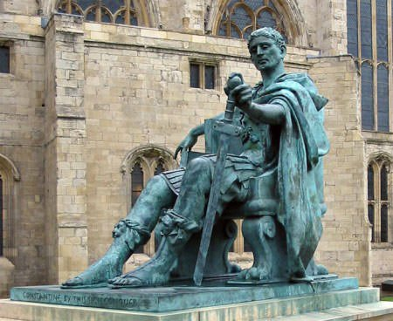
Emperor Constantine (272-337 AD)

Slide 18
Diocletian (244 – 311 AD)

Slide 19
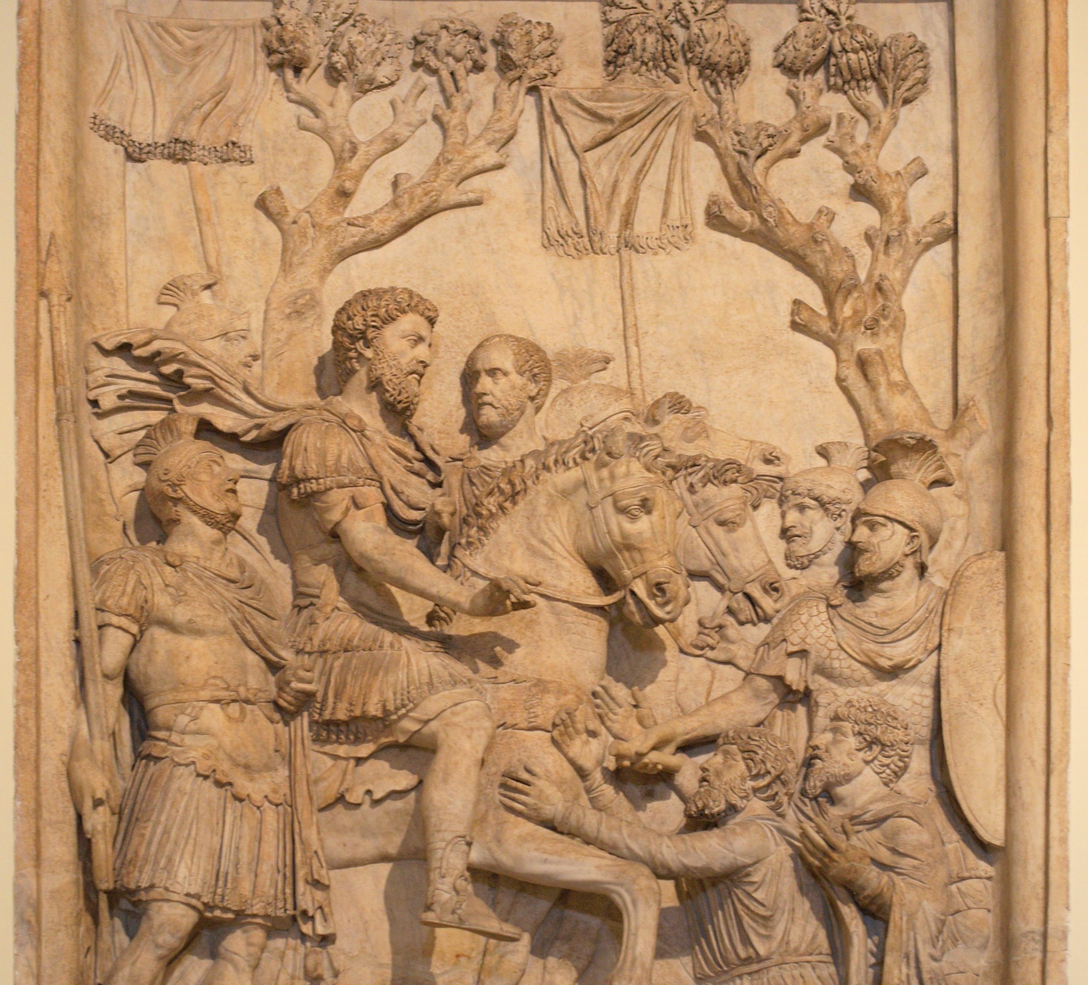
Marcus Aurelius (121-180 AD)

Slide 20
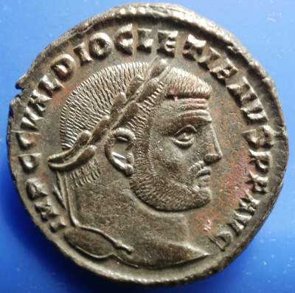
Diocletian

Slide 21
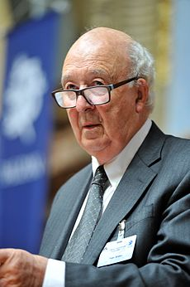
Peter Brown (b.1935)

Slide 22
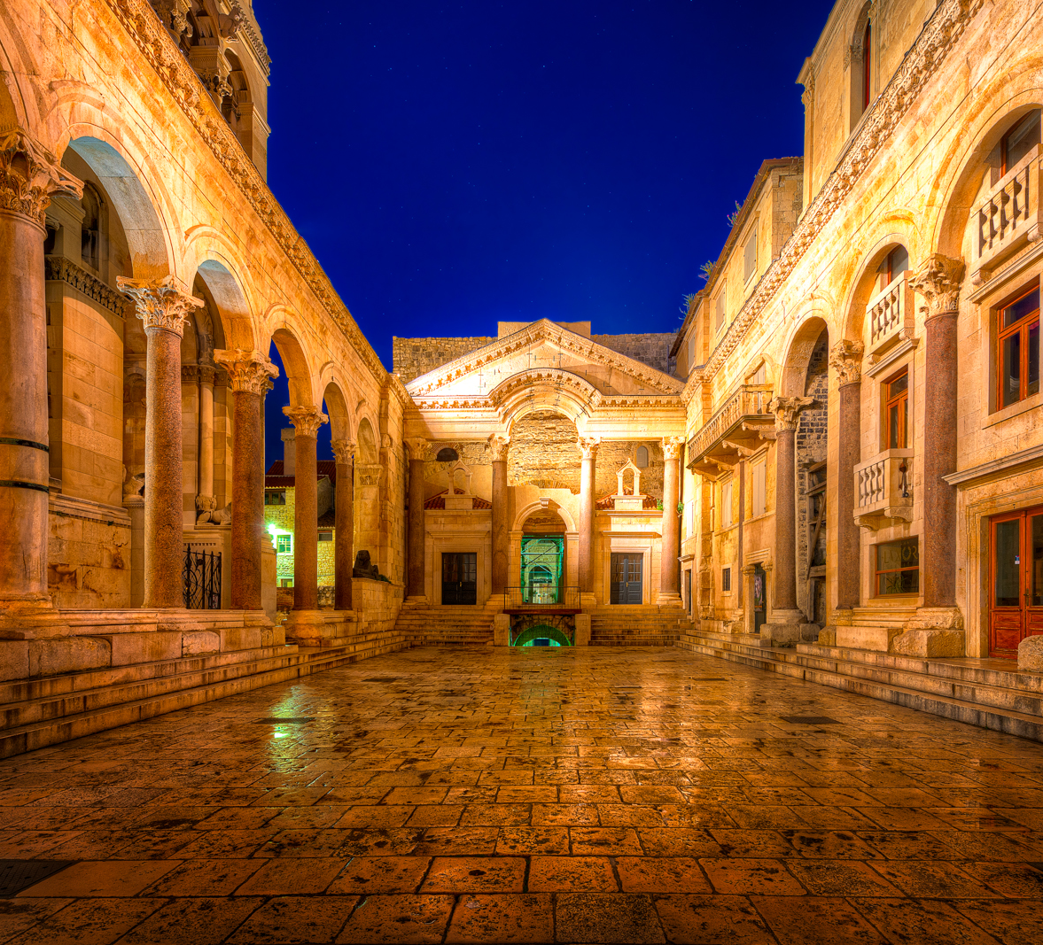
Split, Croatia

Slide 23
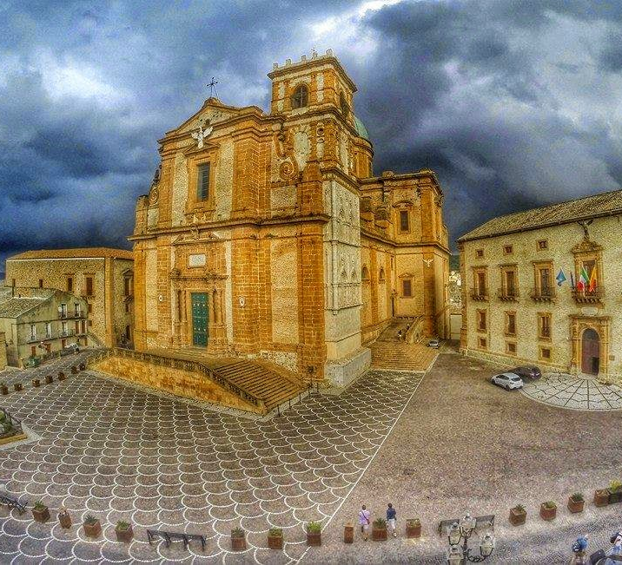
Piazza, Armerina

Slide 24
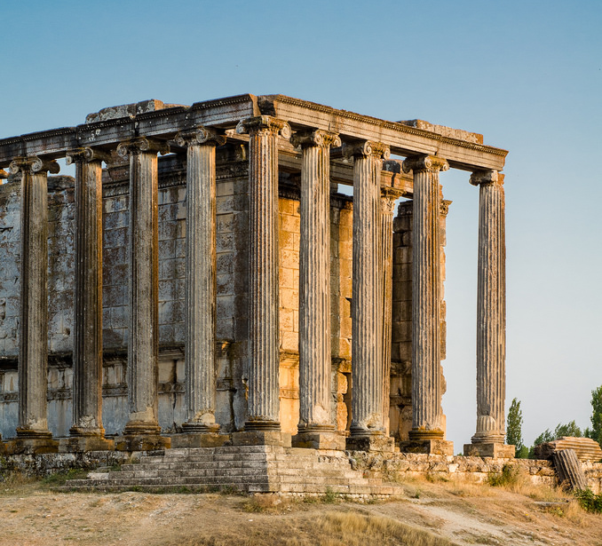
Aezanis, Asia Minor (Çavdarhisar, Turkey)

Slide 25
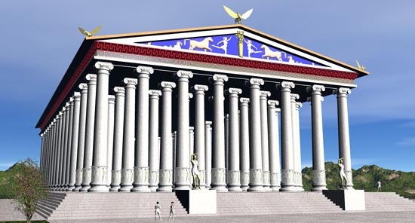
Artemis at Ephesus

Slide 26
Lactantius De Mortibus Persecutorum 10
Cum ageret in partibus Orientis, ut erat pro timore scrutator rerum futurarum, immolabat pecudes et in iecoribus earum ventura quaerebat. Tum quidem ministrorum scientes dominum cum adsisterent immolanti, imposuerunt frontibus suis inmortale signum; quo facto fugatis daemonibus sacra turbata sunt. Trepidabant aruspices nec solitas in extis notas videbant et, quasi non litassent, saepius immolabant.
Diocletian, as being of a timorous disposition, was a searcher into futurity, and during his abode in the East he began to slay victims, that from their livers he might obtain a prognostic of events; and while he sacrificed, some attendants of his, who were Christians, stood by, and they put the immortal sign on their foreheads. At this the demons were chased away, and the holy rites interrupted. The soothsayers trembled, unable to investigate the wonted marks on the entrails of the victims. They frequently repeated the sacrifices, as if the former had been unpropitious; but the victims, slain from time to time, afforded no tokens for divination.

Slide 27
Lactantius De Mortibus Persecutorum 10
Verum identidem mactatae hostiae nihil ostendebant, donec magister ille aruspicum Tagis seu suspicione seu visu ait idcirco non respondere sacra, quod rebus divinis profani homines interessent.Tunc ira furens sacrificare non eos tantum qui sacris ministrabant, sed universos qui erant in palatio iussit et in eos, si detrectassent, verberibus animadverti, datisque ad praepositos litteris, etiam milites cogi ad nefanda sacrificia praecepit, ut qui non paruissent, militia solverentur.
At length Tages, the chief of the soothsayers, either from guess or from his own observation, said, “there are profane persons here who obstruct the rites.” Then Diocletian in furious passion ordered not only all who were assisting at the holy ceremonies, but also all who resided within the palace, to sacrifice, and, in case of their refusal, to be scourged. And further, by letters to the commanding officers, he enjoined that all soldiers should be forced to the like impiety, under pain of being dismissed the service.

Slide 28
Lactantius De Mortibus Persecutorum 10
Hactenus furor eius et ira processit nec amplius quicquam contra legem aut religionem dei fecit. 6 Deinde interiecto aliquanto tempore in Bithyniam venit hiematum eodemque tum Maximianus quoque Caesar inflammatus scelere advenit, ut ad persequendos Christianos instigaret senem vanum, qui iam principium fecerat.
Thus far his rage proceeded; but at that season he did nothing more against the law and religion of God. After an interval of some time he went to winter in Bithynia; and presently Galerius Cæsar came there, inflamed with furious resentment, and purposing to excite the inconsiderate old man to carry on that persecution which he had begun against the Christians.

Slide 29
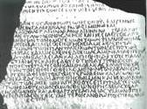
Arycanda Inscription, 312 AD
Your kinsmen the gods have rendered kindness to everyone who concerns himself with their cult on behalf of the eternal well-being of your all-conquering majesties. We have thus thought it right to apply to your eternal monarchy to request that the Christians, long raging mad to this day maintaining their mania unchanged, should at last be stopped and not trespass against the cult due to the gods with any sinister novelty of worship;…and that the power of the atheists to pursue their detestable devotions is forbidden and barred, while all men show their zeal, on behalf of your eternal and incorruptible emperorship, in the worship of your kinsmen the gods. For this, it is obvious, is of the greatest benefit to all of your subjects.

Slide 30
Milvian Bridge

Slide 31
Lactantius (250-325 AD)

Slide 33
Chi-Rho, or Christogram

Slide 34
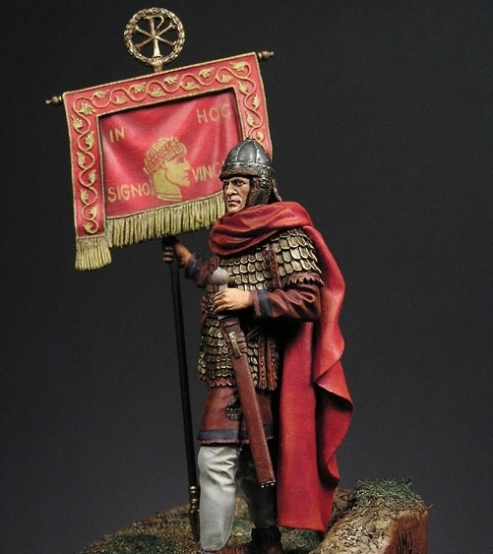
Labarum
In Hoc Signo Vinces
By this sign, Thou Shalt Conquer

Slide 35
Ticinum Medallion

Slide 37
The Many, Various Interpretations of Constantine
Despite considerable advances in source criticism, chronology, and critical method, scholars are in many ways still no closer to arriving at an agreed upon interpretation of Emperor Constantine. To understand how this is so, it is worth examining, even if only briefly, the perspectives of at least some of Constantine’s most significant interpreters from the mid-nineteenth century up to the present. Superficial though it must be, such a survey will give an impression both of the development of approaches to Constantine in modern scholarship, and also of the sheer breadth of opinion that continues to prevail.

Slide 38
Jacob Burkhardt (1818-1897)

Slide 39
Any survey about the many, different scholarly attitudes towards Constantine must begin with this Swiss scholar who offered the first truly critical look at the full range of evidence available. From this vantage, Burkhardt conceived of Constantine as a sly and cynical impresario who exploited the power of the Church to promote his own political program without ever convincing himself of the validity of the Christian religion.

Slide 40
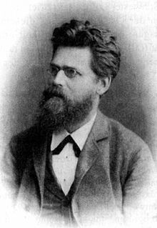
Otto Seeck (1850-1921)
This image stands in open contrast with the Constantine of Burckhardt’s younger contemporary, Seeck, according to whom Constantine was a sincere war hero whose trust in his own good fortune was ultimately transformed into a belief that he had been sent as the earthly agent of the heavenly God.

Slide 41
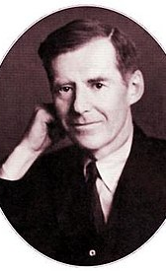
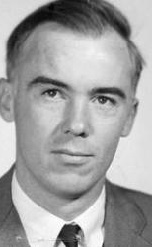
A.H.M Jones Ramsay MacMullen (1818-1897) (b. 1928)
Similarly sober Constantines prevail in the works of mid-twentieth century scholars such as A.H.M. Jones and Ramsay MacMullen, who accepted the earnestness of Constantine’s religious convictions, but depicted him as a credulous, and, often, bumbling bully, lacking in discipline, and often heedless of the consequences of his impulsive actions.

Slide 42
Henri Grégoire (1881-1964) From yet another perspective, Grégoire raised objections to Constantine’s story of conversion altogether. He argued that it was rather Licinius who initiated philo-Christian imperial politics in the 310s, and that Constantine only converted after taking control of Licinius’ domains in the East, where the power of the Christian movement could be exploited for political advantage.

Slide 43
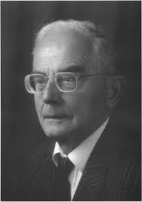
Jochen Bleicken (1926-2005)
This understanding continued to form the core of arguments made by Bleicken as recently as 1992.
Thus from the mid-nineteenth to the mid-twentieth century, most scholars put little credence in a genuinely Christian Constantine, preferring instead to hold political motives or simple fatuousness responsible for what proved almost by accident to have been the emperor’s momentous decision to convert.

Slide 44
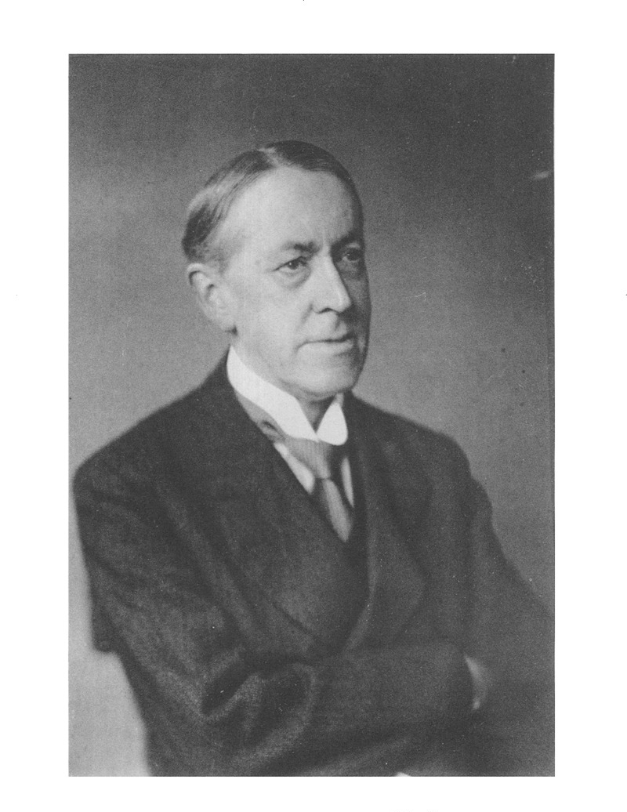
Norman H. Baynes (1926-2005)
Opposition to this viewpoint was, however, expressed by N. H. Baynes already by 1929 in his work Constantine the Great and the Christian Church.
His Constantine experienced a sincere conversion and became a deeply religious Christian who strove to reenact his personal convictions at the global level by tirelessly working to Christianize his subjects.
Based as it was on the wealth of Constantinian documents preserved in Christian sources, this viewpoint exercised tremendous influence by the mid-twentieth century and came to enjoy widespread support from scholars like

Slide 45
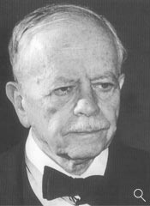
Andreas Alföldi (1895-1981)

Slide 46
Salvatore Calderone
Constantino e il Cattolicesimo (2001)

Slide 47
Timothy Barnes (b. 1942)
Barnes, who is surely the most important scholar of Constantine still publishing, has been on something of a crusade to use the tools of scientific history to prove the decisiveness of Constantine’s conversion in 312 and to argue that the emperor became rigidly intransigent against non-Christians from 324 onward.
In recent years this unquestionably Christian Constantine has been presented in even more mannered fashion in the studies of C. Odahl and T. Elliott, the latter of whom holds that the emperor had no need for conversion since he had been raised a Christian from childhood.2

Slide 48
In the past twenty years, work has appeared with dizzying rapidity, and in it the trend has been to accept a Christian Constantine but to add shading to his broader outlines by focusing on motifs other than Christianity that served as guideposts for the emperor’s life and rule.
Recent Scholarship

Slide 49
H.A. Drake Constantine and the Bishops Drake, whose work first moved studies on Constantine into a twenty-first-century analytical framework, conceives of a Christian emperor, to be sure, but one ready to seek compromise and concessions in his pursuit of consensus and harmony.

Slide 50
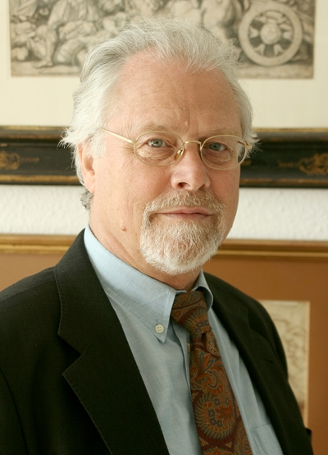
Klaus Martin Girardet
Girardet’s Constantine is deeply spiritual, a convert already by 311, who from this point forward became ever more concerned with his role not just as a politician, but above all as a religious leader.

Slide 51
H. Brandt
Similar is the Constantine of Brandt, whose Constantine made a clear “qualitative leap” toward Christianity after his conversion, even if the roots of that conversion—like the roots of most of Constantine’s policies—lay in ground well prepared by his tetrarchic predecessors.

Slide 52
P. Stephenson
Stephenson outlines an emperor who was riding a rising wave of conversion when he turned to Christianity, and who hoped to use his new religion as a guarantor of military victory

Slide 53
Paul Veyne
Veyne, by contrast, sees Constantine’s conversion as a radical but ingenious maneuver that exploited the inherent brilliance of this new religion to set the church on a path toward world dominance.
Nevertheless, these Christian Constantines are by no means the only actors on the stage. Many contemporary scholars cleave to a more spiritually neutral figure, much more interested in politics and rulership than faith or religion.

Slide 54
A. Marcone
Marcone’s Constantine is Christian, to be sure, but became so entangled in obsessions with sexual morality, family intrigue, and dynastic politics that he diminished his impact as a standard-bearer for the faith.

Slide 55
R. Van Dam
Van Dam conceives of a Constantine who revolutionizes the empire on a number of other fronts without expressing any pronounced concern for Christianity. Standing as a sort of living embodiment of the late Roman Zeitgeist, this Constantine finds his way almost by accident toward a Christian empire that is constructed around him by bishops and biographers.

Slide 56
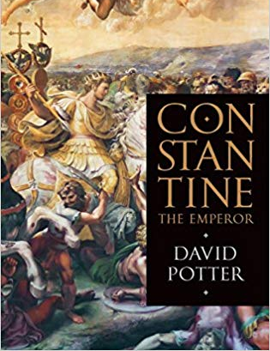
David Potter
Potter’s Constantine is a highly sensible ruler with more important matters on his mind than an obsession with religion.

Slide 57
J. Harries
The Constantine of Harries is by all means Christian but is cautious in his reforms and always willing to compromise in order to maintain tradition and keep the peace.
Without denying conversion on some level, these scholars thus refocus attention on aspects of Constantine that pull our gaze away from the classic Constantinian question.
Others view Constantine as a transitional figure whose understanding of Christianity was far from monolithic and who drew just as freely from traditions of ruler cult and sun worship as from Christian theology.

Slide 58
M. Walraff
Wallraff views the abundant evidence for Constantine’s attachment to the Sun God as confirmation that he had no firm notion of a clear line between pagan and Christian practice and no strong idea what would distinguish a Christian ruler from his pagan predecessors.

Slide 59
E. Herrmann-Otto
According to E. Herrmann-Otto, Constantine’s turn toward Christianity was rooted in the failure of the Great Persecution, not his heavenly vision, and his involvement in church politics reflected more the dutiful performance of his traditional role as pontifex maximus than his commitment to the faith.

Slide 60
O. Schmitt
Schmitt’s Constantine hearkens back to that of Seeck in his ignorance of anything but warfare and his astonishing obtuseness about the new religion that apologists like Eusebius and Lactantius ascribe to him

Slide 61
J. Bardill
Most recently, J. Bardill’s Constantine builds on traditions of divine rulership and solar monotheism in order to reconstruct himself into a new type of leader that could stand as the earthly representative of a new but hardly unique God named Christ.
These ambiguous Constantines prove that the early twentieth-century tradition of an emperor only incompletely aware of what it might mean to be a Christian ruler is far from moribund.

Slide 62
Conclusion
This survey, incomplete though it is, gives some fleeting impression of the sheer variety of interpretations that prevail right up to the present. Not surprisingly, most of them focus in one way or another on the question of Christian religion, Constantine’s understanding of it, and his commitment to its furtherance. This is true even of those studies by scholars who are by no means convinced that religion was of paramount concern to Constantine.
Indeed, struggle though scholars might to escape an eternal return to the problem of Constantine qua homo religiosus, for any number of reasons such efforts almost always prove elusive.
Nor is this obsession with Constantine’s conversion and his efforts to instantiate it at the level of the Roman Empire necessarily a problem, for given the nature of our sources and the magnitude of his conversion (regardless of how one feels about its timing or sincerity), Christianity will always remain the central “Constantinian question.” Yet on precisely this issue, as this survey has revealed, there remains little accord.
The variety of Constantines that came into being in the immediate aftermath of his death and then proliferated into the Middle Ages and beyond shows no signs of diminishing, qualitatively or quantitatively.

Slide 63
St. Hosius of Corduba (257-359 AD)

Slide 64
Ticinum Medallion

Slide 68
Magnentius (303-353 AD)

Slide 70
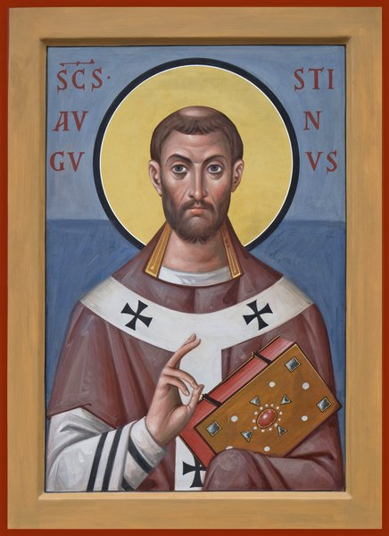

Slide 71
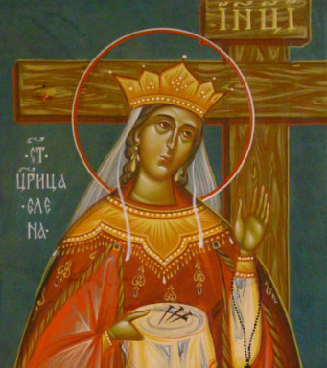
St. Helen (250-330 AD)

Slide 72
Edict of Milan, 313 AD

Slide 73
J.B. Bury (1861-1927)

Slide 74
Edict of Milan, 313 AD

Slide 75
When I, Constantine Augustus, as well as I Licinius Augustus d fortunately met near Mediolanurn (Milan), and were considering everything that pertained to the public welfare and security, we thought -, among other things which we saw would be for the good of many, those regulations pertaining to the reverence of the Divinity ought certainly to be made first, so that we might grant to the Christians and others full authority to observe that religion which each preferred; whence any Divinity whatsoever in the seat of the heavens may be propitious and kindly disposed to us and all who are placed under our rule And thus by this wholesome counsel and most upright provision we thought to arrange that no one whatsoever should be denied the opportunity to give his heart to the observance of the Christian religion, of that religion which he should think best for himself, so that the Supreme Deity, to whose worship we freely yield our hearts) may show in all things His usual favor and benevolence. Therefore, your Worship should know that it has pleased us to remove all conditions whatsoever, which were in the rescripts formerly given to you officially, concerning the Christians and now any one of these who wishes to observe Christian religion may do so freely and openly, without molestation. We thought it fit to commend these things most fully to your care that you may know that we have given to those Christians free and unrestricted opportunity of religious worship. When you see that this has been granted to them by us, your Worship will know that we have also conceded to other religions the right of open and free observance of their worship for the sake of the peace of our times, that each one may have the free opportunity to worship as he pleases ; this regulation is made we that we may not seem to detract from any dignity or any religion.

Slide 76
Moreover, in the case of the Christians especially we esteemed it best to order that if it happens anyone heretofore has bought from our treasury from anyone whatsoever, those places where they were previously accustomed to assemble, concerning which a certain decree had been made and a letter sent to you officially, the same shall be restored to the Christians without payment or any claim of recompense and without any kind of fraud or deception, Those, moreover, who have obtained the same by gift, are likewise to return them at once to the Christians. Besides, both those who have purchased and those who have secured them by gift, are to appeal to the vicar if they seek any recompense from our bounty, that they may be cared for through our clemency,. All this property ought to be delivered at once to the community of the Christians through your intercession, and without delay. And since these Christians are known to have possessed not only those places in which they were accustomed to assemble, but also other property, namely the churches, belonging to them as a corporation and not as individuals, all these things which we have included under the above law, you will order to be restored, without any hesitation or controversy at all, to these Christians, that is to say to the corporations and their conventicles: providing, of course, that the above arrangements be followed so that those who return the same without payment, as we have said, may hope for an indemnity from our bounty. In all these circumstances you ought to tender your most efficacious intervention to the community of the Christians, that our command may be carried into effect as quickly as possible, whereby, moreover, through our clemency, public order may be secured. Let this be done so that, as we have said above, Divine favor towards us, which, under the most important circumstances we have already experienced, may, for all time, preserve and prosper our successes together with the good of the state. Moreover, in order that the statement of this decree of our good will may come to the notice of all, this rescript, published by your decree, shall be announced everywhere and brought to the knowledge of all, so that the decree of this, our benevolence, cannot be concealed.

