Slide 1
Lecture one
Introduction

Slide 2
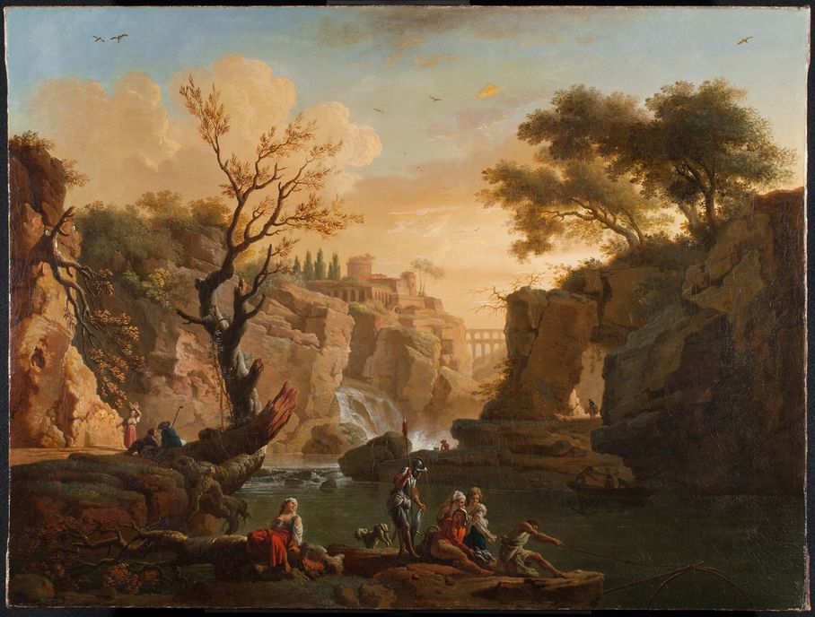
Grand Tour

Slide 3
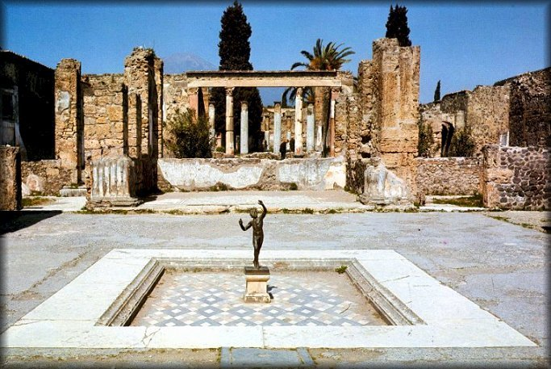
Pompeii

Slide 4
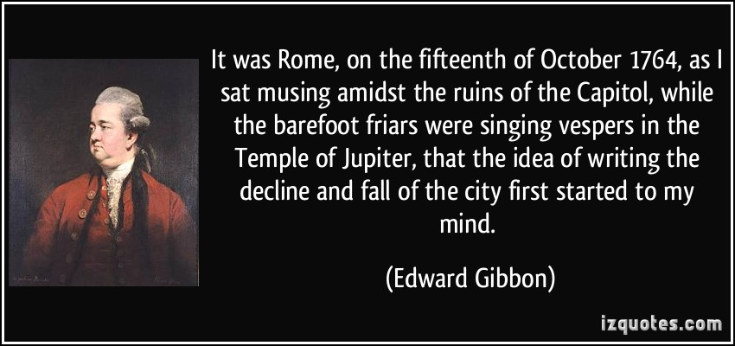
Edward Gibbon
The Decline and Fall of the Roman Empire

Slide 5
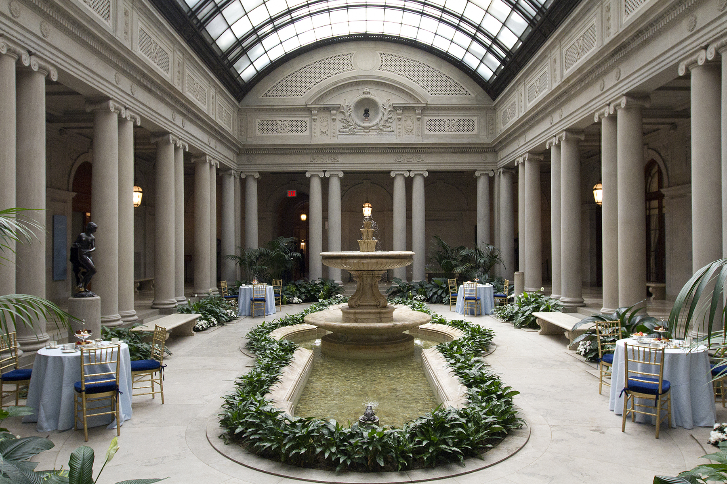

Slide 6
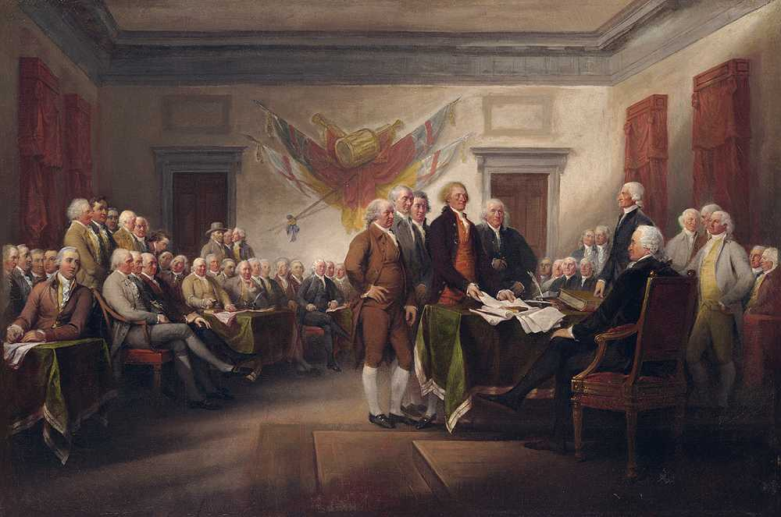
Signing of the Declaration of Independence

Slide 7
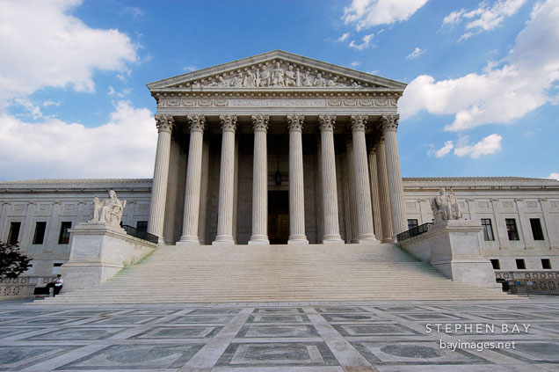

Slide 8
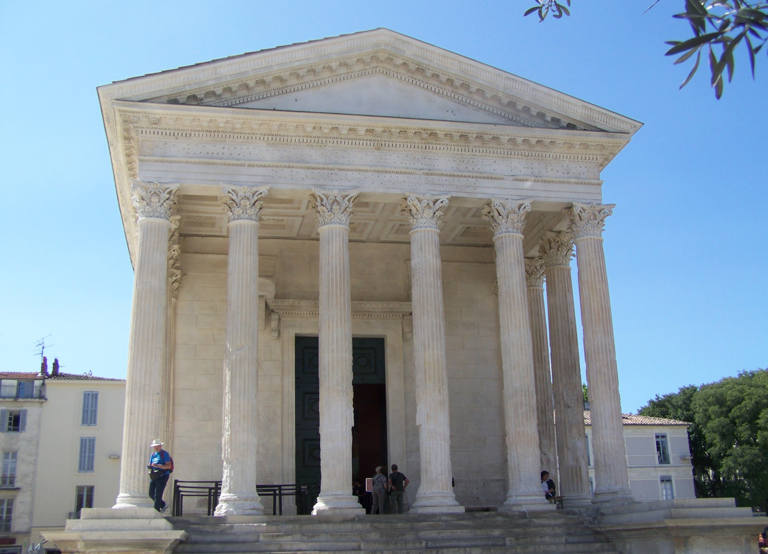
La Maison Carrée

Slide 9
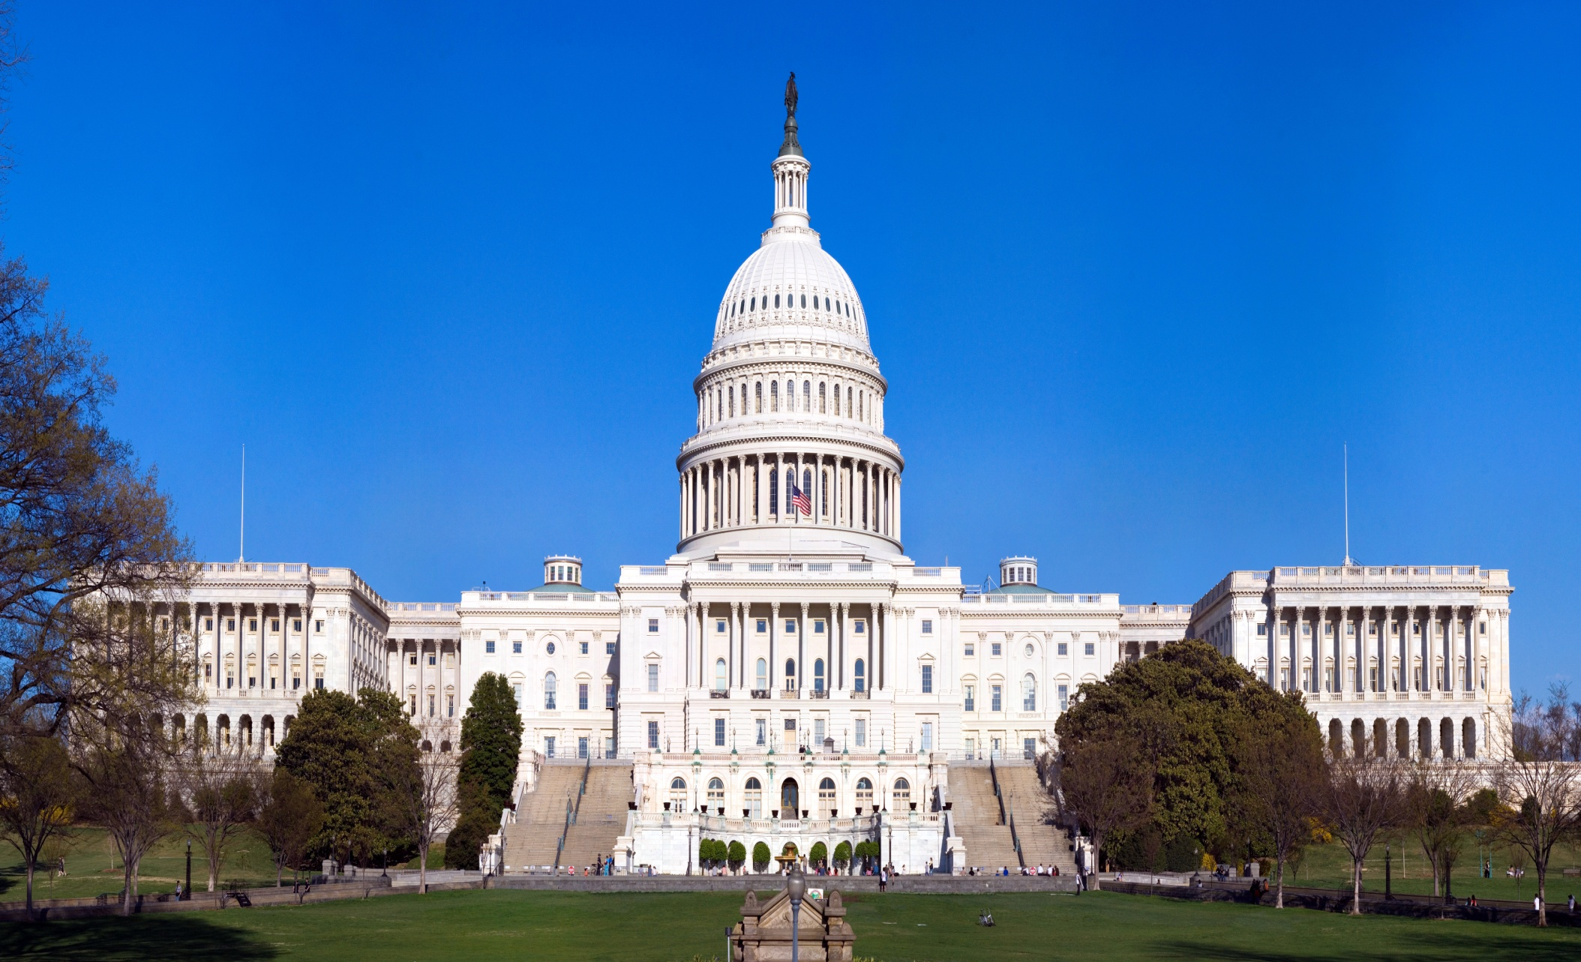
Capitol Building in Washington DC

Slide 10
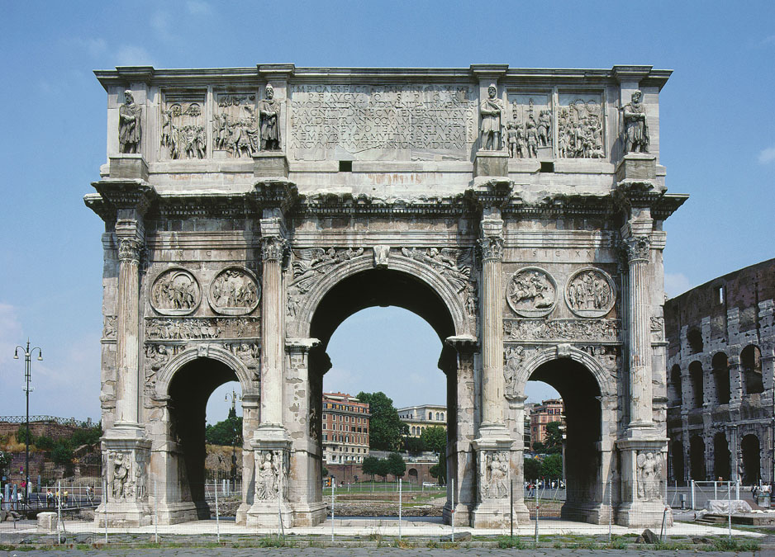
Arch of Emperor Constantine the Great

Slide 11
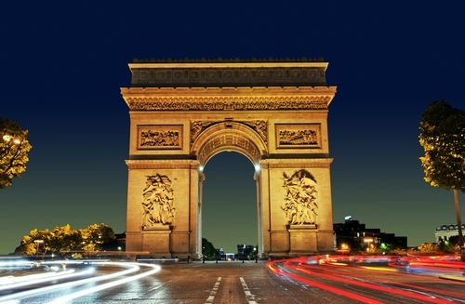
Arc de Triomphe, Paris

Slide 12
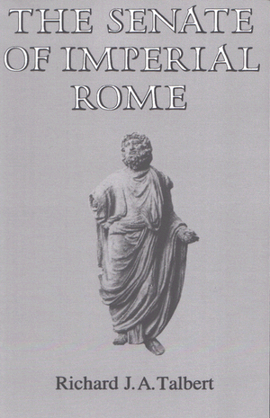

Slide 13
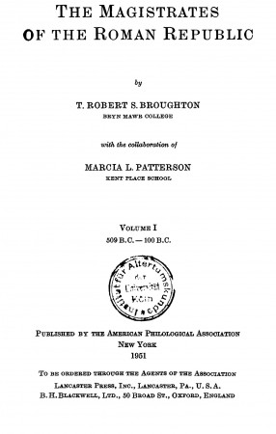

Slide 14
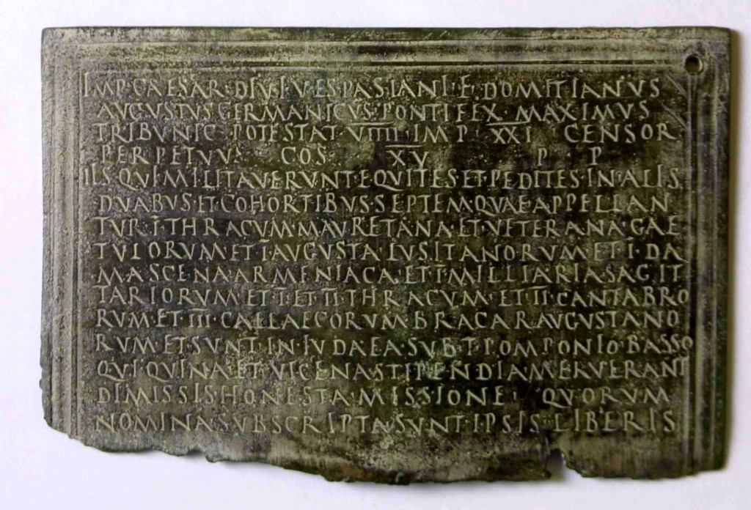

Slide 15
E.P. Thomson (1968) The Making of the English Working Class
“I am seeking to rescue the poor stockinger, the ludite cropper, the obsolete hand-loom weaver, the utopian artisan, and even the deluded follower of Joanna Southcott from the enormous condescension of posterity.”

Slide 16
Fergus Millar (1979) The Emperor in the Roman World
“In preparing the work, I have rigidly avoided reading sociological works on kingship and related topics, or studies of monarchic institutions on societies other than those of Greece and Rome. I am purposely conscious that I will have involved considerable losses of participants, and an awareness of whole ranges of questions that I could have asked. Nonetheless, I am confident that the loss in the opposite case would have been greater. For, to have come to the subject with an array of concepts derived from the study of other societies would merely have made even more unobtainable the proper objective of a historian.

Slide 17
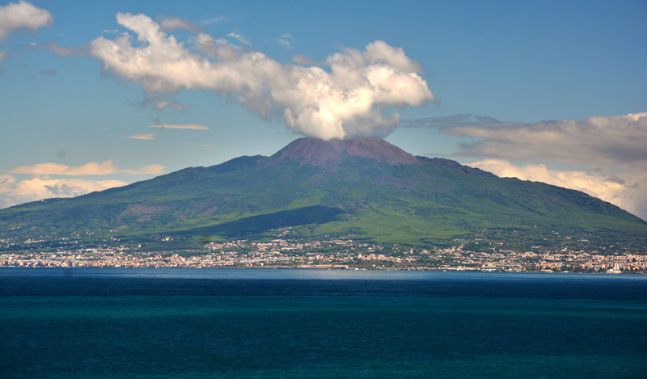
Mt. Vesuvius

Slide 18
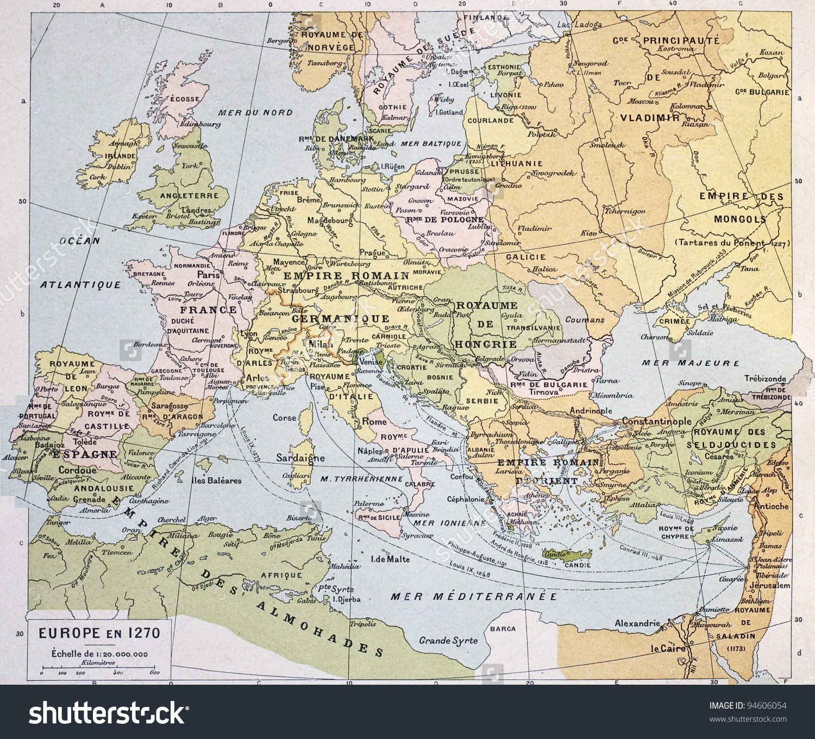

Slide 19
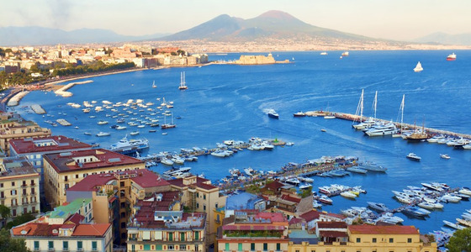
Bay of Naples

Slide 20
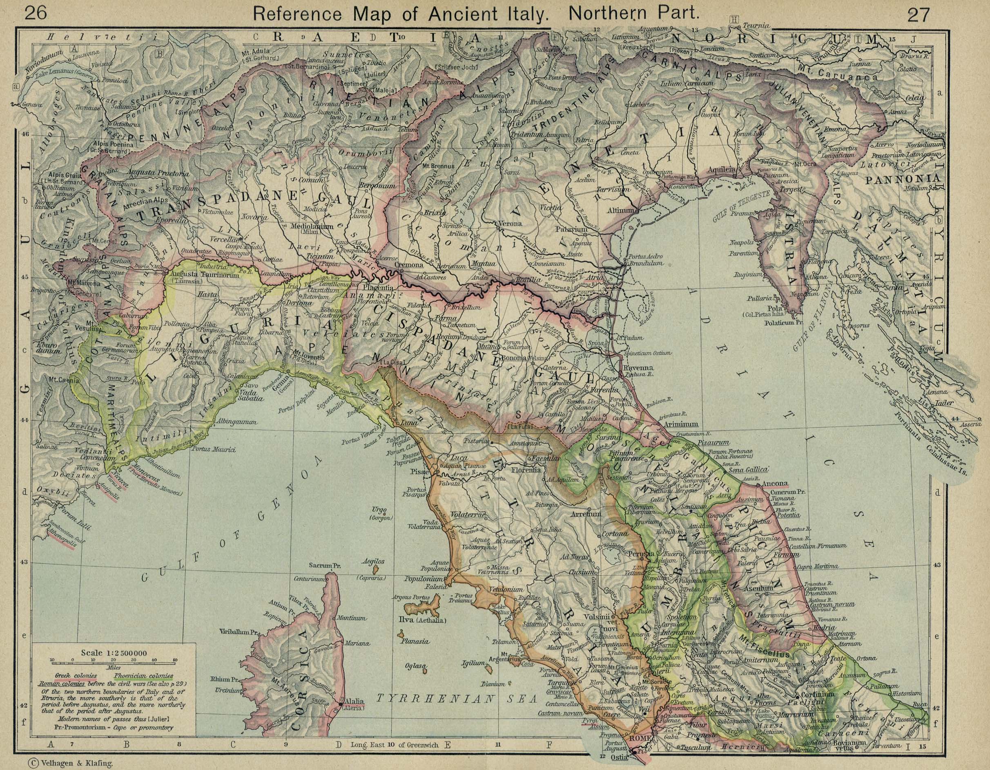
Northern Italy

Slide 21
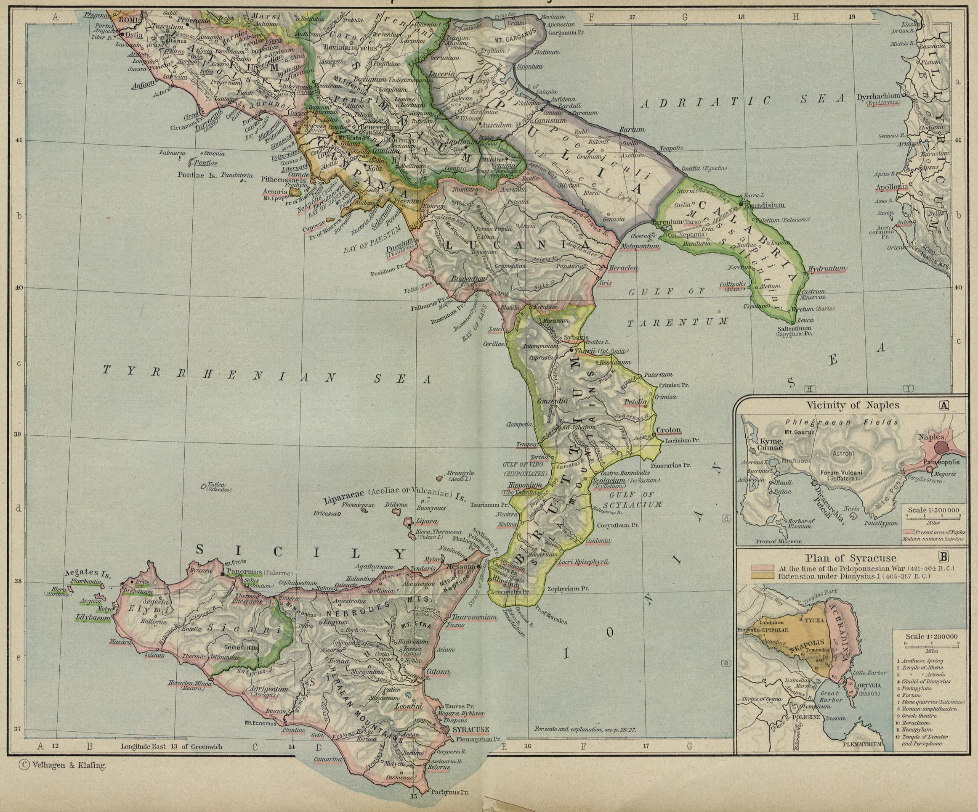
Southern Italy and Sicily

Slide 22
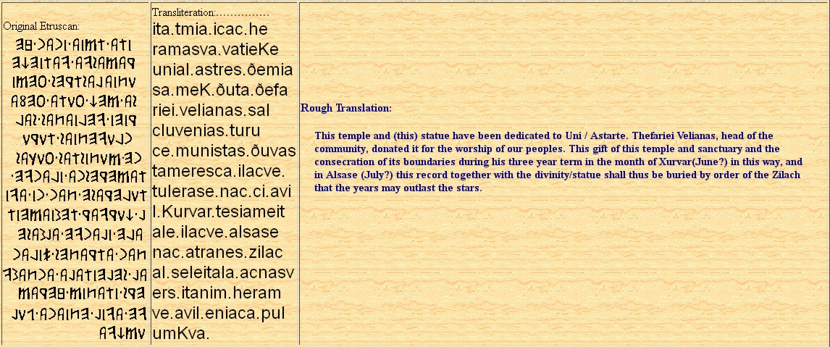
Etruscan Language Inscriptions

Slide 23

The Etruscan Language

Slide 24
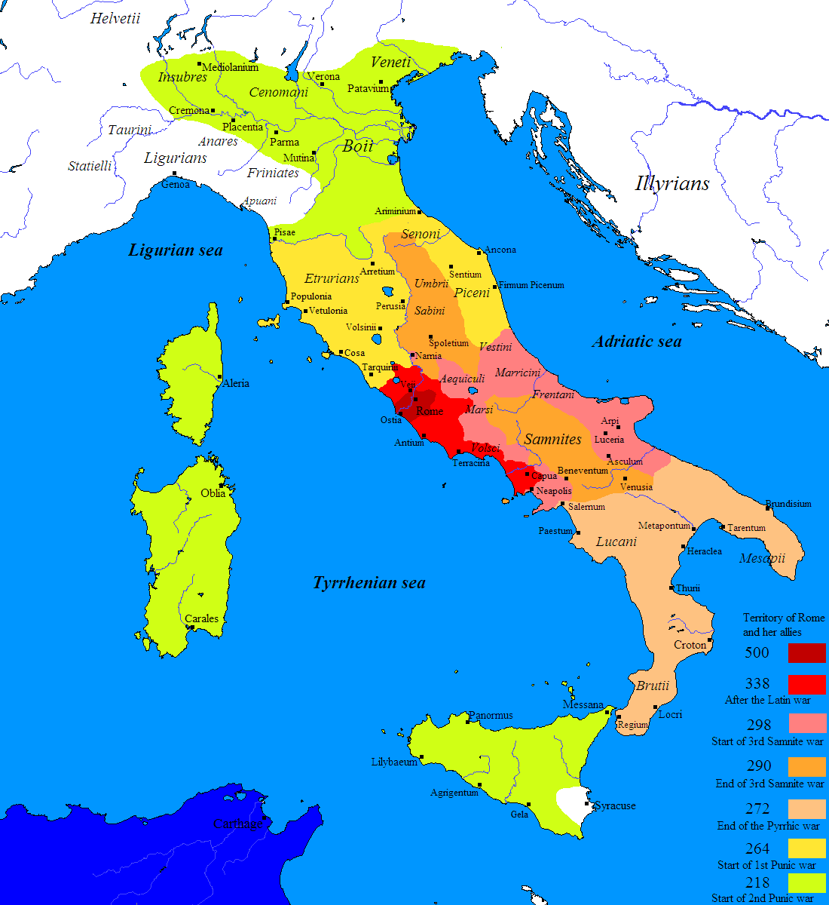

Slide 25
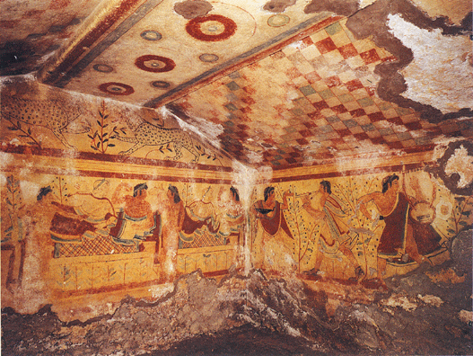
Etruscan Tomb Paintings

Slide 26
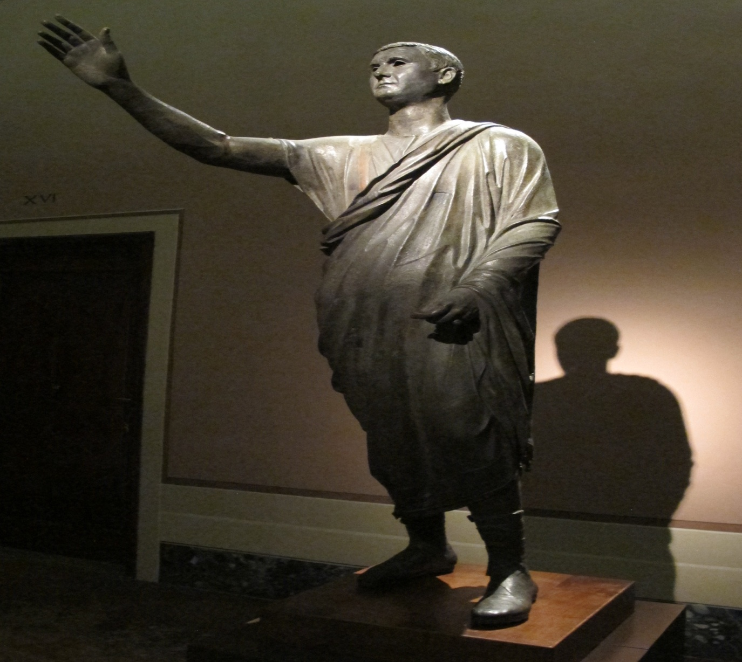
The Toga was Originally an Etruscan Article of Clothing

Slide 27
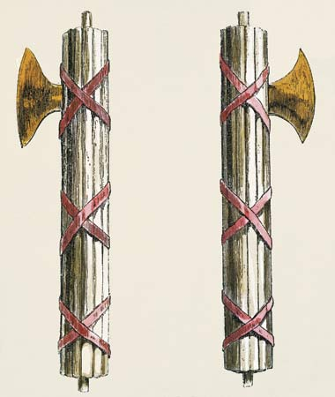
Fasces

Slide 28
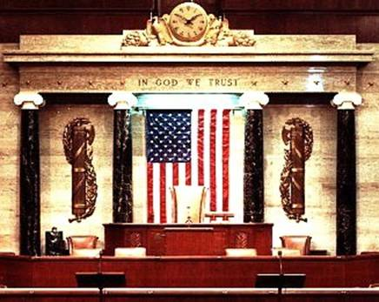

Slide 29
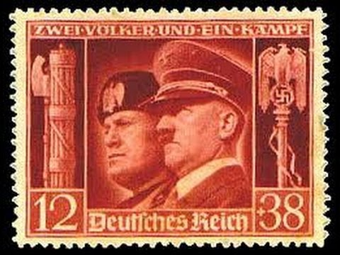

Slide 30
Livy I.8
[Romulus] thought the rustic population more likely to be bound by his laws if he made himself venerable by adopting symbols of office. Therefore he put on a more august state in every way, and especially by the assumption of twelve lictors. Some think the twelve birds which had given him an augury of kingship led him to choose this number. For my part, I am content to share the opinion of those who derive it from the neighboring Etruscans (whence were borrowed the curule chair and purple-bordered toga) not only the type of attendants but their number as well —a number which the Etruscans themselves are thought to have chosen because each of the twelve cities which united to elect the king contributed one lictor.

Slide 31
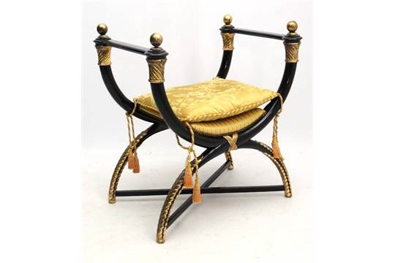
Curule Chair

Slide 32
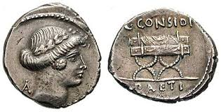
Curule Chair

Slide 34
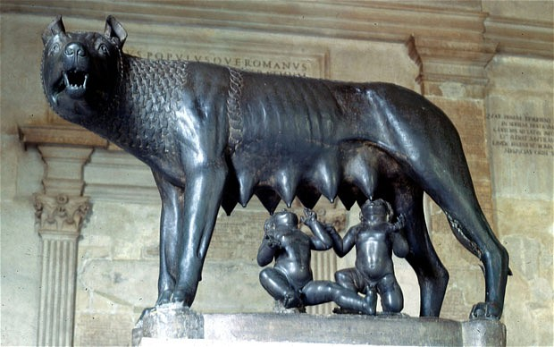
Romulus and Remus

Slide 35
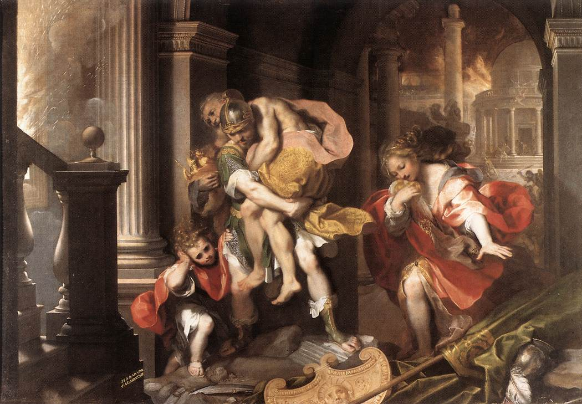
Aeneas Fleeing Troy

Slide 36
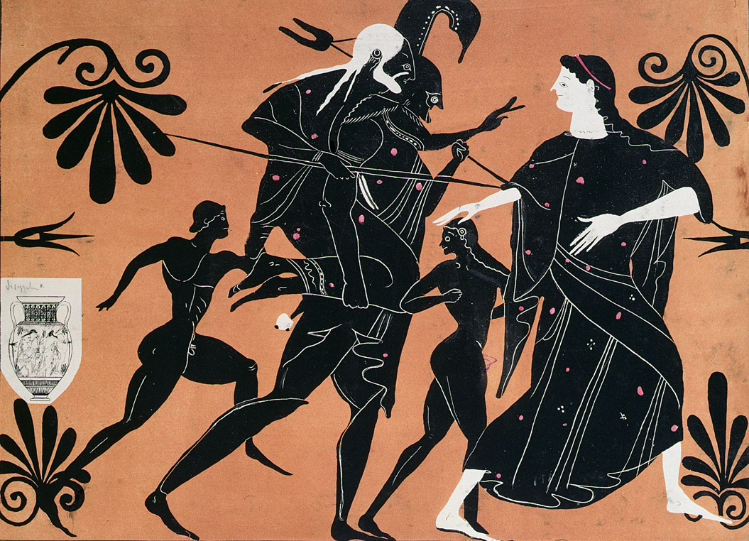
Aeneas Fleeing Troy

Slide 37
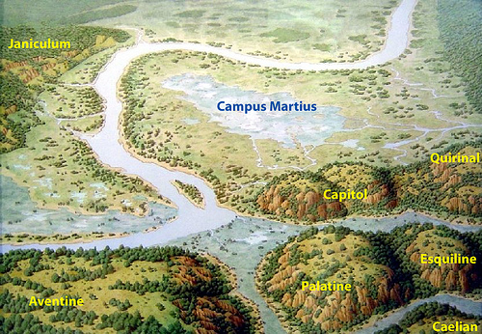
Pre-Historic Rome

Slide 38
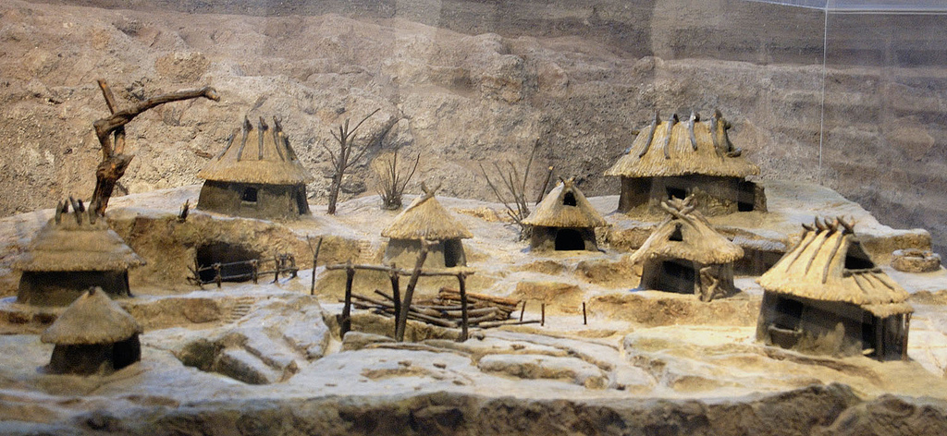
Model, Iron Age Huts of Rome

Slide 39
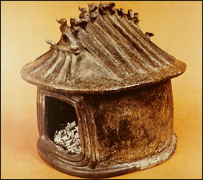
Archaic Hut Urn

Slide 40
