Slide 1
Lecture Three
The Struggle of the Orders
&
Roman Expansion in Italy

Slide 2
Racial Difference Between the Plebs and Patricians
Ness Painter, author of History of White People (1996) found it astonishing that American Nordicist Madison Grant (1865-1937) argued in The Passing of the Great Race that the patricians were of nordic origin.

Slide 3
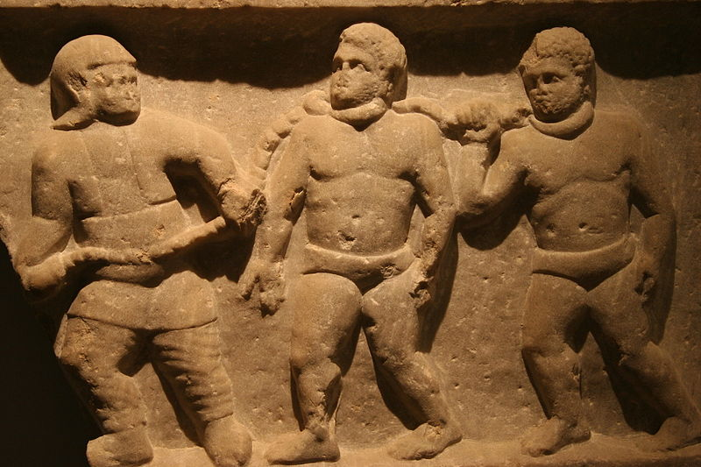
Debt Bondage

Slide 4
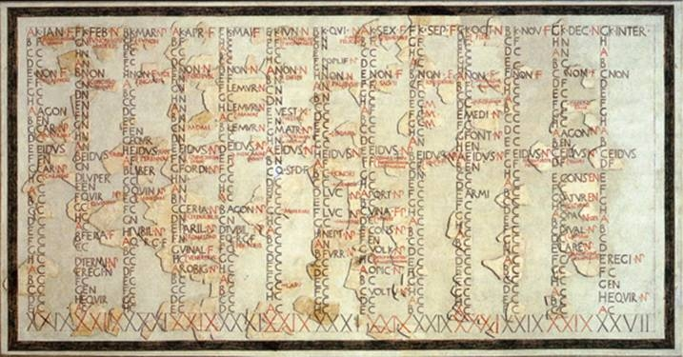
Fasti

Slide 5
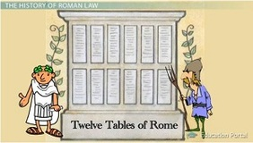
The Twelve Tables

Slide 6
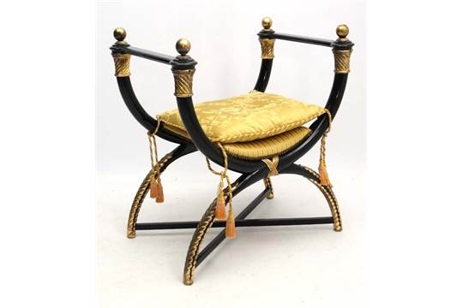
Curule Chair

Slide 7
Tabula III, De Aere Alieno
Aeris confessi rebusque iure iudicatis xxx dies iusti sunto. Post deinde manus iniectio esto. In ius ducito. In ius ducito. Ni iudicatum facit, aut quis endo eo in iure vindicit, secum ducito. Vincito aut nervo aut compedibus. XV pondo ne minore. aut si volet maiore vincito. Si volet suo vivito. Ni suo vivit [qui eum vinctum habebit] libras farris endo dies dato; si volet, plus dato.

Slide 8
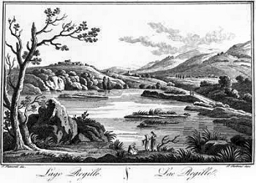
Lake Regillus

Slide 9
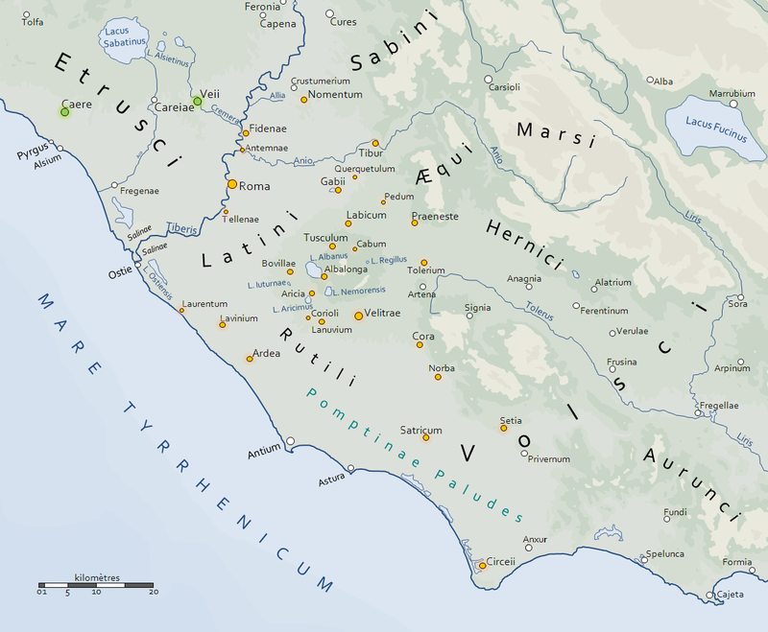
The Latin League

Slide 10
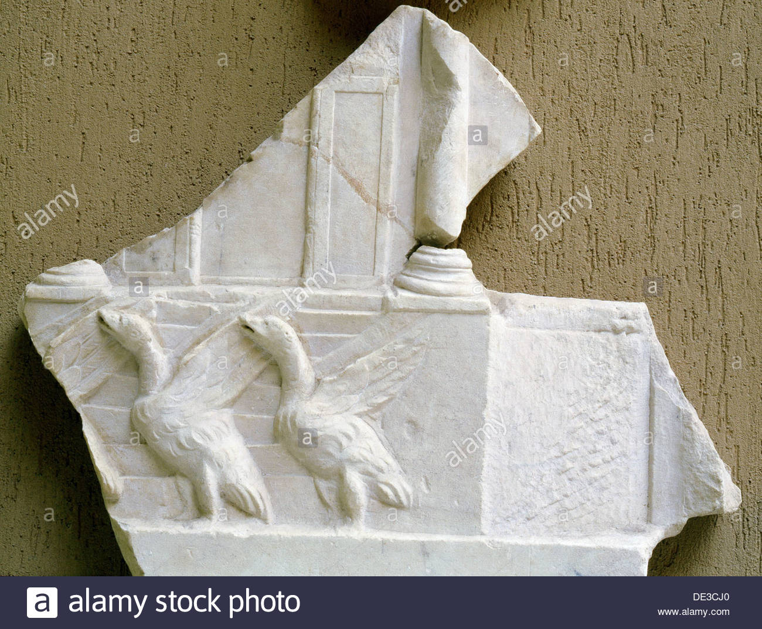
Sacred Geese

Slide 11
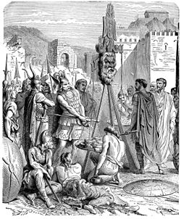
Brennus, Vae Victis

Slide 12
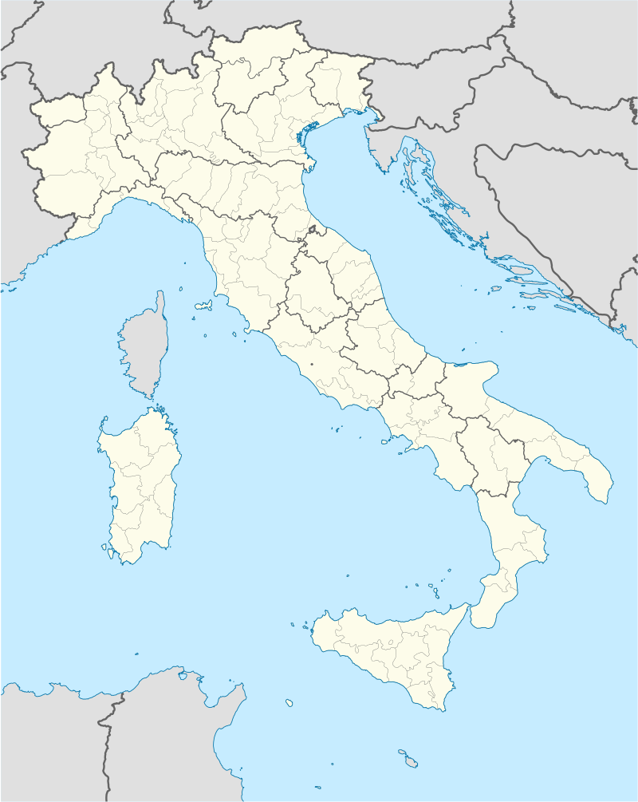
Tarentum

Slide 13
