Slide 1
Lecture Seven
The Gracchi
&
Marius and Sulla

Slide 2
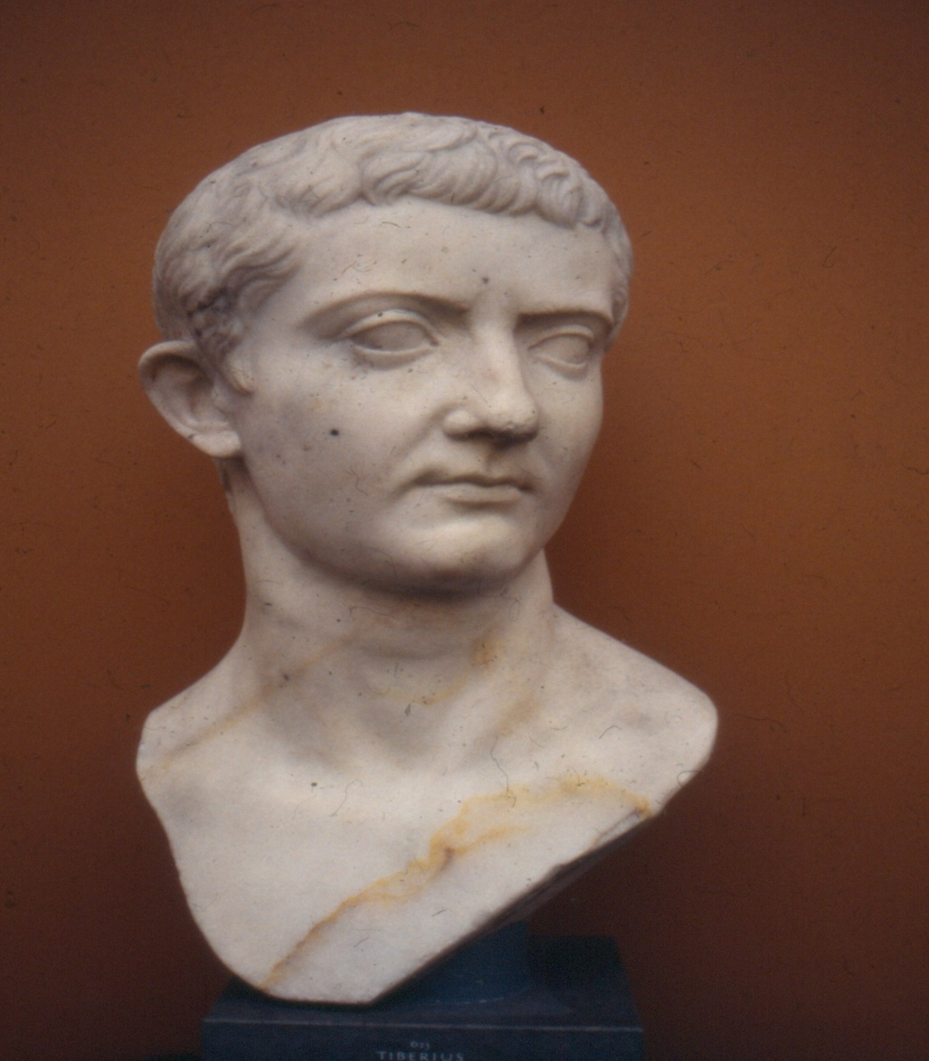
Tiberius Sempronius Gracchus

Slide 3
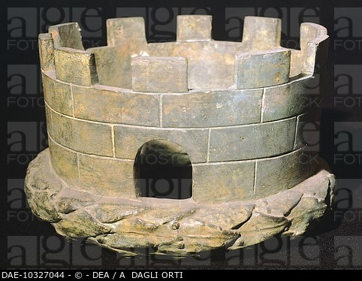
Corona Muralis

Slide 4
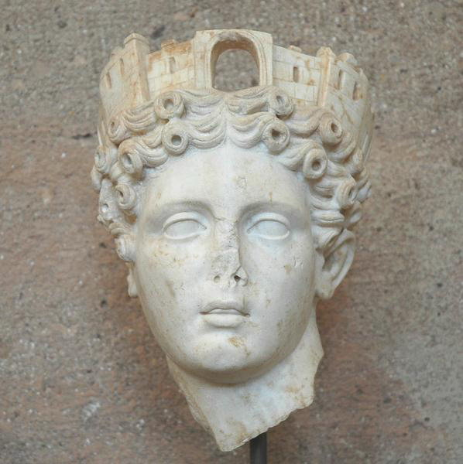
Corona Muralis

Slide 5
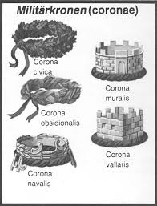
Coronae Militares

Slide 6
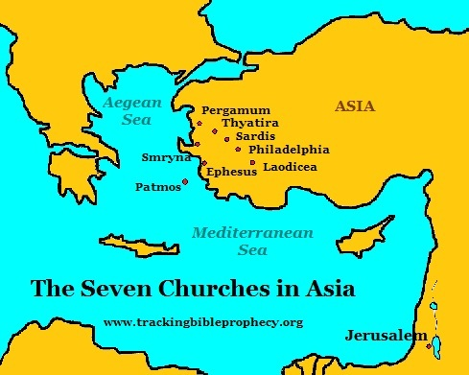
Kingdom of Pergamum

Slide 7
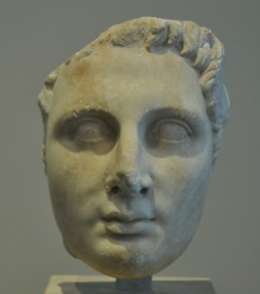
King Attalus III (c. 170 – 133 BC)

Slide 8
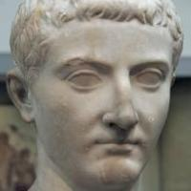
C. Sempronius Gracchus (154 – 121 BC)

Slide 9
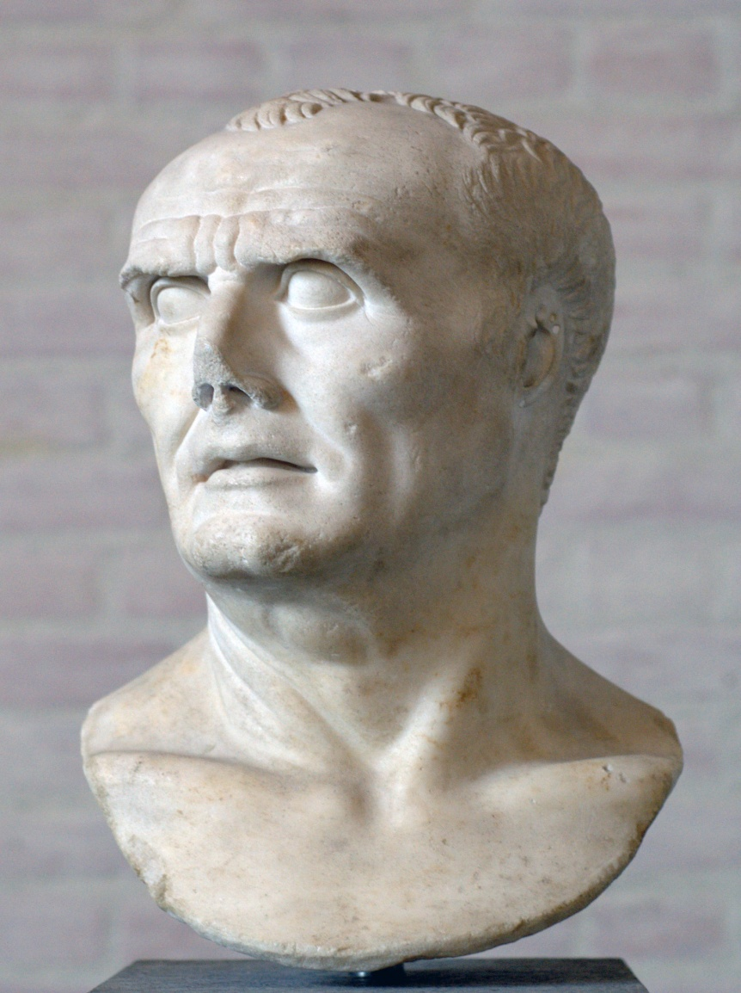
C. Marius (157 – 86 BC)

Slide 10
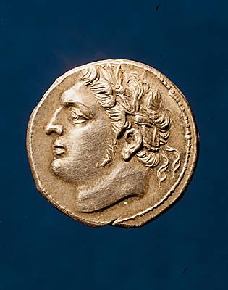
Jugurtha (c. 160 – 104 BC)

Slide 11
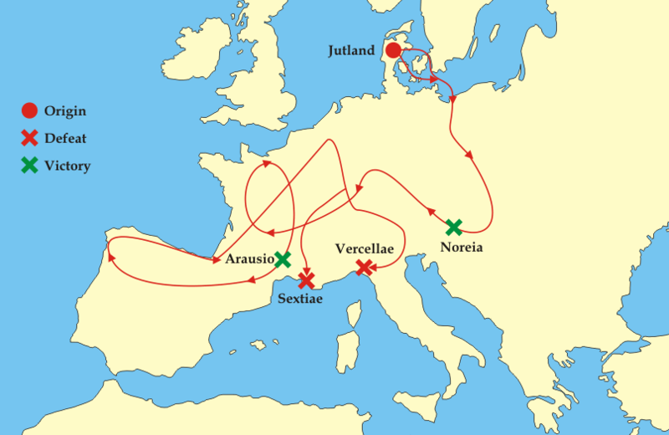
Cimbri and Teutones

Slide 12
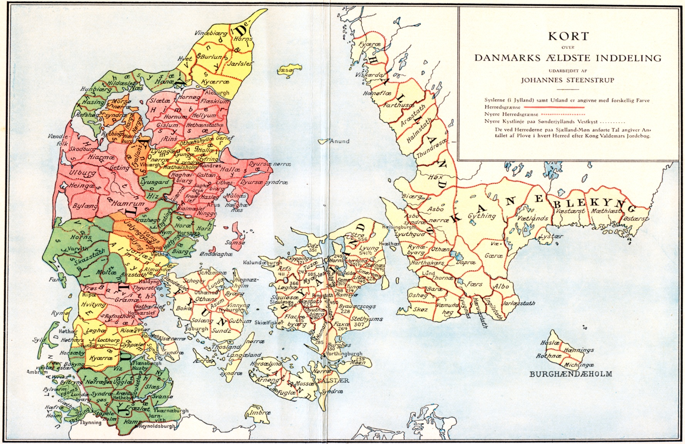
Cimbri

Slide 13
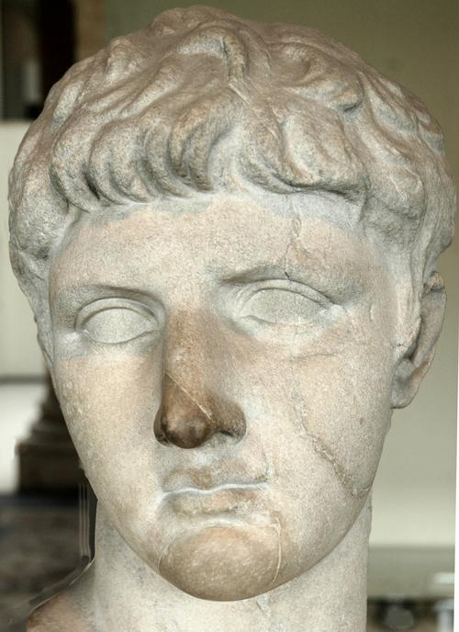
M. Livius Drusus (d. 91 BC)

Slide 14
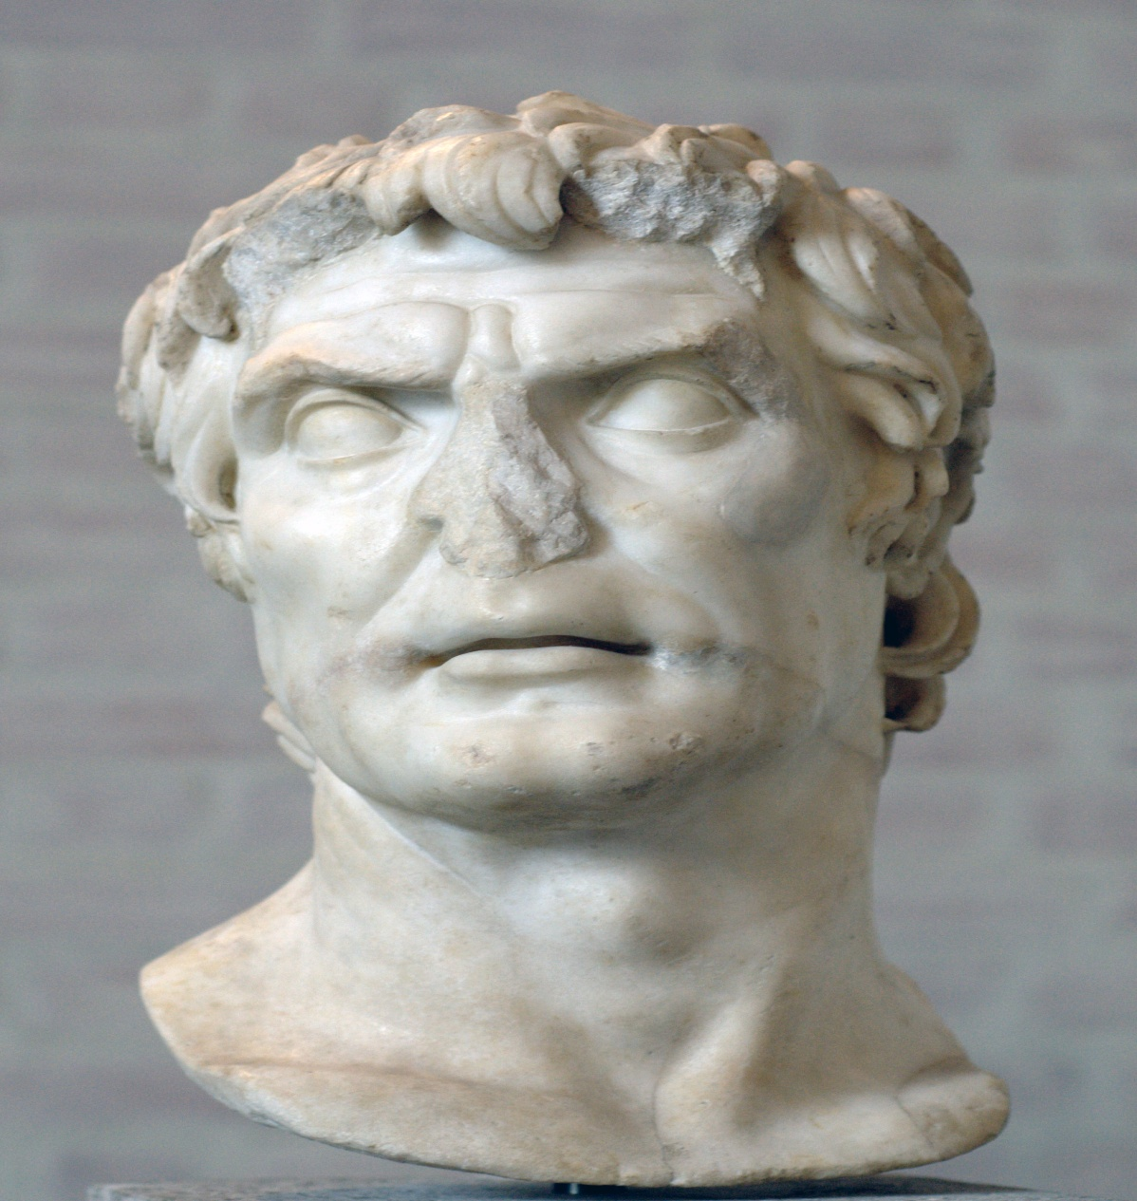
L. Cornelius Sulla (139 – 78 BC)

Slide 15
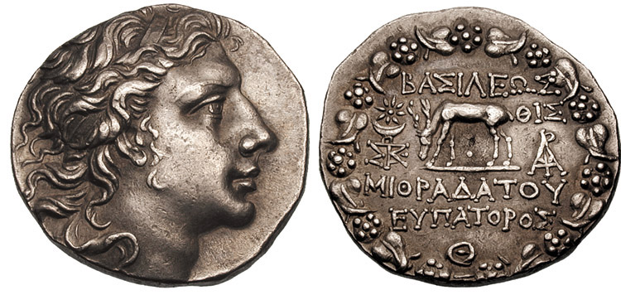
Mithridates VI of Pontus (134 – 63 BC)

Slide 16
Plutarch, Life of Sulla 21
[Sulla] took away all civil rights from the sons and grandsons of those who had been proscribed, and confiscated the property of all. Moreover, proscriptions were made not only in Rome, but also in every city of Italy, and neither temple of God, nor hearth of hospitality, nor paternal home was free from the stain of bloodshed, but husbands were butchered in the embraces of their wedded wives, and sons in the arms of their mothers. Those who fell victims to political resentment and private hatred were as nothing compared with those who were butchered for the sake of their property, nay, even the executioners were prompted to say that his great house killed this man, his garden that man, his warm baths another. Quintus Aurelius, a quiet and inoffensive man, who thought his only share in the general calamity was to condole with others in their misfortunes, came into the forum and read the list of the proscribed, and finding his own name there, said, “Ah! woe is me! my Alban estate is prosecuting me.” And he had not gone far before he was dispatched by some one who had hunted him down.

Slide 17
