Slide 1
Lecture Five
Rome in the Eastern Mediterranean
&
Explaining the Rise of Roman Power
&
Roman Hellenization

Slide 2
Polybius 1.1
Can any one be so indifferent or idle as not to care to know by what means, and under what kind of constitution, almost the whole inhabited world was conquered and brought under the dominion of the single city of Rome, and that too within a period of not quite fifty-three years?

Slide 3
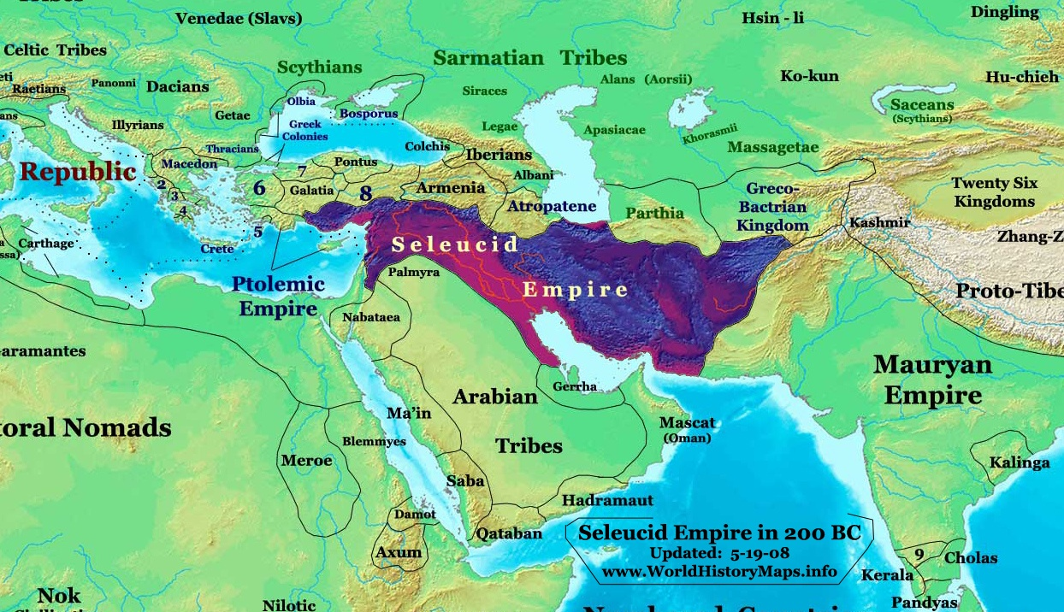
Seleucid Empire circa 200 BC

Slide 4
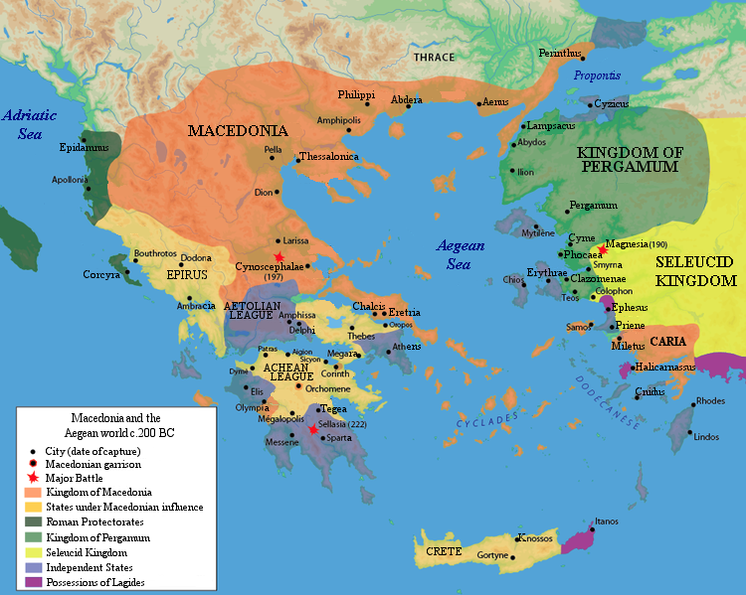
Battle of Cynoscephalae 197 BC

Slide 5
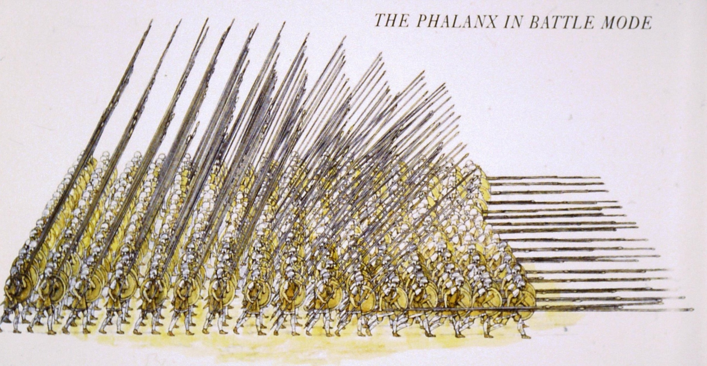
Macedonian Phalanx

Slide 6
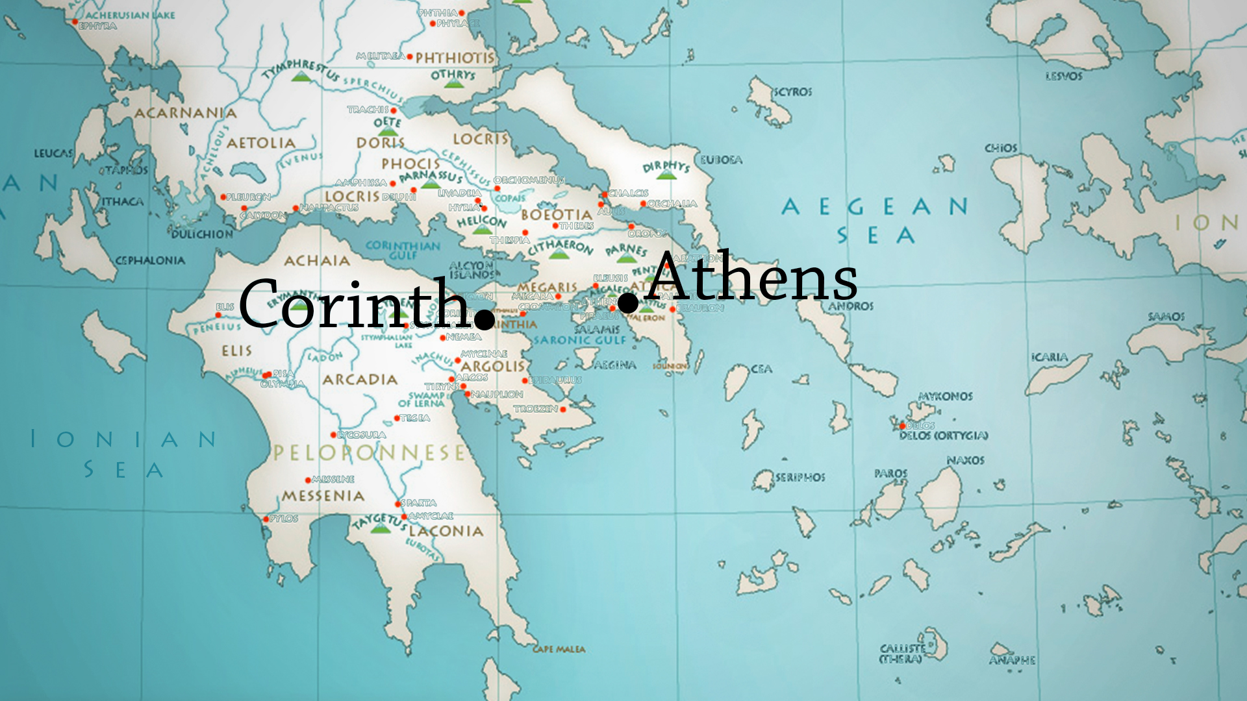
Destruction of Corinth in 146 BC

Slide 7
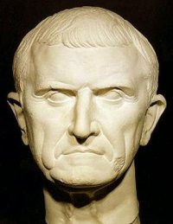
Lucius Mummius Achaicus

Slide 8
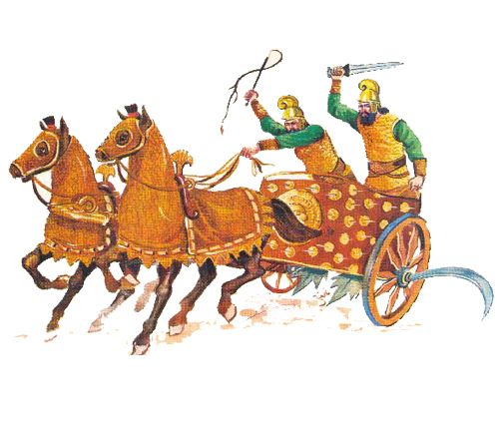
Scythed Chariots

Slide 9
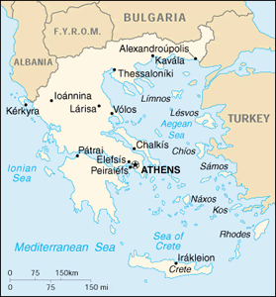
Rhodes

Slide 10
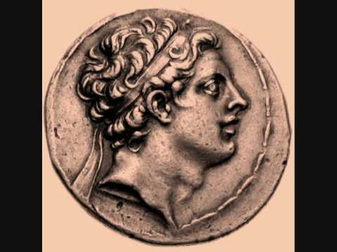
Antiochus IV Epiphanes c. 215 BC – 164 BC

Slide 11
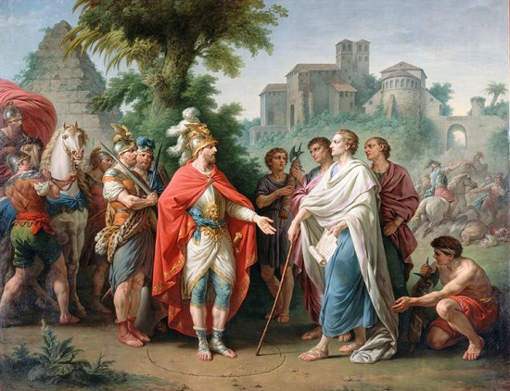
Gaius Popillius Laenas

Slide 12
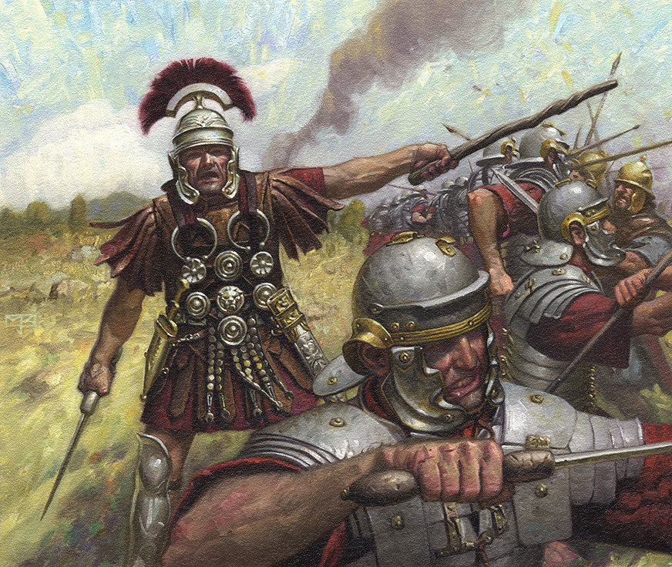
Centurion

Slide 13
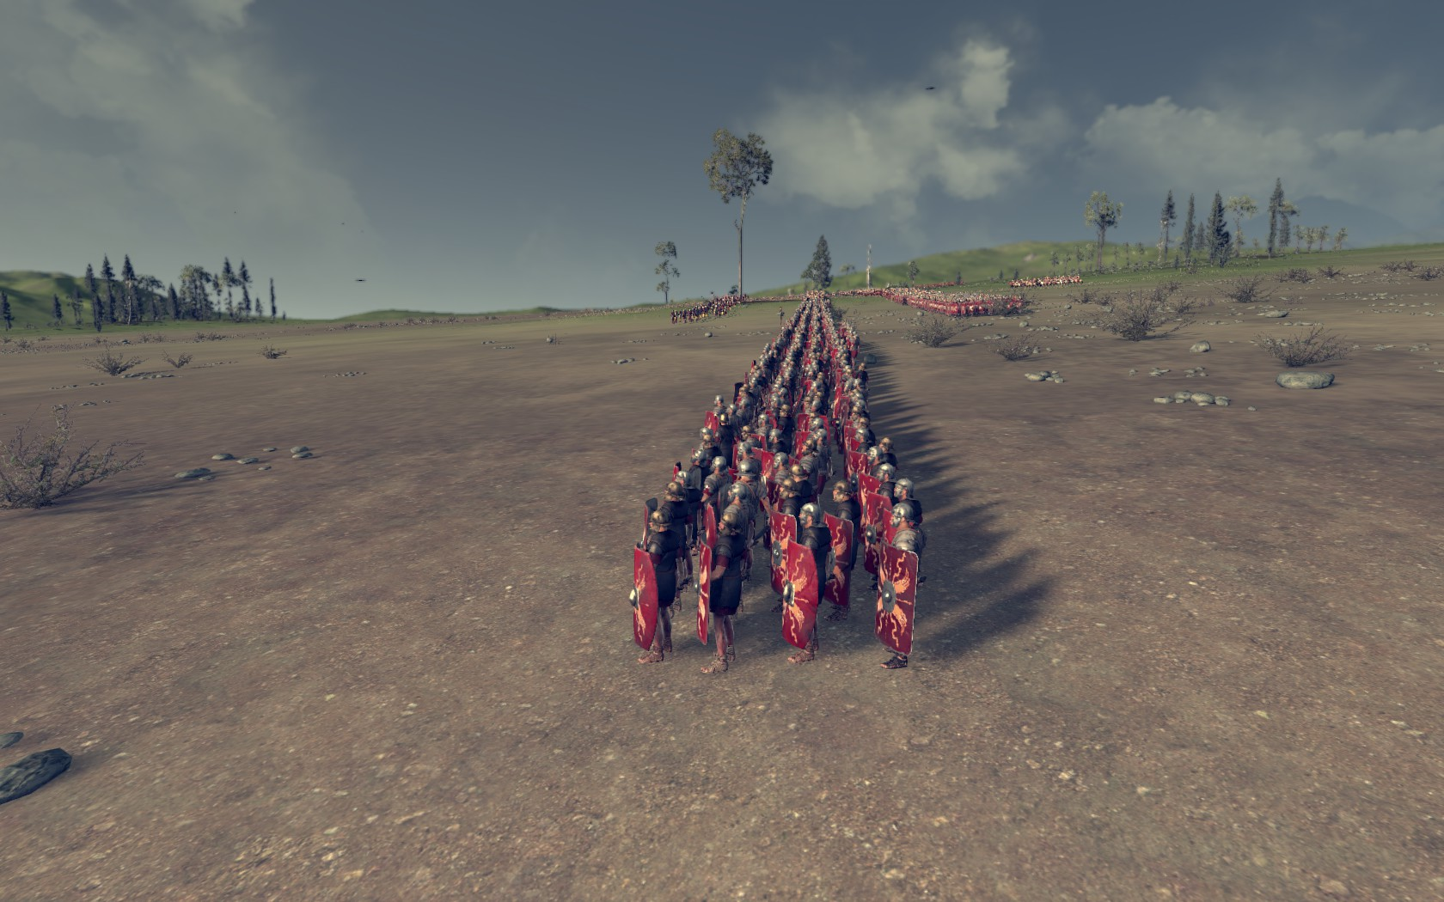
Acies Triplex

Slide 14
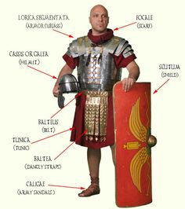
Roman Legionary

Slide 15
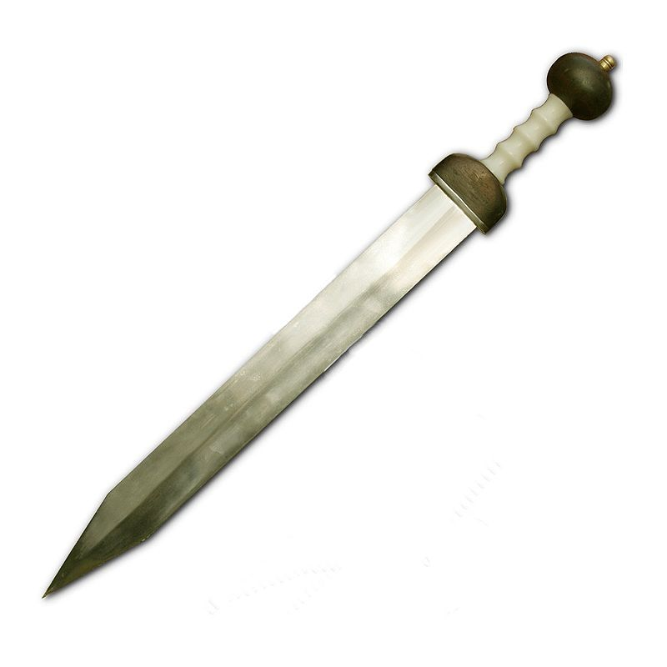
Gladius Hispaniensis

Slide 16
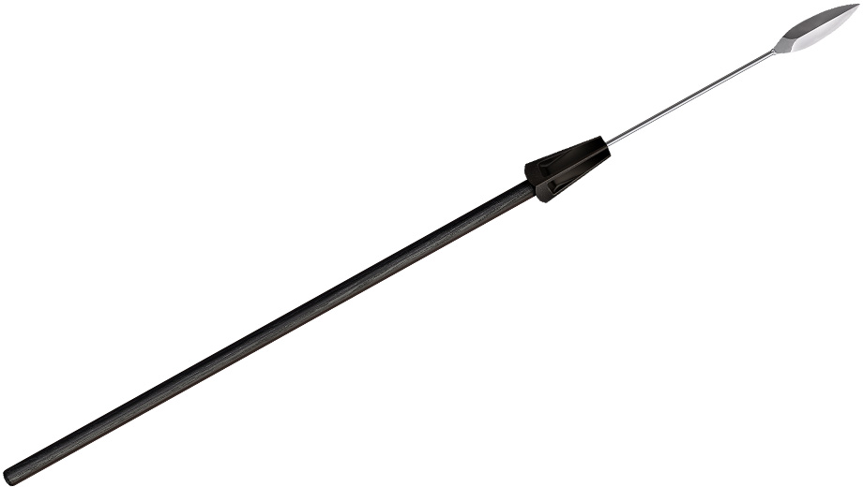
Pilum

Slide 17
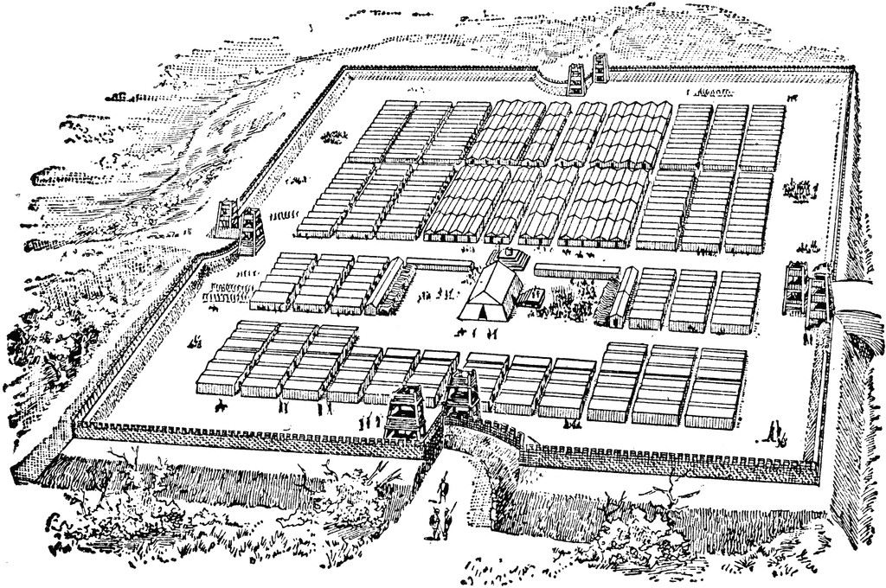
Roman Marching Camp

Slide 18
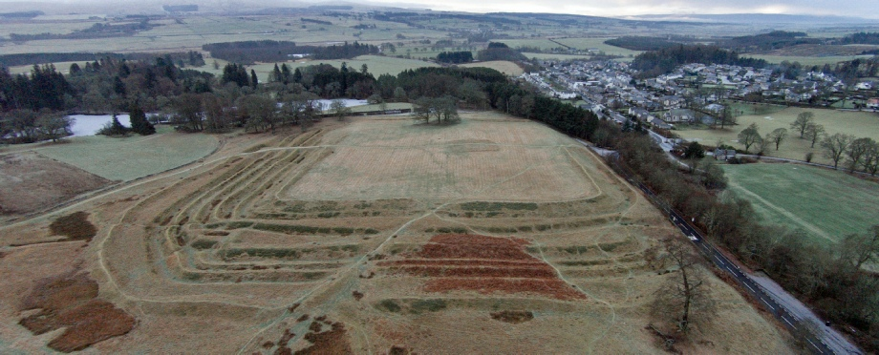
Roman Marching Camp in Scotland

Slide 19
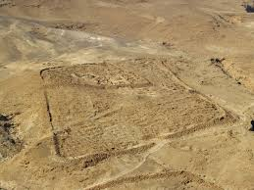
Roman Camp at Massada, Israel

Slide 20
Aeneid 6.847-853
excudent alii spirantia mollius aera
(credo equidem), vivos ducent de marmore vultus,
orabunt causas melius, caelique meatus
describent radio et surgentia sidera dicent:
tu regere imperio populos, Romane, memento
(hae tibi erunt artes), pacique imponere morem,
parcere subiectis et debellare superbos.

Slide 21
John Dryden Translation
Let others better mould the running mass Of metals, and inform the breathing brass,
And soften into flesh the marble face;
Plead better at the bar; describe the skies
(Both when the stars descend and when they rise);
But, Rome, 'tis thine alone with awful sway
To rule mankind and make the world obey.
Disposing peace and war by thy own majestic way.
To tame the proud, the fettered slave to free:
These are imperial arts, and worthy thee.

Slide 22
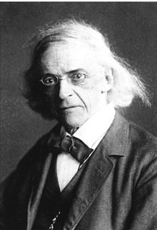
Theodor Mommsen (1817-1903)

Slide 23
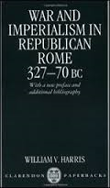
War and Imperialism in Republican Rome

Slide 24
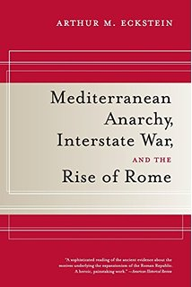
Arthur Eckstein

Slide 25
Thucydides (5th century BC)
The “Melian Dialogue”
Melians: It is an excusable and natural thing that men in our position should have much to say and should indulge in many fancies. But we admit that this conference has met to consider the question of our preservation; and therefore let the argument proceed in the manner which you propose.
Athenians: Well, then, we Athenians will use no flue words; we will not go out of our way to prove at length that we have a right to rule, because we overthrew the Persians; or that we attack you now because we are suffering any injury at your hands. We should not convince you if we did; nor must you expect to convince us by arguing that, although a colony of the Lacedaemonians, you have taken no part in their expeditions, or that you have never done us any wrong. But you and we should say what we really think, and aim only at what is possible, for we both alike know that into the discussion of human affairs the question of justice only enters where the pressure of necessity is equal, and that the strong do as they will, and the weak suffer what they must.
Melians: Well, then, since you set aside justice and invite us to speak of expediency, in our judgment it is certainly expedient that you should respect a principle which is for the common good; and that to every man when in peril a reasonable claim should be accounted a claim of right, and any plea which he is disposed to urge, even if failing of the point a little, should help his cause. Your interest in this principle is quite as great as ours, inasmuch as you, if you fall, will incur the heaviest vengeance, and will be the most terrible example to mankind.
Athenians: Of the gods we believe, and of men we know, that by a law of their nature wherever they can rule they will.This law was not made by us, and we are not the first who have acted upon it; we did but inherit it, and shall bequeath it to all time, and we know that you and all mankind, if you were as strong as we are, would do as we do.

Slide 26
Horace, Epistles II.1.156-7
Graecia capta ferum victorem cepit et artes intulit agresti Latio.
Conquered Greece took captive her savage conqueror, and brought her arts into rustic Latium.

Slide 27
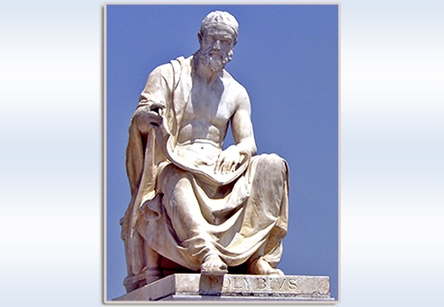
Polybius (c. 200 – c. 118 BC)

Slide 28
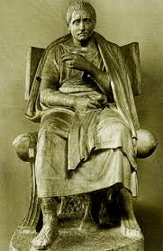
Livius Andronicus

Slide 29
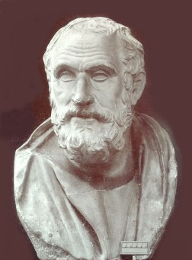
Carneades (c. 214 BC – c. 129 BC)

Slide 30
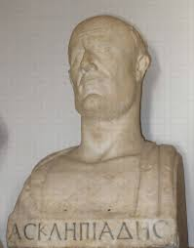
Asclepiades (d. 40 BC)

Slide 31
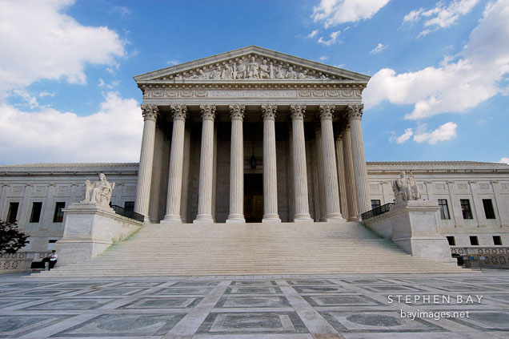
Roman Style Temple

Slide 32
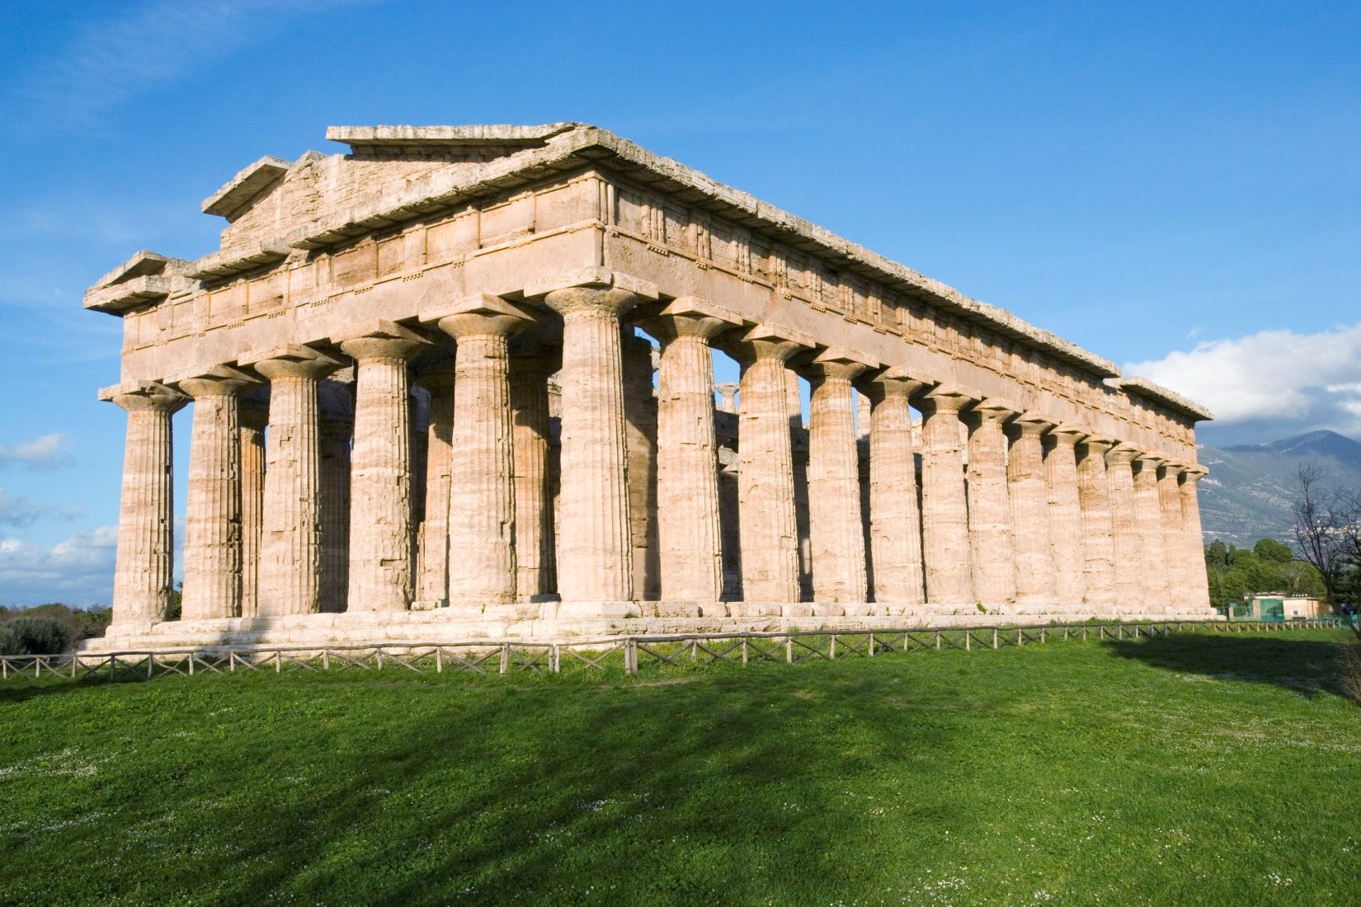
Greek Style

Slide 33
Iliad VI.447-449
εὖ γὰρ ἐγὼ τόδε οἶδα κατὰ φρένα καὶ κατὰ θυμόν: ἔσσεται ἦμαρ ὅτ' ἄν ποτ' ὀλώλῃ Ἴλιος ἱρὴ καὶ Πρίαμος καὶ λαὸς ἐϋμμελίω Πριάμοιο.
This thing I know well in my mind and in my spirit, that there will come a day when sacred Ilion will be destroyed, both Priam, and the people of spear-bearing Priam.

Slide 34
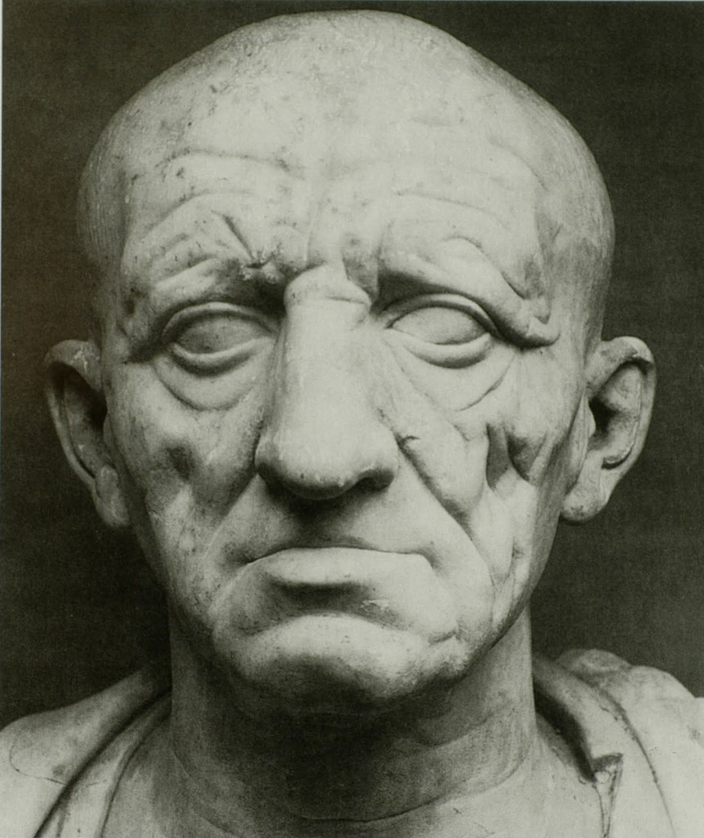
Marcus Porcius Cato (234 – 139 BC)

