Slide 1
The Departure from Classical Christian Education in Modern America

Slide 2
Wilhelm Maximilian Wundt (1832-1920)

Slide 3
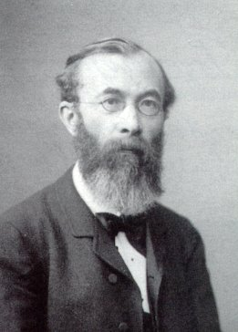
Wundt was the founder of experimental psychology and the force behind its dissemination in the western world.
It truly appears to be a useless waste of energy to keep returning to such aimless discussions about the nature of the psyche, which were in vogue for a while, and practically still are, instead, rather, of applying one’s energies where they will produce real results.

Slide 4
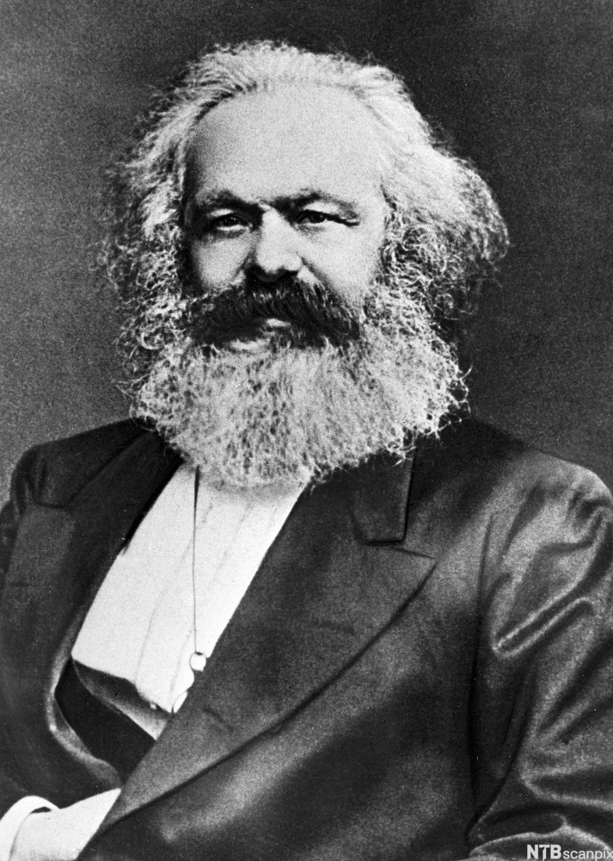
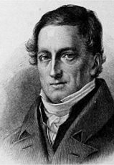
Karl Marx Johann Herbart Gustav Fechner (1818-1893) (1776-1841) (1801-1887)

Slide 5
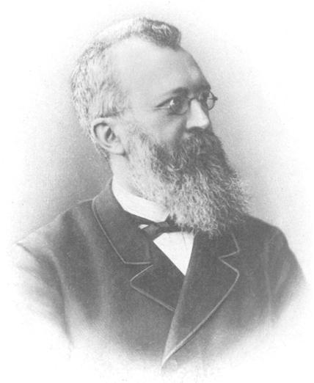
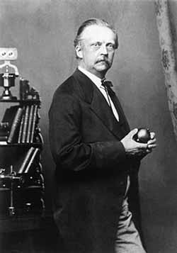
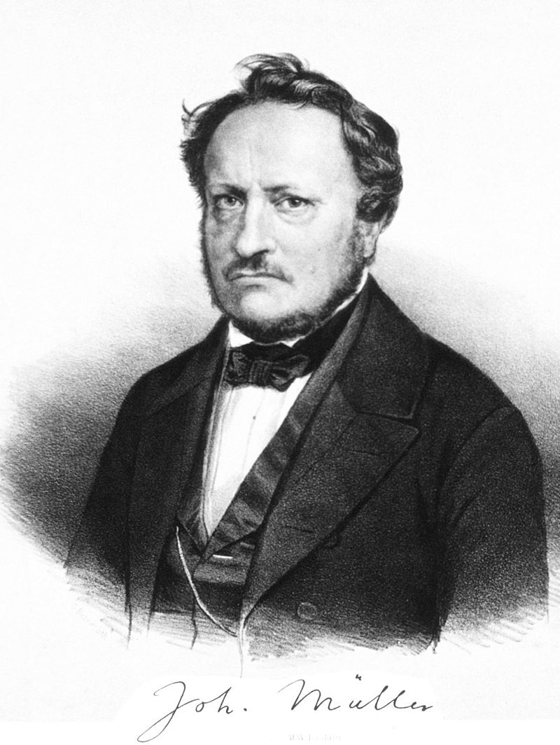

Slide 6
Wundt stated his overall intention in clear terms
The work which I here present to the public is an attempt to mark out a new domain of science.

Slide 7
Wundt noticed that reactions began with stimulation, followed by:
1) perception, in which the experience exists within the individual;
2) “apperception,” in which the body (or so he thought) identifies the stimulus and combines it with other stimuli, and
3) an act of will which results in
4) a reaction to the stimulus.

Slide 8
from Edna Heidbreder, Seven Psychologies (1933): 96-7
It seems, at times, that Wundt was the kind of person who is particularly likely to be underestimated. His personality was not sufficiently picturesque to make him stand out on that account; and his work shows no single, brilliant contribution to knowledge that can be readily circumscribed and labeled with a phrase. His great achievement was the bringing into effective relations of many things which, it is true, had existed before, but which had not been integrated into an effective organization; and somehow human beings are prone to regard such achievements as less striking and less creative than those of the order of Helmholtz’s and Fechner’s.

Slide 9
from Edna Heidbreder, Seven Psychologies (1933): 96-7
But the man who sensed the movements of scientific thought as Wundt did, who embodied them in the first laboratory, who gave them form in an influential system, and who imparted them to enthusiastic students who were proud to carry on his work, has no small claim to the title often accorded him, that of father of modern psychology. Wundt himself was not unaware of the debt psychology owed him, and not altogether indifferent as to whether or not it was recognized.

Slide 10
from Edna Heidbreder, Seven Psychologies (1933): 96-7
In his role as father, he inclined toward the patriarchal, almost toward the papal; he reserved the right to speak with authority, to pronounce ex cathedra on psychology and psychologists, and to draw a distinct line of demarcation between authentic psychology and psychology of which he did not approve. Even today, so great have been his influence and prestige, the term “experimental psychology” to many still has as its first connotation the kind of psychology which was taught in Wundt’s laboratory or which Wundt recognized and approved.

Slide 11
from Wundt, quoted in Rudolph Pinter, An Outline of Educational Psychology (1934): 79
Learning is a result of modifiability in the paths of neural conduction. Explanations of even such forms of learning as abstraction and generalization demand of the neurons only growth, excitability, conductivity, and modifiability. The mind is the connection-system of man; and learning is the process of connecting. The situation-response formula is adequate to cover learning of any sort, and the really influential factors in learning are readiness of the neurons, sequence in time, belongingness, and satisfying consequences.

Slide 12
from Duane Shultz, A History of Modern Psychology (1969): 45
Through these students, the Leipzig Laboratory exercised an immense influence on the development of psychology. It served as the model for the many new laboratories that were developed in the latter part of the nineteenth century. The many students who flocked to Leipzig, united as they ere in point of view and common purpose, constituted a school of thought in psychology.

Slide 13
from Edna Heidbreder, Seven Psychologies (1933): 94-5
Naturally Leipzig became the Mecca of students who wished to study the “new psychology – a psychology that was no longer a branch of speculative philosophy, no longer a fragment of the science of physiology, but a novel and daring and exciting attempt to study mental processes by the experimental and quantitative methods common to science. For the psychology of Leipzig was, in eighties and nineties, the newest thing under the sun. It was the psychology for both young radicals who believed that the ways of the mind could be measured and treated experimentally – and who possibly thought of themselves, in their private reflections, as pioneers on the newest frontier of science, pushing into reaches of experience that it had never before invaded.

Slide 14
from Edna Heidbreder, Seven Psychologies (1933): 94-5
At any rate they threw themselves into their tasks with industry and zest. They became trained introspectionists, and, adding introspection to the resources of the psychological laboratories, they attempted the minute analysis of sensation and perception. They measured reaction times, following their problems into numerous and widespread ramifications. They investigated verbal reactions, thus extending their researches into the field of association. They measured the span and the fluctuations of attention and noted some of its more complex features in the “complication experiment,” a laboratory method patterned after the situation that gave rise to the astronomer’s problem of “personal equation.” In their studies of feeling and emotion they recorded pulse-rates, breathing-rates, and fluctuations in muscular strength, and in the same connection they developed methods of recording systematically and treating statistically the impressions observed by introspection.

Slide 15
from Edna Heidbreder, Seven Psychologies (1933): 94-5
They also developed the psychophysical methods and in addition made constant use of resources of the physiological laboratory. And throughout all their endeavors, they were dominated by the conception of a psychology that should be scientific as opposed to speculative; always they attempted to rely on exact observation, experimentation, and measurement. Finally, when they left Leipzig and worked in laboratories of their own – chiefly in American or German universities – most of them retained enough of the Leipzig impression to teach a psychology that, whatever the subsequent development of the individual’s thought, bore traces of the system which was recognized at Leipzig as orthodox .

Slide 16
G. Stanley Hall (1846-1924)

Slide 18
A typical installation modelled after Wundt’s Leipzig facility; in this case, the main psychological laboratory at Harvard University (1893).

Slide 19
Experimental psychology at work – the backdrop for today’s educational methods.

Slide 20
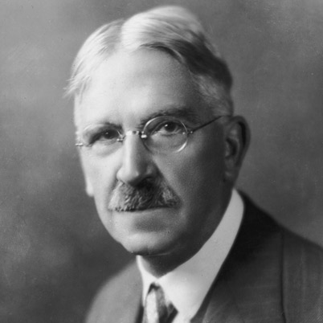
From Lawrence Cremin, A History of Teachers College, Columbia University (1954): 45.
“Dewey…sought to apply the doctrines of experience and experiment to everyday life, and hence, to education…seeking via this model institution to pave the way for the ‘schools of the future.’ There he had put into practice three of the revolutionary beliefs he had culled from the new psychology: that to put the child in possession of his fullest talents, education should be active rather than passive; that to prepare the child for a democratic society, the school should be social than individualistic; and that to enable the child to think creatively, experimentation rather than imitation should be encouraged.”

Slide 21
From John Dewey, Lectures for the First Course in Pedagogy (1896): 28.
“Education consists either in the ability to use one’s powers in a social direction, or else in ability to share in the experiences of others, and thus widen the individual consciousness to that of the race”

Slide 22
From John Dewey, Plan of Organization of the University Primary School (1895): 88.
“The ultimate problem of all education is to coordinate the psychological and social factors…the coordination demands…that the child be capable of expressing himself, but in such a way as to realize social ends.”

Slide 23
G. Stanley Hall (1846-1924)

Slide 24
James McKeen Chattell (1860-1944)

Slide 25
Francis Galton (1822-1911)

Slide 26
James Mark Baldwin (1861-1934)

Slide 27
Charles Judd (1873-1946)

Slide 28
James Earl Russell (1864-1945)

Slide 29
Frank McMurry (1862-1936)

Slide 30
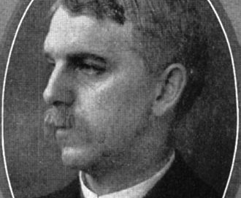
from, Lawrence Cremin, A History of Teachers College, Columbia University (1954): 46.
“Active in the National Educational Association and in the National Society for the Scientific Study of Education, of which his brother Charles McMurry was the executive secretary, Frank soon attracted the attention of James Russell. The result was that in the fall of 1898 he joined the Teachers College Faculty.”

Slide 31
from, Lawrence Cremin, A History of Teachers College, Columbia University (1954): 46.
His own studies of the principles of method of John Dewey emerged in 1907 in his book How to Study and Teaching How to Study, followed by many additional treatments of the same theme. His basic interests also extended to the curriculum of the elementary school; his teaching and writing in this realm quickly established him as a pioneer of modern progressive educational theory.

Slide 32
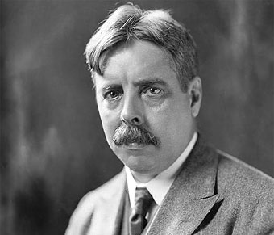
Edward Lee Thorndike (1871-1949)
“Subjects such as arithmetic, language, and history include content that is intrinsically of little value.”

Slide 33
from, Lawrence Cremin, A History of Teachers College, Columbia University (1954): 44
As briefly stated by Thorndike himself, psychology was the science of the intellect, character, and behavior of animals, including man.

Slide 34
from, Lawrence Cremin, A History of Teachers College, Columbia University (1954): 43
Although the Dean found him ‘dealing with the investigations of mice and monkeys,’ he came away ‘satisfied that he was worth trying out on humans.’

Slide 35
from, Edward Thorndike, The Principles of Teaching Based on Psychology (1906): 7-8
“The art of giving and withholding stimuli with the result of producing or preventing certain responses. In this definition, the term stimulus is used widely for any event which influences a person – for a word spoken to him, a look, a sentence which he reads, the air he breathes, etc., etc. The term response is used for any reaction made by him – a new thought, a feeling of interest, a bodily act, any mental or bodily condition resulting from stimulus. The aim of the teacher is to produce desirable and prevent undesirable changes in human beings by producing and preventing certain responses.”

Slide 36
from, Edward Thorndike, The Principles of Teaching Based on Psychology (1906): 7-8
“The means at the disposal of the teacher are the stimuli which can be brought to bear upon the pupil – the teacher’s words, gestures, and appearance, the condition and appliances of the school room, the books to be used and objects to be seen, and so on through a long list of the things and events which the teacher can control.”

Slide 37
from, Edward Thorndike, The Principles of Teaching Based on Psychology (1906): 6
“Education is interested primarily in the general interrelation of man and his environment, in all the changes which make possible a better adjustment of human nature to its surroundings.”

Slide 38
from, Edward Thorndike, Elementary Principles of Education (1929): 308
“Studies of the capacities and interests of young children indicate the advisability of placing little emphasis before the age of six upon either the acquisition of those intellectual resources known as the formal tools – reading, spelling, arithmetic, writing, etc. – or upon abstract intellectual analysis.”

Slide 39
from, Edward Thorndike, Elementary Principles of Education (1929): 311-12
“Despite rapid progress in the right direction, the program of the average elementary school is too narrow and academic in character. Traditionally the elementary school has been primarily devoted to teaching the fundmental subjects, the three Rs, and closely related disciplines.”

Slide 40
from, Edward Thorndike, Elementary Principles of Education (1929): 311-12
“Artificial exercises, like drills on phonetics, multiplication tables, and formal writing movements, are used to a wasteful degree. Subjects such as arithmetic, language, and history include content that is intrinsically of little value. Nearly every subject is enlarged unwisely to satisfy the academic ideal of thoroughness. That the typical school overemphasizes instruction in these formal, academic skills as a means of fostering intellectual resources…is a justifiable criticism.

Slide 41
from, Edward Thorndike, Elementary Principles of Education (1929): 311-12
“Elimination of unessentials by scientific study, then, is one step in improving the curriculum.”

Slide 42
from, Edward Thorndike, Elementary Principles of Education (1929): 310.
1) to provide for each child six years of experience designed to enable him to make at each step in the period adjustments to the most essential phases of life…To adjust this general education to each child requires a considerable degree of specialization in accordance with individual differences.

Slide 43
from, Edward Thorndike, Elementary Principles of Education (1929): 310.
2) to determine as accurately as possible the native intellectual capacities, the physical, emotional temperamental, recreational, aesthetic, and other aptitudes of children. Since some pupils will find it necessary or advisable to enter a vocation in the middle teens, a third function is essential in some degree, namely

Slide 44
from, Edward Thorndike, Elementary Principles of Education (1929): 310.
3) to explore the vocational interests and aptitudes of pupils and to provide some measure of vocational adjustment for those who will leave school at the earliest legal age.”

Slide 45
from, Edward Thorndike, Elementary Principles of Education (1929): 320.
When all facts are taken into account, we believe it will be found that the best interests of the individual and society will be served by providing a certain number of the pupils least gifted in intelligence with the equipment needed to begin their vocational career by the completion of the junior high school period, or even earlier in a few cases.

Slide 46
from, Edward Thorndike, Elementary Principles of Education (1929): 320.
Other individuals will advance their own welfare and that of society by securing but one more year, others by two, others by three additional years. Thus although the great majority of children should spend some time in the junior high school, not all of them should be expected to continue to the completion of the senior-high-school course. Each child should have as much high-school work as the common good requires.

Slide 47
John D. Rockefeller (1839-1937)

Slide 48
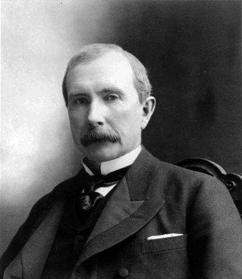
John D. Rockefeller (1839-1937)
I believe the power to make money is a gift from God – just as are the instincts for art, music, literature, the doctor’s talent – to be developed and used to the best of your ability for the good of mankind. Having been endowed with the gift I possess, I believe it is my duty to make money and still more money and to use the money I make for the good of my fellow-man according to the dictates of my conscience.

Slide 49
Frederick Taylor Gates (1853-1929)

Slide 50
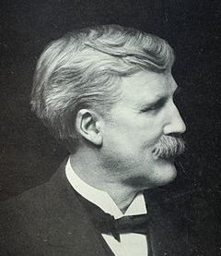
from Peter Collier, The Rockefellers: An American Dynasty (1976): 59.
“I trembled as I witnessed the unreasoning popular resentment at Mr. Rockefeller’s riches, to the mass of people, a national menace. It was not, however, the unreasoning public prejudice of his vast fortune that chiefly troubled me. Was it to be handed on to posterity as other great fortunes have been handed down by their possessors, with scandalous results to their descendants and powerful tendencies to social demoralization? I saw no other course but for Mr. Rockefeller and his son to form a series of great corporate philanthropies for forwarding civilization in all its elements in this land and all lands; philanthropies, if possible, limitless in time and amount, broad in scope, and self-perpetuating.

Slide 51
from John D. Rockefeller, Random Reminiscences of Men and Events (1909): 165.
If a combination to do business is effective in saving waste and in getting better results, why is not combination far more important in philanthropic work?

Slide 52
Robert C. Ogden (1836-1913)

Slide 53
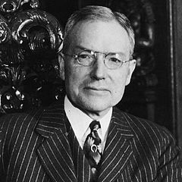
John D. Rockefeller, Jr.
Gates was the brilliant dreamer and creator. I was the salesman – the go-between with father at the opportune moment. Gates and I were father’s lieutenants, each of us with a different task, but acting in perfect harmony. Gates did the heavy thinking, and my part was to sell his ideas to father. Of course, I was in a unique position. I could talk with father at the strategic moment. It might be in a relaxed mood after dinner, or while we were driving together. Consequently I could often get his approval of ideas which others couldn’t have secured because the moment wasn’t right.

Slide 54
The object of this Association is to provide a vehicle through which capitalists of the North who sincerely desire to assist in the great work of Southern education may act with assurance that their money will be wisely used.

Slide 55
In our dreams, we have limitless resources and the people yield themselves with perfect docility to our molding hands. The present education conventions fade from their minds, and unhampered by tradition, we work our own good will upon a grateful and responsive rural folk. We shall not try to make these people or any of their children into philosophers or men of learning, or men of science. We have not to raise up from among them authors, editors, poets or men of letters. We shall not search for embryo great artists, painters, musicians, nor lawyers, doctors, preachers, politicians, statesmen, of whom we have an ample supply. The task we set before ourselves is very simple as well as a very beautiful one, to train these people as we find them to a perfectly ideal life just where they are. So we will organize our children and teach them to do in a perfect way the things their fathers and mothers are doing in an imperfect way, in the homes, in the shops, and on the farm.

Slide 56
John D. Rockefeller (1839-1937)

Slide 57
As a thank offering to Almighty God for the preservation of his family and household on the occasion of the destruction by fire of his country home in Pocantico Hills, New York, on the night of September 17, 1902, my father makes the following pledge. Understanding that the total indebtedness of Teachers College at the present time amounts to $200,000 in round numbers, which same was incurred partly because of a deficit in last year’s running expenses, and partly by reason of certain necessary repairs and alterations; as soon as he shall receive satisfactory evidence that this entire indebtedness has been wiped out my father will contribute two hundred and fifty thousand dollars ($250,000) as an endowment to the college. Furthermore, during a period of two years from the date, my father will duplicate, dollar for dollar, all contributions in cash made by others toward endowment, up to a total from him of two hundred and fifty thousand dollars ($250,000).

Slide 59
Abraham Flexner (1866-1959)

Slide 60
New York Times, January 21, 1917 Section 7 & 8, pg. 2
Unblushing materialism finds its crowning triumph in the theory of the modern school. In the whole plan there is not a spiritual thought, not an idea that rises above the need of finding money for the pocket and food for the belly…It is a matter of instant inquiry, for very sober consideration, whether the general Education Board, indeed, may not with the immense funds at its disposal be able to shape to its will practically all the institutions in which the youth of the country are trained.
If this experiment bears the expected fruit we shall see imposed upon the country a system of education born of the theories of one or two men, and replacing a system which has been the natural outgrowth of the American character and the needs of the American people…The plans of the general Education Board fall for careful examination.

Slide 61
New York Journal of Commerce Senate Congressional Record, Feb. 8, 1917, 2834
Instances can be given in abundance where the mere prospect of an immense gift has changed the whole current of a college administrator’s thought and made him trim his sails on an entirely new tack to catch the favoring breezes of prosperity.

Slide 62
Manufacturers’ Record, Baltimore MD Senate Congressional Record, Feb. 8, 1917, 2834
Control, through possession of the millions massed in the Educational Trust, of two or three or four times as many millions of dollars in education makes possible control of the machinery and the methods of education. It makes it possible for the central controlling body to determine the whole character of American education, the textbooks to be used, the aims to be emphasized. Operating through State, denominational, and individual systems of schools and colleges, it gives the financial controller power to impose upon its beneficiaries its own views, good or bad, and thereby to dominate public opinion in social, economic and political matters.

Slide 63
New Orleans Times -- Democrat Senate Congressional Record, Feb. 8, 1917, 2834
The case here is plainly stated. The fund which the General Education Board administers is largely provided by men whose interest in shaping public opinion upon certain matters of vital concern to society and to the State is very great. Whether their philanthropy serves as a cloak to attain the ends desired, or whether the plan is unselfishly conceived and the sinister influence unconsciously exerted, the effect is likely to be the same in the end.
The gifts are hedged about by restrictions and conditions, with the education board to name them and to see that they are complied with. Every college which shares in the largess poses as a supplicant, in a sense. Not only is its policy partially directed by the Board, but it is additionally influenced, wittingly or unwittingly, by the desires of its benefactors.

Slide 64
Bishop Warren A. Candler, Chancellor of Emory University in Atlanta, GA.
With this financial power in its control, the general board is in position to do what no body in this country can at present even attempt. It can determine largely what institutions shall grow, and in some measure what shall stand still or decay. It can look over the territory of the Nation, note the places where there is a famine of learning, and start new educational plants of any species it chooses, or revive old ones. It can do in many ways what the Government does for education in France and Germany. Its power will be enormous; it seems as if it might be able to determine the character of American education. The funds it holds represent only a fraction of the amounts which it will control; by giving a sum to an institution on condition that the institution raise an equal or greater amount, it will be able to direct much larger amounts than it possesses.

Slide 65
Bishop Warren A. Candler, Chancellor of Emory University in Atlanta, GA.
As a mechanism for controlling academic opinion there had, perhaps, never been anything in the history of education that would compare with the board system of subsidizing learning…
…we owe something to our ancestors, who founded and maintained our older institutions of learning. We have no right to bind up the offerings which they laid upon the altar of higher education in the enslaving conditions prescribed by the Rockefeller board for institutions to which it grants its humiliating doles.

Slide 67
Harold Rugg (1886-1960)

Slide 68
First and foremost, the development of a new philosophy of life and education which will be fully appropriate to the new social order; Second, the building of an adequate plan for the production of a new race of educational workers; Third, the making of new activities and materials for the curriculum.

Slide 69
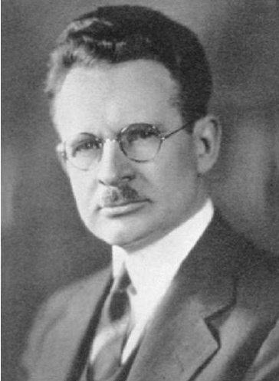
George S. Counts (1889-1974)
Historic capitalism, with its deification of the principle of selfishness, its reliance upon the forces of competition, its placing of property above human rights, and its exaltation of the profit motive, will either have to be displaced altogether, or so radically changed in form and spirit that its identity will be completely lost…That the teachers should deliberately reach for power and then make the most of their conquest is my firm conviction. To the extent that they are permitted to fashion the curriculum and procedures of the school they will definitely and positively influence the social attitudes, ideals and behavior of the coming generation.

Slide 70
William H. Kilpatrick (1861-1975)

