Slide 1
Early Christian Reception of Classical Education
The Greek fathers

Slide 2
St. Justin Martyr The Philosopher (100-165 AD)
St. Justin was a convert to Christianity from paganism, and had been educated in the traditional system of Greco-Roman paideia.
He tells us in his first Apology that he had studied in various philosophical schools, but had never been able to find the true wisdom for which his soul yearned.
In Christianity, he said, he ultimately found the fulfillment of all his deepest desires for wisdom and knowledge.

Slide 3
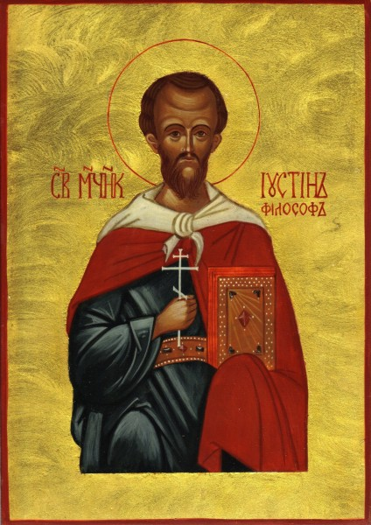
St. Justin’s Teaching on the Logos
The Gospel according to St. John begins: “In the beginning was the Word (Logos) and the Word was with God, and the Word was God.”
St. Justin makes this identification of Christ with the Logos the basis for how pagan Greek philosophers were able to reach certain aspects of truth, albeit dimly, in their speculations, by the “seed of the Logos” (logos spermatikos) that was within them.

Slide 4
From St. Justin’s First Apology
The philosophers called Stoics teach that even God Himself shall be resolved into fire, and they say that the world is to be formed anew by this revolution; but we understand that God, the Creator of all things, is superior to the things that are to be changed. If, therefore, on some points we teach the same things as the poets and philosophers whom you honour, and on other points are fuller and more divine in our teaching, and if we alone afford proof of what we assert, why are we unjustly hated more than all others? For while we say that all things have been produced and arranged into a world by God, we shall seem to utter the doctrine of Plato; and while we say that there will be a burning up of all, we shall seem to utter the doctrine of the Stoics: and while we affirm that the souls of the wicked, being endowed with sensation even after death, are punished, and that those of the good being delivered from punishment spend a blessed existence, we shall seem to say the same things as the poets and philosophers; and while we maintain that men ought not to worship the works of their hands, we say the very things which have been said by the comic poet Menander, and other similar writers, for they have declared that the workman is greater than the work.

Slide 5
From St. Justin’s Second Apology
And those of the Stoic school — since, so far as their moral teaching went, they were admirable, as were also the poets in some particulars, on account of the seed of reason [the Logos] implanted in every race of men— were, we know, hated and put to death — Heraclitus for instance, and, among those of our own time, Musonius and others. For, as we intimated, the devils have always effected, that all those who anyhow live a reasonable and earnest life, and shun vice, be hated. And it is nothing wonderful; if the devils are proved to cause those to be much worse hated who live not according to a part only of the word diffused [among men] but by the knowledge and contemplation of the whole Word, which is Christ. And they, having been shut up in eternal fire, shall suffer their just punishment and penalty. For if they are even now overthrown by men through the name of Jesus Christ, this is an intimation of the punishment in eternal fire which is to be inflicted on themselves and those who serve them. For thus did both all the prophets foretell, and our own teacher Jesus teach

Slide 6
From St. Justin’s Second Apology
Our doctrines, then, appear to be greater than all human teaching; because Christ, who appeared for our sakes, became the whole rational being, both body, and reason, and soul. For I whatever either lawgivers or philosophers uttered well, they elaborated by finding and contemplating some part of the Word. But since they I did not know the whole of the Word, which is Christ, they often contradicted themselves. And those who by human birth were more ancient than Christ, when they attempted to consider and prove things by reason, were brought before the tribunals as impious persons and busybodies.

Slide 7
From St. Justin’s Second Apology
And Socrates, who was more zealous in this direction than all of them, was accused of the very same crimes as ourselves. For they said that he was introducing new divinities, and did not consider those to be gods whom the state recognised. But he cast out from the state both Homer and the rest of the poets, and taught men to reject the wicked demons and those who did the things which the poets related; and he exhorted them to become acquainted with the God who was to them unknown, by means of the investigation of reason, saying, that That it is neither easy to find the Father and Maker of all, nor, having found Him, is it safe to declare Him to all. But these things our Christ did through His own power. For no one trusted in Socrates so as to die for this doctrine, but in Christ, who was partially known even by Socrates (for He was and is the Word who is in every man, and who foretold the things that were to come to pass both through the prophets and in His own person when He was made of like passions, and taught these things), not only philosophers and scholars believed, but also artisans and people entirely uneducated, despising both glory, and fear, and death; since He is a power of the ineffable Father, not the mere instrument of human reason.

Slide 8
From St. Justin’s Second Apology
For I myself, when I discovered tile wicked disguise which the evil spirits had thrown around the divine doctrines of the Christians, to turn aside others from joining them, laughed both at those who framed these falsehoods, and at the disguise itself and at popular opinion and I confess that I both boast and with all my strength strive to be found a Christian; not because the teachings of Plato are different from those of Christ, but because they are not in all respects similar, as neither are those of the others, Stoics, and poets, and historians. For each man spoke well in proportion to the share he had of the spermatic word, seeing what was related to it. But they who contradict themselves on the more important points appear not to have possessed the heavenly wisdom, and the knowledge which cannot be spoken against. Whatever things were rightly said among all men, are the property of us Christians. For next to God, we worship and love the Word who is from the unbegotten and ineffable God, since also He became man for our sakes, that becoming a partaker of our sufferings, He might also bring us healing. For all the writers were able to see realities darkly through the sowing of the implanted word that was in them. For the seed and imitation impacted according to capacity is one thing, and quite another is the thing itself, of which there is the participation and imitation according to the grace which is from Him.

Slide 9
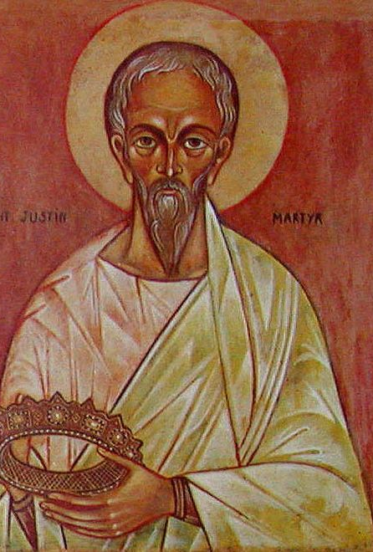
From the Menaion of June 1st
Σοφίᾳ Θεοῦ, Ἰουστῖνος ὁ σοφὸς κεκοσμημένος, τὴν τῶν Ἑλλήνων ἀπεμώρανε, φιλοσoφίαν ἐν χάριτι, πείσας προσκυνεῖν τὴν Τριάδα, ὀρθοδόξως κραυγάζειν τε· Εὐλογητός εἶ ὁ Θεός, ὁ τῶν Πατέρων ἡμῶν.
Adorned by the Wisdom of God, Justin the Wise has confounded the philosophy of the pagans, having persuaded them of philosophy in grace, to worship the Trinity and to cry aloud in Orthodox manner, "Blessed art Thou O God of our fathers!"

Slide 10
Clement of Alexandria (c.150-c.215)
“[Philosophy] was a schoolmaster to bring the Greek mind to Christ, as the Law of Moses was for the Hebrews. Philosophy was a preliminary education (propaideia) preparing the way for him who is to be perfected in Christ” (Strom. 5.5).
By a happy utterance of divination, not without divine help, concurring in certain prophetic declarations, and, seizing the truth in portions and aspects, in terms not obscure, and not going beyond the explanation of the things, [the philosophers] honored it as pertaining the appearance of relation with the truth. Whence the Hellenic philosophy is like the torch of wick which men kindle, artificially stealing the light from the sun. But on the proclamation of the Word all that holy light shone forth. In this way, in houses by night the stolen light is useful; but by day the fire blazes, and all the night is illuminated by such a sun of intellectual light.

Slide 11
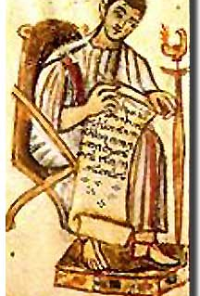
Tatian (c.120 – c.180)
Tatian was a convert to Christianity from paganism, and had been educated in the traditional Roman system.
He is the most extreme critic of classical culture and literature to be found among the early Christian writers.
He died outside the Church as the author of the Encratite heresy.

Slide 12
“Address to the Greeks”
Tatian’s Oratio ad Graecos (Address to the Greeks) condemns paganism as worthless, and praises the reasonableness and high antiquity of Christianity. As early as Eusebius, a 4th century Church historian and bishop of Caesarea, Tatian was praised for his discussions of the antiquity of Moses and of the Hebraic law, and it was because of this chronological section of the Oratio that it was not generally condemned, though its anti-intellectual spirit is very much out of keeping with the other Greek fathers.

Slide 13
Saint Basil the Great (330 – 379)

