Slide 1
Early Christian Reception of Classical Education
The Latin fathers

Slide 2
Historical Context
When Christianity first arrived in Rome, the instruction of the youth was largely confined to the study of poets and historians, chief among whom at a very early date appear the quadriga of Vergil and Terrence, Sallust and Livy.
Until the peace of the Church, early in the fourth century, the value and use of classical studies were not even questioned.
The new converts to Christianity brought with them such mental cultivation as they had received while still pagans.
They used their knowledge of mythology and ancient traditions as a means of attacking paganism; their skills as orators and writers were placed at the service of proclaiming their new Faith.
They could not conceive how a thorough education could be obtained under any conditions other than those in which they had grown up.

Slide 3
Minucius Felix (d. 260) is perfect example of this
He wrote a dialogue in defense of the Christian faith, the Octavius (the form is unique among early Christian writings, being itself a Platonic borrowing).
In it he carefully gathered together whatever seemed to show harmony between the new doctrine and ancient learning.

Slide 4
Analogous to Tatian in the East, Tertullian in the West is the sole voice among early Christian Latins decrying Christian participation in secular education. He forbade Christians to teach, for instance, although he admitted that school attendance by Christian pupils was unavoidable (De Idolatria 10).
Quaerendum autem est etiam de ludimagistris, sed et ceteris professoribus litterarum. Immo non dubitandum affines illos esse multimodae idololatriae. Primum quibus necesse est deos nationum praedicare, nomina, genealogias, fabulas, ornamenta honorifica quaeque eorum enuntiare, tum sollemnia festaque eorundem obseruare, ut quibus uectigalia sua supputent. Quis ludimagister sine tabula VIIidolorum Quinquatria tamen frequentabit? Ipsam primam noui discipuli stipem Mineruae et honori et nomini consecrat, ut, etsi non profanatus alicui idolo uerbotenus de idolothyto esse dicatur, pro idololatra uitetur. Quid? Minus est inquinamenti? Eoque praestat quaestus et nominibus et honoribus idolo nuncupatus? Quam Minerualia Mineruae, quam Saturnalia Saturni, quae etiam seruiculis sub tempore Saturnalium celebrari necesse est. Etiam strenuae captandae et septimontium, et Brumae et carae cognationis honoraria exigenda omnia, Florae scholae coronandae ; flaminicae et aediles sacrificant creati; schola honoratur feriis. Idem fit idoli natali; omnis diaboli pompa frequentatur. Quis haec competere Christiano existimabit, nisi qui putabit conuenire etiam non magistro? Scimus dici posse: si docere litteras dei seruis non licet, etiam nec discere licebit, et, quomodo quis institueretur ad prudentiam interim humanam uel ad quemcumque sensum uel actum, cum instrumentum sit ad omnem uitam litteratura? Quomodo repudiamus saecularia studia, sine quibus diuina non possunt? [5] Videamus igitur necessitatem litteratoriae eruditionis, respiciamus ex parte eam admitti [non] posse, ex parte uitari. Fideles magis discere quam docere litteras capit; diuersa est enim ratio discendi et docendi. Si fidelis litteras doceat, insertas idolorum praedicationes sine dubio, dum docet, commendat, dum tradit, affirmat, dum commemorat, testimonium dicit. [6] Deos ipsos hoc nomine obsignat, cum lex prohibeat, ut diximus, deos pronuntiari et nomen hoc in uano conlocari. Hinc prima diabolo fides aedificatur ab initiis eruditionis. Quaere, an idololatrian committat qui de idolis catechizat. At cum fidelis haec discit, si iam sapit, quid sit, neque recipit neque admittit, multo magis, si dudum sapit. Aut ubi coeperit sapere, prius sapiat oportet quod prius didicit, id est de deo et fide. Proinde illa respuet nec recipiet et erit tam tutus, quam qui sciens uenenum ab ignaro accipit nec bibit. Huic necessitas ad excusationem deputatur, quia aliter discere non potest. Tanto autem facilius est litteras non docere quam non discere, quanto et reliqua scholarum de publicis ac propriis sollemnitatibus inquinamenta facilius discipulis fidelis non adibit quam magister non frequentabit.

Slide 5
Nevertheless, such rigorist views were never carried out even so far as the prohibition of teaching was concerned.
Arnobius taught rhetoric, and was very proud of having Christian colleagues. (Adversus Nationes II.4)
One of Arnobius’ students was Lactantius, himself a rhetorician and imperial professor at Nicomedia.
Among the martyrs, we hear of school teachers like Cassianus (Prudentius, Persist. 9) whom his pupils stabbed to death with a stylus; also Gorgonis, another humble teacher, whose epitaph in the Roman catacombs dates from the third century.
The final persecution of the Church, under Julian (360-362) led Christian writers to express more definitely their own views on the subject.

Slide 6
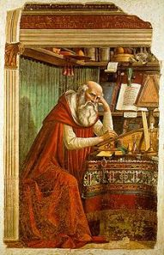
Marius Victorinus (290-364)
imperatoris Iuliani temporibus lege data prohibiti sunt christiani docere litteraturam et oratoriam. quam legem ille amplexus, loquacem scholam deserere maluit quam verbum tuum, quo linguas infantium facis disertas.
--St. Augustine Confessions VIII.5

Slide 7
During the fourth century, there sprang up an opposition between classical literature and the Bible.

Slide 8
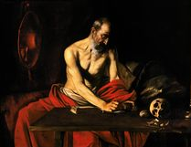
In the Sacred Scriptures, St. Jerome discovered a Horace, a Catullus, and an Alcaeus.
Epistle 30

Slide 9
In his quarrel with Rufinus, St. Jerome declares that he has not read the profane authors since he left school, “though I admit I read them while there. Must I drink then the waters of Lethe that I may forget?” (Adv. Ruf. I.30)
Thus in defending himself, the first figure that occurs to him is taken from mythology.
On another occasion (Epist. 21), he finds fault with ecclesiastics who find too keen a pleasure in the reading of Vergil, adding nevertheless, that youths are indeed compelled to study him.

Slide 10
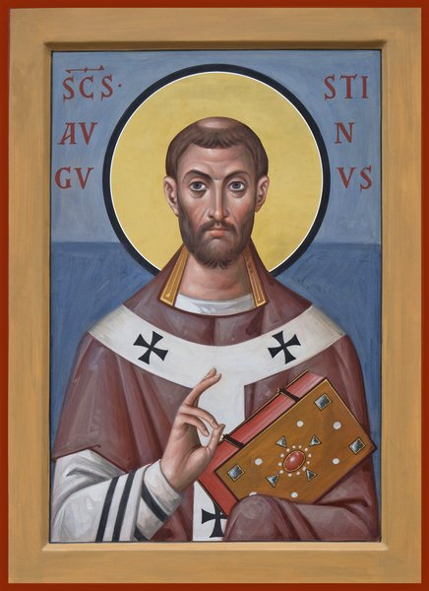
In his De Doctrina Christiana, Saint Augustine (354-430) shows how the scriptures could be turned to account for the study of eloquence; he analyses periods for instance of the Prophet Amos, and shows examples of rhetorical figures in the Epistles of St Paul.
De Doctrina Christiana IV 6-7

Slide 11
9. Here, perhaps, some one inquires whether the authors whose divinely-inspired writings constitute the canon, which carries with it a most wholesome authority, are to be considered wise only, or eloquent as well. A question which to me, and to those who think with me, is very easily settled. For where I understand these writers, it seems to me not only that nothing can be wiser, but also that nothing can be more eloquent. And I venture to affirm that all who truly understand what these writers say, perceive at the same time that it could not have been properly said in any other way. For as there is a kind of eloquence that is more becoming in youth, and a kind that is more becoming in old age, and nothing can be called eloquence if it be not suitable to the person of the speaker, so there is a kind of eloquence that is becoming in men who justly claim the highest authority, and who are evidently inspired of God. With this eloquence they spoke; no other would have been suitable for them; and this itself would be unsuitable in any other, for it is in keeping with their character, while it mounts as far above that of others (not from empty inflation, but from solid merit) as it seems to fall below them. Where, however, I do not understand these writers, though their eloquence is then less apparent, I have no doubt but that it is of the same kind as that I do understand. The very obscurity, too, of these divine and wholesome words was a necessary element in eloquence of a kind that was designed to profit our understandings, not only by the discovery of truth, but also by the exercise of their powers.
10. I could, however, if I had time, show those men who cry up their own form of language as superior to that of our authors (not because of its majesty, but because of its inflation), that all those powers and beauties of eloquence which they make their boast, are to be found in the sacred writings which God in His goodness has provided to mould our characters, and to guide us from this world of wickedness to the blessed world above. But it is not the qualities which these writers have in common with the heathen orators and poets that give me such unspeakable delight in their eloquence; I am more struck with admiration at the way in which, by an eloquence peculiarly their own, they so use this eloquence of ours that it is not conspicuous either by its presence or its absence: for it did not become them either to condemn it or to make an ostentatious display of it; and if they had shunned it, they would have done the former; if they had made it prominent, they might have appeared to be doing the latter. And in those passages where the learned do note its presence, the matters spoken of are such, that the words in which they are put seem not so much to be sought out by the speaker as spontaneously to suggest themselves; as if wisdom were walking out of its house,—that is, the breast of the wise man, and eloquence, like an inseparable attendant, followed it without being called for.

Slide 12
11. For who would not see what the apostle meant to say, and how wisely he has said it, in the following passage: “We glory in tribulations also: knowing that tribulation worketh patience; and patience, experience; and experience, hope: and hope maketh not ashamed; because the love of God is shed abroad in our hearts by the Holy Ghost which is given unto us”? Now were any man unlearnedly learned (if I may use the expression) to contend that the apostle had here followed the rules of rhetoric, would not every Christian, learned or unlearned, laugh at him? And yet here we find the figure which is called in Greek κλίμαζ (climax,) and by some in Latin gradatio, for they do not care to call it scala (a ladder), when the words and ideas have a connection of dependency the one upon the other, as we see here that patience arises out of tribulation, experience out of patience, and hope out of experience. nother ornament, too, is found here; for after certain statements finished in a single tone of voice, which we call clauses and sections (membra et cæsa), but the Greeks κῶλα and κόμματα, there follows a rounded sentence (ambitus sive circuitus) which the Greeks call περίοδος, the clauses of which are suspended on the voice of the speaker till the whole is completed by the last clause. For of the statements which precede the period, this is the first clause, “knowing that tribulation worketh patience;” the second, “and patience, experience;” the third, “and experience, hope.” Then the period which is subjoined is completed in three clauses, of which the first is, “and hope maketh not ashamed;” the second, “because the love of God is shed abroad in our hearts;” the third, “by the Holy Ghost which is given unto us.” But these and other matters of the same kind are taught in the art of elocution. As then I do not affirm that the apostle was guided by the rules of eloquence, so I do not deny that his wisdom naturally produced, and was accompanied by, eloquence.
12. In the Second Epistle to the Corinthians, again, he refutes certain false apostles who had gone out from the Jews, and had been trying to injure his character; and being compelled to speak of himself, though he ascribes this as folly to himself, how wisely and how eloquently he speaks! But wisdom is his guide, eloquence his attendant; he follows the first, the second follows him, and yet he does not spurn it when it comes after him. “I say again,” he says, “Let no man think me a fool: if otherwise, yet as a fool receive me, that I may boast myself a little. That which I speak, I speak it not after the Lord, but as it were foolishly, in this confidence of boasting. Seeing that many glory after the flesh, I will glory also. For ye suffer fools gladly, seeing ye yourselves are wise. For ye suffer, if a man bring you into bondage, if a man devour you, if a man take of you, if a man exalt himself, if a man smite you on the face. I speak as concerning reproach, as though we had been weak. Howbeit, whereinsoever any is bold (I speak foolishly), I am bold also. Are they Hebrews? so am I. Are they Israelites? so am I. Are they the seed of Abraham? so am I. Are they ministers of Christ? (I speak as a fool), I am more: in labors more abundant, in stripes above measure, in prisons more frequent, in deaths oft. Of the Jews five times received I forty stripes save one, thrice was I beaten with rods, once was I stoned, thrice I suffered shipwreck, a night and a day I have been in the deep; in journeyings often, in perils of waters, in perils of robbers, in perils by mine own countrymen, in perils by the heathen, in perils in the city, in perils in the wilderness, in perils in the sea, in perils among false brethren; in weariness and painfulness, in watchings often, in hunger and thirst, in fastings often, in cold and nakedness. Besides those things which are without, that which cometh upon me daily, the care of all the churches. Who is weak, and I am not weak? who is offended, and I burn not? If I must needs glory, I will glory of the things which concern my infirmities.” The thoughtful and attentive perceive how much wisdom there is in these words. And even a man sound asleep must notice what a stream of eloquence flows through them.

Slide 13
13. Further still, the educated man observes that those sections which the Greeks call κόμματα, and the clauses and periods of which I spoke a short time ago, being intermingled in the most beautiful variety, make up the whole form and features (so to speak) of that diction by which even the unlearned are delighted and affected. For, from the place where I commenced to quote, the passage consists of periods: the first the smallest possible, consisting of two members; for a period cannot have less than two members, though it may have more: “I say again, let no man think me a fool.” The next has three members: “if otherwise, yet as a fool receive me, that I may boast myself a little.” The third has four members: “That which I speak, I speak it not after the Lord, but as it were foolishly, in this confidence of boasting.” The fourth has two: “Seeing that many glory after the flesh, I will glory also.” And the fifth has two: “For ye suffer fools gladly, seeing ye yourselves are wise.” The sixth again has two members: “for ye suffer, if a man bring you into bondage.” Then follow three sections (cæsa): “if a man devour you, if a man take of you, if a man exalt himself.” Next three clauses (membra): if p. 579 “a man smite you on the face. I speak as concerning reproach, as though we had been weak.” Then is subjoined a period of three members: “Howbeit, whereinsoever any is bold (I speak foolishly), I am bold also.” After this, certain separate sections being put in the interrogatory form, separate sections are also given as answers, three to three: “Are they Hebrews? so am I. Are they Israelites? so am I. Are they the seed of Abraham? so am I.” But a fourth section being put likewise in the interrogatory form, the answer is given not in another section (cæsum) but in a clause (membrum): 1944 “Are they the ministers of Christ? (I speak as a fool.) I am more.” Then the next four sections are given continuously, the interrogatory form being most elegantly suppressed: “in labors more abundant, in stripes above measure, in prisons more frequent, in deaths oft.” Next is interposed a short period; for, by a suspension of the voice, “of the Jews five times” is to be marked off as constituting one member, to which is joined the second, “received I forty stripes save one.” Then he returns to sections, and three are set down: “Thrice was I beaten with rods, once was I stoned, thrice I suffered shipwreck.” Next comes a clause: “a night and a day I have been in the deep.” Next fourteen sections burst forth with a vehemence which is most appropriate: “In journeyings often, in perils of waters, in perils of robbers, in perils by mine own countrymen, in perils by the heathen, in perils in the city, in perils in the wilderness, in perils in the sea, in perils among false brethren, in weariness and painfulness, in watchings often, in hunger and thirst, in fastings often, in cold and nakedness.” After this comes in a period of three members: “Besides those things which are without, that which cometh upon me daily, the care of all the churches.” And to this he adds two clauses in a tone of inquiry: “Who is weak, and I am not weak? who is offended, and I burn not?” In fine, this whole passage, as if panting for breath, winds up with a period of two members: “If I must needs glory, I will glory of the things which concern mine infirmities.” And I cannot sufficiently express how beautiful and delightful it is when after this outburst he rests himself, and gives the hearer rest, by interposing a slight narrative. For he goes on to say: “The God and Father of our Lord Jesus Christ, which is blessed for evermore, knoweth that I lie not.” And then he tells, very briefly the danger he had been in, and the way he escaped it.

Slide 14
4. It would be tedious to pursue the matter further, or to point out the same facts in regard to other passages of Holy Scripture. Suppose I had taken the further trouble, at least in regard to the passages I have quoted from the apostle’s writings, to point out figures of speech which are taught in the art of rhetoric? Is it not more likely that serious men would think I had gone too far, than that any of the studious would think I had done enough? All these things when taught by masters are reckoned of great value; great prices are paid for them, and the vendors puff them magniloquently. And I fear lest I too should smack of that puffery while thus descanting on matters of this kind. It was necessary, however, to reply to the ill-taught men who think our authors contemptible; not because they do not possess, but because they do not display, the eloquence which these men value so highly.
15. But perhaps some one is thinking that I have selected the Apostle Paul because he is our great orator. For when he says, “Though I be rude in speech, yet not in knowledge,” 1945 he seems to speak as if granting so much to his detractors, not as confessing that he recognized its truth. If he had said, “I am indeed rude in speech, but not in knowledge,” we could not in any way have put another meaning upon it. He did not hesitate plainly to assert his knowledge, because without it he could not have been the teacher of the Gentiles. And certainly if we bring forward anything of his as a model of eloquence, we take it from those epistles which even his very detractors, who thought his bodily presence weak and his speech contemptible, confessed to be weighty and powerful. 1946
I see, then, that I must say something about the eloquence of the prophets also, where many things are concealed under a metaphorical style, which the more completely they seem buried under figures of speech, give the greater pleasure when brought to light. In this place, however, it is my duty to select a passage of such a kind that I shall not be compelled to explain the matter, but only to commend the style. And I shall do so, quoting principally from the book of that prophet who says that he was a shepherd or herdsman, and was called by God from that occupation, and sent to prophesy to the people of God. 1947 I shall not, however, follow the Septuagint translators, who, being themselves under the guidance of the Holy Spirit in their p. 580 translation, seem to have altered some passages with the view of directing the reader’s attention more particularly to the investigation of the spiritual sense; (and hence some passages are more obscure, because more figurative, in their translation;) but I shall follow the translation made from the Hebrew into Latin by the presbyter Jerome, a man thoroughly acquainted with both tongues.

Slide 15
16. When, then, this rustic, or quondam rustic prophet, was denouncing the godless, the proud, the luxurious, and therefore the most neglectful of brotherly love, he called aloud, saying: “Woe to you who are at ease in Zion, and trust in the mountain of Samaria, who are heads and chiefs of the people, entering with pomp into the house of Israel! Pass ye unto Calneh, and see; and from thence go ye to Hamath the great; then go down to Gath of the Philistines, and to all the best kingdoms of these: is their border greater than your border? Ye that are set apart for the day of evil, and that come near to the seat of oppression; that lie upon beds of ivory, and stretch yourselves upon couches that eat the lamb of the flock, and the calves out of the midst of the herd; that chant to the sound of the viol. They thought that they had instruments of music like David; drinking wine in bowls, and anointing themselves with the costliest ointment: and they were not grieved for the affliction of Joseph.” Suppose those men who, assuming to be themselves learned and eloquent, despise our prophets as untaught and unskillful of speech, had been obliged to deliver a message like this, and to men such as these, would they have chosen to express themselves in any respect differently—those of them, at least, who would have shrunk from raving like madmen?
17. For what is there that sober ears could wish changed in this speech? In the first place, the invective itself; with what vehemence it throws itself upon the drowsy senses to startle them into wakefulness: “Woe to you who are at ease in Zion, and trust in the mountains of Samaria, who are heads and chiefs of the people, entering with pomp into the house of Israel!” Next, that he may use the favors of God, who has bestowed upon them ample territory, to show their ingratitude in trusting to the mountain of Samaria, where idols were worshipped: “Pass ye unto Calneh,” he says, “and see; and from thence go ye to Hamath the great; then go down to Gath of the Philistines, and to all the best kingdoms of these: is their border greater than your border?” At the same time also that these things are spoken of, the style is adorned with names of places as with lamps, such as “Zion,” “Samaria,” “Calneh,” “Hamath the great,” and “Gath of the Philistines.” Then the words joined to these places are most appropriately varied: “ye are at ease,” “ye trust,” “pass on,” “go,” “descend.”
18. And then the future captivity under an oppressive king is announced as approaching, when it is added: “Ye that are set apart for the day of evil, and come near to the seat of oppression.” Then are subjoined the evils of luxury: “ye that lie upon beds of ivory, and stretch yourselves upon couches; that eat the lamb from the flock, and the calves out of the midst of the herd.” These six clauses form three periods of two members each. For he does not say: Ye who are set apart for the day of evil, who come near to the seat of oppression, who sleep upon beds of ivory, who stretch yourselves upon couches, who eat the lamb from the flock, and calves out of the herd. If he had so expressed it, this would have had its beauty: six separate clauses running on, the same pronoun being repeated each time, and each clause finished by a single effort of the speaker’s voice. But it is more beautiful as it is, the clauses being joined in pairs under the same pronoun, and forming three sentences, one referring to the prophecy of the captivity: “Ye that are set apart for the day of evil, and come near the seat of oppression;” the second to lasciviousness: “ye that lie upon beds of ivory, and stretch yourselves upon couches;” the third to gluttony: “who eat the lamb from the flock, and the calves out of the midst of the herd.” So that it is at the discretion of the speaker whether he finish each clause separately and make six altogether, or whether he suspend his voice at the first, the third, and the fifth, and by joining the second to the first, the fourth to the third, and the sixth to the fifth, make three most elegant periods of two members each: one describing the imminent catastrophe; another, the lascivious couch; and the third, the luxurious table.

Slide 16
19. Next he reproaches them with their luxury in seeking pleasure for the sense of hearing. And here, when he had said, “Ye who chant to the sound of the viol,” seeing that wise men may practise music wisely, he, with wonderful skill of speech, checks the flow of his invective, and not now speaking to, but of, these men, and to show us that we must distinguish the music of the wise from the p. 581 music of the voluptuary, he does not say, “Ye who chant to the sound of the viol, and think that ye have instruments of music like David;” but he first addresses to themselves what it is right the voluptuaries should hear, “Ye who chant to the sound of the viol;” and then, turning to others, he intimates that these men have not even skill in their art: “they thought that they had instruments of music like David; drinking wine in bowls, and anointing themselves with the costliest ointment.” These three clauses are best pronounced when the voice is suspended on the first two members of the period, and comes to a pause on the third.
20. But now as to the sentence which follows all these: “and they were not grieved for the affliction of Joseph.” Whether this be pronounced continuously as one clause, or whether with more elegance we hold the words, “and they were not grieved,” suspended on the voice, and then add, “for the affliction of Joseph,” so as to make a period of two members; in any case, it is a touch of marvelous beauty not to say, “and they were not grieved for the affliction of their brother;” but to put Joseph for brother, so as to indicate brothers in general by the proper name of him who stands out illustrious from among his brethren, both in regard to the injuries he suffered and the good return he made. And, indeed, I do not know whether this figure of speech, by which Joseph is put for brothers in general, is one of those laid down in that art which I learnt and used to teach. But how beautiful it is, and how it comes home to the intelligent reader, it is useless to tell any one who does not himself feel it.
21. And a number of other points bearing on the laws of eloquence could be found in this passage which I have chosen as an example. But an intelligent reader will not be so much instructed by carefully analysing it as kindled by reciting it with spirit. Nor was it composed by man’s art and care, but it flowed forth in wisdom and eloquence from the Divine mind; wisdom not aiming at eloquence, yet eloquence not shrinking from wisdom. For if, as certain very eloquent and acute men have perceived and said, the rules which are laid down in the art of oratory could not have been observed, and noted, and reduced to system, if they had not first had their birth in the genius of orators, is it wonderful that they should be found in the messengers of Him who is the author of all genius? Therefore let us acknowledge that the canonical writers are not only wise but eloquent also, with an eloquence suited to a character and position like theirs.

Slide 17
St. Augustine suggested his method, however, only to those who wished to become priests, and even for these he did not mean to make it obligatory. Others were permitted to use the ordinary method of instruction.
Additionally, the De Doctrina Christiana was written in the year 427, at a time in which the Saint’s advancing old age and the increasing strictness of monastic life might have inclined Augustine to a rigorous solution.

Slide 18
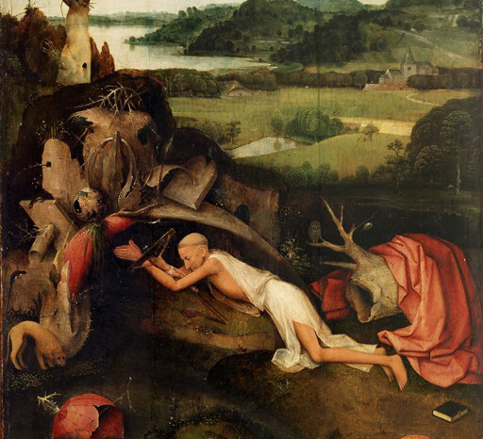
Most famously, in regards to the relationship of Christian piety and classical learning, St. Jerome relates a vision he had (Epist. 21)

Slide 19
What they desired seems not so much to be the separation, but rather the combination of the treasures of classical literature and of Christian truth.
St. Jerome, for instance, recalls the precept of Deuteronomy: “If you desire to marry a captive, you must first shave her head and eyebrows, shave the hair on her body and cut her nails, so must it be done with profane literature, after having removed all that was earthly and idolatrous, unite with her and make her fruitful to the Lord.” (Epist. 83)
St. Augustine uses another Biblical allegory. For him, the Christian who seeks his knowledge in the pagan authors resembles the Israelites who despoil the Egyptians of their treasures in order to build the tabernacle of God.

Slide 20
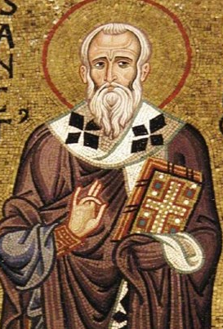
This trepidation on the part of many prominent Latin Church Fathers is to be contrasted with the ease and liberality of St. Ambrose of Milan (337-397), one of the last Latin bishops to be educated in the traditional, Greek paideia.
He has no doubts or fears whatsoever as touching up the value of the classical humanities, quoting freely from Seneca, Vergil, the Consolatio of Servius Sulpicius, Homer, Plato, and even Epicurus.
He accepts the earlier view handed down from the Apologists of previous generations (like St. Justin the philosopher) that ultimately everything good found in the literature of the ancients comes from God.
He often takes exempla from the classical poets, and uses them in a distinctively Christian way.

Slide 21
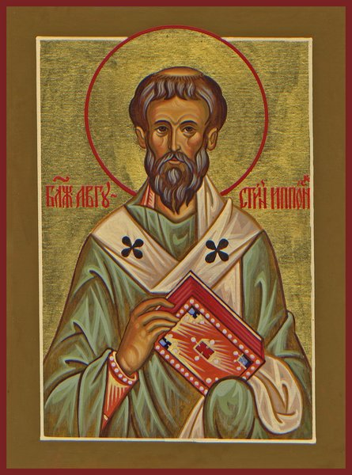
Nevertheless, in all of this, it was universally presupposed that pagan studies were subordinate to Christian truth.
In the second book of his De Doctrina Christiana, Saint Augustine explains how pagan classics lead to a more perfect apprehension of the Christian Scriptures, and are indeed an introduction to them.
In this sense, St. Jerome in a letter to one Magnus, a professor of eloquence at Rome, recommends the use of classical authors; classical literature was a captive (Epist. 85)
Indeed, men neither dared nor were able to do without classical teaching.

Slide 22
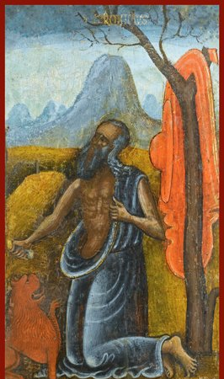
St. Jerome’s Letter on the Education of Christian Girl is one of the most eloquent articulations of the fusion of Classical education and Christian piety in Late Antiquity

Slide 23
Saint Augustine’s Dialogue De Magistro (On the Teacher) is a Christian response to the problems posed in Plato’s dialogue Meno

Slide 24
“Meno’s Paradox”
Meno asks Socrates: "And how will you inquire into a thing when you are wholly ignorant of what it is? Even if you happen to bump right into it, how will you know it is the thing you didn't know?" Socrates rephrases the question, which has come to be the canonical statement of the paradox: "[A] man cannot search either for what he knows or for what he does not know[.] He cannot search for what he knows--since he knows it, there is no need to search--nor for what he does not know, for he does not know what to look for."[

Slide 25
Socrates responds to this sophistical paradox with a mythos (poetic story) according to which souls are immortal and have learned everything prior to transmigrating into the human body. Since the soul has had contact with real things prior to birth, we have only to 'recollect' them when alive. Such recollection requires Socratic questioning, which according to Socrates is not teaching. Socrates demonstrates his method of questioning and recollection by interrogating a slave who is ignorant of geometry.

Slide 26
Socrates begins one of the most influential dialogues of Western philosophy regarding the argument for inborn knowledge. By drawing geometric figures in the ground Socrates demonstrates that the slave is initially unaware of the length that a side must be in order to double the area of a square with two-foot sides. The slave guesses first that the original side must be doubled in length (four feet), and when this proves too much, that it must be three feet. This is still too much, and the slave is at a loss.

Slide 27
Socrates claims that before he got hold of him the slave (who has been picked at random from Meno's entourage) might have thought he could speak "well and fluently" on the subject of a square double the size of a given square. Socrates comments that this "numbing" he caused in the slave has done him no harm and has even benefited him.

Slide 28
Socrates then draws a second square figure using the diagonal of the original square. Each diagonal cuts each two foot square in half, yielding an area of two square feet. The square composed of four of the eight interior triangular areas is eight square feet, double that of the original area. He gets the slave to agree that this is twice the size of the original square and says that he has "spontaneously recovered" knowledge he knew from a past life without having been taught. Socrates is satisfied that new beliefs were "newly aroused" in the slave.

Slide 29
Socrates then draws a second square figure using the diagonal of the original square. Each diagonal cuts each two foot square in half, yielding an area of two square feet. The square composed of four of the eight interior triangular areas is eight square feet, double that of the original area. He gets the slave to agree that this is twice the size of the original square and says that he has "spontaneously recovered" knowledge he knew from a past life without having been taught. Socrates is satisfied that new beliefs were "newly aroused" in the slave.

Slide 30
After witnessing the example with the slave boy, Meno tells Socrates that he thinks that Socrates is correct in his theory of recollection, to which Socrates replies, “I think I am.
This demonstration shows the slave capable of learning a geometrical truth, because "he already has the knowledge in his soul.“ In this way, Socrates shows Meno that learning is possible through recollection, and that the learner's paradox is false. Meno's paradox claims that learning is impossible, but the examination of the slave shows that it is possible.

