Slide 1
Lecture Two
Modern Theoretical Approaches to Myth

Slide 2
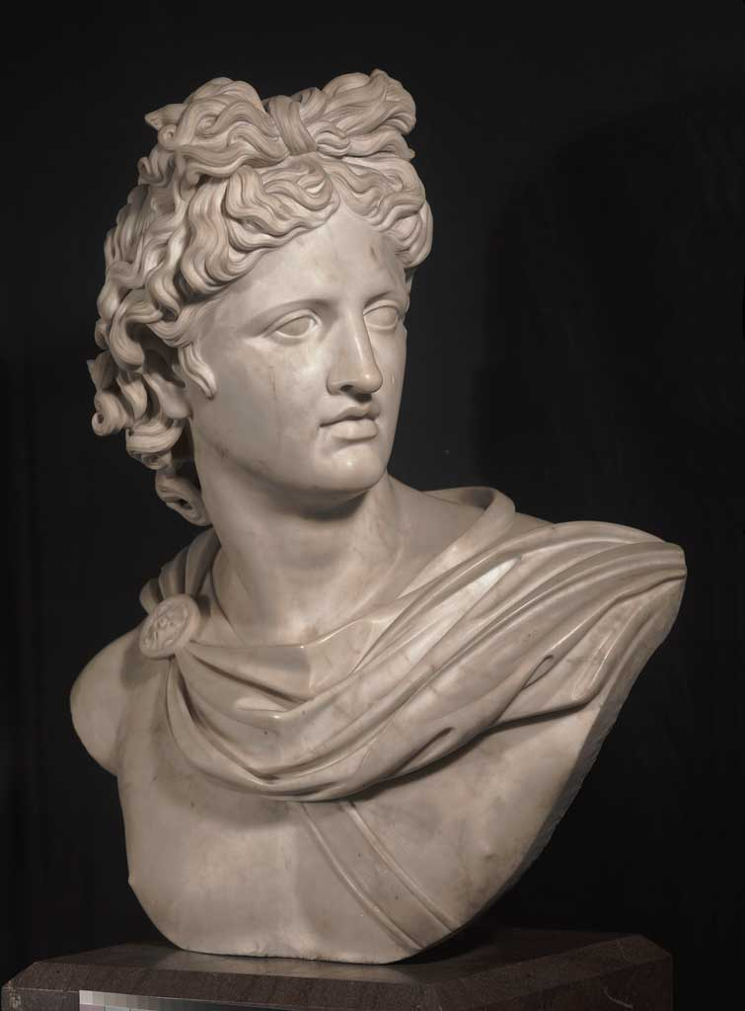
What is Myth?

Slide 3
The Question of Myth
The question “what is myth?” has no easy or obvious answer. As used in popular speech, “myth” has several meanings that we can exclude right away.
It is often used to mean a lie, a mistaken belief, or a misconception.
These usages do not concern us here.
Despite the difficulties of definition, most people have a sense that the category of myth exists, and that they know it when they see it.

Slide 4
We can begin to supplement our working definition by identifying five characteristics of “myth”

Slide 5
Myths are traditional tales or stories. Myths are presented in narrative form. Myths are handed down in a society from one generation to the next. It is usually impossible to say who first “invented” a particular myth. In this regard, they are unlike most other forms of narrative, such as poems, novels, and plays.

Slide 6
Myths are set in the past. A myth recounts events of long ago (usually very long ago). Myths often reflect the assumption that in the far past, things were different in many ways.

Slide 7
Myths are ostensibly “true;” that is, they present themselves as giving an accurate narrative of “what really happened.” A culture rarely recognizes its own mythology as mythology. Judged from within a culture, myths are true accounts of the way things really are.

Slide 8
Myths often explain, justify, instruct, or warn. An aetiological myth may explain why things are as they are, or how certain events, entities, or conditions came into existence. A charter myth may offer a justification for a certain rite or social institution. A myth may instruct its audience in how people ought or ought not to behave. Such instruction frequently takes the form of a warning by showing the consequences of misbehavior.

Slide 9
Myths frequently concern gods and the supernatural. This area of myth overlaps with religion. Obviously, categorization of certain narratives about divinities as “myths” depends largely on whether the observer believes those narratives or not.

Slide 10
From antiquity onward, many scholars have come up with theories that attempt to define and explain myth. These theories fall into two main types, which could be called the “what” and the “why” types of theory.

Slide 11
“What theories attempt to explain myth by identifying it as a subcategory, derivative, or forerunner of something else (such as history, ritual, or philosophy). At their worst, such theories are excessively reductive; they tend to say that myth “is only” misunderstood history, or primitive science, or some other thing.

Slide 12
Even at their best, such theories tend to ignore the distinctive qualities that make myth appealing; the theories cannot explain why transformations into myth occur in the first place.

Slide 13
“Why” theories look for wider explanations to identify the impetus in the human mind or human culture that motivates myth-making. Psychological and structuralist theories fall under this heading.
“Why” theories assume that myth is an extra- or transcultural phenomenon; the same narrative elements serve the same functions in different cultures.

Slide 14
Some overlap exists, of course, between these two types of theories.
As we shall see, “what” theories were more common in the 19th century, and “why” theories in the 20th.

Slide 15
One very popular theory that has been resurrected over and over since antiquity is that myths are a form of allegory.

Slide 16
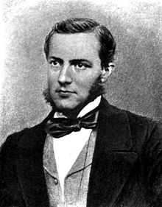
Max Müller (1823-1900) was a German born philologist who lived and studied in Britain for most of his life.
He developed the allegorical interpretation of myth into what is often called the “Solar Mythology” theory. Müller thought that myths were misunderstood statements about the battle between light (specifically sunlight) and darkness. In a phrase that became infamous, Müller said that mythology is “a disease of language.” (“Krankheit der Sprache”). He meant that as terms changed meaning, people misinterpreted them. Thus the “maiden dawn” came to be seen, much later, as a female deity.

Slide 17
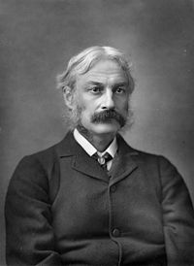
The primary challenge to Müller’s theory was mounted by the Scottish poet and folklorist Andrew Lang (1844-1912)
Lang saw explanation as the essential function of myth. Myth, he thought, was driven by the same impulse that would later develop into science; in fact, myths were “primitive” science. Thus all myths were basically aetiological.

Slide 18
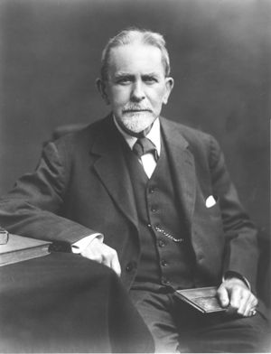
One of the most influential theorists was Scottish social anthropologist & scholar of mythology and comparative religion, Sir James Frazer (1854-1941)
For Frazer, myth was part of a continuum, running from magic through religion to science. He modified the idea of myth as explanation to argue that myth, in all societies, was specifically an explanation for ritual.

Slide 19
In The Golden Bough (first published in 1890), Frazer presented evidence collected from around the world to demonstrate myth’s origins in primordial religious beliefs common to most human societies. He argued that narratives of myth remain long after the rituals that are based on have disappeared. The most important strand of Frazer’s argument was his claim about a “King of the Wood,” who represented grain, and who had to be killed by a younger successor.

Slide 20
The Golden Bough was a pioneering work, but its methodology was flawed, and few scholars today accept its premises. Frazer took examples out of context and claimed that details from myths in different societies performed the same function. Frazer’s work inspired “The Cambridge School” of myth scholars, who saw ritual as the primary motivating force for myth.

Slide 21
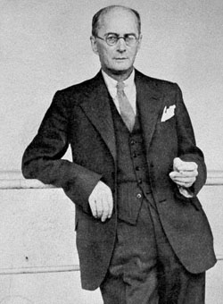
The next important school of myth theory to arise after Frazer was Functionalism, pioneered by the Polish anthropologist, Bronisław Malinowski
(1884-1942).

Slide 22

Malinowski studied myth as a living tradition among the Trobriand islanders, and concluded that the defining characteristic of myth was its functionality.

Slide 23
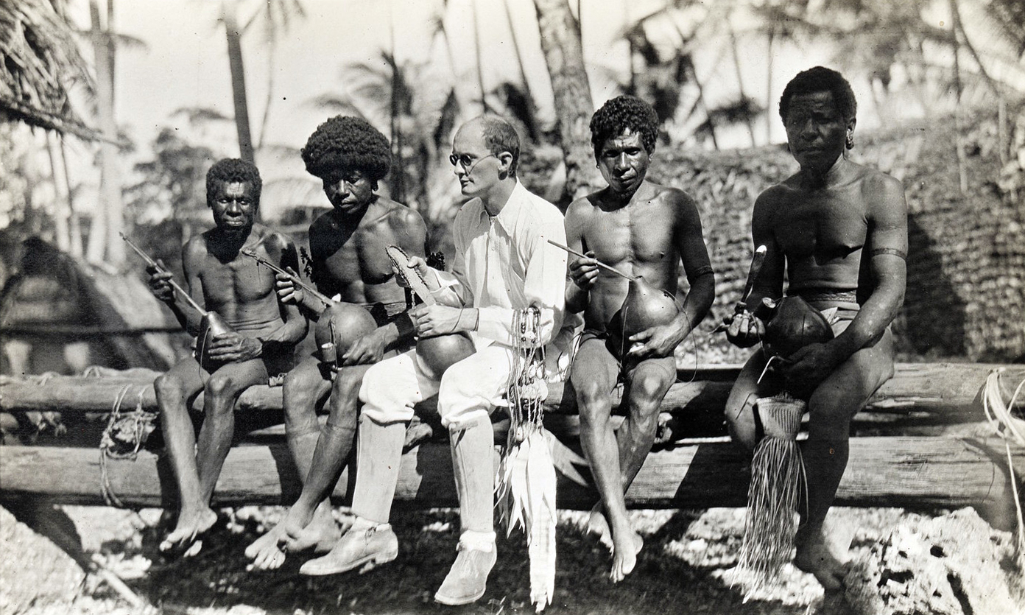
Myth contributes to society by helping to maintain the social system. Its origin is less important than its function. Malinowski rejected the idea that myth’s primary purpose is to explain, rather than to help justify and maintain the social system.

Slide 24
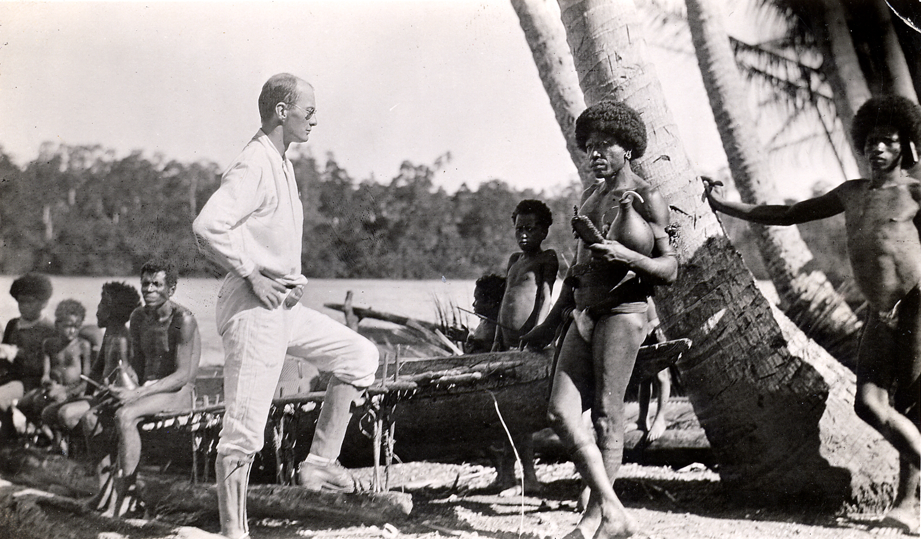
Myths, do not, in fact, refer to any culture outside of their own. He called such justificatory myths “charters;” that is, they provided validation for the social institutions they described.

Slide 25
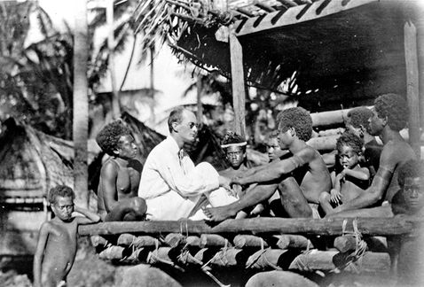
Malinowski also posited a hard and fast distinction between myth as “sacred” narrative, and folktale as “entertainment,” with a third category of historicizing legend in between these two poles.

Slide 26
Each of these theories has struck its critics as unsatisfactory in at least some regards. Some seem too restrictive. The “Solar Myth” hypothesis of the 19th century is perhaps the most obvious example, but other theories, too, fall short in this regard: if myths must be tied to rituals, then how do we account for stories that seem to have no ritual associations whatsoever? If myths must concern the gods, then the stories of Oedipus, Theseus, Perseus, and many others are excluded by definition. If myths must provide charters for social institutions, how do we explain those that seem to perform no such function?

Slide 27
The most obvious answer in each case is to say that those tales that do no fit the definition are not myths at all, but some other type of traditional tale. This sort of narrowing of the definition to make the theory work is not very satisfactory. Another answer is to say that in each case, the myth has undergone change or corruption that has disguised its original character. But this is a form of special pleading, persuasive only to those who have already accepted the theory in question. It seems better to admit that, so far, no “monolithic” theory has completely defined or explained myth.

Slide 28
Why is Myth?

Slide 29
“Why” Theories of Myth
This century has seen the development of crucially important, extremely influential, and very complex “why” theories of myth, which assume that myths reflect the same underlying human realities in all cultures, and, therefore, are somehow cross-cultural or transcultural. The most obvious instances of this type of theory are psychological.

Slide 30
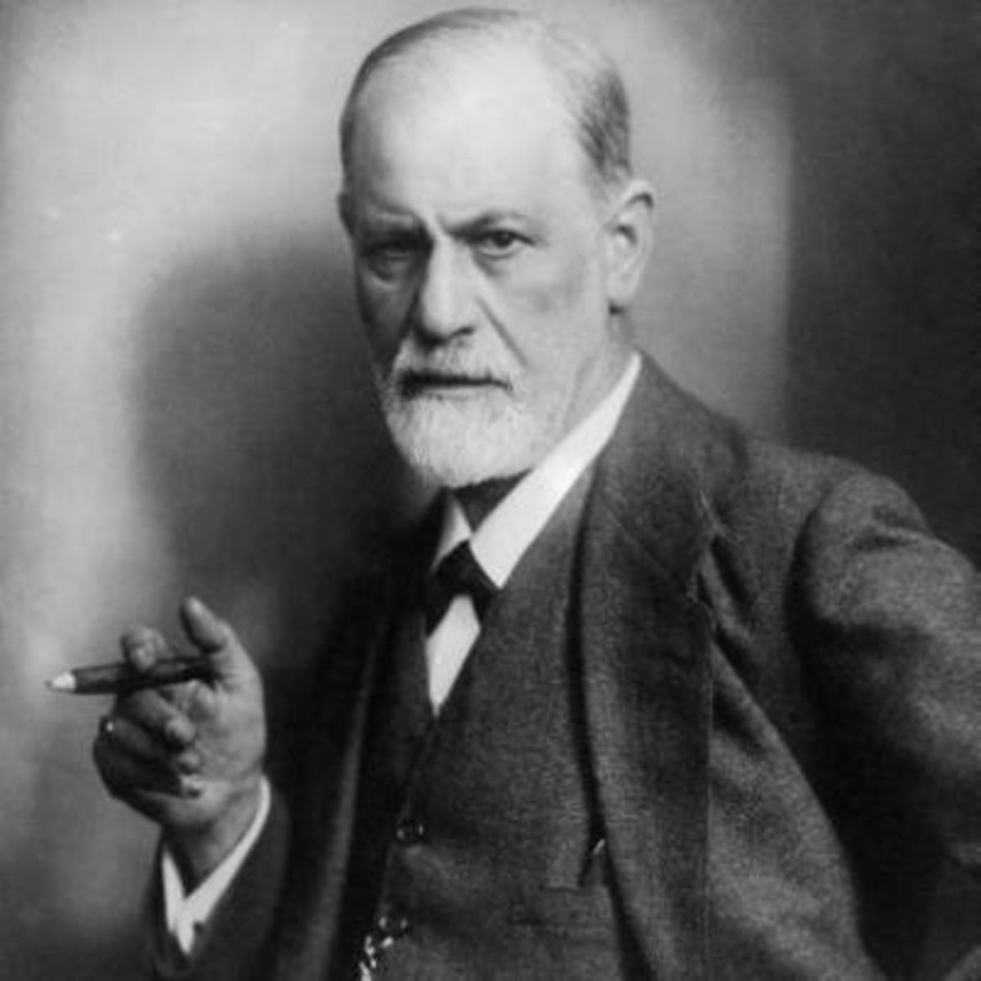
Sigmund Freud (1856-1939) proposed that myth reflects psychological forces present in the individual.
His most famous theory for the study of myth was, of course, the Oedipus complex. According to this theory, the story of Oedipus, who killed his father and married his mother, reflected the repressed desires of all male children. According to Freud, myths are the collective dreams of the human race; myths use the same kind of imagery, condensation, and displacement that are found in an individual’s dreams.

Slide 31
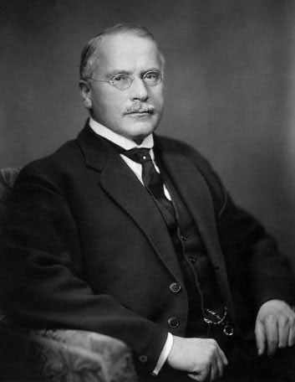
Carl Jung (1875-1961) saw myths as reflections of the “collective unconscious.”
In Jung’s view, the collective unconscious contains archetypes, or recurrent images that exist cross-culturally and throughout time. Myths use these archetypes (such as the “Earth Mother” or the “Wise Old Man”). Because they reflect the collective unconscious, and feature archetypes, myths are crucially important.

Slide 32
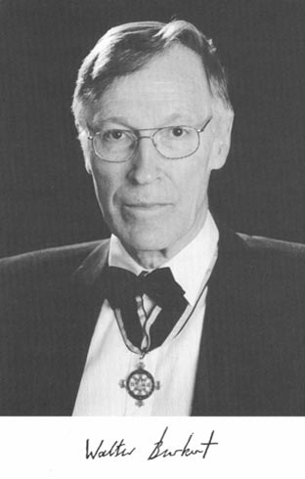
Another “universal” approach to myth is Structuralism, “a system of definable relations between the parts or elements of a whole which admit predictable transformations,” according to Walter Berkert (1931-2015)
W. Berkert (1983) Structure and History in Greek Mythology and Ritual. (University of Californaia Press): pg. 5.

Slide 33
There are two primary primary varieties of structuralist theory:
1) The “Formalist” school
2) The “Lévi-Strauss” school

Slide 34
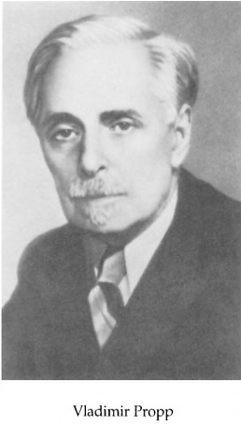
The “Formalist School” was developed by the Russian folklorist Vladimir Propp (1895-1970).
It analyzes traditional tales based on their surface elements. In analyzing Russian folktales, Propp found one basic pattern, the “quest pattern,” which he further analyzed analyzed into thirty-one separate “functions.” Although not all of these functions are present in any given tale, they are constant elements in the tales, and they appear in fixed sequence. Thus the sequence of functions creates (or defines) the tale; the characters who happen to appear in the tale are not its defining characteristic.

Slide 35
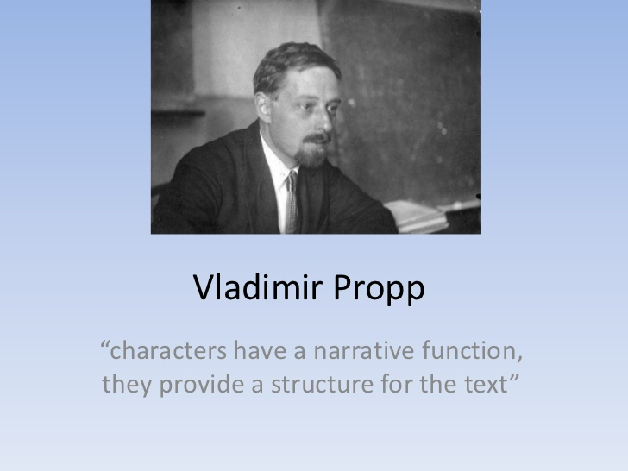

Slide 36
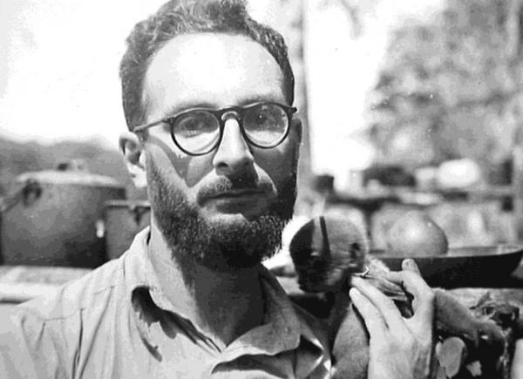
The second main category of structuralism looks at the underlying structure of the myths, rather than at their surface narratives. Claude Lévi-Strauss (1908-2009) developed this approach.
Lévi-Strauss’s theory claims that myth provides a mediation of contradictions, a way of dealing with binary oppositions that underlie the human mind. Myth is analogous to language; just as the individual components of language (phonemes) have no inherent meaning in themselves, but gain meaning only in relationship to one another, so too are the components of myth (sometimes called “mythemes”) significant only as part of a structure. Lévi-Strauss held that “a myth is made up of all its variants.”

Slide 37
Walter Berkert developed a structuralist approach that differs from both Propp and Lévi-Strauss’s in assigning the basic impetus for certain myths to biological “programs of action.”

Slide 38
Burkert’s theory resembles Propp’s in that he isolates narrative elements that recur in different myths; an example of this is his description of “the girl’s tragedy.” Burkert’s thesis that these narrative elements can be traced to early human or even pre-human biological necessities — from menarche to deflowering to bearing a first child — is controversial.
Burkert also assigns great importance to ritual; thus, he is sometimes called a “neo-ritualist.”

Slide 39
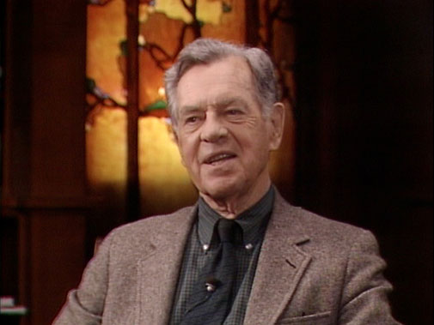
The best-known theorist of myth to appear in recent decades is Joseph Campbell (1904-1987). Though he is often called a Jungian, a better term to describe his approach to myth may be “metaphysical.” Campbell takes as a given that all myth is the same cross-culturally.
His method, like Frazer’s, depends largely on gathering examples of narrative similarities from different cultures. Campbell assumes that myth is “true” in a metaphysical sense. He imputes a spiritual meaning to myth that he thinks is both constant across societies and crucial for individual psychological and spiritual health. He separates this meaning from the specific religious doctrines held by the societies that formed the particular myths.

Slide 40
Most scholars do not have a high opinion of Campbell’s work. He never attempts to demonstrate the validity of his interpretations of myth; instead, he attempts to demonstrate the validity of his interpretations — as a given. He claims to be discussing narratives (“monomyths”) that occur worldwide, but, in fact he takes elements from many narratives to make a composite that does not actually occur anywhere. He assumes that the multiplication of examples amounts to proof of his interpretation. He assumes that similar narrative elements must have the same meanings in different cultures. But Amazons or snakes, for example, have different functions in different times and places.

Slide 41
These universalist “why” theories, no less than the “what” theories of the first part of the lecture, have struck many critics as unsatisfactory, mainly because they tend to rest on unproven and unprovable assumptions. The psychological theories of Freud and Jung both espouse the idea that myths are in some sense the “dreams of the people.” This idea implies that a “people” or a society has a collective mind that is capable of dreaming. Freud further assumes that dreams have the same significance cross-culturally. But the interpretation of dream symbols changes according to time and place. Jung posits the “collective unconscious” as an entity and assumes that it produces the archetypes. Lévi-Strauss assumes that the mediation of oppositions is a driving force of all cultures. Burkert’s assumption that myth is rooted in pre-cultural biological realities, while fascinating, can only be asserted, not demonstrated.

Slide 42
The best approach may be to recognize that myth is a varied, but recognizable category that can include all these theories (and more). No one theory seems adequate to explain “myth” overall. Theories can be useful for elucidating individual myths. The theories we have discussed cannot be proven, but they cannot be disproven either; we will use these theories as tools when and where they are helpful.

Slide 43
Where does this leave us? My own working definition combines elements from several of these approaches. Again, I define myths as “traditional stories a society tells itself that encode or represent the world-view, beliefs, principles and often fears of that society.” As such, myths offer insight into what a specific culture thinks about the nature of the world in general and about key questions, such as: the nature and of function of the gods. Humans’ relationship to the gods. What it means to be human. The two sexes’ relationship to one another. I find the universalizing “why” theories of myth less useful than an approach that examines myth in the context of the culture that developed it. However, I will refer to the “why” theories at key points throughout our course together.

Slide 45
Religion vs. Myth
One useful distinction of categorizing is to say that religion refers to what people actually do to honor their gods — the rites, ceremonies rituals, and so forth that people enact in honor of their gods — whereas myth refers to the underlying narratives, the narratives that explain or justify or go along with those rites, rituals and ceremonies.

